Slide 1
Welcome to our…
Art and DT Family Learning Morning

Slide 2
Aims of the morning
To have a greater understanding of how we teach Art and DT across the school.
To understand how Art and DT is developed within each year group.

Slide 3
Art Intent
Enable children to develop their creative imagination.
To give children opportunities to experiment, invent and create their own art.
To enrich the children’s knowledge of famous artists and their work.
To teach children the skills needed so that they are able to develop them further throughout their time at Forest and Sandridge.
Notes:
We want children to develop their creative imagination and enjoy talking about art. We want the children to feel confident in communicating what they see, feel and think through a range of tools, media and materials.
We intend to give the children lots of opportunities to experiment, invent and create art.
We want the children to be inspired by famous artists.
We want the children to be able to leave Forest and Sandridge with the skills needed that they can continue to develop throughout secondary school.

Slide 4
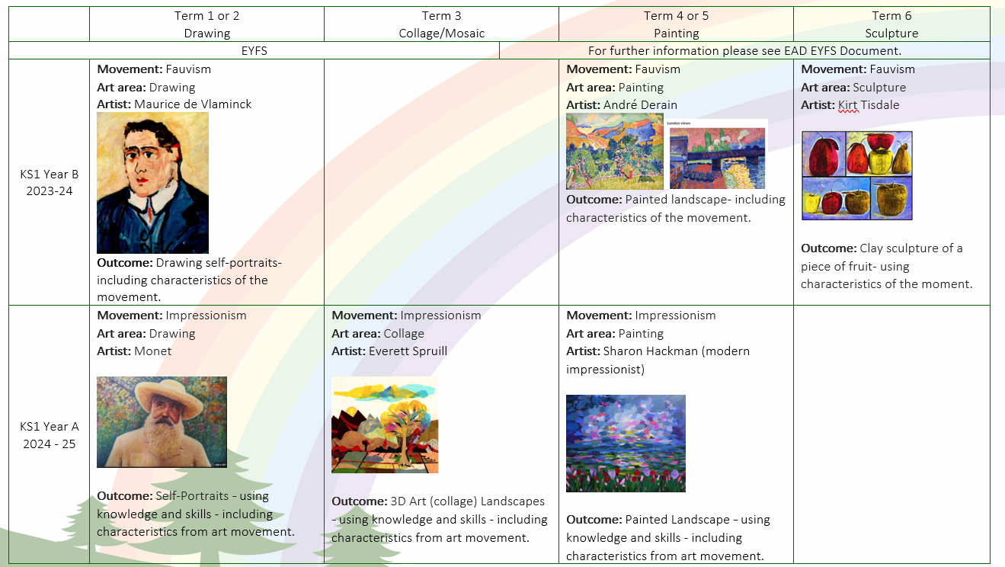
Art Overview
Notes:
Every year group will do Drawing, collage, painting and sculpture over the year. They will be given a key artist and a set of skills to look at during that unit.
For example as you can see KS1 will focus on drawing self portraits in the style of Monet. They will be working on skills like- To be able to show pattern and texture using dots and lines. The year after they will re-visit drawing with a different artist and different skills.

Slide 5
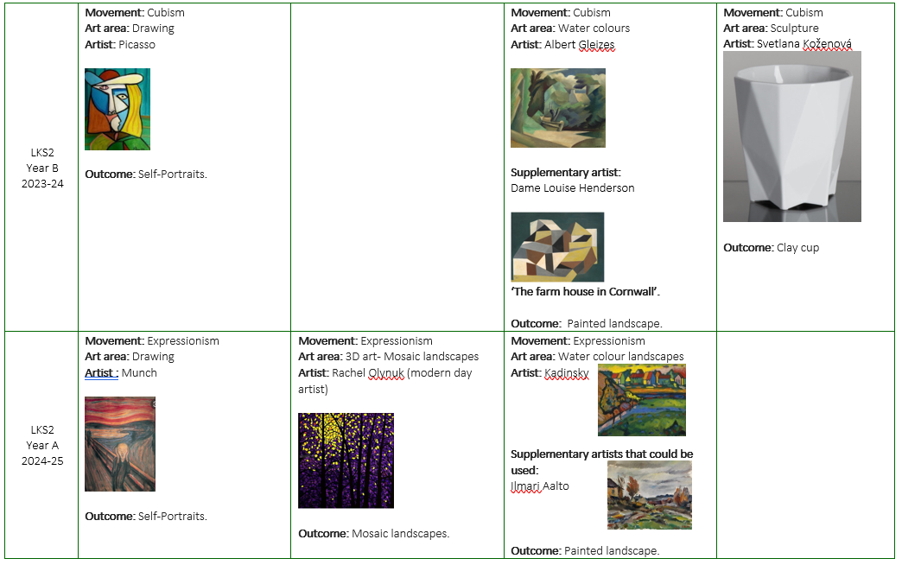

Slide 6
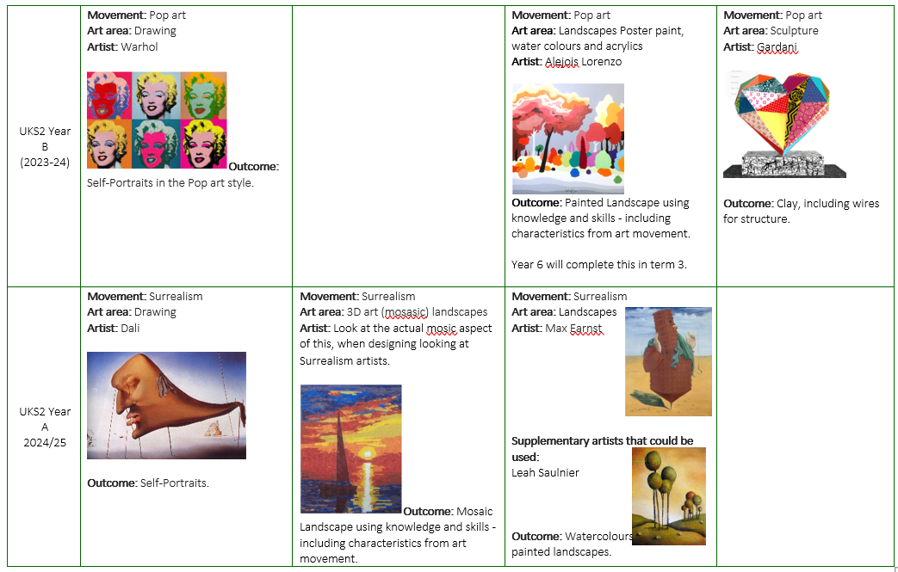

Slide 7
DT Intent
To enable the children to develop their creativity through designing, making and evaluating. To combine and apply their skills with knowledge and understanding in order to design, make and evaluate a product. To be taught skills progressively and be able to learn and practice in order to develop those skills as they move through the school. To learn basic cooking skills.

Slide 8
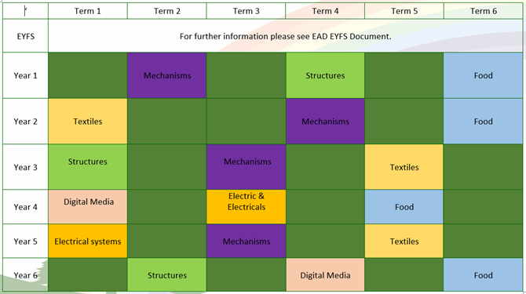
DT Overview

Slide 9
What does an Art and DT unit at Forest & Sandridge look like?
Art:
Research the artist.
Explore and develop the skills and technique.
Design and create a final piece of art.
DT:
Investigate/research product
Design
Make
Evaluate

Slide 10
Take One Picture
Take One Picture is a programme for primary schools, which aims to inspire a lifelong love of art and learning.
Every year, The National Gallery chooses one picture from the collection to inspire cross-curricular work in primary classrooms.
Notes:
We are taking part in an Art Day very soon and we have recently introduced the painting that will inspire the children for the day. The first thing we did with the children to introduce the picture was to get them to listen to the soundscape and imagine what they thought the painting would look like.

Slide 11
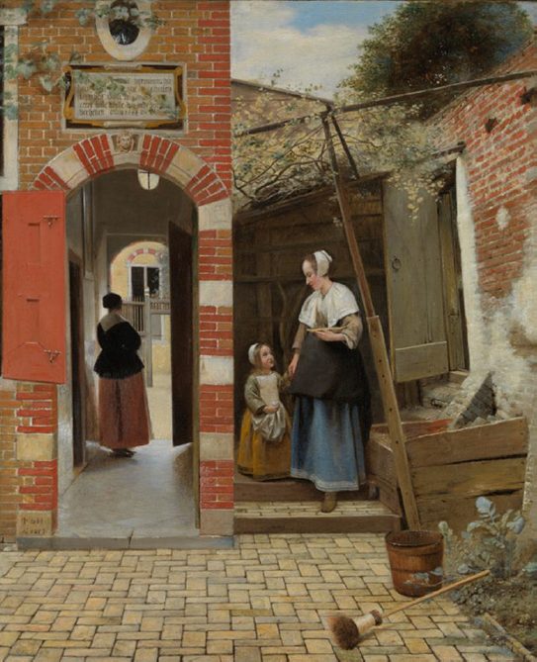
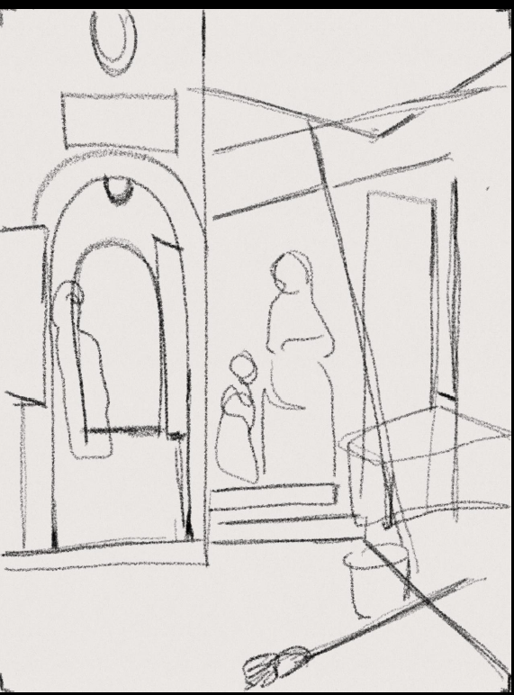
Take One Picture
Notes:
We then revealed the picture to see if they had guessed correctly. The children then had 5 minutes to do a quick line drawing of the painting.

Slide 12
Please spend the rest of the session in classes experiencing Art and DT with your child or children.
We will meet back in the hall at 10am to discuss what you have seen and answer any questions ☺

Slide 13
Any questions?
Please place any questions in the question box and we will answer these once you have been to the classrooms.

