Slide 1
Writing at Forest and Sandridge

Slide 2
Curriculum Intent
Why do we teach this? Why do we teach it in the way we do?
At Forest & Sandridge C.E. Primary School, we strive to help our children develop into articulate and imaginative communicators, who are well-equipped with the basic skills they need to become life-long learners; English learning is key in this. We aim to ensure all of our children develop a genuine love of language and the written word, through a text-based approach; this links closely to the way we teach reading.
Careful links are made across the curriculum to ensure that children’s English learning is relevant and meaningful: where possible linking our reading, writing and the topic that we are covering in History and Geography. We ensure that children develop an understanding of how widely writing is used in everyday life and, therefore, how important and useful the skills are that they are learning.
Notes:
Throughout the Early Years, Key Stage 1 and Key Stage 2, we teach writing through a text-based approach, which allows us to meet the needs of the children that we are teaching – through choosing a text that will engage, inspire and motivate. As well as reading a wide variety of genres, children are given frequent opportunities to develop their skills in writing in different genres. Through covering one text per term in depth and good quality supplementary texts, children are exposed to a broad range of text types, styles and genres which must include diverse books. All children are given the opportunity to put their writing skills into practice through two pieces of extended writing per term: one fiction and one non-fiction. Each term, children will publish a piece of writing and will be displayed on clipboards in the corridors throughout the school; this is known as “Clip it, clap it”. This allows every child to have a written piece of work on the walls, which can be seen and celebrated by all, as well as knowing they are writing for a purpose and being seen as real writers.

Slide 3
Our intentions in writing are for children to:
Write for a purpose
See themselves as real writers
Take ownership of their writing
See writing as an interesting and enjoyable process
Acquire the ability to organise and plan their written work

Slide 4
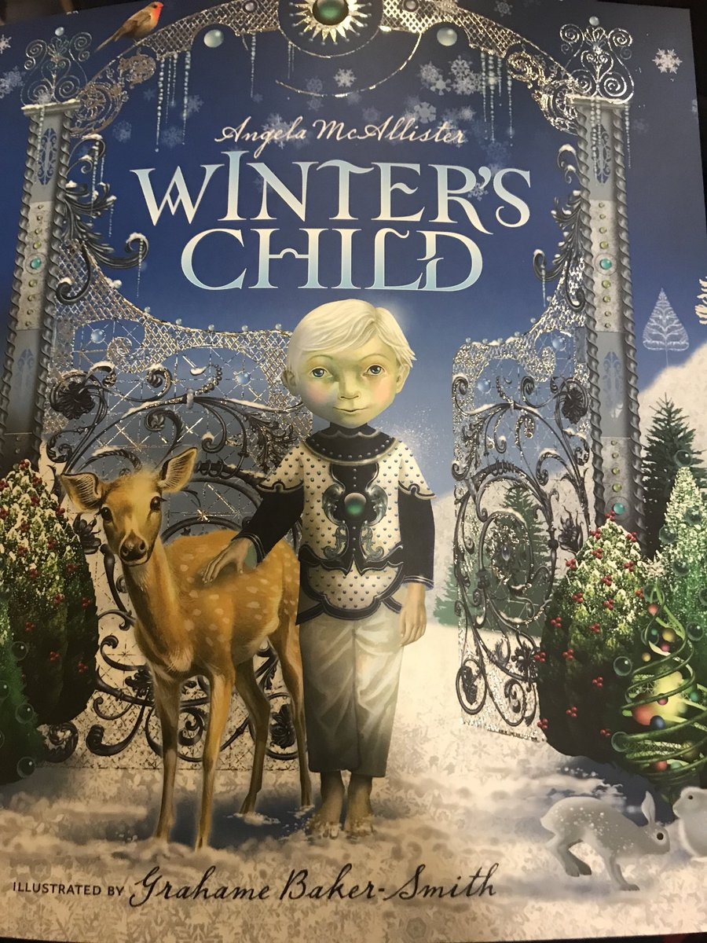
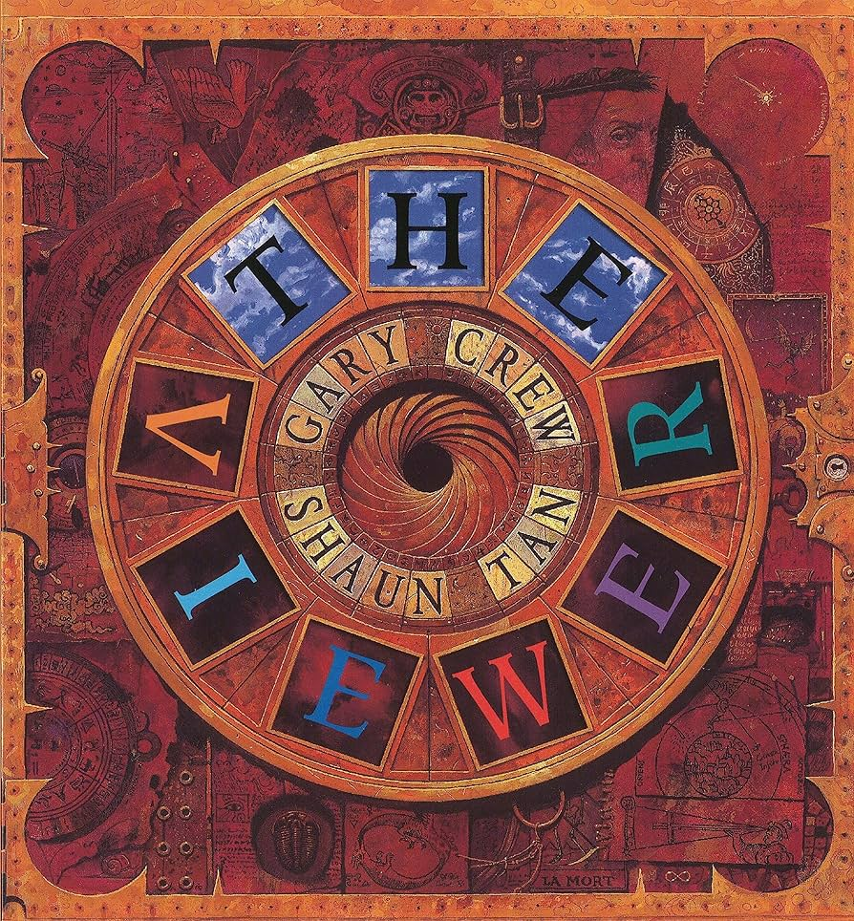
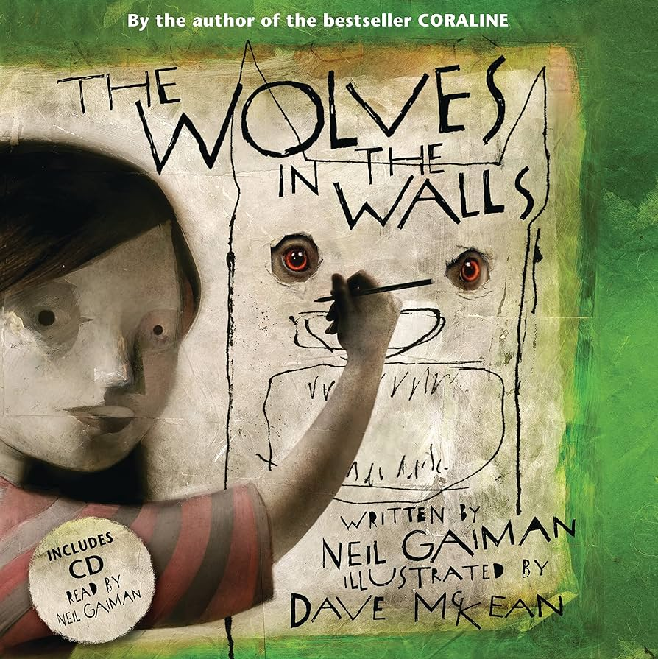
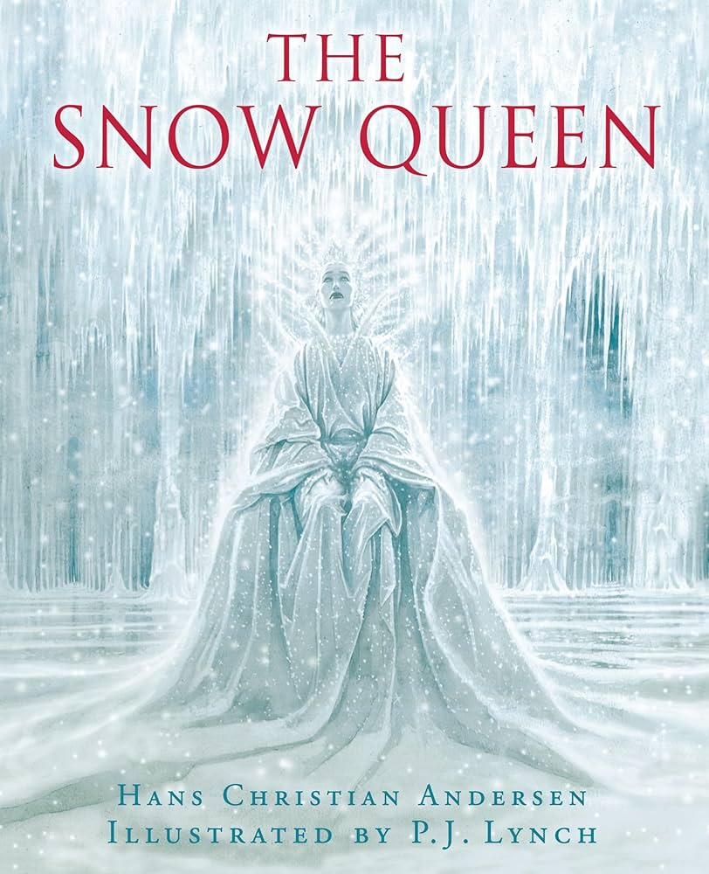
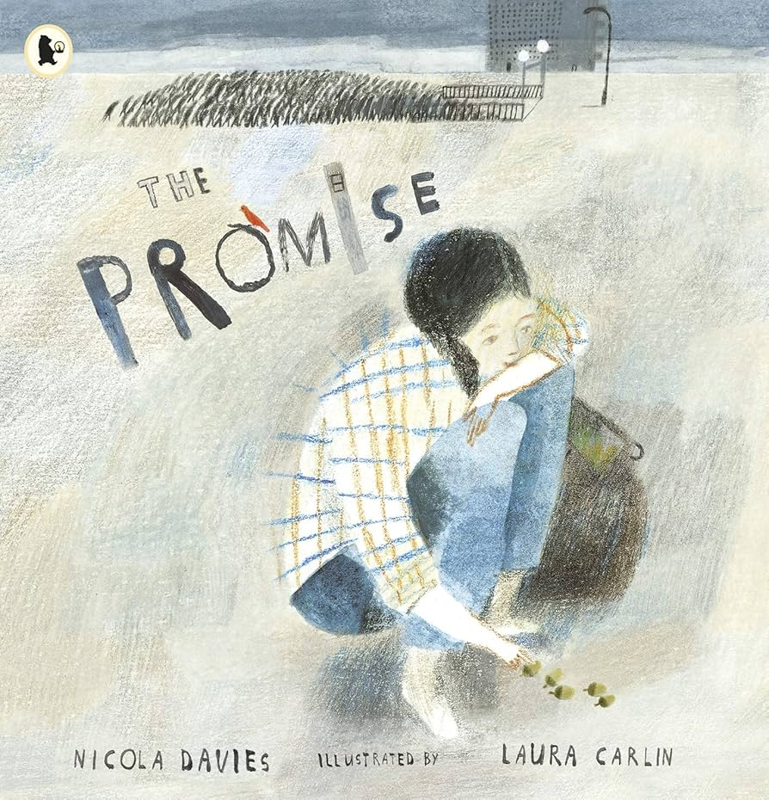
We teach writing through a text-based approach, which allows us to meet the needs of the children that we are teaching – through choosing a text that will engage, inspire and motivate.

Slide 5
In each year group, through every unit, students will be given the opportunity to immerse themselves in a genre and writing purpose through the use of a powerful stimuli and oracy activities (such as drama, debate and discussion).
Students will then develop specific writing and language skills through explicit teaching and well designed deliberate practise tasks.
They will then move on to plan, draft, edit and revise their work before successfully publishing a final piece that they can be proud of.

Slide 8
Spelling
In KS1 children follow the Rocket Phonics SSP scheme and begin to read and spell high frequency words.
Once children are confident in reading and spelling high frequency words, they are taught spelling rules and are encouraged to apply these rules in their writing.
In KS2, spelling is taught 2-3 times a week during focused sessions using the No Nonsense scheme. We follow the recap, teach, practise, apply approach and parents are encouraged to help their children learn spellings at home. A mixture of known and unknown spellings (which follow the same rule) are assessed weekly and statutory words are assessed throughout the year.

Slide 9
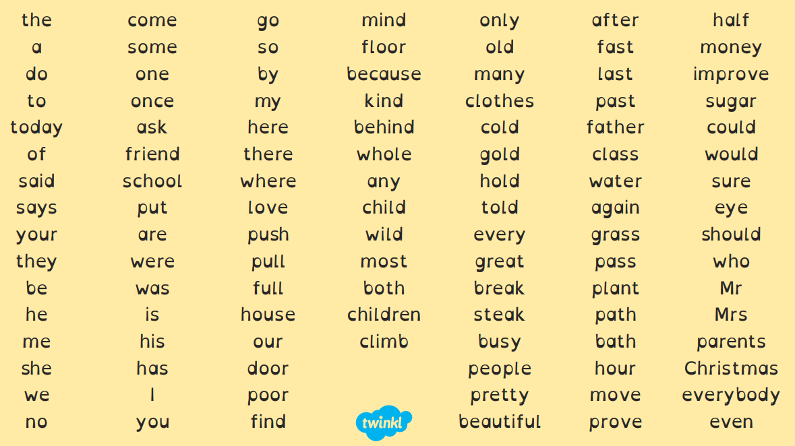
Statutory Spelling Words
Year 1 and 2
Notes:
Handout

Slide 10
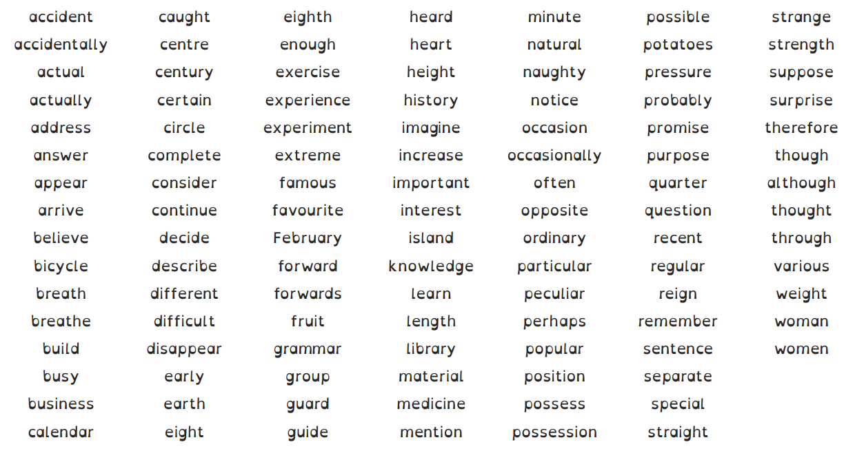
Statutory Spelling Words
Year 3 and 4

Slide 11
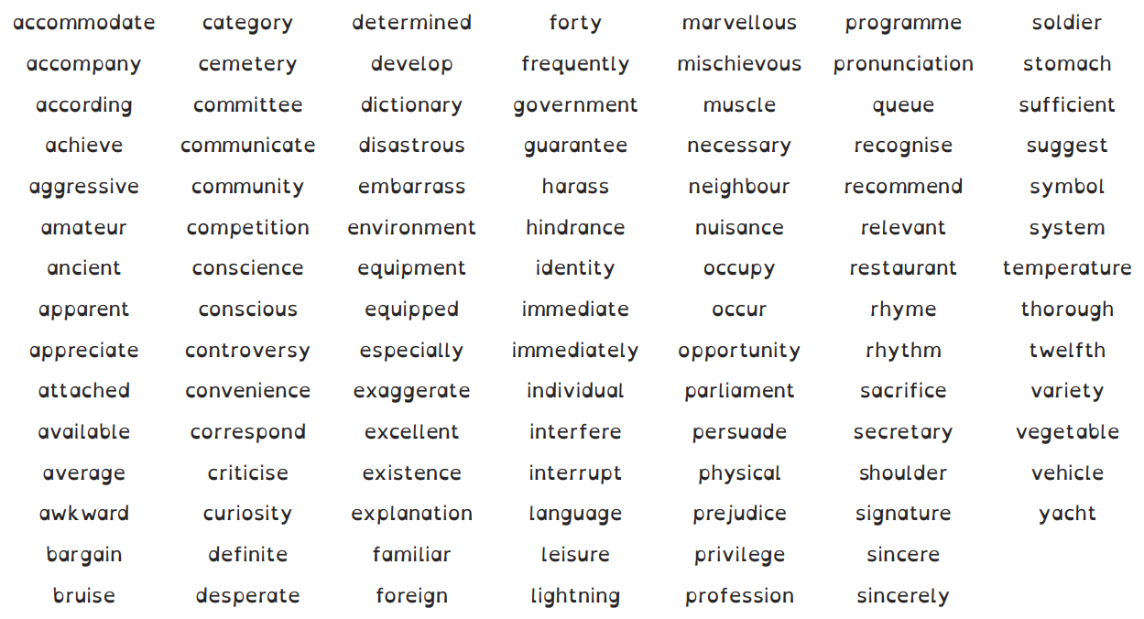
Statutory Spelling Words
Year 5 and 6

Slide 12
Handwriting
Year 1 Handwriting
Pupils are taught to:
sit correctly at a table, holding a pencil comfortably and correctly
begin to form lower-case letters in the correct direction, starting and finishing in the right place
form capital letters
form digits 0-9
understand which letters belong to which handwriting ‘families’ (ie letters that are formed in similar ways) and to practise these.

Slide 13
Year 2 Handwriting
Pupils are taught to:
form lower-case letters of the correct size relative to one another
start using some of the diagonal and horizontal strokes needed to join letters and understand which letters, when adjacent to one another, are best left unjoined
write capital letters and digits of the correct size, orientation and relationship to one another and to lower-case letters
use spacing between words that reflects the size of the letters.
Notes:
form lower-case letters of the correct size relative to one another
start using some of the diagonal and horizontal strokes needed to join letters and understand which letters, when adjacent to one another, are best left unjoined
write capital letters and digits of the correct size, orientation and relationship to one another and to lower-case letters
use spacing between words that reflects the size of the letters.

Slide 14
Year 3 and 4 Handwriting and Presentation
Pupils are taught to:
use the diagonal and horizontal strokes that are needed to join letters and understand which letters, when adjacent to one another, are best left unjoined
increase the legibility, consistency and quality of their handwriting, [for example, by ensuring that the downstrokes of letters are parallel and equidistant, and that lines of writing are spaced sufficiently so that the ascenders and descenders of letters do not touch.
Notes:
use the diagonal and horizontal strokes that are needed to join letters and understand which letters, when adjacent to one another, are best left unjoined
increase the legibility, consistency and quality of their handwriting, [for example, by ensuring that the downstrokes of letters are parallel and equidistant, and that lines of writing are spaced sufficiently so that the ascenders and descenders of letters do not touch.

Slide 15
Year 5 and 6 Handwriting and Presentation
Pupils are taught to:
write legibly, fluently and with increasing speed by:
choosing which shape of a letter to use when given choices and deciding whether or not to join specific letters
choosing the writing implement that is best suited for a task.
Notes:
write legibly, fluently and with increasing speed by:
choosing which shape of a letter to use when given choices and deciding whether or not to join specific letters
choosing the writing implement that is best suited for a task.

Slide 16
Task
On your tables, you have some examples of writing from Year 2, Year 4 and Year 6
Can you find the features in the text you have been given …
Sentence starters
Vocabulary e.g. adjectives, verbs, adverbs
Punctuation
Layout/handwriting
Have you noticed anything else?

Slide 17
You can now spend time in class with your children.
Please come back to the hall for 10am for feedback. Enjoy!

