Slide 1
Welcome to our…
Geography and History Family Learning Morning

Slide 2
Aims of the morning
To have a greater understanding of how we teach Geography and History across the school.
To understand how Geography and History is developed within each year group.

Slide 3
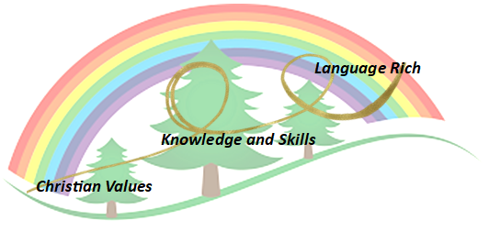
History Intent
The study of History ignites children’s curiosity about the past in Britain and the wider world. Through finding out about how and why the world, our country, culture and local community have developed over time, children understand how the past influences the present.
History enables children to develop a context for their growing sense of identity and a chronological framework for their knowledge of significant events and people. What they learn through history can influence their decisions about personal choices, attitudes and values.
At Forest and Sandridge, History is integral to ensuring children develop an appreciation and understanding of the past, using a range of primary and secondary source in order to give an insight in how people around the world used to live.

Slide 4
Geography Intent
Children are encouraged to develop a greater understanding and knowledge of their world, as well as their place in it.
To inspire in children a curiosity and fascination about the world and people within it; to promote the children’s interest and understanding of diverse places, people, resources, changes over time and natural and human environments, together with a deep understanding of the Earth’s key physical and human processes.
Our lessons are intended to improve children’s geographical vocabulary, map skills and geographical facts and provide opportunities for consolidation, challenge and variety to ensure interest and progress in the subject.

Slide 5
History Themes
FS2
Year 1-6
Notes:
Eyfs – don’t follow the NC - Use Birth to 5 and development matters as the basis of their curriculum. It’s the foundation to the national curriculum so all our themes start within foundation and prepares them for the NC .
Y1-6 follow the NC – History is divided into themes such as changes in toys in year 1 to through the Iron age , Romans and WW2 in year 6 . Each topic contains sequential steps to ensure Children build upon their learning.
History has 6 strands are revisited repeatedly through the themes to ensure that the children know more and remember more.
In a moment we will look at one of theses strands in a lesson. Evidence and interpretation.

Slide 6
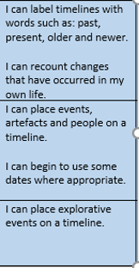
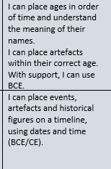
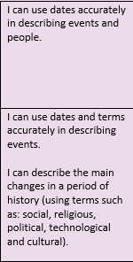
EYFS
Year one
Year three
Year five
Notes:
These strands are revisited repeatedly and built upon.

Slide 7
Geography Themes
FS2
Year 1-5
Year 6
Notes:
Eyfs – don’t follow the NC - Use Birth to 5 and development matters as the basis of their curriculum. It’s the foundation to the national curriculum so all our themes start within foundation and prepares them for the NC .
Y1-6 follow the NC at Forest we Grammasuraus as a resource to teach the NC- our bespoke to our school and area – E.G –
These strands are revisited repeatedly through a range of themes during children’s time in school to ensure that do more, know more and remember more.

Slide 8
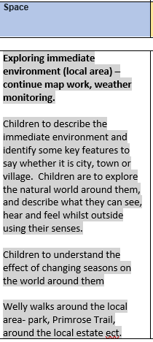
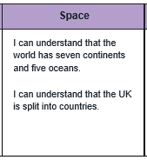
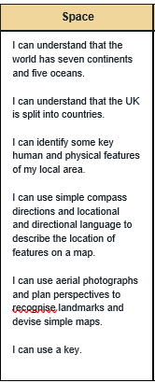
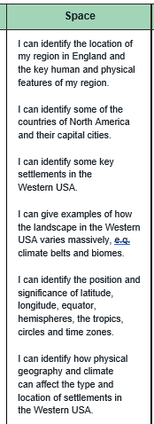
Year one
Year two
EYFS
Year five
Notes:
These strands are revisited repeatedly through a range of themes during children’s time in school to ensure that do more, know more and remember more.

Slide 9
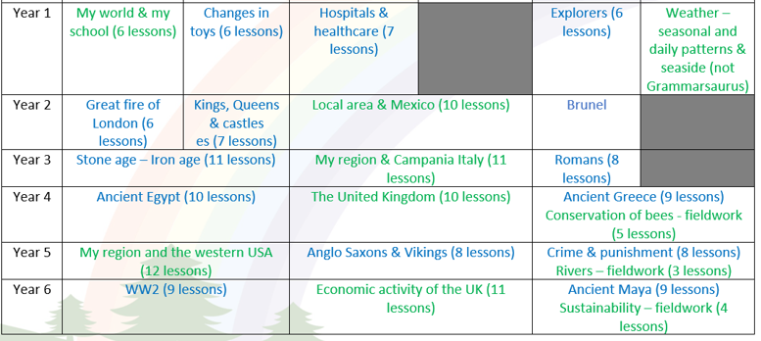
Our Curriculum
Notes:
Some flexibility – topic days and trips to enhance the learning. Wher possible we will make links e.g Vikings /English
Stone age / English / science

Slide 10
What does a Geography and History lesson at Forest & Sandridge look like?
Key Question for the lesson
Recap of prior learning
- Key vocabulary for new learning
- New learning
- Apply new learning in an activity
Notes:
Lesson for years 1-6 . EYFS will be doing discovery time where they will be exploring History and Geography the natural worlds and past and present.

Slide 11
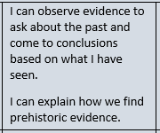
How did daily life change from the Stone Age to the Iron Age?
.
Key questions we will answer:
What are roundhouses?
Key historical skills we will use:
Evidence and interpretation.
w

Slide 12
Recap prior learning
4
Why did iron become the most popular metal to use?
Over time, copper and tin deposits started to run out, with so much of it being
taken from mines. Soon iron became the most common metal used in weapons
and tools. The introduction of iron meant that weapons were cheaper to make.
Oscar says bronze is no longer used as a metal during the iron age. Is he correct?
Explain your answer.
Bronze was still used in the iron age but wasn't as common as iron. Bronze
was harder to mine and more difficult to repair.
www.grammarsaurus.co.uk

Slide 13
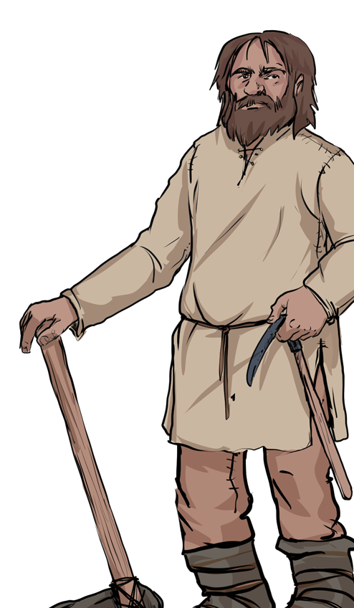
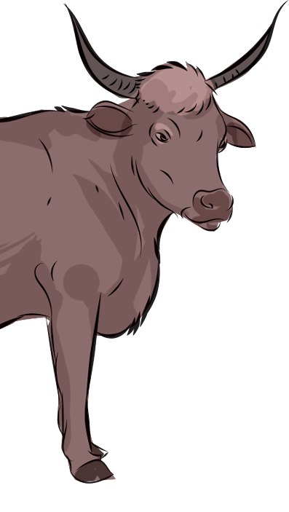
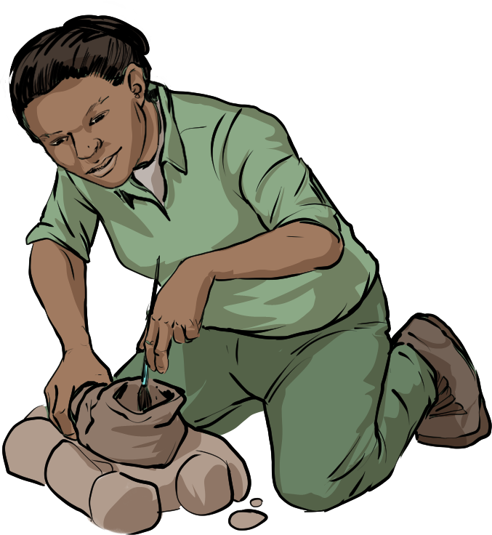
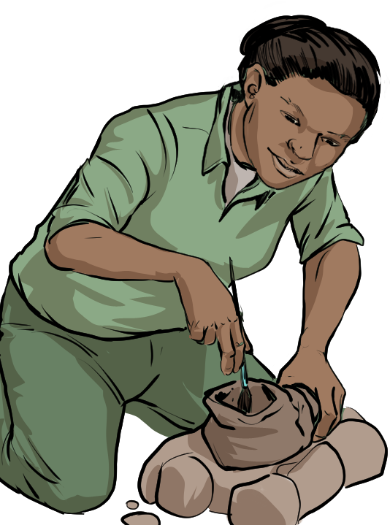
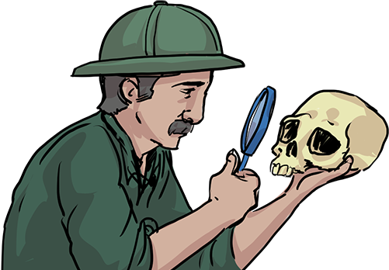
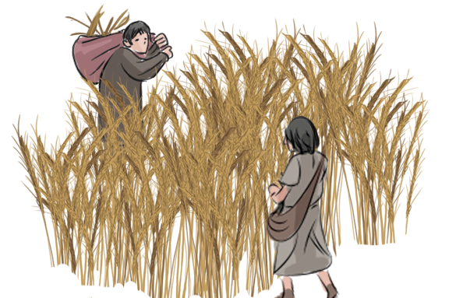
Key vocabulary for this lesson:
2
excavation
– finding artefacts and remains
construct
– building and putting together
settlement
– a place where people live
www.grammarsaurus.co.uk

Slide 14
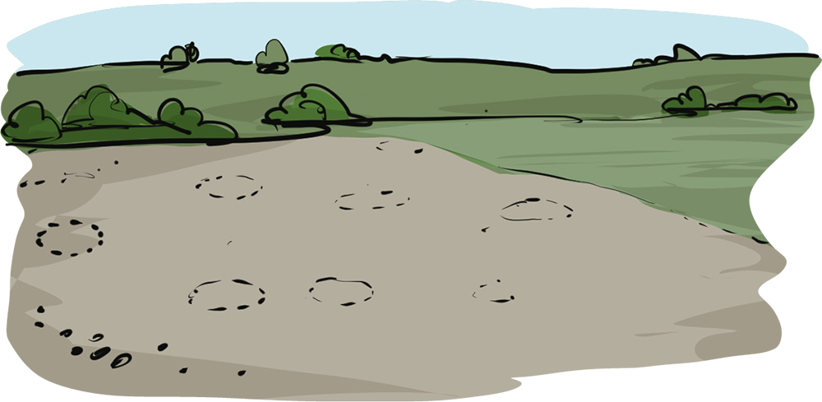
Excavation site
5
Until 2.20
History KS2: Iron Age daily life - BBC Teach
Hi! I’m an archaeologist, and I’ve been excavating this field in Essex.
We have found evidence of holes dug into circles dating back to the Iron Age.
What do you think this historical evidence is showing?
Discuss this question with your learning partner, and be ready to share your ideas with the class.
www.grammarsaurus.co.uk

Slide 15
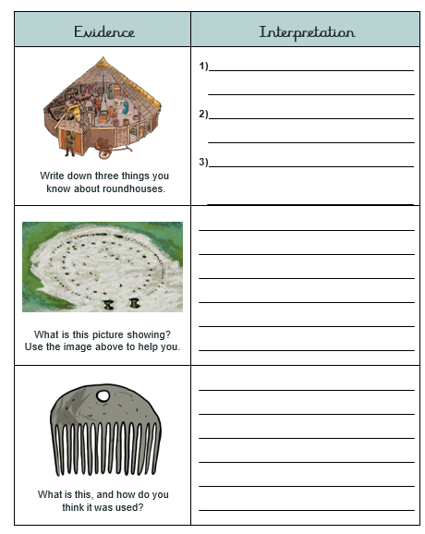
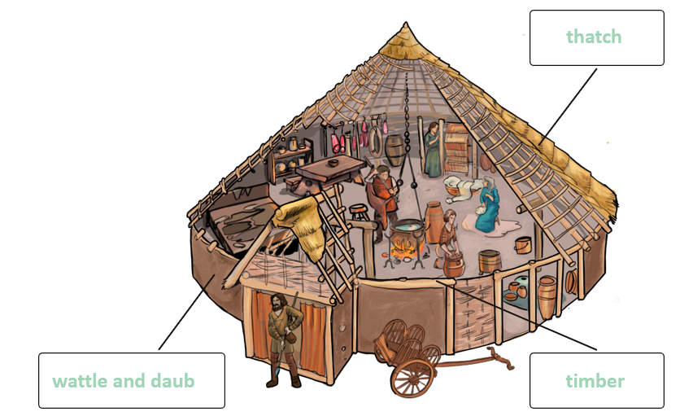
Complete the sheet.
Sketch and label a roundhouse.

Slide 16
Your turn !

Slide 17
Please spend the rest of the session in classes experiencing Geography and History with your child or children.
We will meet back in the hall at 10am to discuss what you have seen and answer any questions ☺

Slide 18
Any questions?
Please place any questions in the question box and we will answer these once you have been to the classrooms.

