Slide 1
Welcome to Family Learning Morning
Maths
Just some of the things you could have noticed…
Even number.
Has 4-digits.
Half of 7432 is 3716.
Rounded to the nearest thousand is 7000.
One more than 7432 is 7433.
The digit 4 represents 400.
7432
What do you notice about this number?
What do you know about this number?

Slide 2
Aims of the morning
To have a greater understanding of how we teach maths across the school.
To gain an understanding of what mastery is.
To have ideas that you can use when helping your children practise maths at home.
Notes:
Maths at Forest and Sandridge has changed over the last few years. We now follow a mastery model of mathematics whereby children are taught concepts in depth to ensure understanding and preparation for the following year group.

Slide 3
What does the National Curriculum say?
Fluency in arithmetic
Mathematical reasoning
Problem solving
Notes:
The national curriculum for mathematics aims to ensure that all pupils:
Become fluent in the fundamentals of mathematics, including through varied and frequent practice with increasingly complex problems over time, so that pupils develop conceptual understanding and the ability to recall and apply knowledge rapidly and accurately.
Reason mathematically by following a line of enquiry, conjecturing relationships and generalisations, and developing an argument, justification or proof using mathematical language
Can solve problems by applying their mathematics to a variety of routine and non-routine problems with increasing sophistication, including breaking down problems into a series of simpler steps and persevering in seeking solutions.

Slide 4
Our Intent
Notes:
Intent linked to our golden threads.

Slide 5
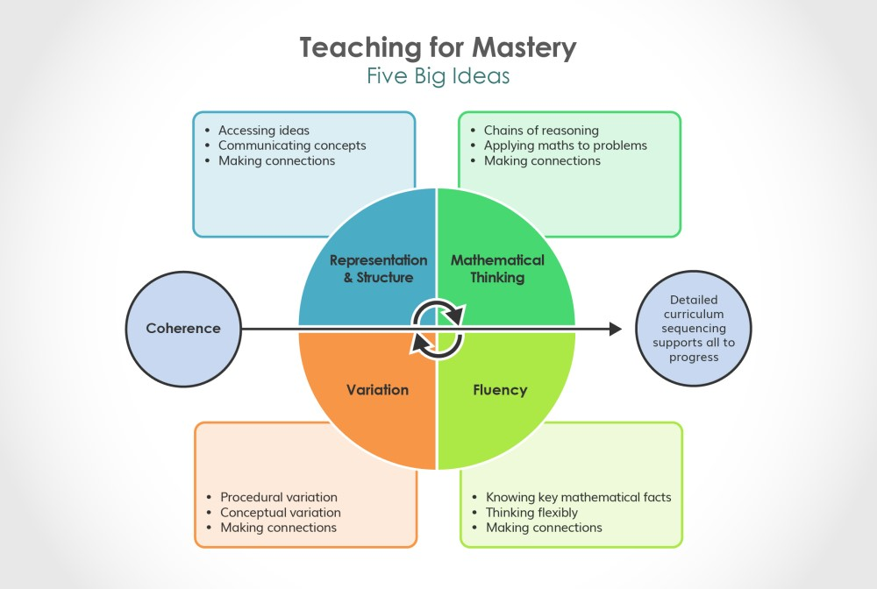
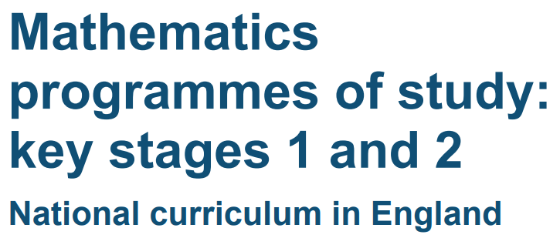
Our Maths Curriculum
Notes:
Our aim and how this links to teaching for mastery in maths.

Slide 6
Can Do Maths
Small progressive, manageable and carefully planned steps.
Build knowledge to know more and remember more.
Notes:
Can Do Maths is the starting point for our Maths Curriculum and provides small progressive, manageable and carefully planned steps build knowledge to know more and remember more We use other resources to enhance and enrich the offer for children. We have chosen the Can Do approach as we strongly believe that it meets the needs of our pupils (High level of disadvantaged and EAL). The approach is linked to our Golden Threads.

Slide 7
LESSON STRUCTURE: New Learning
HOOK
TEACH IT
PRACTISE IT
Hinge Question
DO IT
TWIST IT
DEEPEN IT
REVIEW IT

Slide 8
Notes:
A main maths lesson is broken down into 3 main parts.

Slide 9
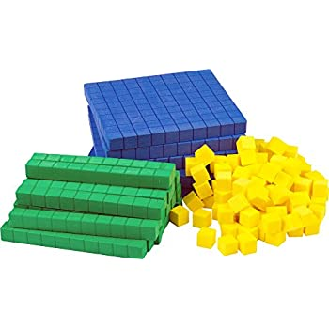
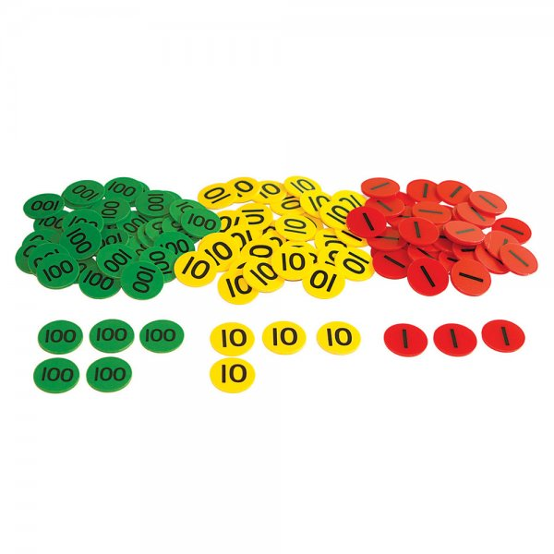
Do it!
Carefully chosen examples to build learning (including pictorial representations and solving problems)
Children experience early success with straightforward examples (what it is)
Addressing any ‘bumps in the road’
Can they ‘do it’?
Notes:
What do we mean by ‘do it’?

Slide 10
Twist it
Use of key misconception to secure understanding (what it isn’t / odd one out)
Develop reasoning through explaining
Independent explanations, developed through class discussion
Children develop and demonstrate conceptual understanding
Children should be using STEM sentences and key vocabulary
Notes:
What do we mean by ‘twist it’?

Slide 11
DYU
Apply the key learning to solve open-ended problems
Stretch and challenge – “deepen mathematical thinking”
Making links and connections with other mathematical learning
Chains of reasoning
Notes:
What do we mean by ‘DYU’?

Slide 12
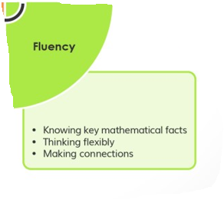
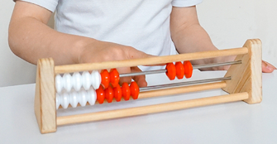
KS1 Mastering Number
Notes:
Supporting children in leaving KS1 with fluency in calculation and a confidence and flexibility with number.

Slide 13
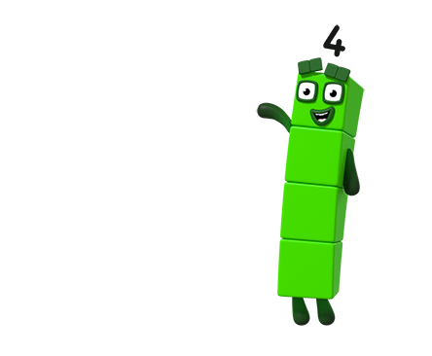
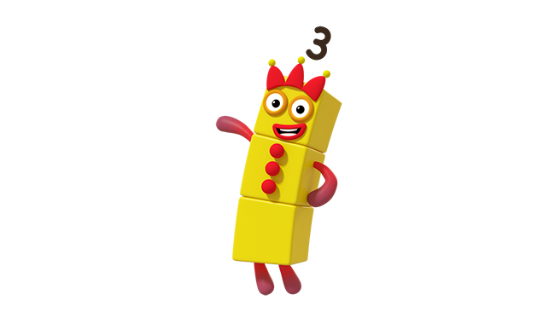
Play our spotty game! Look and say how many dots without counting.
Subitising – the ability to look at a small set of objects and instantly know how many there are without counting them.
Images © 2021 Alphablocks Ltd. All rights reserved. Mastering Number 2021/22 ncetm.org.uk
Notes:
Subitising

Slide 14
Mastering Number 2021/22 ncetm.org.uk

Slide 15
Mastering Number 2021/22 ncetm.org.uk

Slide 16
Mastering Number 2021/22 ncetm.org.uk

Slide 17
Mastering Number 2021/22 ncetm.org.uk

Slide 18
Mastering Number 2021/22 ncetm.org.uk

Slide 19
Mastering Number 2021/22 ncetm.org.uk

Slide 20
Mastering Number 2021/22 ncetm.org.uk

Slide 21
Mastering Number 2021/22 ncetm.org.uk

Slide 22
Mastering Number 2021/22 ncetm.org.uk

Slide 23
Mastering Number 2021/22 ncetm.org.uk

Slide 24
Mastering Number 2021/22 ncetm.org.uk

Slide 25
Mastering Number 2021/22 ncetm.org.uk

Slide 26
Mastering Number 2021/22 ncetm.org.uk

Slide 27
Mastering Number 2021/22 ncetm.org.uk

Slide 28
Mastering Number 2021/22 ncetm.org.uk

Slide 29
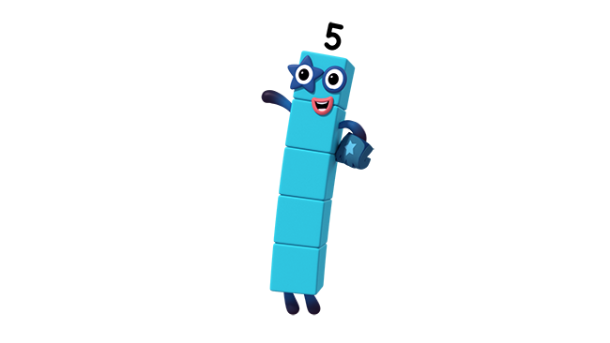
Can you use your rekenrek to make ME?
_____ needs _____ to make 5.
Image © 2021 Alphablocks Ltd. All rights reserved. Mastering Number 2021/22 ncetm.org.uk

Slide 30
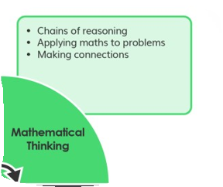
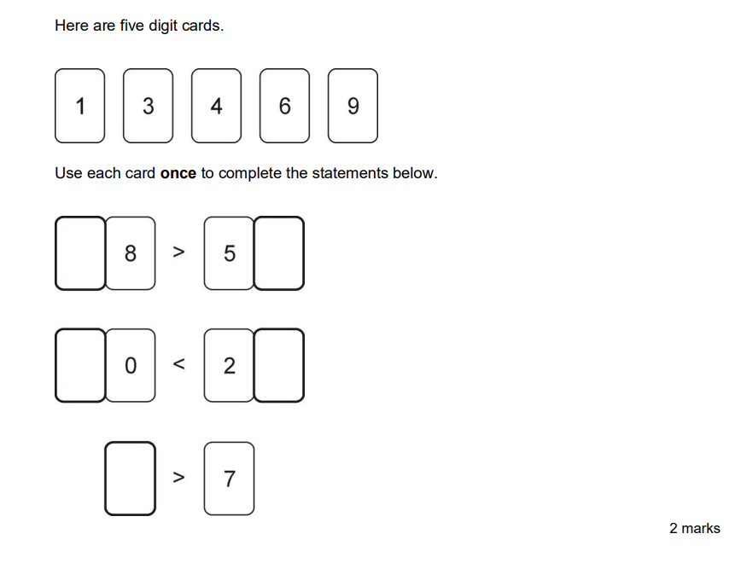
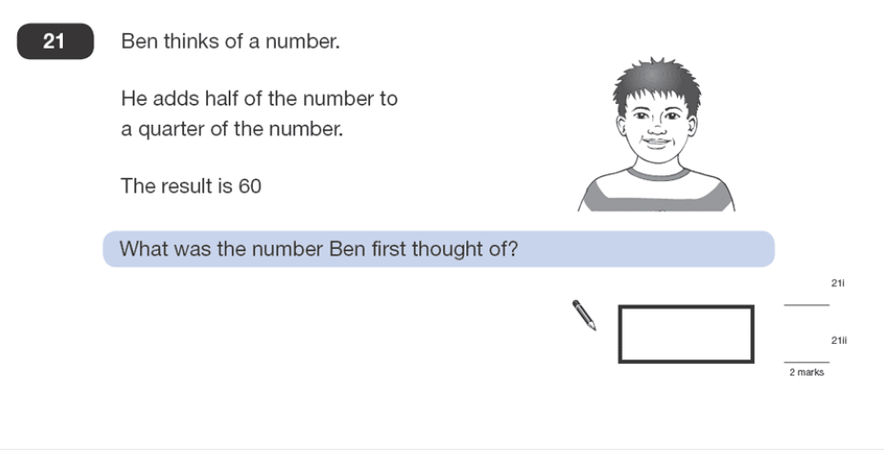
KS2 SATS
Discuss with your table, how you would go about solving this KS2 SATS questions.
What knowledge would you need?
Notes:
Scott to lead

Slide 31
What do you need to know in order to solve this?
Notes:
Scott to lead

Slide 32
What do you need to know in order to solve this?
Notes:
Scott to lead

Slide 33
How can you help at home?
Times tables
Practise four operations
Counting and place value
Money
Time
Weighing
Measuring
Take away any fear
I see Maths – ideas for fun mathematical games
Hit the Button – number bonds & times tables
Maths Zone – fun interactive games
TT Rockstars – times tables
BBC Bitesize – useful video as well as games
Notes:
Let children see you use Maths in your everyday routines – recognise the importance and value of maths in our everyday lives.

Slide 34
You will now spend some time in classrooms. Please return back to the hall for 10am ☺
Any questions?
Please place any questions in the question box and we will answer these once you have been to the classrooms.

