Slide 1
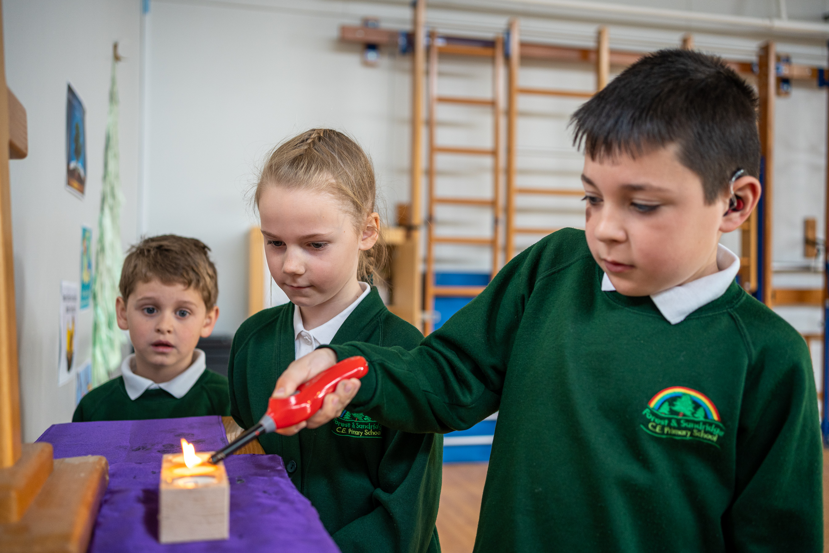
Welcome to our…
Church School Distinctiveness and RE Family Learning Morning

Slide 2
What is a church school?
“A community school with a distinctive Christian character.”

Slide 3
From the earliest days, the purpose of Church schools was to enable children to flourish by providing a basic education and by developing their moral character.

Slide 4
We will offer children an experience of faith through collective worship and links with the parish church.

Slide 5
What are the differences you will notice?
That distinctive difference will be rooted in Christian values that affect the way everyone behaves and in the way everyone is respected.
Around the school, there will be signs and symbols which reflect the Christian heritage on which the school is built.
There may also be areas for reflection which contain school prayers and prayers that the children have created themselves.
Worship Council
Additionally, there will be a much greater emphasis on links with the local parish church than would usually be the case in a non Church school.
Collective Worship as a the core.
Notes:
Behaviour – all comes back to values and our vision.
Environment – all around you will see links to our vision and values – these are well embedded with children – want to broaden this out to parents and visitors.
Reflection – Children

Slide 6
Church schools have Christian beliefs and values at their heart. This means that every child and adult associated with the school is not just important because they are members of the school but also because they are seen as unique individuals within God’s creation.

Slide 8
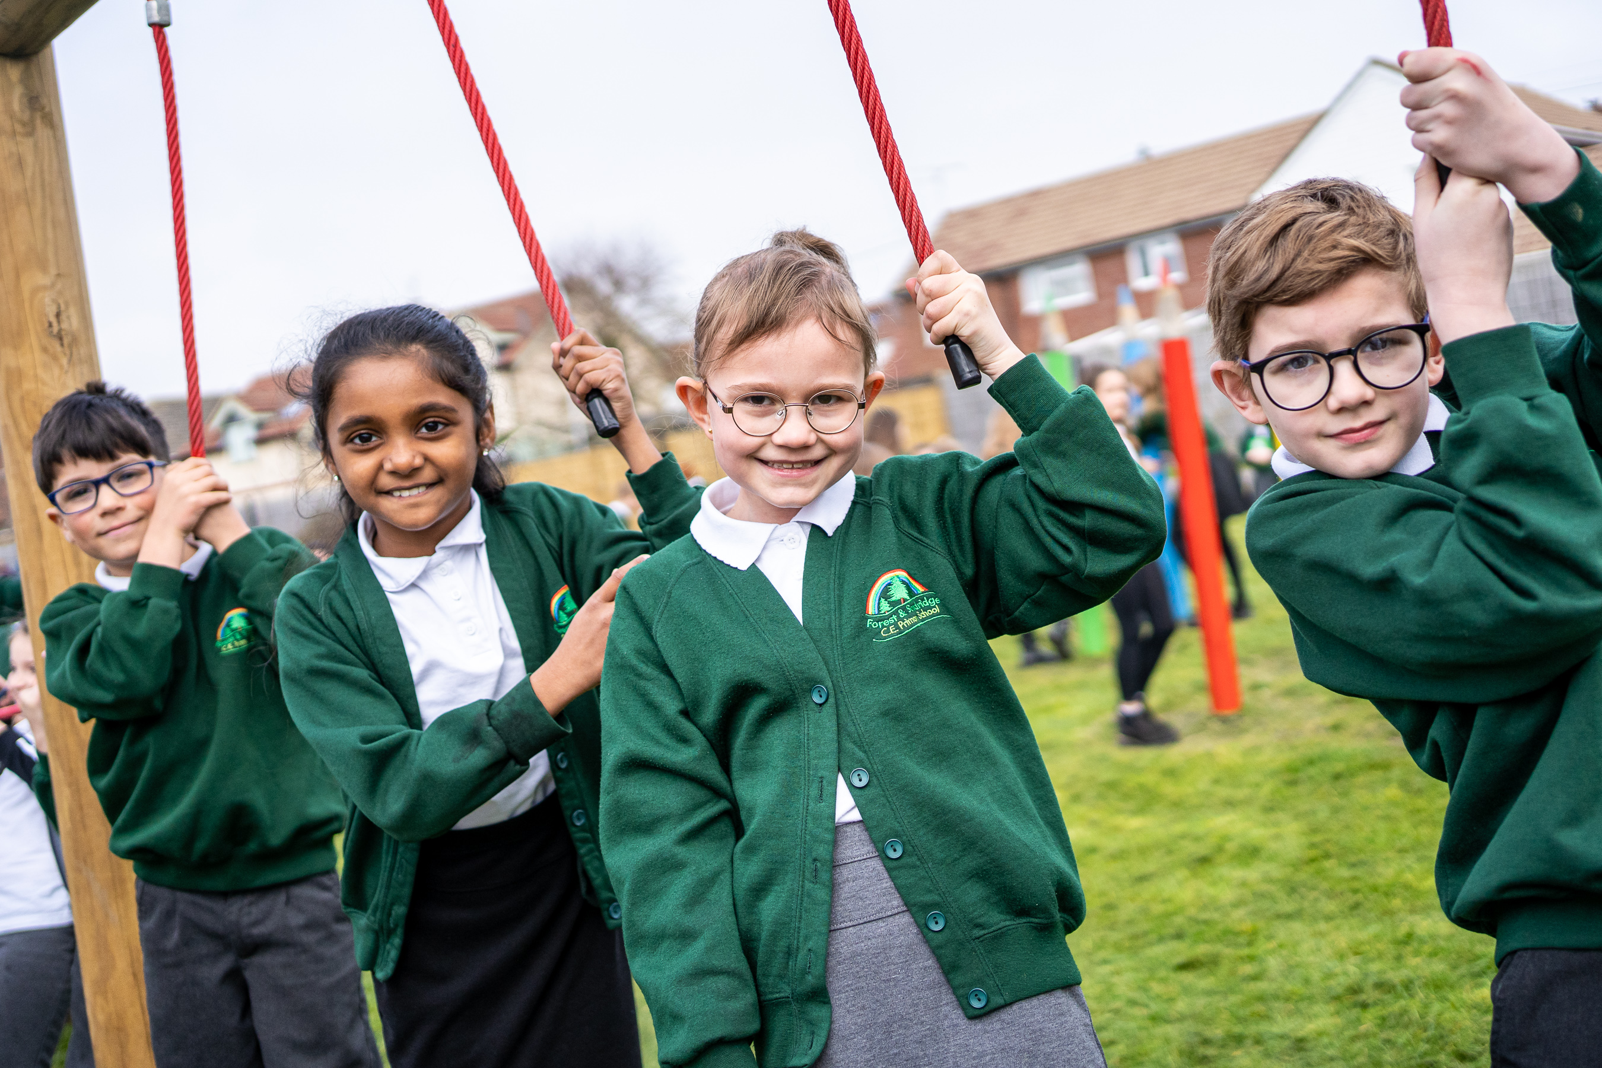
School vision should be… ‘The way we do things around here…’

Slide 12
"For I know the plans I have for you," says the Lord... "Plans to give you hope and a future."
Jeremiah 29:11

Slide 13
Church schools recognise that as well as academic and emotional intelligence human beings also have spiritual intelligence. The spiritual aspects of life will be recognised, and nurtured alongside the academic and emotional needs of all.

Slide 14
Church of England schools are places where questioning of belief and non belief is encouraged as we all try to make sense of the world, the gift of life and the purpose of our own personal lives.

Slide 15
Collective Worship
Collective worship is a central part of the school day for both children and staff. It is an opportunity for us to gather together to worship God, to consider spiritual and moral issues and to explore our own beliefs. The children take active participation through class led worship, leading in prayer, acting, singing and supporting worship. Our worship has a distinctively Christian theme and we develop a theme across the term with the children. We select themes based on the needs of our school and members of our community.
Opportunities for children to lead
IT IS NOT RE.
Notes:
Collective worship is a big part of daily school life.
It is central for the adults and children. One child in a pupil voice recently commented ‘If we didn’t have worship, it would feel like something big was missing’.
We have 6 values across a year which are explored in more detail during worships.

Slide 16
Collective Worship
Monday- Whole School
Tuesday- Whole School
Wednesday- Hymn Practice
Thursday- Class Worship
Friday- Golden Book
As well as our Harvest, remembrance, Christmas, Easter, Advent and Lent Services.
Class Worships
Reflections- Advent and Lent- opportunities to develop Spirtuality.

Slide 17
Collective Worship is to be “wholly or mainly of a broadly Christian Character”, and within the traditions of the Church of England. Over a term the majority of acts of worship must be wholly or mainly of a broadly Christian character. Pupils who do not come from Christian families should be able to join in the daily act of collective worship, even though this would, in the main reflect the broad traditions of Christian belief
Notes:
Collective worship are wholly Christian based however those who are from other faiths are able to join in – links are made with other faiths where relevant.

Slide 18
What does a Collective Worship need to include? How is it invitational, inspiring and inclusive?
Welcome- A worshipful atmosphere is created through music and a focus for reflection when the pupils enter. Candle- Jesus is the light of the world. Call and response. Big Question- video stimulus.
Learning – bible story, shared information or experience, truth or life lesson. Inspiring and engaging.
Reflecting - During each worship, there is the opportunity for whole school reflection. A piece of ‘reflection music’ is played, a focus for reflection is displayed and the children and adults participate in reflection together.
Responding - Do you feel that you have been inspired or challenge to do something different as a result of the time of worship? Can you describe your response? How did the leaders of worship help everyone to pray? What made this a special part of the worship time?
Notes:
4 main parts to a worship. We make sure they are invitational, inspiring and inclusive.
Try to ensure children are involved as much as possible.

Slide 19
SIAMS
SIAMS stands for the Statutory Inspection of Anglican and Methodist Schools. All Church of England dioceses and the Methodist Church use the National Society's framework as a process for evaluating the extent to which church schools are "distinctively and recognisably Christian".
SIAMS inspection explores the question, “How effective is the school’s distinctive Christian vision, established and promoted by leadership at all levels, in enabling pupils and adults to flourish?”
Notes:
As a church school, we have an additional inspection called SIAMs which judges us on our Church School Distinctiveness and how effective this is across the school.
It explores the question…

Slide 20
SIAMS October 2019
Notes:
At our last inspection we were graded excellent which is the highest grade you can get. Very proud of our Church school distinctiveness – it is recognised through everything we do – curriculum, behaviour, relationships with children and parents.

Slide 21
Spirituality in RE
Understanding Christianity and Discovery RE used alongside each other.
It is through using these two schemes alongside each other that we are providing children with a holistic and balanced RE curriculum.
Notes:
UC & DRE – both allow for deep thinking and reflection upon what is being taught in the classroom and often follows on from worship making links where possible.

Slide 22
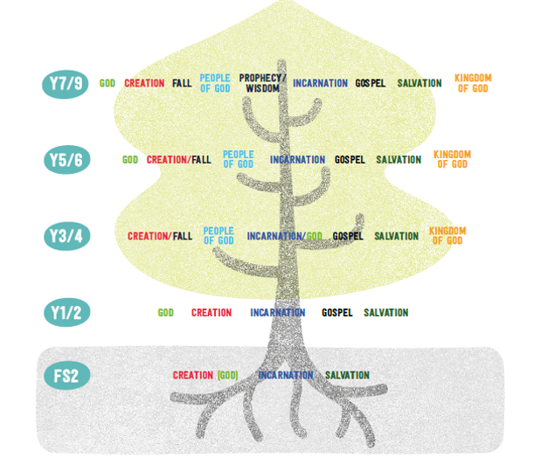
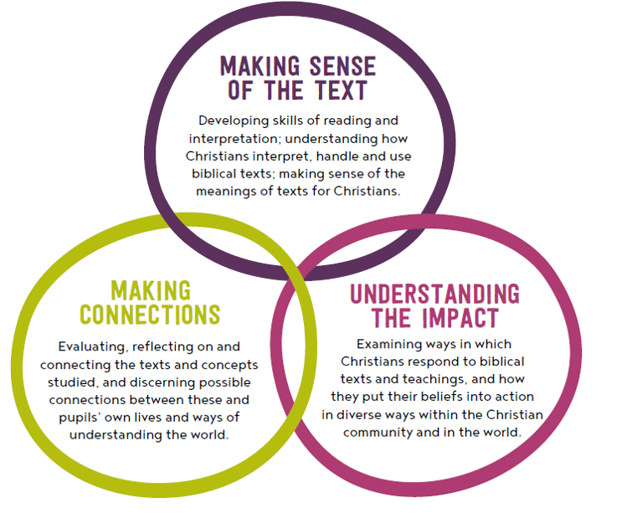
Understanding Christianity
Understanding Christianity is based upon seven core Christian concepts. Children will explore the different concepts in a range of inspiring activities as they move through the school, starting in Foundation Stage and developing a great depth of understanding by the time they reach Year 6.
Notes:
Making sense of the text – understanding how Christians interpret, handle and use biblical texts and understanding the meaning of the texts for Christians.
Understanding the impact – Looking at how Christians respond to biblical texts and teachings and how they put these beliefs into action
Making connections – Evaluation and reflecting on how they can make possible connections between these texts and their own lives and to help with their own understanding of the world

Slide 23
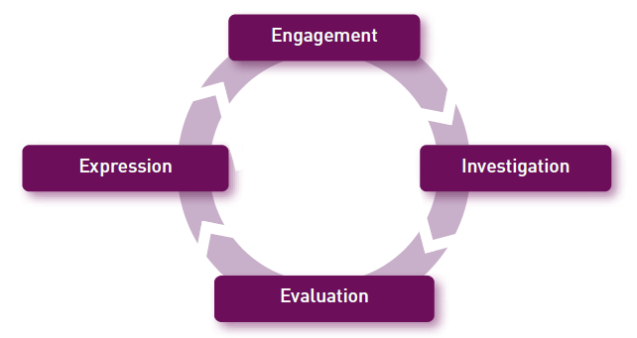
Discovery RE
Discovery RE, an enquiry based approach, is used alongside Understanding Christianity to ensure that children are given opportunities to explore a wide range of different religions throughout their time in Primary School.
Notes:
Engagement – big question linked to their own lives e.g. How do Sikh’s show commitment to God? First look at commitment in their own lives.
Investigation – enquiry based part and gaining subject knowledge related to the key question.
Evaluation – Making their own conclusions and evaluations on the big question
Expression – Link back to engagement and the impact the big question has on their own lives

Slide 24
Understanding Christianity and Discovery RE
Each unit begins with a big question that the unit explores throughout the term.
Creative teaching approaches
Art, drama, music
Discussions
Religious texts
Working walls
Self-reflection
Notes:
UC & DRE – both allow for deep thinking and reflection upon what is being taught in the classroom and often follows on from worship making links where possible.
Each RE concept begins with a ‘Big Question’ – allowing children to reflect upon their understanding and help steer their learning.

Slide 25
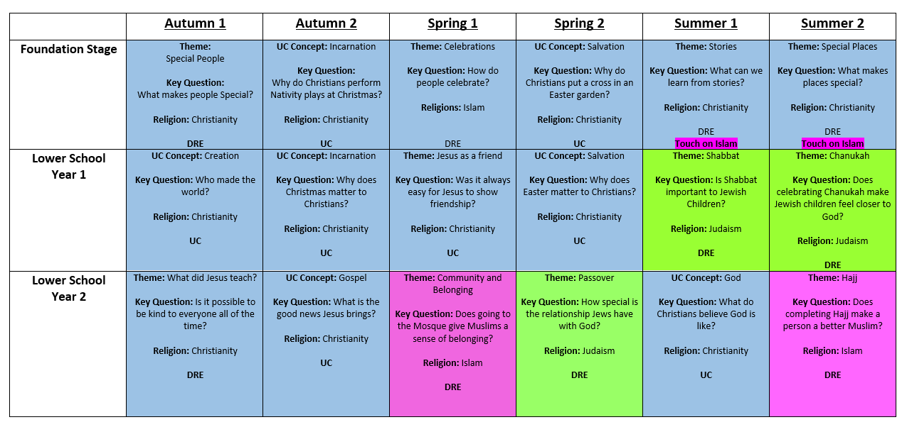
Our Curriculum
Notes:
Planned for development and progression not only within the year but across the school so that a religion or concept is revisited and built upon to deepen their understanding.
- Teaching other faiths – whilst covering these we use our Christian values to help us discuss the differenced and similarities between other faiths and Christianity.
- Our planning progression is carefully thought out and we are going to continue to develop this this year to ensure that we are building upon knowledge effectively across the school.

Slide 26
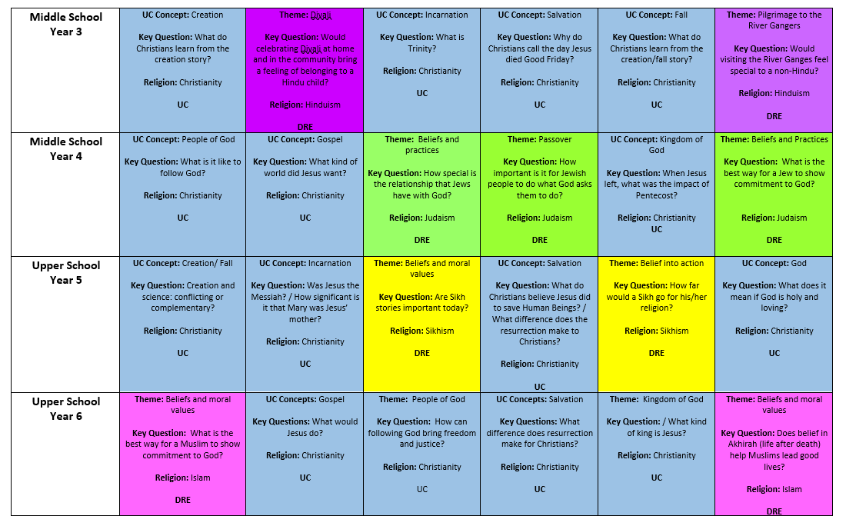

Slide 27
Teaching RE:
Understanding Christianity & Discovery RE
Creative teaching approaches
RE working walls
Self reflection
Links to local and global issues
Notes:
UC & DRE – both have a similar format beginning with BQ’s
Creative – art, music , drama

Slide 28
Any questions?
Please place any questions in the question box and we will answer these once you have been to the classrooms.

Slide 29
Please spend the rest of the session in classes experiencing RE with your child or children.
We will meet back in the hall at 10.00 to discuss what you have seen and answer any questions ☺

