Slide 1
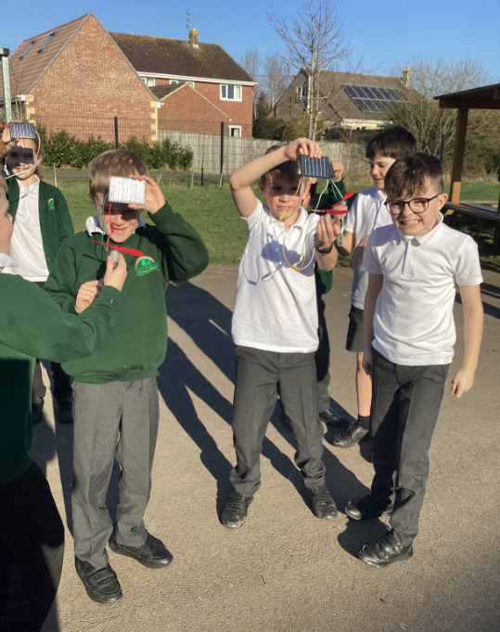
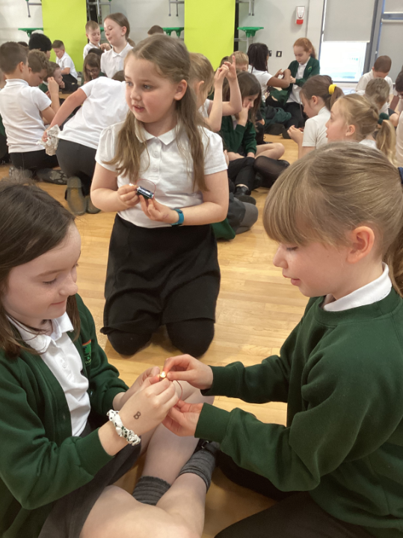
Welcome to our Family Learning Morning
Science
2023
Notes:
Lucy

Slide 2
Aims of the morning
To have a greater understanding of how we teach Science across the school.
To understand how Science is developed within each year group.
To have a greater knowledge of how to support your children with science and investigative activities at home.

Slide 4
Our Intent
Supporting our children to do more, know more and remember more.
To prepare our children for their future with a “hands –on”, inquiry-based science curriculum that enables them to confidently explore and discover the world around them.
To motivate and actively engage our children to nurture and grow their curiosity.
For all our children to be life-long learners who are inquisitive, independent thinkers, confident to ask ‘Big Questions’ and who are well prepared for their future in the ever changing world.

Slide 5
Science lessons at Forest & Sandridge:
Are as creative as possible
Have cross-curricular links
Answer big questions
Give children the opportunity to pose and answer their own questions
Offer opportunities to explore and investigate

Slide 6
Science Strands
Knowledge and Understanding
- developing scientific knowledge and conceptual understanding through the specific disciplines of biology, chemistry and physics. Children should build up extended specialist vocabulary and use this in Science lessons, both verbally and through written work.
Working Scientifically
- the understanding of the nature, processes and methods of Science for each year group. This is taught within each Science unit. Children learn to use a variety of approaches to answer relevant scientific questions. These types of scientific enquiry should include: observing over time; pattern seeking; identifying, classifying and grouping; comparative and fair testing (controlled investigations); and researching using secondary sources. Children should also seek answers to questions through collecting, analysing and presenting data.

Slide 7
Science Units
EYFS – Science is taught through ‘Knowledge and Understanding of the World’
Year 1 – Animals including Humans, Materials, Plants, Seasonal Changes
Year 2 - Animals including Humans, Uses of Everyday Materials, Living Things and their Habitats, Plants
Year 3 - Animals including Humans, Forces and Magnets, Rocks, Plants, Light
Year 4 - Animals including Humans, States of Matter, Living Things and their Habitats, Electricity, Sound
Year 5 - Animals including Humans, Forces and Magnets, Properties and Changes of Materials, Living Things and their Habitats, Earth and Space.
Year 6 - Animals including Humans, Evolution and Inheritance, Living Things and their Habitats, Electricity, Light

Slide 8
What does a Science lesson at Forest & Sandridge look like?
Recap of prior learning at the start of the lesson
Key vocabulary
New learning
Task / activity – practical wherever possible
- Recap of new learning at the end of the lesson learning

Slide 9
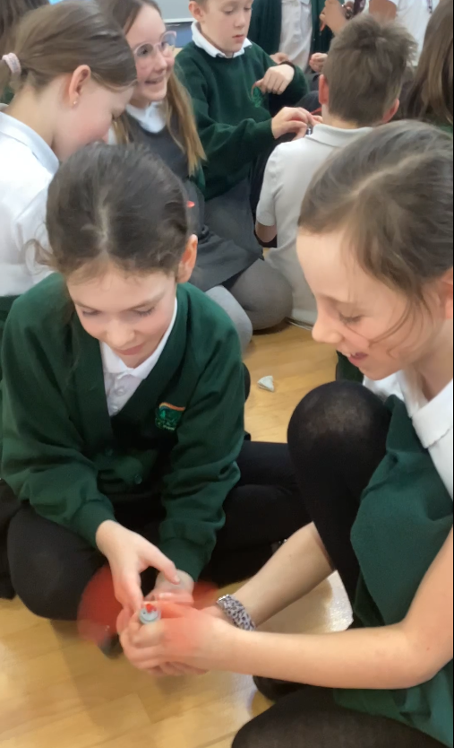
Time in Classrooms
You will now spend some time in classrooms watching a Science lesson.
Please be back in the hall for 10am.

Slide 10
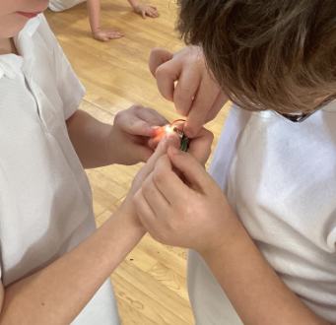
Your turn…
Can you make the light bulb light up?

Slide 11
How can you support your child with Science learning at home?
Explore questions together
Support your child’s curiosity
Encourage your child to make predictions and to record observations (verbally, drawing, writing, taking a photograph)

Slide 12
Any Questions?

Slide 13
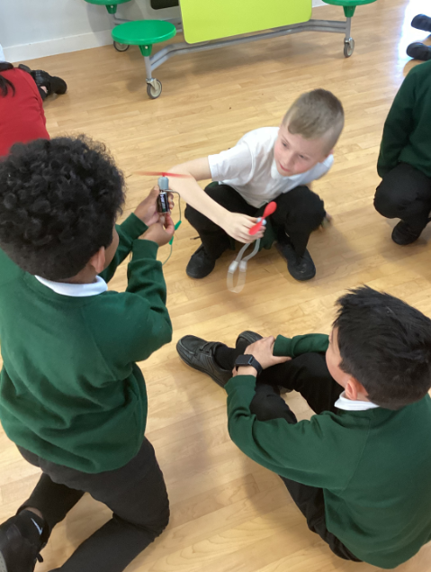
Feedback
Thank you for joining us this morning. We would appreciate any feedback. Please use the iPads to scan the QR code.
Notes:
Lucy
https://forms.gle/17xR9uyoi9JE2Vcw7
Make QR code on the morning

