Slide 1
Writing Morning
2023 – 2024

Slide 2
National Curriculum
Aims
The overarching aim for English in the national curriculum is to promote high standards of language and literacy by equipping pupils with a strong command of the spoken and written language, and to develop their love of literature through widespread reading for enjoyment. The national curriculum for English aims to ensure that all pupils:
read easily, fluently and with good understanding
develop the habit of reading widely and often, for both pleasure and information
acquire a wide vocabulary, an understanding of grammar and knowledge of linguistic conventions for reading, writing and spoken language appreciate our rich and varied literary heritage
write clearly, accurately and coherently, adapting their language and style in and for a range of contexts, purposes and audiences
use discussion in order to learn; they should be able to elaborate and explain clearly their understanding and ideas
are competent in the arts of speaking and listening, making formal presentations, demonstrating to others and participating in debate.
Notes:
read easily, fluently and with good understanding
develop the habit of reading widely and often, for both pleasure and information
acquire a wide vocabulary, an understanding of grammar and knowledge of linguistic conventions for reading, writing and spoken language appreciate our rich and varied literary heritage
write clearly, accurately and coherently, adapting their language and style in and for a range of contexts, purposes and audiences
use discussion in order to learn; they should be able to elaborate and explain clearly their understanding and ideas
are competent in the arts of speaking and listening, making formal presentations, demonstrating to others and participating in debate.

Slide 3
Writing at Forest and Sandridge
Curriculum Intent
Throughout the Early Years, Key Stage 1 and Key Stage 2, we teach writing through a text-based approach, which allows us to meet the needs of the children that we are teaching – through choosing a text that will engage, inspire and motivate. As well as reading a wide variety of genres, children are given frequent opportunities to develop their skills in writing in different genres. Through covering one text per term in depth and good quality supplementary texts, children are exposed to a broad range of text types, styles and genres which must include diverse books. All children are given the opportunity to put their writing skills into practice through two pieces of extended writing per term: one fiction and one non-fiction. Each term, children will publish a piece of writing and will be displayed on clipboards in the corridors throughout the school; this is known as “Clip it, clap it”. This allows every child to have a written piece of work on the walls, which can be seen and celebrated by all, as well as knowing they are writing for a purpose and being seen as real writers.
Notes:
Throughout the Early Years, Key Stage 1 and Key Stage 2, we teach writing through a text-based approach, which allows us to meet the needs of the children that we are teaching – through choosing a text that will engage, inspire and motivate. As well as reading a wide variety of genres, children are given frequent opportunities to develop their skills in writing in different genres. Through covering one text per term in depth and good quality supplementary texts, children are exposed to a broad range of text types, styles and genres which must include diverse books. All children are given the opportunity to put their writing skills into practice through two pieces of extended writing per term: one fiction and one non-fiction. Each term, children will publish a piece of writing and will be displayed on clipboards in the corridors throughout the school; this is known as “Clip it, clap it”. This allows every child to have a written piece of work on the walls, which can be seen and celebrated by all, as well as knowing they are writing for a purpose and being seen as real writers.

Slide 4
Writing at Forest and Sandridge
Our intentions are for children to:
Write for a purpose
See themselves as real writers
Take ownership of their writing
See writing as an interesting and enjoyable process
Acquire the ability to organise and plan their written work.

Slide 5
We teach writing through a text-based approach, which allows us to meet the needs of the children that we are teaching – through choosing a text that will engage, inspire and motivate.
Notes:
Can you tell me the text your child has done this term?

Slide 6
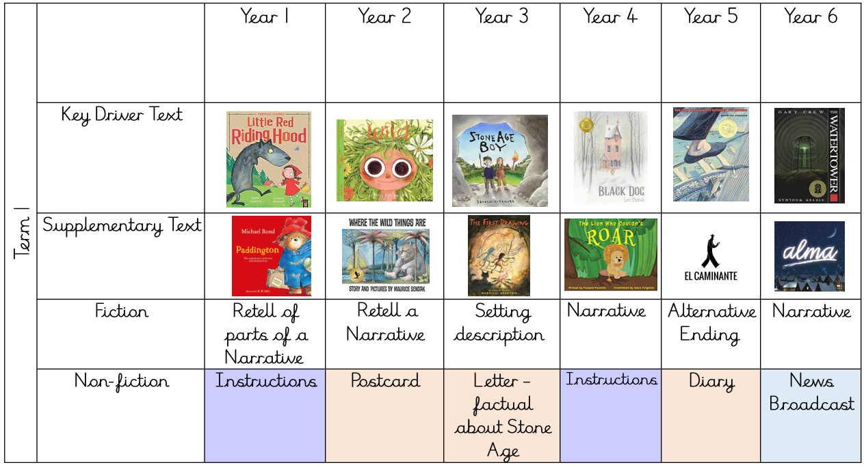

Slide 7
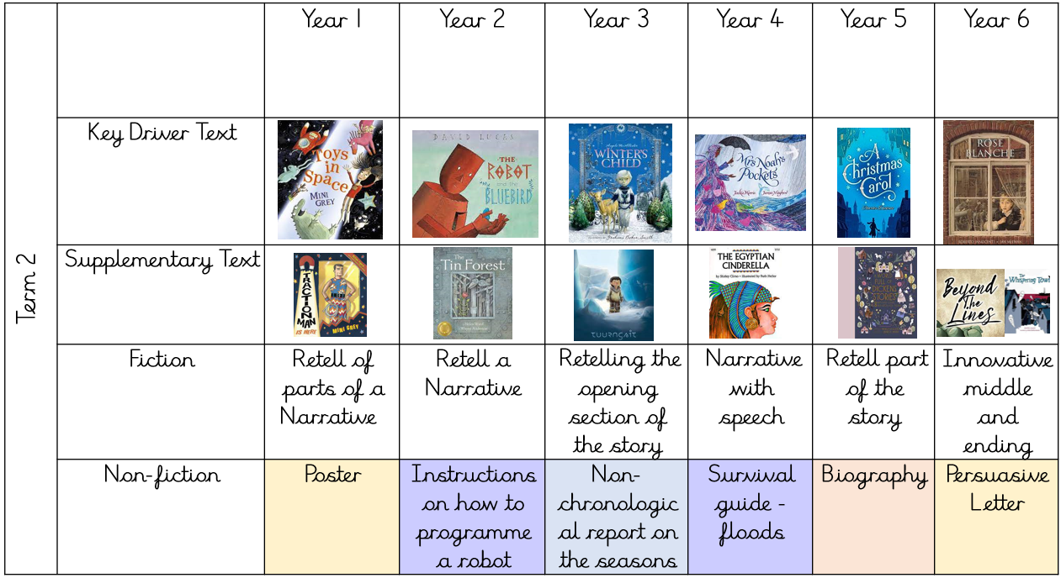

Slide 8
Spelling

Slide 9
In KS1 children follow the Rocket Phonics SSP scheme and begin to read and spell high frequency words. Learning to recognise the high frequency words on sight is crucial in developing fluency and accuracy in reading and then writing. High frequency words are the words that appear most often in printed materials. Some of the high frequency words are referred to as ‘tricky words’ as the children are unable to use their phonic knowledge to decode every part of the word.
Once children are confident in reading and spelling high frequency words, they are taught spelling rules and are encouraged to apply these rules in their writing. In KS2, spelling is taught 2-3 times a week during focused sessions using the No Nonsense scheme. We follow the recap, teach, practise, apply approach and parents are encouraged to help their children learn spellings at home. A mixture of known and unknown spellings (which follow the same rule) are assessed weekly and statutory words are assessed four times per year.
Notes:
In KS1 children follow the Rocket Phonics SSP scheme and begin to read and spell high frequency words. Learning to recognise the high frequency words on sight is crucial in developing fluency and accuracy in reading and then writing. High frequency words are the words that appear most often in printed materials. Some of the high frequency words are referred to as ‘tricky words’ as the children are unable to use their phonic knowledge to decode every part of the word.
Once children are confident in reading and spelling high frequency words, they are taught spelling rules and are encouraged to apply these rules in their writing. In KS2, spelling is taught 2-3 times a week during focused sessions using the No Nonsense scheme. We follow the recap, teach, practise, apply approach and parents are encouraged to help their children learn spellings at home. A mixture of known and unknown spellings (which follow the same rule) are assessed weekly and statutory words are assessed four times per year.

Slide 10
Once children are confident in reading and spelling high frequency words, they are taught spelling rules and are encouraged to apply these rules in their writing.
For example, in Years 3 and 4, the following spelling rules and patterns will be taught:
Adding suffixes -er, -ing to verbs, for example: 'beginner' and 'beginning'
Words containing 'y' where it sounds like 'i', such as 'myth' and 'gym'
Words containing 'ou' where it sounds like 'u' such as 'young' and 'touch'
Words containing prefixes (groups of letters added to the start of a word) such as mis-, dis-, im-, il-, ir-, re-, sub-, inter-, super-, anti-, auto-
Words containing suffixes (groups of letters added to the end of each word) such as -ation, -ly
Words ending -sure and -ture (such as 'measure' and 'creature')
Words ending -sion, -tion, -ssion, -cian (such as 'confusion', 'rejection', 'permission' and 'musician')
Words ending -ous (such as 'dangerous' and 'courageous')
Words containing ch where it sounds like ‘sh’ or ‘k’ (such as 'chef' and 'scheme')
Words ending -gue and -que (such as 'league' and 'antique')
Homophones (pairs of words that sound the same but are spelled differently, for example: 'meddle' and 'medal’)
Notes:
Once children are confident in reading and spelling high frequency words, they are taught spelling rules and are encouraged to apply these rules in their writing.
For example, in Years 3 and 4, the following spelling rules and patterns will be taught:

Slide 11
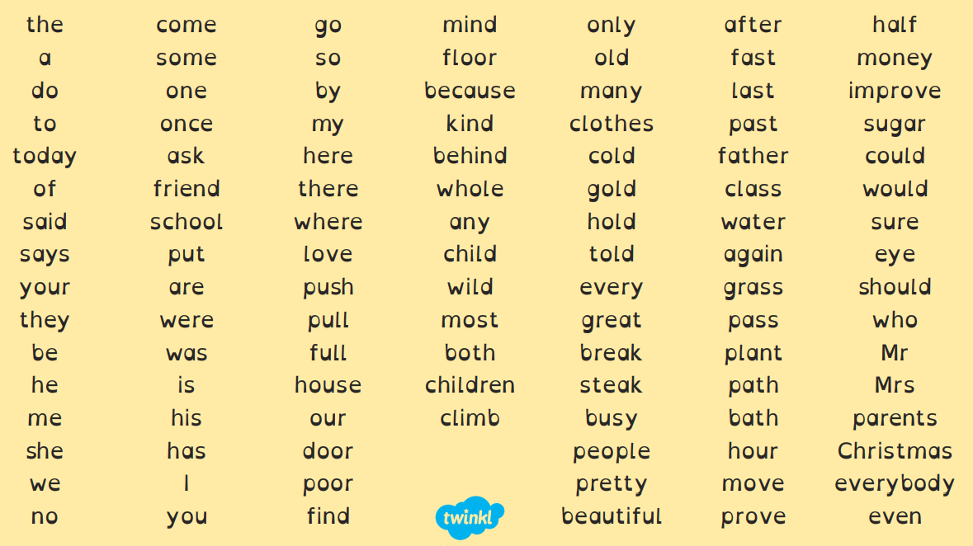
Statutory Spelling Words
Year 1 and 2
Notes:
Handout

Slide 12
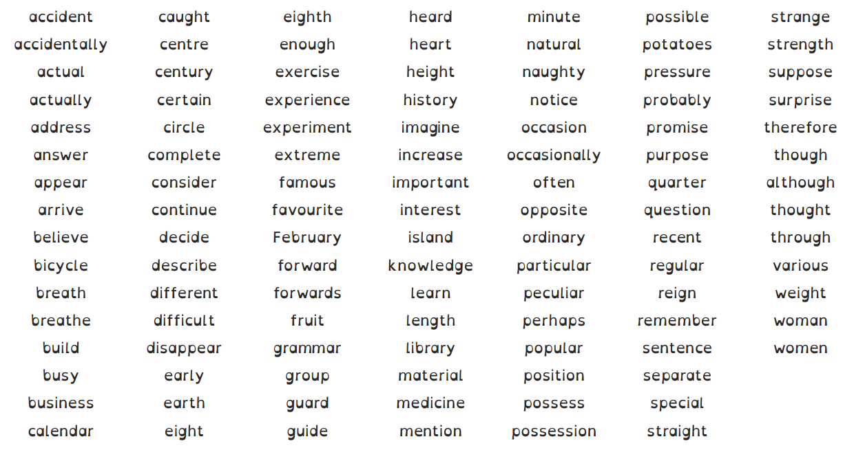
Statutory Spelling Words
Year 3 and 4

Slide 13
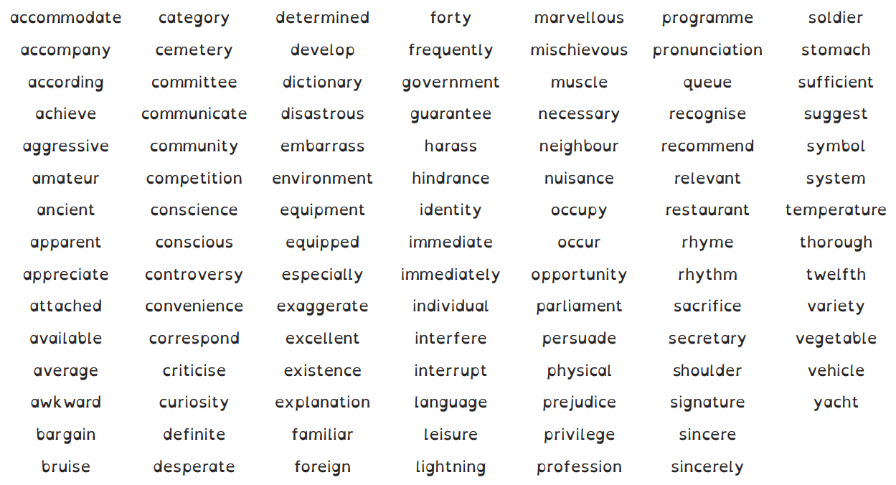
Statutory Spelling Words
Year 5 and 6

Slide 14
Handwriting

Slide 15
Year 1 Handwriting
Pupils should be taught to:
sit correctly at a table, holding a pencil comfortably and correctly
begin to form lower-case letters in the correct direction, starting and finishing in the right place
form capital letters
form digits 0-9
understand which letters belong to which handwriting ‘families’ (ie letters that are formed in similar ways) and to practise these.
Notes:
sit correctly at a table, holding a pencil comfortably and correctly
begin to form lower-case letters in the correct direction, starting and finishing in the right place
form capital letters
form digits 0-9
understand which letters belong to which handwriting ‘families’ (ie letters that are formed in similar ways) and to practise these.

Slide 16
Year 2 Handwriting
Pupils should be taught to:
form lower-case letters of the correct size relative to one another
start using some of the diagonal and horizontal strokes needed to join letters and understand which letters, when adjacent to one another, are best left unjoined
write capital letters and digits of the correct size, orientation and relationship to one another and to lower-case letters
use spacing between words that reflects the size of the letters.
Notes:
form lower-case letters of the correct size relative to one another
start using some of the diagonal and horizontal strokes needed to join letters and understand which letters, when adjacent to one another, are best left unjoined
write capital letters and digits of the correct size, orientation and relationship to one another and to lower-case letters
use spacing between words that reflects the size of the letters.

Slide 17
Year 3 and 4 Handwriting and Presentation
Pupils should be taught to:
use the diagonal and horizontal strokes that are needed to join letters and understand which letters, when adjacent to one another, are best left unjoined
increase the legibility, consistency and quality of their handwriting, [for example, by ensuring that the downstrokes of letters are parallel and equidistant, and that lines of writing are spaced sufficiently so that the ascenders and descenders of letters do not touch.
Notes:
use the diagonal and horizontal strokes that are needed to join letters and understand which letters, when adjacent to one another, are best left unjoined
increase the legibility, consistency and quality of their handwriting, [for example, by ensuring that the downstrokes of letters are parallel and equidistant, and that lines of writing are spaced sufficiently so that the ascenders and descenders of letters do not touch.

Slide 18
Year 5 and 6 Handwriting and Presentation
Pupils should be taught to:
write legibly, fluently and with increasing speed by:
choosing which shape of a letter to use when given choices and deciding whether or not to join specific letters
choosing the writing implement that is best suited for a task.
Notes:
write legibly, fluently and with increasing speed by:
choosing which shape of a letter to use when given choices and deciding whether or not to join specific letters
choosing the writing implement that is best suited for a task.

Slide 19
Handwriting at Forest and Sandridge.
We use a scheme called letter-join.

Slide 20
Today you will take part in a KS2 handwriting lesson.
Shopping List

Slide 21
You can now spend time in class with your children.
You may see a writing lesson, a spelling lesson or a handwriting lesson.
Please come back to the hall for 10am for feedback. Enjoy!

Slide 22
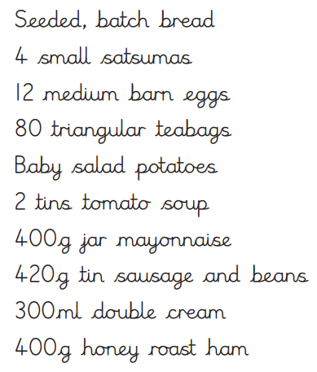

Slide 23
Please fill in the feedback on the iPads.
Any questions?

