Slide 1
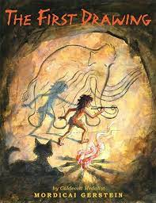
Term 1 |  | Year 1 | Year 2 | Year 3 | Year 4 | Year 5 | Year 6
 | Key Driver Text
 | Supplementary Text
 | Fiction | Retell of parts of a Narrative | Retell a Narrative | Setting description | Narrative | Alternative Ending | Narrative
 | Non-fiction | Instructions | Postcard | Letter – factual about Stone Age | Instructions | Diary | News Broadcast

Slide 2
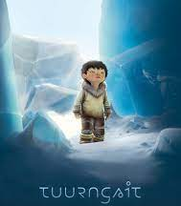
Term 2 |  | Year 1 | Year 2 | Year 3 | Year 4 | Year 5 | Year 6
 | Key Driver Text
 | Supplementary Text
 | Fiction | Retell of parts of a Narrative | Retell a Narrative | Retelling the opening section of the story | Narrative with speech | Retell part of the story | Innovative middle and ending
 | Non-fiction | Poster | Instructions on how to programme a robot | Non-chronological report on the seasons | Survival guide - floods | Diary | Persuasive Letter

Slide 3
Term 3 |  | Year 1 | Year 2 | Year 3 | Year 4 | Year 5 | Year 6
 | Key Driver Text
 | Supplementary Text
 | Fiction | Retell of parts of a Narrative | Retell a Narrative | Alternative Ending | Retell with a new character | AlternativeChapter | Alternative Chapter
 | Non-fiction | Letter | Persuasive Letter | Instructions – how to catch an Iron Man | Persuasive Letter |  | Diary
 |  | Poster

Slide 4
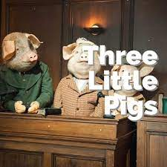
Term 4 |  | Year 1 | Year 2 | Year 3 | Year 4 | Year 5 | Year 6
 | Key Driver Text
 | Supplementary Text or Animation
 | Fiction | Retell of parts of a Narrative | Retell a Narrative | Write from a different perspective | Setting Description | Story from another point of view | Twisted Tale
 | Non-fiction | Instructions | Non-chronological Report | Newspaper Report | Persuasive advert about the circus. | Instructions | Persuasive letter in role
 |  | Postcard
 |  |  |  |  |  |  | Police Report

Slide 5
Term 5 |  | Year 1 | Year 2 | Year 3 | Year 4 | Year 5 | Year 6
 | Key Driver Text
 | Supplementary Text
 | Fiction | Retell of parts of a Narrative | Retell a Narrative | Setting Description | Continue an adventure story | Sequel | Duel third and first person narrative
 |  |  |  | Poetry
 | Non-fiction | Postcard | Non-chronological Report |  |  | Persuasive brochure | Non-chronological Report
 |  | Letter

Slide 6
Term 6 |  | Year 1 | Year 2 | Year 3 | Year 4 | Year 5 | Year 6
 | Key Driver Text
 | Supplementary Text
 | Fiction | Retell of parts of a Narrative | Retell a Narrative | Re-tell using own plot | Alternative Ending | Setting Description | Alternative Ending
 | Non-fiction | Instructions | Instructions | Persuasive Letter | Diary | TV news report | Balanced Argument
 |  | Letter

Slide 7
Non-Fiction
Writing to Inform |  | Writing to Argue |  | Writing to Explain
Reports | Recounts | Persuasion | Discussion | Instructions | Explanation
Non-chronological reports Film reviews Book reviews Sports reviews Weather reports News reports News broadcasts Police reports Information texts | Postcards Thank you letters Recounts based on real experiences Diaries in role Letters in role Blogs Emails Eyewitness reports Biographies Autobiographies | Invitations Letters in role Wanted posters Posters to advertise Letters for real purposes Radio, television, magazines or hording adverts Leaflets Travel brochures Written arguments | Debates Written balanced arguments | Rules Recipes Directions Experiments Survival guides Instruction manuals | Processes or cycles Explanations linked to work in other subject areas.

