Slide 1
KS4 Mastery
Module 4
Interests and Influences

Slide 2
Contents
Vocabulary sheets
Homework vocabulary
Translation task
Writing task (Example Questions: Foundation and Higher/ WAGOLL answers (What A Good One Looks Like)/ Answer Boosters)
90 word 'cheat' sheet
Answers for each task for you to mark.
This will help you to improve your Spanish skills and master the work we cover in class.

Slide 3
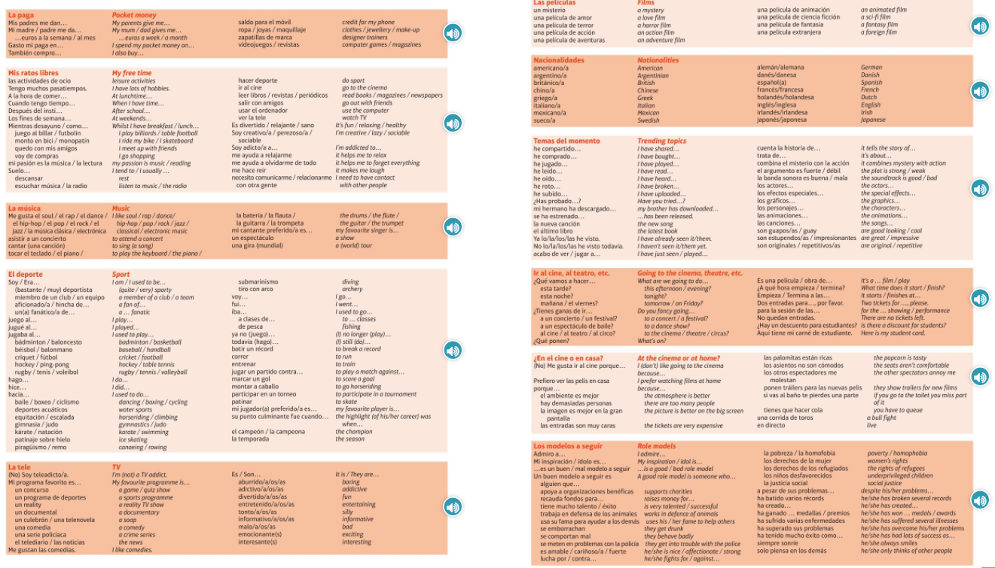
Module vocab

Slide 4
Vocab – Quizlet links
Week 1 https://quizlet.com/_ag6053?x=1jqt&i=3gxpjt
Week 2 https://quizlet.com/_ag62tu?x=1jqt&i=3gxpjt
Week 3 https://quizlet.com/_ag649m?x=1jqt&i=3gxpjt
Week 4 https://quizlet.com/_ag65oy?x=1jqt&i=3gxpjt
Week 5 https://quizlet.com/_ag66vb?x=1jqt&i=3gxpjt
Week 6 https://quizlet.com/_ag68dn?x=1jqt&i=3gxpjt
Week 7 https://quizlet.com/_ag69jx?x=1jqt&i=3gxpjt
Week 8 https://quizlet.com/_ag6dgw?x=1jqt&i=3gxpjt
Week 9 https://quizlet.com/_ag6ewk?x=1jqt&i=3gxpjt
Week 10 https://quizlet.com/_ag6guz?x=1jqt&i=3gxpjt

Slide 5
Topic translations into English
Use the vocab sheet and your existing knowledge of Spanish to translate the following sentences into English.
1. No soy teleadicto pero mi programa favorito es una seria policiaca porque es muy divertida.
2. Un buen modelo a seguir es alguien que trabaja en defensa de los animales.
3. Mis padres me dan cinco euros a la semana y los uso para comprar videojuegos.
4. Jugaba al béisbol cuando era más joven, pero ahora hago patinaje sobre hielo los fines de semana.
5. Se ha estreneado la nueva canción de Ed Sheeran, y me encanta porque tiene mucho talento.
6. Cuando tengo tiempo, me gusta ir al cine para ver una película de acción porque los efectos especiales son increíbles.

Slide 6
Respuestas – mark your answers
1. I'm not a TV addict but my favourite programme is a crime series because it is very fun.
2. A good role model is someone who works in defence of animals.
3. My parents give me five euros a week and I use them to buy video games.
4. I used to play baseball when I was younger but now I do ice skating at the weekends.
5. The new song from Ed Sheeran has been released and I love it because he is very talented.
6. When I have time, I like to go to the cinema to watch an action film because the special effects are incredible.

Slide 7
Topic translations into Spanish
Use the sentence builder and your existing knowledge of Spanish to translate the following sentences into Spanish.
1. After school, I ride my bike because it helps me to forget everything.
2. I used to do horseriding but now my passion is music.
3. A bad role model is someone who gets in trouble with the police.
4. I don't like the cinema because the other spectators annoy me, but the popcorn is tasty.
5. Do you fancy going to a festival tonight?
6. three tickets for the horror film, please.

Slide 8
Respuestas – mark your answers
1. Después del insti, monto en bici porque me ayuda a olvidarme de todo.
2. Hacía equitación pero ahora mi pasión es la música.
3. Un mal modelo a seguir es alguien que se meten en problemas con la policía.
4. No me gusta el cine porque los otros espectadores me molestan, pero las palomitas están ricas.
5. ¿Tienes ganas de ir a un festival esta noche?
6. Tres entradas para la película de terror, por favor.

Slide 9
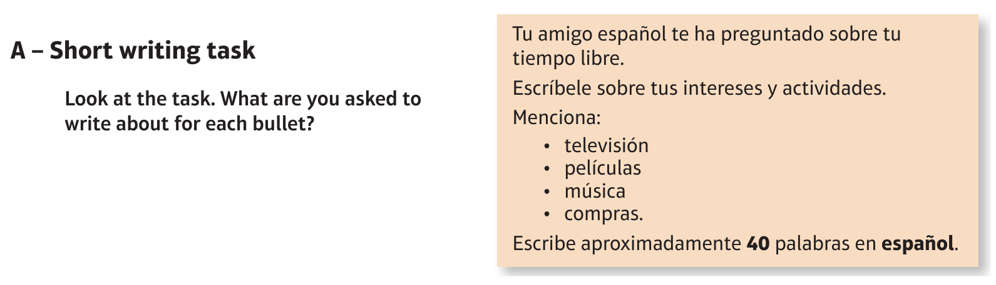
Foundation Free time: los ratos libres

Slide 10
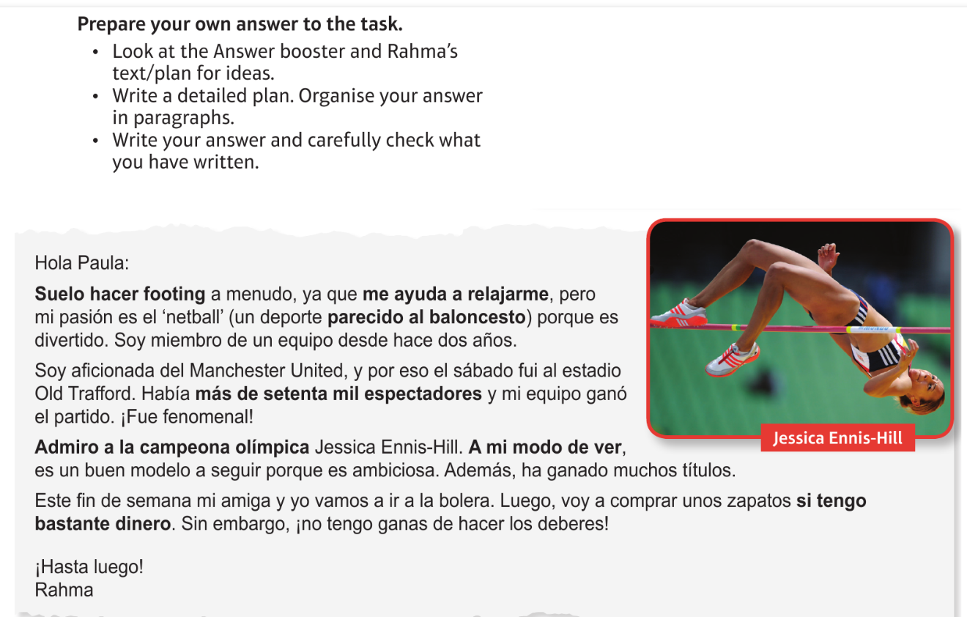
Foundation Free time: los ratos libres

Slide 11
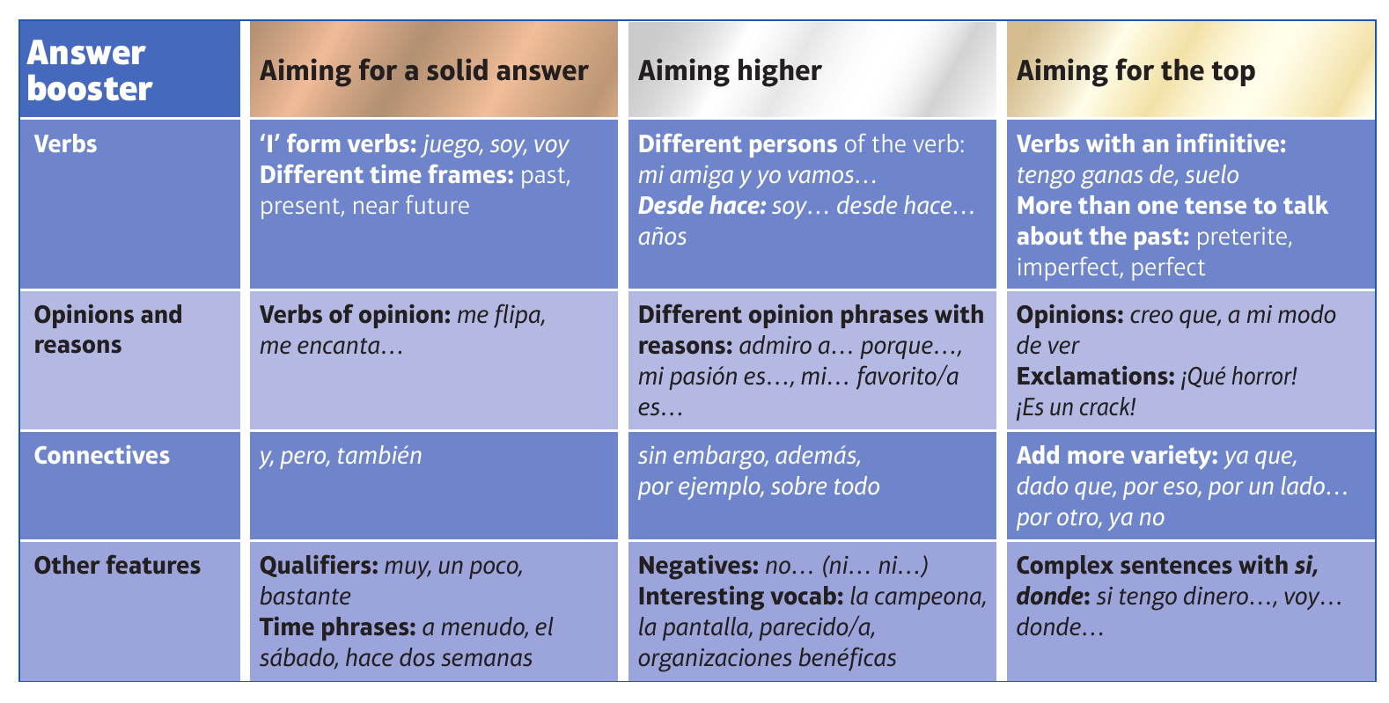
F

Slide 12
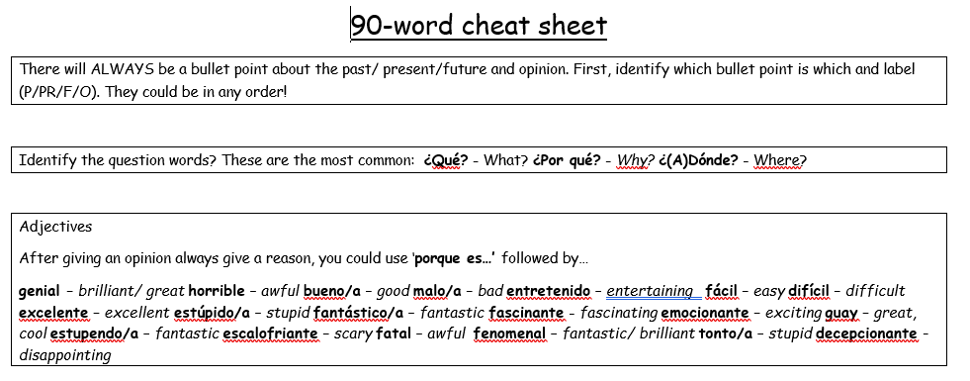
90 word 'cheat' sheet pg. 1

Slide 13
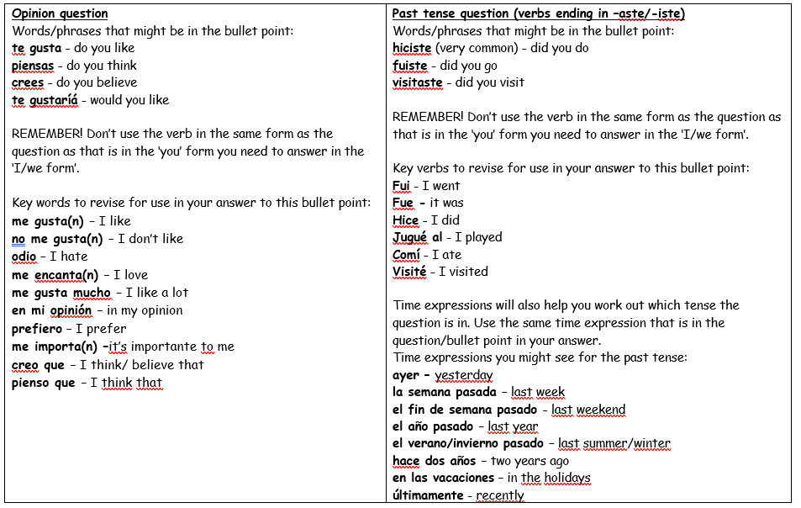
90 word 'cheat' sheet pg. 2

Slide 14
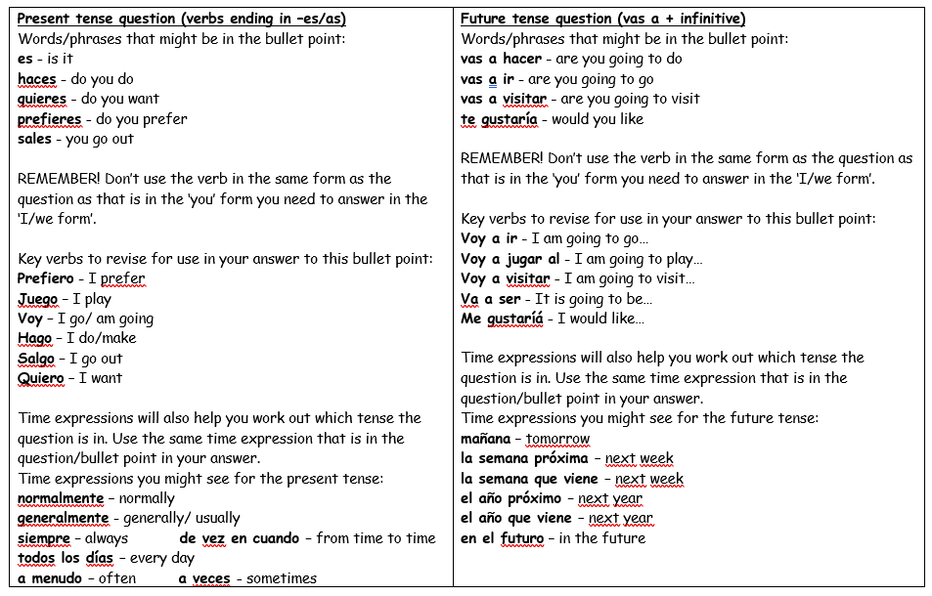
90 word 'cheat' sheet pg. 3

Slide 15
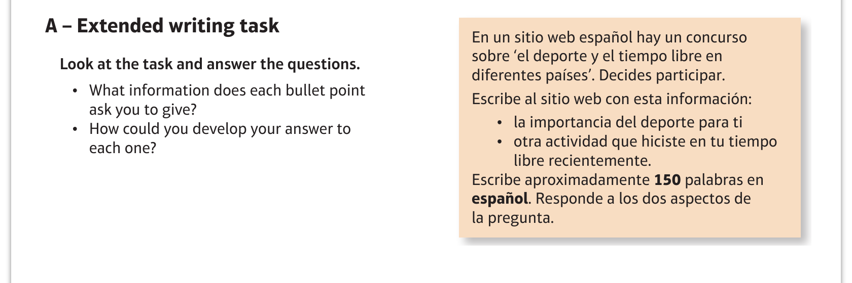
Higher Free time: los ratos libres

Slide 16
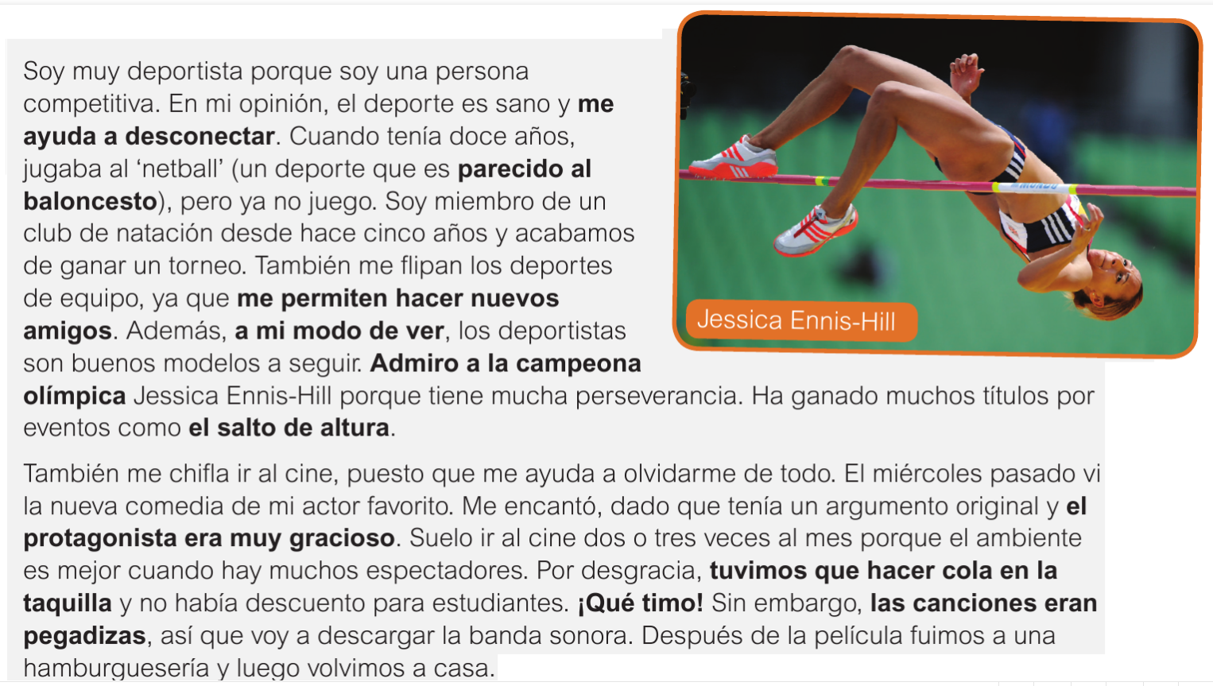
Higher Free time: los ratos libres

Slide 17
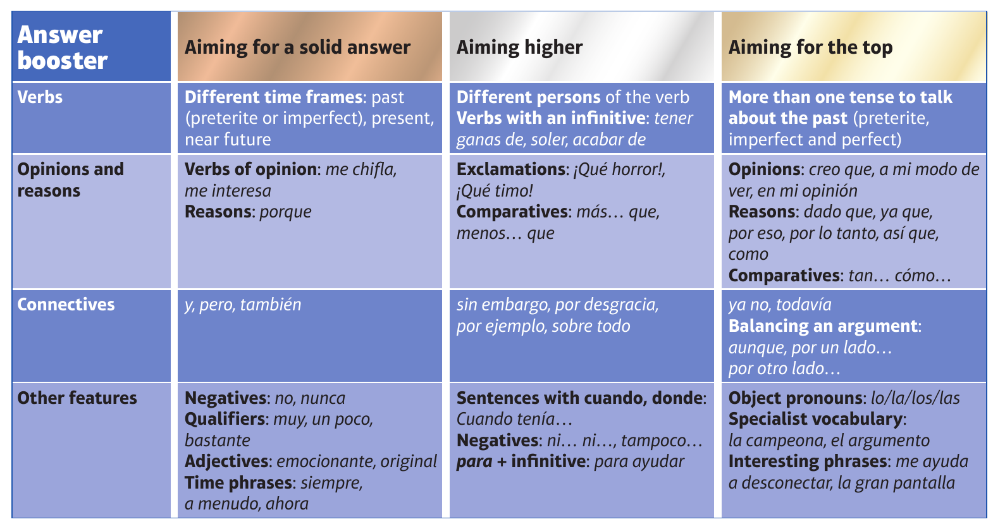
H

