Slide 1
Y11 Transition to Y12
Health and Social Care
Diploma (Double) and Extended Diploma (Triple)
Unit 14 – Physiological Disorders and their care
Pre-learning

Slide 2
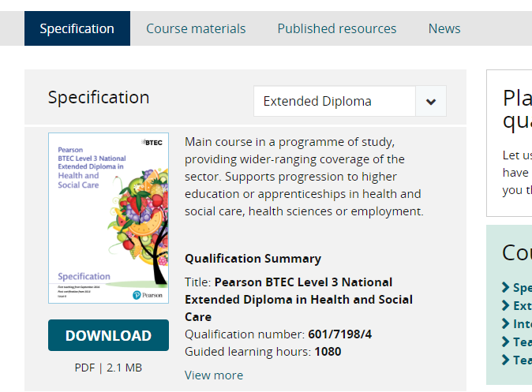
Specification / Context
You can find the specification for the course at: https://qualifications.pearson.com/en/qualifications/btec-nationals/health-and-social-care-2016.html
Make sure that you select the correct course from the specification drop down box before selecting download:
Find the unit information within the specification for Unit 14 Physiological Disorders.
Read through this so that you are familiar about the content of the unit and how you will be assessed. We will go through this thoroughly at the beginning of the course.

Slide 3
About the unit
This is a 60 Guided Learning Hours unit.
It is assessed through a piece of coursework which is composed of 2 reports.
You will learn about different physiological disorders and the body systems they impact on.
For the final report you will create a person-centred care plan for someone who suffers from a physiological disorder you have investigated.

Slide 4
Research Task
Produce a research fact file on a physiological disorder of your choice. Your fact file should include:
Information about the body system your chosen disorder impacts on and how.
How do you know someone is suffering from the disorder – what are the signs and symptoms?
Information about charities and organisations who support those suffering from the disorder.
Information from at least 2 different types of source E.g. a book and a website or an interview with someone who has type 2 diabetes and a website.
Possible disorders to consider:
Asthma
Diabetes
Rheumatoid arthritis
Coronary Heart Disease
Dementia
Hypothyroidism
Extra stretch – find an article (from a journal, newspaper, magazine, etc.) that is related to the disorder you have chosen

Slide 5
Suggested reading
Books:
BTEC National Health and Social Care Student Book 1: For the 2016 specifications
Websites:
https://www.nhs.uk/conditions
https://www.diabetes.org.uk/
https://www.diabetes.co.uk/
https://www.versusarthritis.org/
https://www.nras.org.uk/
https://www.heart.org/en/health-topics/consumer-healthcare/what-is-cardiovascular-disease/coronary-artery-disease
https://www.bhf.org.uk/
https://www.asthma.org.uk/
https://www.dementiauk.org/

