Slide 1
Y11 Transition to Y12 Health and Social Care Diploma (Double) and Extended Diploma (Triple)
Unit 1 – Human Lifespan Development
Pre-learning

Slide 2

Specification / Context
You can find the specification for the course at: https://qualifications.pearson.com/en/qualifications/btec-nationals/health-and-social-care-2016.html
Make sure that you select the correct course from the specification drop down box before selecting download:
Find the unit information within the specification for Unit 1 Human Lifespan Development.
Read through this so that you are familiar about the content of the unit and how you will be assessed. We will go through this thoroughly at the beginning of the course.

Slide 3
About the unit
This is a 1 ½ hour written examination, which you will sit in January 2025.
You are allowed to have 3 attempts at the examination. Examinations can be sat in January or in June.
The unit is 90 Guided Learning Hours.
You will learn about the different life stages, development and growth that occurs in each. You will learn about factors that affect growth and development and you will learn about the effects of ageing.
This builds on learning at Level 2, however we will go through it all again so there is not pre-requisite to have completed Level 2.
You will learn about psychological and sociological theorists and develop skills to critically discuss and evaluate their theories.

Slide 4
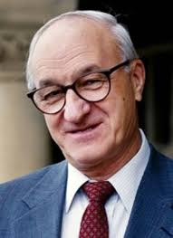
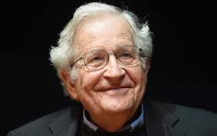
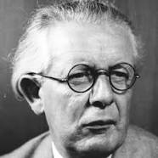
Research Task
Research at least 3 of the following theorists and summarise the key concepts within their research/theories.
Piaget – cognitive development
Chomsky – language development
Erikson – psychosocial development
Lenneberg – language acquisition
Bandura – Social Learning theory
Bowlby – attachment theory
Gesell – maturation theory
Extra stretch – for the two theorists you have chosen, can you find alternative theories that oppose or challenge their findings?

Slide 5
Suggested reading
Books:
BTEC National Health and Social Care Student Book 1: For the 2016 specifications
Human Lifespan Development by Mark Walsh
Theories of Developmental Psychology by Patricia H. Miller
Childhood and Society by Erik H. Erikson
Websites:
https://www.pearsonschoolsandfecolleges.co.uk/FEAndVocational/HealthAndSocialCare/BTEC/BTECNationalsHealthandSocialCare2016/Samples/Student-Book-1/BTEC-National-in-Health-and-Social-Care-Unit-01-web-ready.pdf This is a sample version of the textbook unit 1.
https://www.simplypsychology.org/

