Slide 1
KS4 Mastery
Module 6 Customs and routine

Slide 2
Contents
Vocabulary sheets​​
Homework vocabulary ​​
Translation task​​
Writing task​​ (Example Questions: Foundation and Higher/ WAGOLL answers (What A Good One Looks Like)/ Answer Boosters)
90 word 'cheat' sheet
Answers for each task for you to mark.​​
This will help you to improve your Spanish skills and master the work we cover in class.

Slide 3
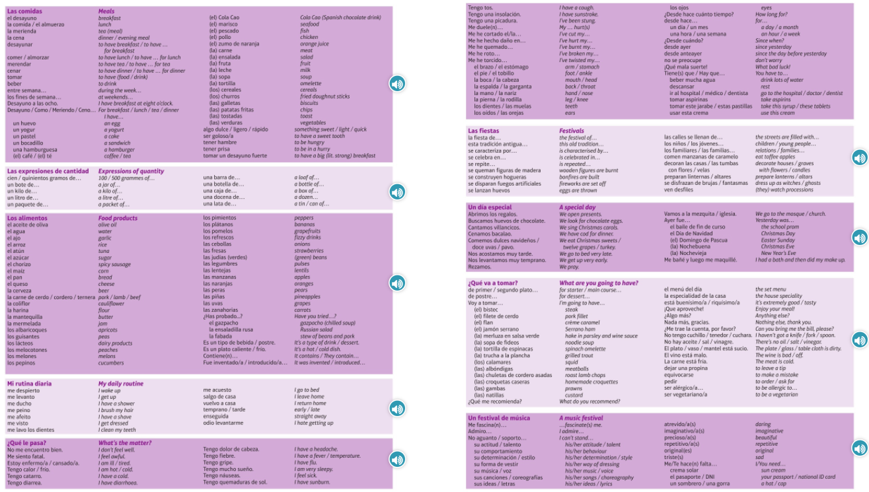
Module vocab

Slide 4
Vocab – Quizlet links
Week 1 https://quizlet.com/_asjlbl?x=1jqt&i=3gxpjt
Week 2 (Higher) https://quizlet.com/_asjprq?x=1jqt&i=3gxpjt

Slide 5
Topic translations into English
Use the vocab sheet and your existing knowledge of Spanish to translate the following sentences into English.
1. En nochebuena, cantamos villancicos y comemos dulces navideños, son deliciosos.
2. Desde anteayer, tengo tos y me duele la cabeza.
3. Primero me levanto, después me ducho y luego desayuno antes de salir.
4. El pomelo es menos rico que las lentejas.
5. Fui al supermercado y compré una barra de pan y quinientos gramos de zanahorias.

Slide 6
Respuestas – mark your answers
1. On Christmas Eve, we sing carols and eat Christmas sweets, they are delicious.
2. Since the day before yesterday, I've had a cough and a headache.
3. First I get up, then I have a shower and then I eat breakfast before leaving.
4. Grapefruit is less tasty than lentils.
5. I went to the supermarket and I bought a loaf of bread and 500g of carrots.

Slide 7
Topic translations into Spanish
Use the sentence builder and your existing knowledge of Spanish to translate the following sentences into Spanish.
1. On New years eve, we eat twelve grapes and fireworks are set off.
2. Since yesterday, I've got a fever and a sore throat so I have to drink lots of water.
3. First, I wake up, then I get dressed and before leaving I brush my teeth and hair.
4. Apricots are sweeter than cucumbers.
5. We went to the market and we bought a bottle of olive oil and a half a kilo of peas.

Slide 8
Respuestas – mark your answers
1. En nochevieja, comemos doce uvas y se disparan fuegos artificiales.
2. desde ayer, tengo fiebre y me duele la garganta por eso tengo que beber mucha agua.
3. Primero me despierto, después me visto y luego antes de salir me lavo los dientes y me peino.
4. Los albaricoques son más dulces que los pepinos.
5. Fuimos al mercado y compramos una botella de aceite y medio kilo de guisantes.

Slide 9
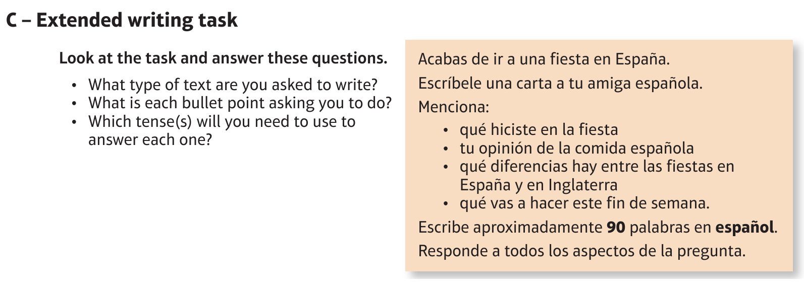
Foundation Spanish Culture: la cultura española

Slide 10
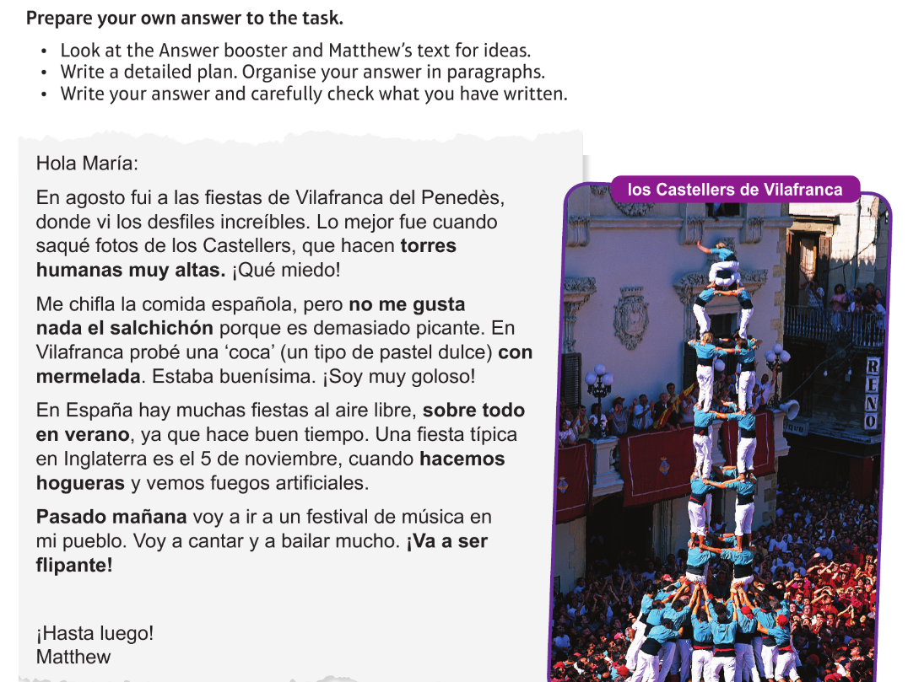
Foundation Spanish Culture: la cultura española

Slide 11
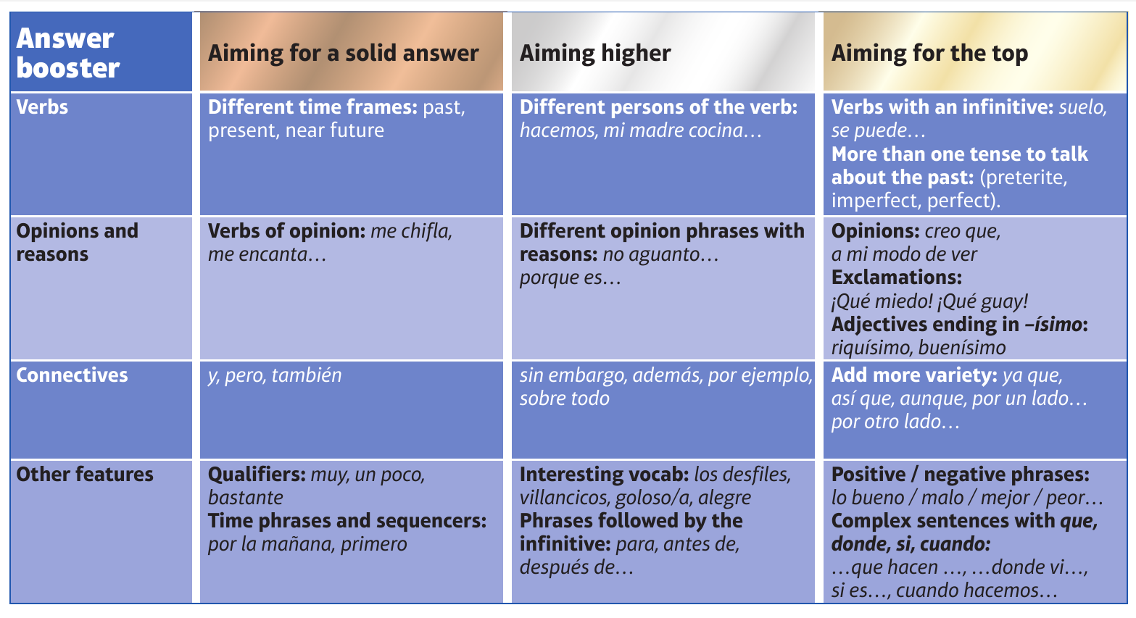
F

Slide 12
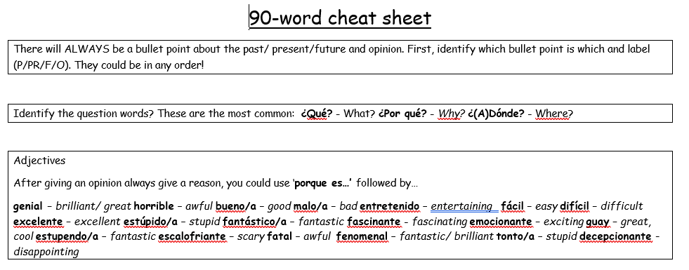
90 word 'cheat' sheet pg. 1

Slide 13
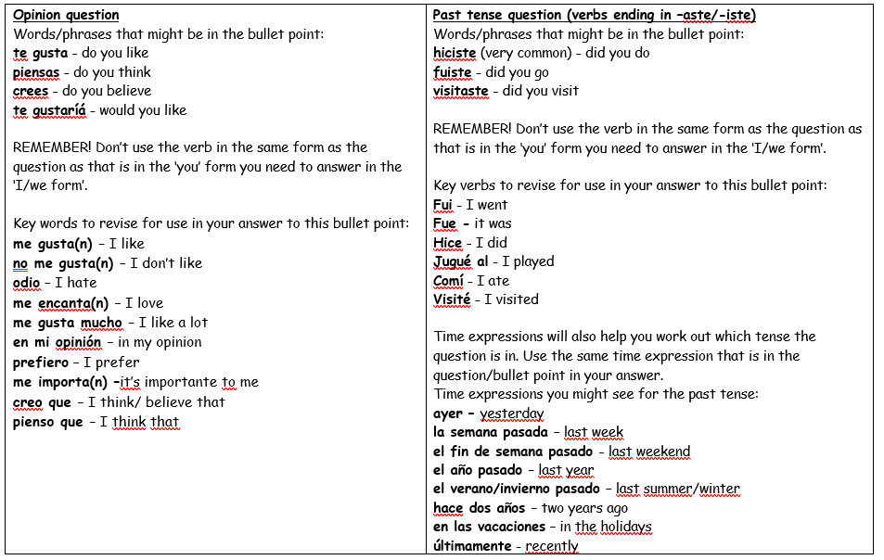
90 word 'cheat' sheet pg. 2

Slide 14
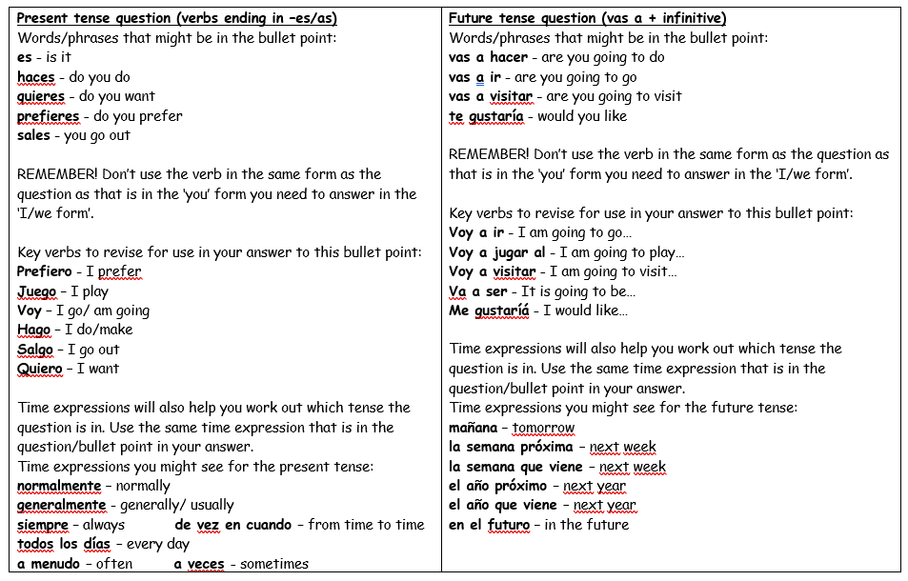
90 word 'cheat' sheet pg. 3

Slide 15
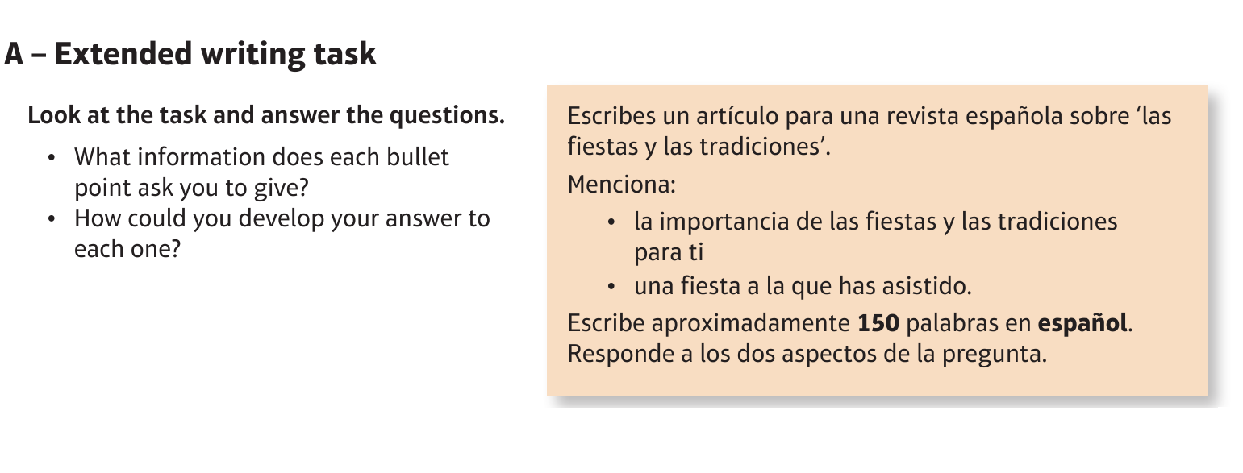
Higher Spanish Culture: la cultura española

Slide 16
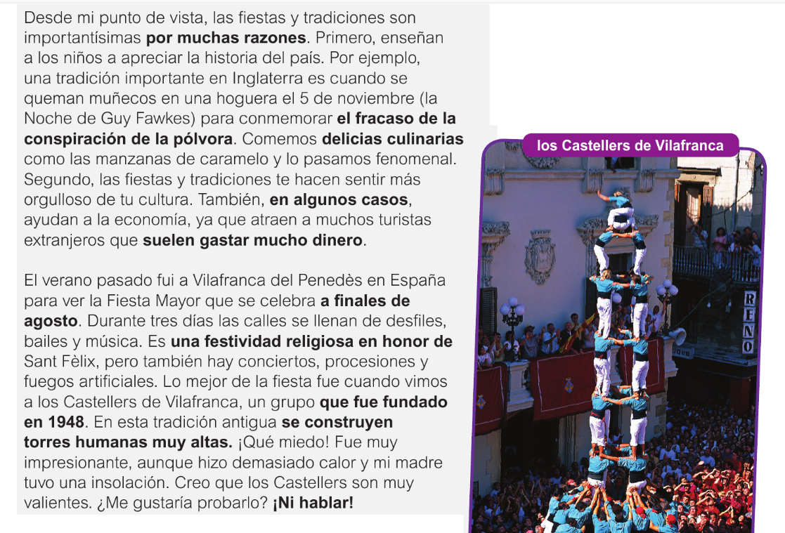
Higher Spanish Culture: la cultura española

Slide 17
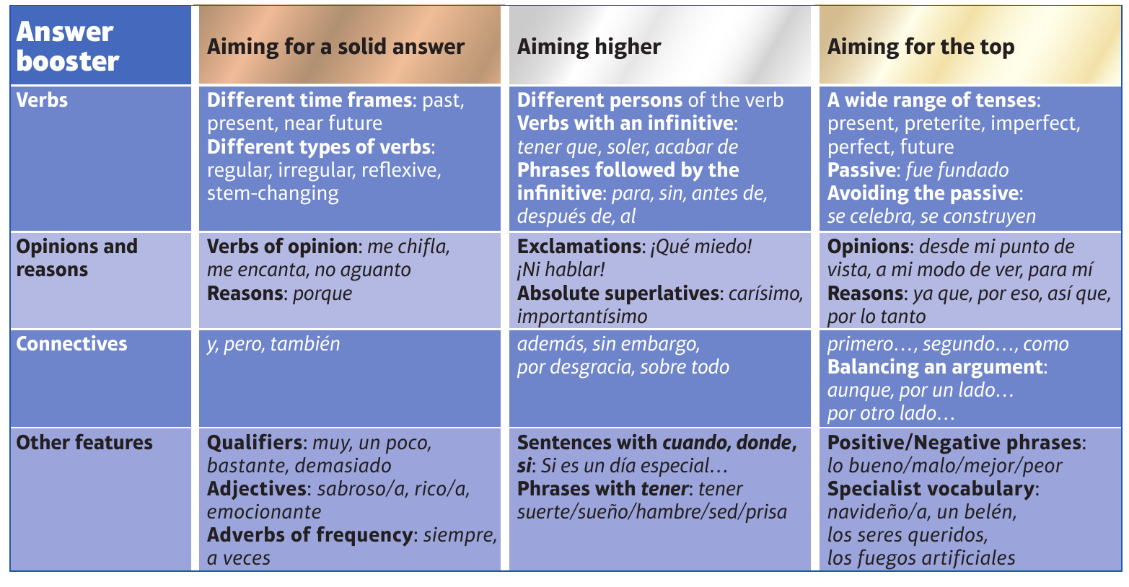
H

