Slide 1
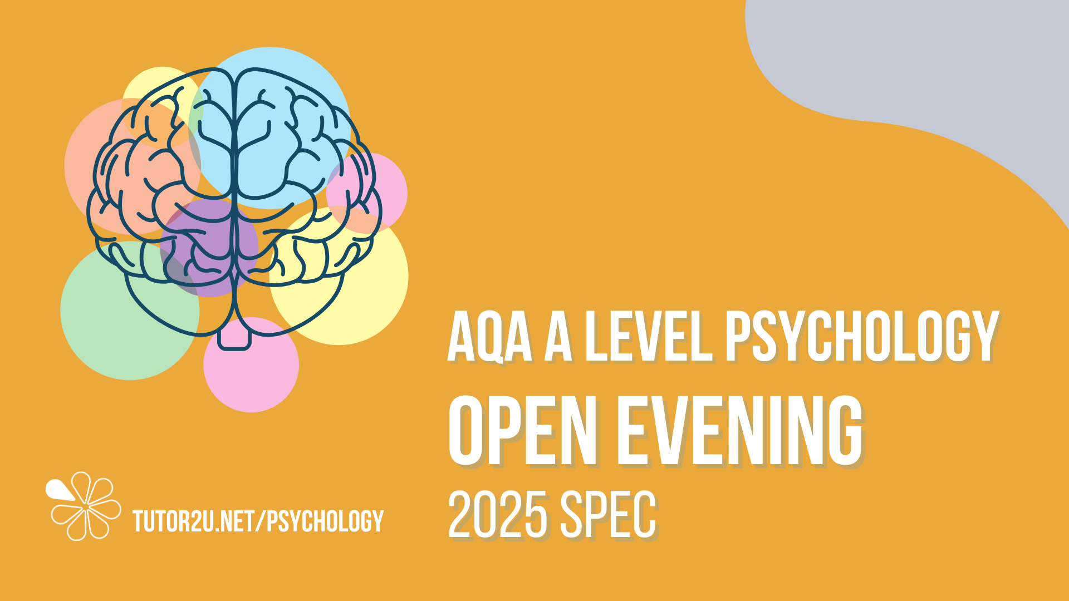

Slide 2


WHAT IS PSYCHOLOGY?
Psychology is the scientific study of the mind and behaviour, including how people think, feel, act, and interact with others.
TUTOR2U.NET/PSYCHOLOGY

Slide 3
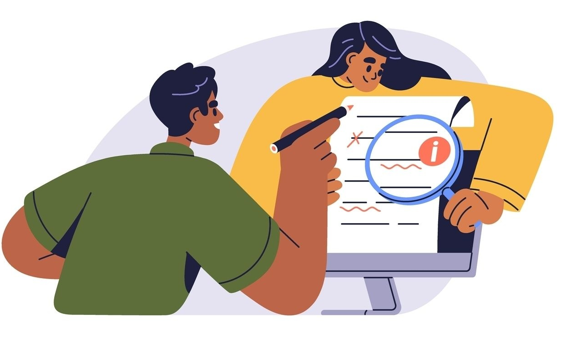
WHY STUDY PSYCHOLOGY?
Studying psychology has benefits for your personal and professional development. By studying psychology, you will:
Understand yourself and others better
Develop critical thinking and research skills
Gain insight into mental health and wellbeing
Enhance your personal development
Prepare for diverse career opportunities
Develop empathy and other personable skills
Think like a scientist
TUTOR2U.NET/PSYCHOLOGY

Slide 4
CAREERS IN PSYCHOLOGY
Psychology offers a wide range of career opportunities across various industries, for example:
Clinical Psychologist
Educational Psychologist
Psychology Teacher
Substance Abuse Counsellor
Neuropsychologist
Human Resources
Researcher / Research Associate
Social Worker
Forensic Psychologist
Sports Psychologist
Marketing
Wellbeing Practioner
TUTOR2U.NET/PSYCHOLOGY

Slide 5
THE COURSE
Your course takes two years to complete and is assessed over three Summer exams.
Each exam will:
Take 2 hours
Be worth 96 marks
Be equivalent to 33.3% of the year
Include a combination of multiple choice, short answers and extended writing questions.
You will then be graded on a scale from A* to U grades.
TUTOR2U.NET/PSYCHOLOGY

Slide 6
THE SPECIFICATION
Paper 1
Memory
Attachment
Clinical Psychology & Mental Health
Social Influence
Paper 2
Research Methods
Approaches
Biopsychology
Paper 3
* Issues and Debates
Plus, one option from the following:
Relationships, Cognition, or Gender
Schizophrenia, Eating Behaviour or Stress
Aggression, Forensic Psychology or Addiction
TUTOR2U.NET/PSYCHOLOGY

Slide 7
WHAT WILL I EXPLORE?
Here are some example questions and topics you will explore in your course!
Are we too obedient?
Why do we conform to others?
How do early attachments affect us?
Is there gender bias in psychology?
Do we understand what ‘normal’ is?
Why do eyewitnesses get it wrong?
Why do we forget things?
How do phobias develop?
Why do we experience depression?
Do our genes cause OCD?
How does psychology help the economy?
Do we have free will?
Should we be studying animals?
Can research cause harm?
TUTOR2U.NET/PSYCHOLOGY

