Slide 1
KS4 Mastery
Module 8
Environment and Global issues

Slide 2
Contents
Vocabulary sheets​​
Homework vocabulary ​​
Translation task​​
Writing task​​ (Example Questions: Foundation and Higher/ WAGOLL answers (What A Good One Looks Like)/ Answer Boosters)
90 word 'cheat' sheet
Answers for each task for you to mark.​​
This will help you to improve your Spanish skills and master the work we cover in class.

Slide 3
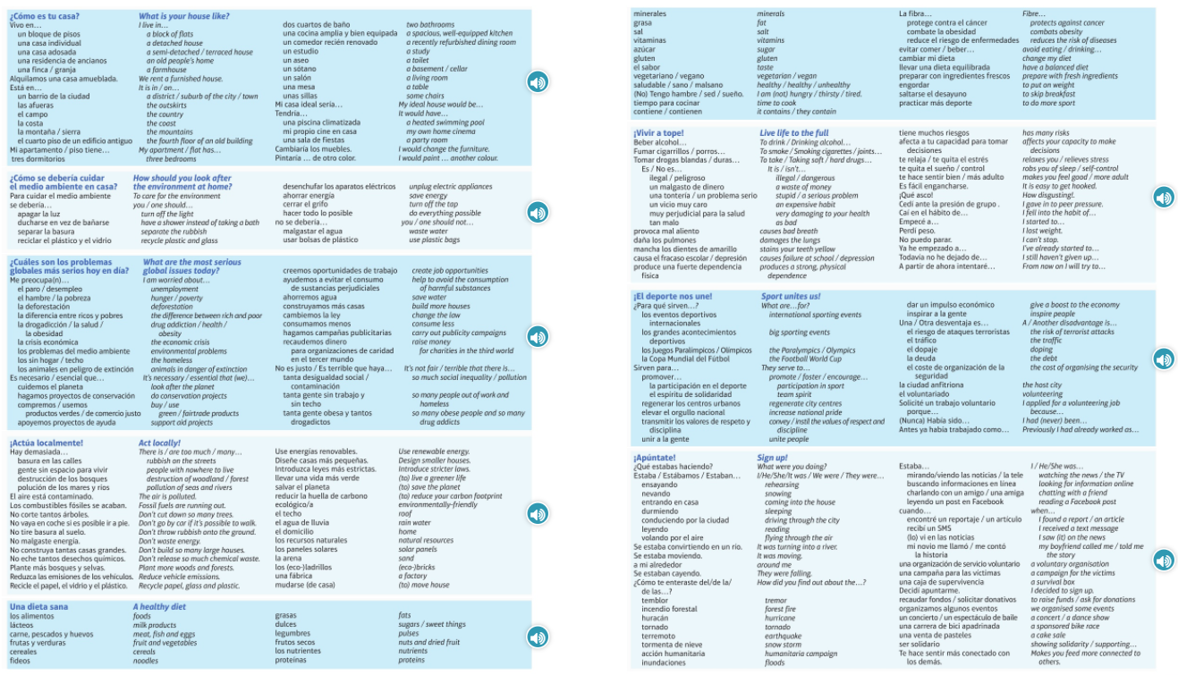
Module vocab

Slide 4
Vocab – Quizlet links
Week 1 https://quizlet.com/_9do6x1?x=1jqt&i=3gxpjt
Week 2 https://quizlet.com/_9doinb?x=1jqt&i=3gxpjt
Week 3 https://quizlet.com/_9f9fdj?x=1jqt&i=3gxpjt
Week 4 https://quizlet.com/_9hkbmt?x=1jqt&i=3gxpjt
Week 5 https://quizlet.com/_auxr22?x=1jqt&i=3gxpjt
Week 6 https://quizlet.com/_auxreu?x=1qqt&i=3gxpjt
Week 7 https://quizlet.com/_9q3p12?x=1jqt&i=3gxpjt
Week 8 (Higher 1) https://quizlet.com/_9s2svf?x=1jqt&i=3gxpjt
Week 9 (Higher 2) https://quizlet.com/_9t0y5g?x=1jqt&i=3gxpjt

Slide 5
Topic translations into English
Use the vocab sheet and your existing knowledge of Spanish to translate the following sentences into English.
1. Alquilamos una casa amueblada en la costa de Alemania.
2. Para cuidar el medio ambiente, se debería ahorrar energía y reciclar el plástico y el vidrio.
3. Es terrible que haya tanta gente sin trabajo y sin techo por eso es esencial que creemos oportunidades de trabajo.
4. Es imprescindible llevar una dieta equilibrada y comer mucha fruta y verdura para obtener más vitaminas.
5. Los Juegos Olímpicos sirven para elevar el orgullo nacional y transmitir los valores de respeto y disciplina.
6. Es fácil engancharse cuando fumas cigarrillos porque producen una fuerte dependencia física.

Slide 6
Respuestas – mark your answers
1. We rent a furnished house on the coast of Germany.
2. To look after the environment you should save energy and recycle plastic and glass.
3. It is terrible that there are so many people out of work and homeless so it is essential that we create job opportunities.
4. It is imperative to lead a balanced diet and eat lots of fruit and veg to get more vitamins.
5. The Olympic Games serve to increase national pride and convey the values of respect and discipline.
6. It is easy to get hooked when you smoke cigarettes because they produce a strong physical dependence.

Slide 7
Topic translations into Spanish
Use the sentence builder and your existing knowledge of Spanish to translate the following sentences into Spanish.
1. You should eat more proteins and eat less salt.
2. Taking soft drugs has many risks and causes failure at school.
3. The air is polluted, so you should use public transport or go by bike.
4. A disadvantage of international sporting events is the risk of terrorist attacks.
5. How did you find out about the earthquake?
6. Helping a voluntary organisation makes you feel more connected to others.

Slide 8
Respuestas – mark your answers
1. Se debería comer más proteínas y menos sal.
2. Tomar drogas blandas tiene muchos riesgos y causa el fracaso escolar.
3. El aire está contaminado así que se debería usar el transporte público o ir en bici.
4. Una desventaja de los eventos deportivos internacionales es el riesgo de ataques terroristas.
5. ¿Cómo te enteraste del terremoto?
6. Ayudar una organización de servicio voluntario te hace sentir más conectado con los demás.

Slide 9
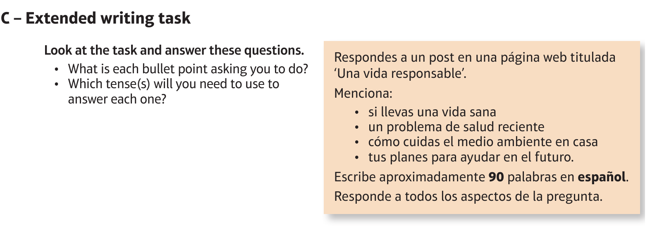
Foundation Environment: el medio ambiente

Slide 10
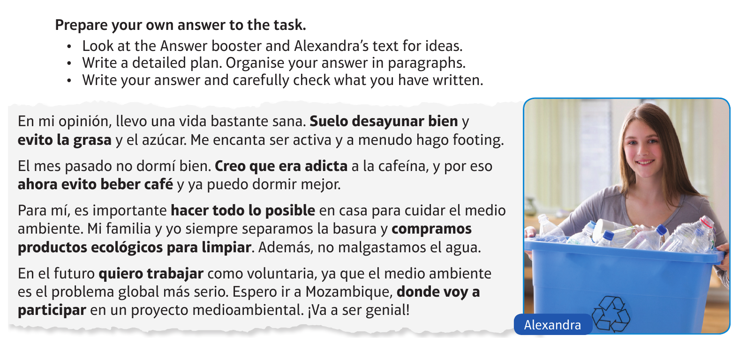
Foundation Environment: el medio ambiente

Slide 11
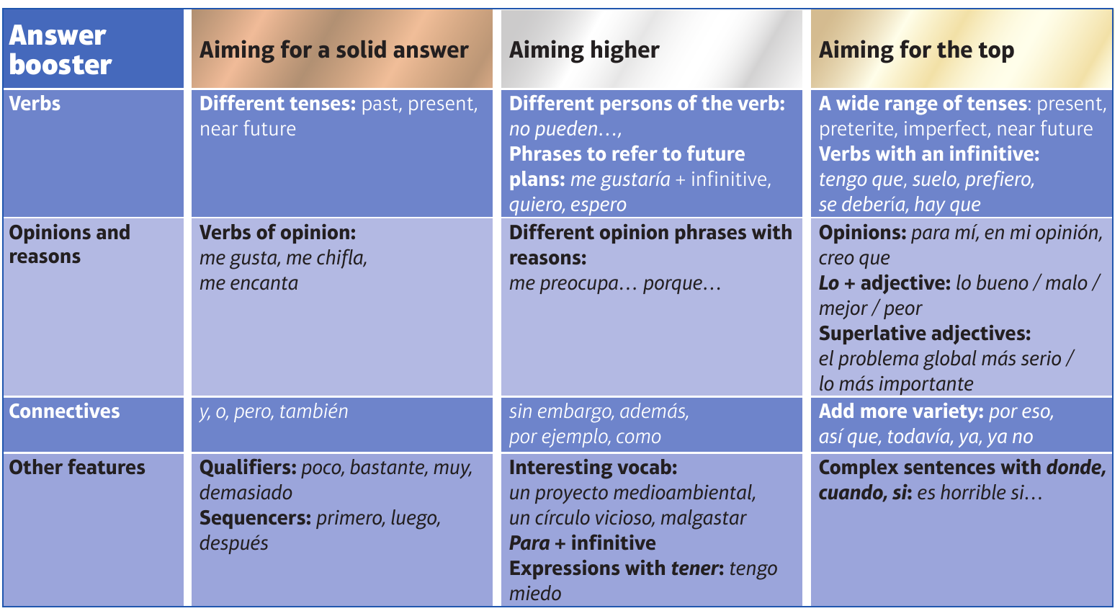
F

Slide 12
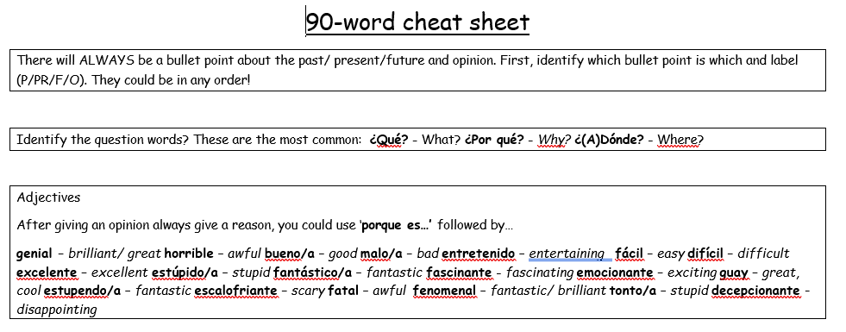
90 word 'cheat' sheet pg. 1

Slide 13
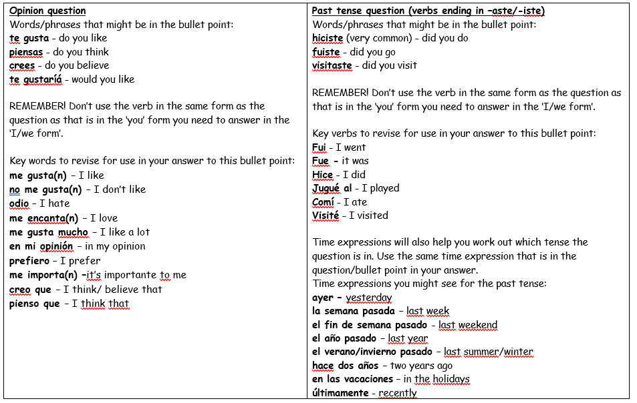
90 word 'cheat' sheet pg. 2

Slide 14
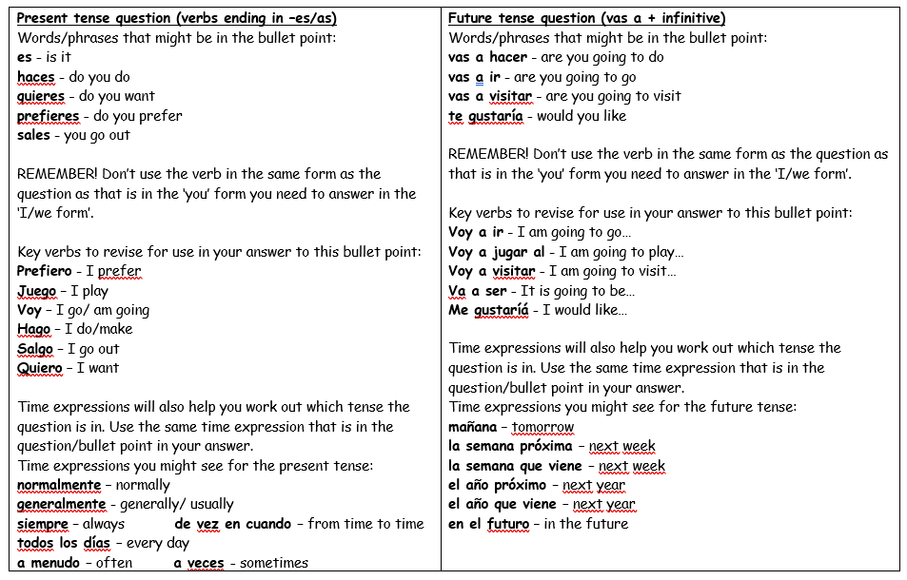
90 word 'cheat' sheet pg. 3

Slide 15
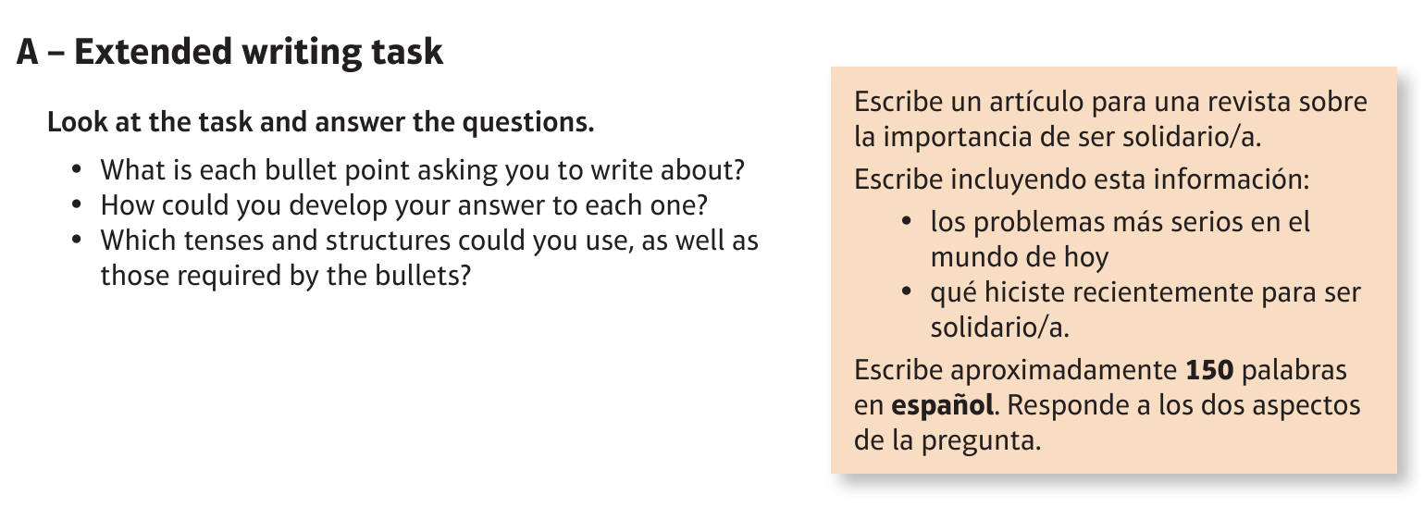
Higher Environment: el medio ambiente

Slide 16
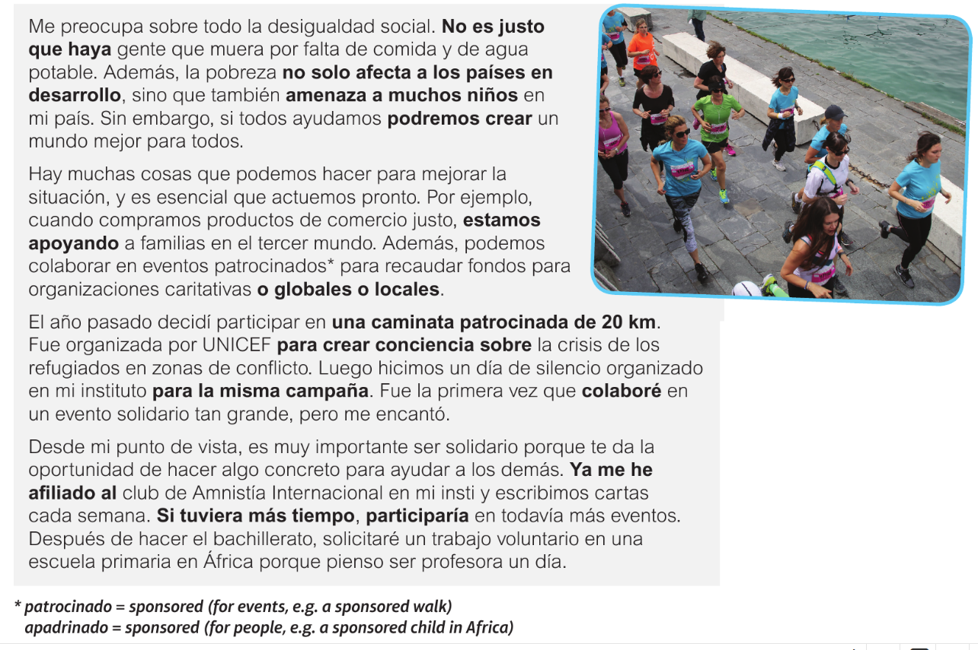
Higher Environment: el medio ambiente

Slide 17
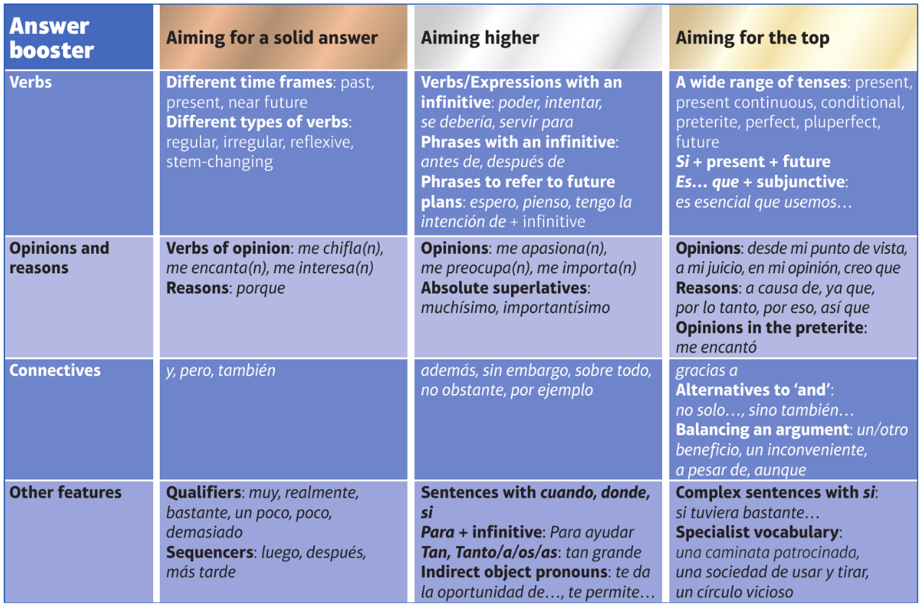
H

