Slide 1
KS4 Mastery
Module 2
School

Slide 2
Contents
Vocabulary sheets
Homework vocabulary
Translation task
Writing task (Example Questions: Foundation and Higher/ WAGOLL answers (What A Good One Looks Like)/ Answer Boosters)
90 word 'cheat' sheet
Answers for each task for you to mark.
This will help you to improve your Spanish skills and master the work we cover in class.

Slide 3
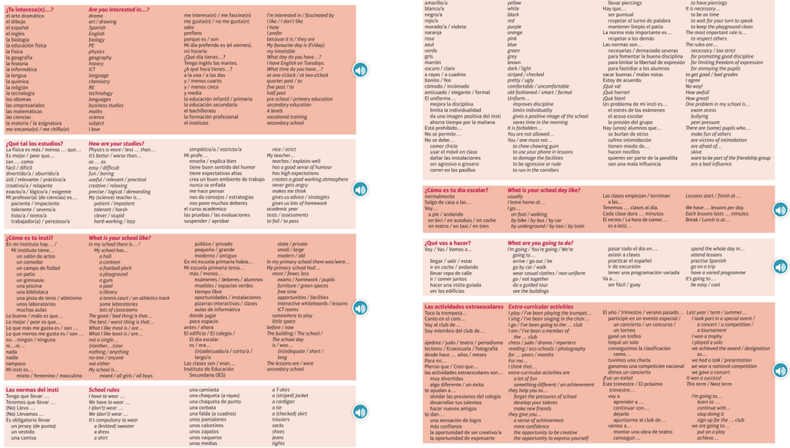
Module vocab

Slide 4
Vocab – Quizlet links
Week 1 https://quizlet.com/_9y38zg?x=1jqt&i=3gxpjt
Week 2 https://quizlet.com/_9y395r?x=1jqt&i=3gxpjt
Week 3 https://quizlet.com/_9y6kqh?x=1jqt&i=3gxpjt
Week 4 https://quizlet.com/_9y6kta?x=1jqt&i=3gxpjt
Week 5 https://quizlet.com/_9y6l17?x=1jqt&i=3gxpjt
Week 6 https://quizlet.com/_9y6lxd?x=1jqt&i=3gxpjt
Week 7 (Higher) https://quizlet.com/_9y6m03?x=1jqt&i=3gxpjt

Slide 5
Topic translations into English
Use the vocab sheet and your existing knowledge of Spanish to translate the following sentences into English.
1. Es obligatorio llevar una corbata a rayas y una camisa también.
2. Las normas son necesarias para fomentar la buena disciplina.
3. Canto en el coro desde hace dos años y el año pasado participé en un concierto.
4. Creo que las actividades extraescolares te dan la oportunidad de ser creativo.
5. Para mí, la educación física es más divertida que las matemáticas, sin embargo mi profe de inglés tiene buen sentido de humor.
6. En mi escuela primaria había más tiempo libre para jugar con mis amigos.

Slide 6
Respuestas – mark your answers
1. It is compulsory to wear a stripy tie and a shirt too.
2. The rules are necessary for promoting good discipline.
3. I have been singing in the choir for 2 years and last year I participated in a concert.
4. I believe that extra-curricular activities give you the opportunity to be creative.
5. For me, PE is more fun than maths however my English teacher has a good sense of humour.
6. In my primary school, there was more free time to play with my friends.

Slide 7
Topic translations into Spanish
Use the sentence builder and your existing knowledge of Spanish to translate the following sentences into Spanish.
1. Are you interested in chemistry?
2. I am going to wear casual clothes and practise Spanish in a restaurant.
3. In my opinion, uniform improves discipline, but I don’t like it because it is a bit uncomfortable.
4. My favourite day is Wednesday, because I study Spanish at ten o clock.
5. In my school, the worst thing is that there isn't a football pitch.
6. If only it had more sports facilities.

Slide 8
Respuestas – mark your answers
1. ¿Te interesa la química?
2. Voy a llevar ropa de calle y practicar el español en un restaurante.
3. En mi opinión, el uniforme mejora la disciplina pero no me gusta porque es un poco incómodo.
4. Mi día preferido es el miércoles porque estudio español a las diez.
5. En mi instituto, lo peor es que no hay un campo de fútbol.
6. Ojalá tuviera más instalaciones de deporte.

Slide 9
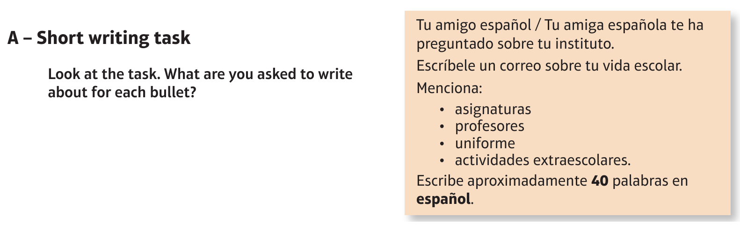
Foundation School: el instituto/ el colegio

Slide 10
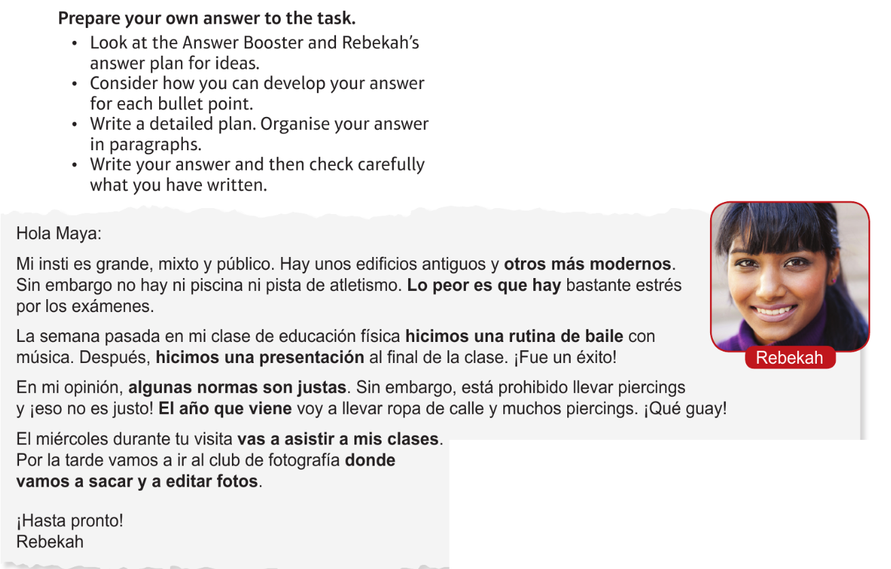
Foundation School: el instituto/ el colegio

Slide 11
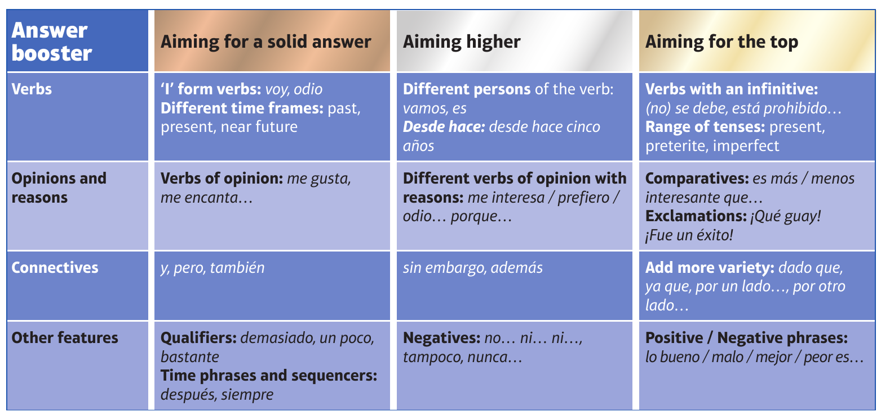
F

Slide 12
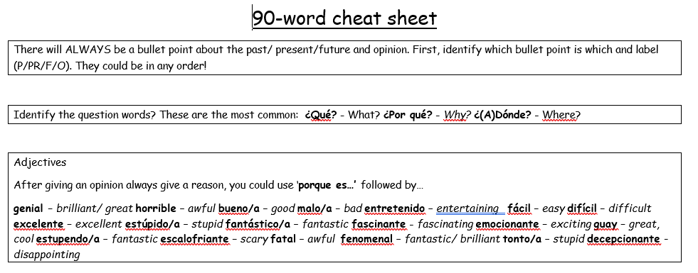
90 word 'cheat' sheet pg. 1

Slide 13
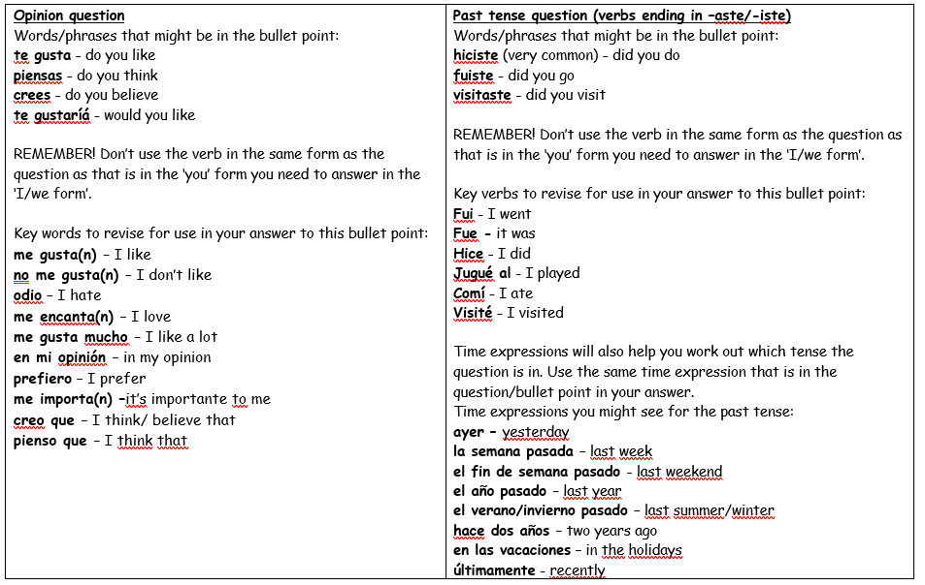
90 word 'cheat' sheet pg. 2

Slide 14
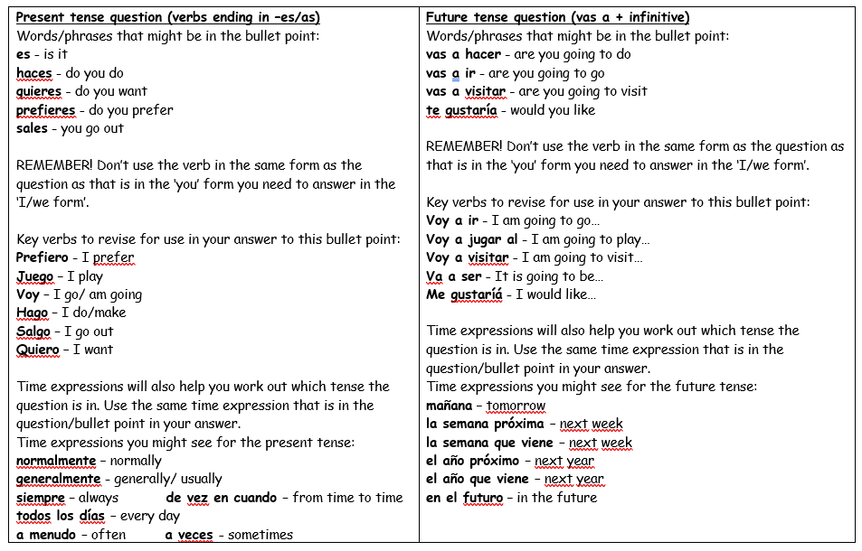
90 word 'cheat' sheet pg. 3

Slide 15
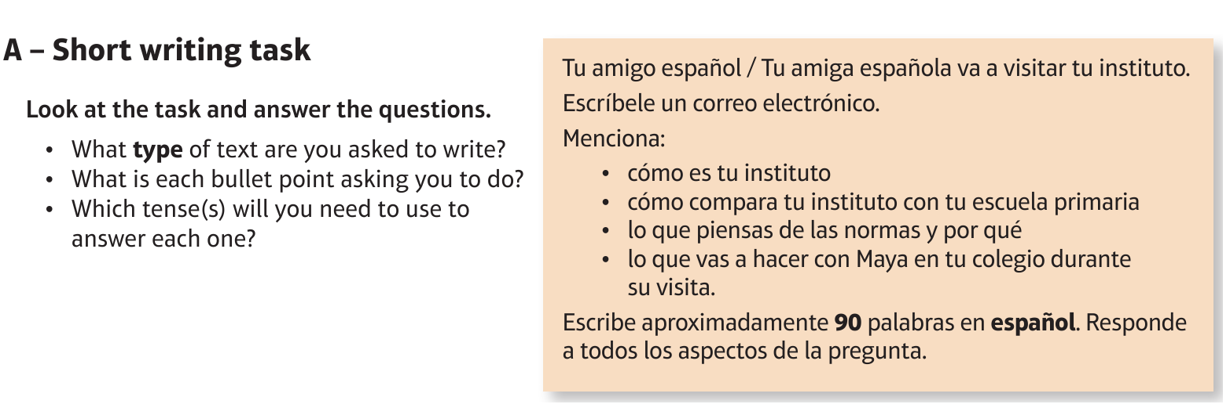
Higher School: el instituto/ el colegio

Slide 16
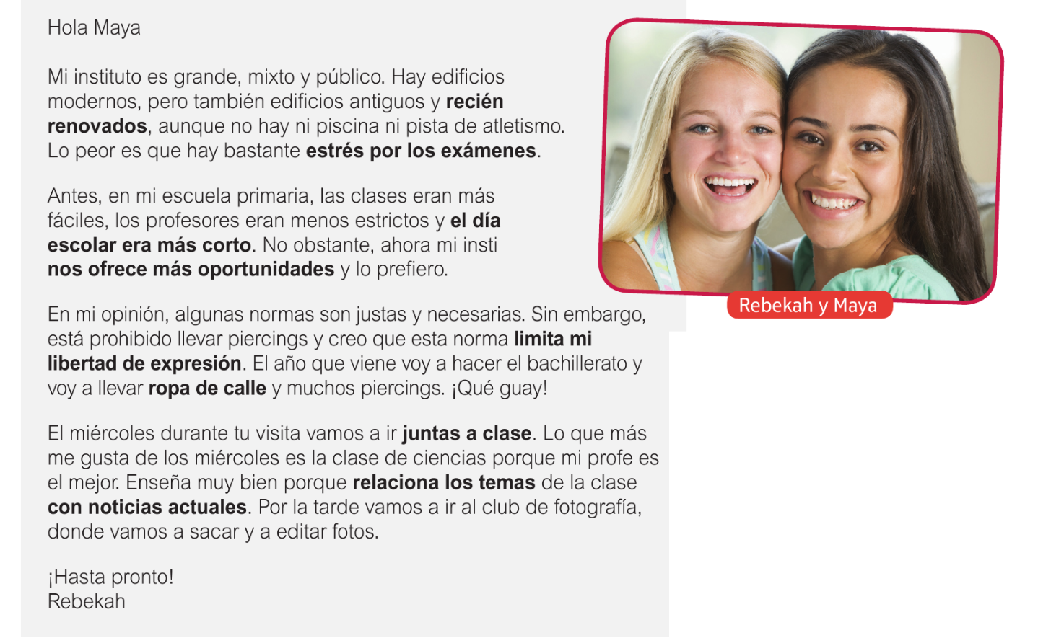
Higher School: el instituto/ el colegio

Slide 17
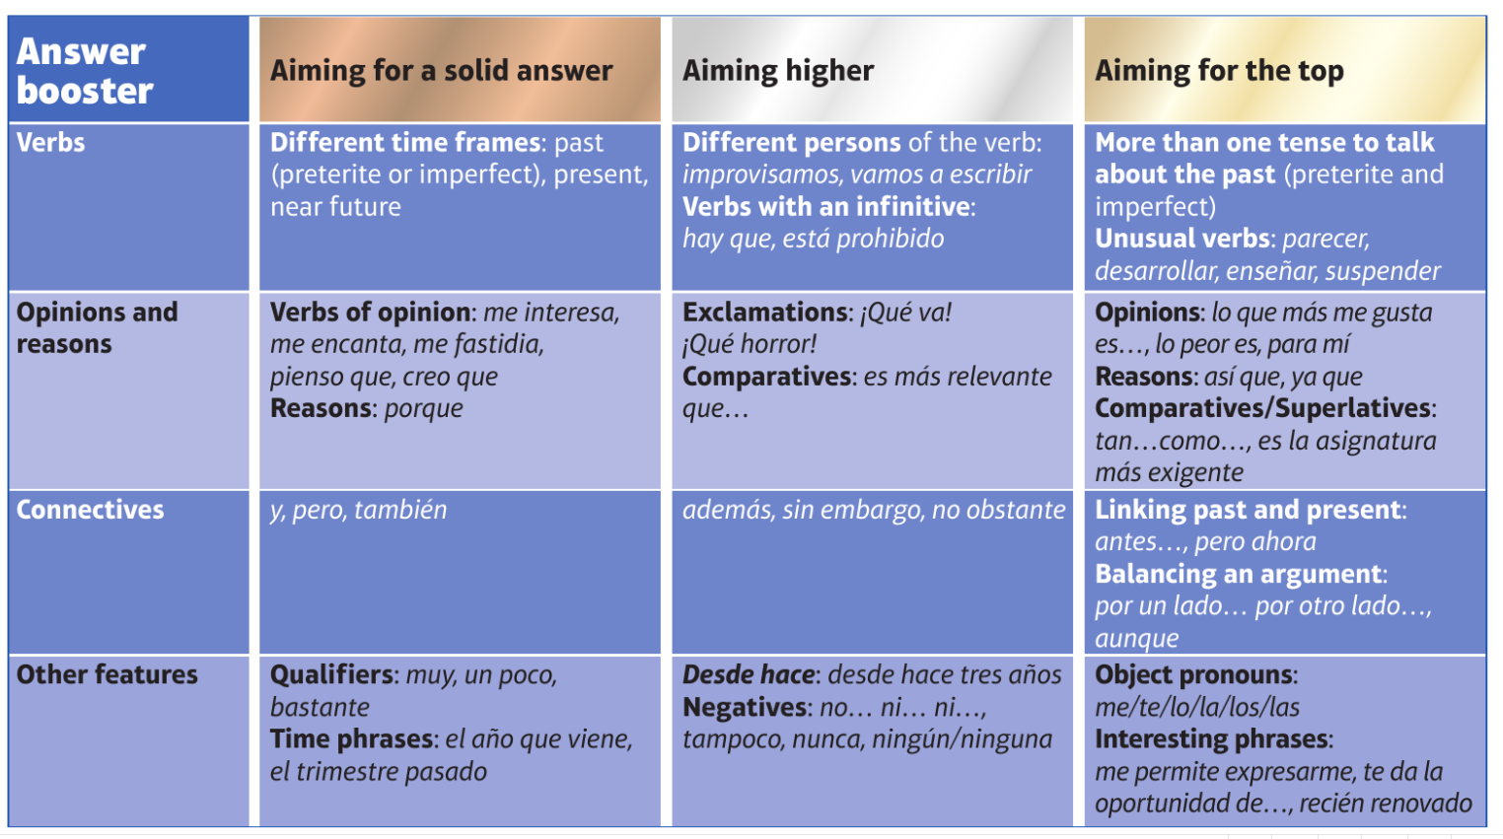
H

