Slide 1
KS4 Mastery
Module 3: Family and new technology

Slide 2
Contents
Vocabulary sheets
Homework vocabulary
Translation task
Writing task (Example Questions: Foundation and Higher/ WAGOLL answers (What A Good One Looks Like)/ Answer Boosters)
90 word 'cheat' sheet
Answers for each task for you to mark.
This will help you to improve your Spanish skills and master the work we cover in class.

Slide 3
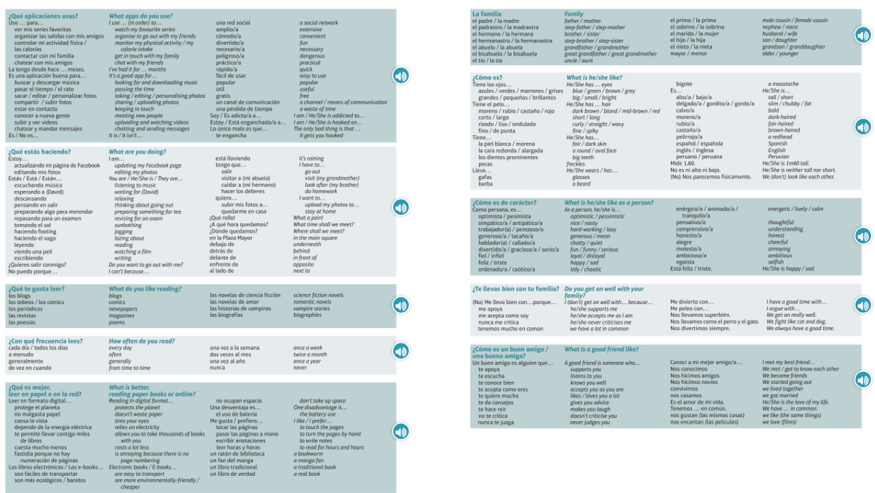
Module vocab

Slide 4
Vocab – Quizlet links
Week 1 https://quizlet.com/_9yerl6?x=1jqt&i=3gxpjt
Week 2 https://quizlet.com/_9yeshz?x=1jqt&i=3gxpjt
Week 3 https://quizlet.com/_9yesxi?x=1jqt&i=3gxpjt
Week 4 https://quizlet.com/_9yetat?x=1jqt&i=3gxpjt
Week 5 https://quizlet.com/_9yetp6?x=1jqt&i=3gxpjt
Week 6 https://quizlet.com/_9yeu1k?x=1jqt&i=3gxpjt
Week 7 https://quizlet.com/_9yf94c?x=1jqt&i=3gxpjt
Week 8 (Higher 1) https://quizlet.com/_9yf9oc?x=1jqt&i=3gxpjt
Week 9 (Higher 2) https://quizlet.com/_9yfakn?x=1jqt&i=3gxpjt
Week 10 (Higher 3) https://quizlet.com/_9yfape?x=1jqt&i=3gxpjt
Week 11 TECHNOLOGY https://quizlet.com/_9yfbpo?x=1jqt&i=3gxpjt
Week 12 TECHNOLOGY (Higher) https://quizlet.com/_9yfbzt?x=1jqt&i=3gxpjt

Slide 5
Topic translations into English
Use the vocab sheet and your existing knowledge of Spanish to translate the following sentences into English.
1. Como persona, él es perezoso y tacaño, y no es nada feliz.
2. Uso Netflix para ver mis series favoritas. ¡Estoy enganchado!
3. ¿A qué hora quedamos en el parque?
4. De vez en cuando, leo las revistas pero es mejor leer en formato digital para proteger el medio ambiente.
5. Un buen amigo te acepta como eres y nunca te juzga.
6. Muchas personas piensan que las redes sociales son bastante peligrosas.

Slide 6
Respuestas – mark your answers
1. As a person, he is lazy and mean, and he isn't at all happy.
2. I use Netflix to watch my favourite series. I'm hooked!
3. What time shall we meet in the park?
4. From time to time, I read magazines, but it is better to read in digital format to protect the environment.
5. A good friend accepts you as you are and never judges you.
6. Lots of people think that social media is quite dangerous.

Slide 7
Topic translations into Spanish
Use the sentence builder and your existing knowledge of Spanish to translate the following sentences into Spanish.
1. I am preparing something for tea and then I am going to go to the cinema.
2. E-books are easy to transport but one disadvantage is the battery use.
3. My brother has blue eyes and he is ginger, but we don't look like each other.
4. Whatsapp is a useful means of communication to keep in touch with my family.
5. I like to read science fiction novels every day because my favourite subject is Physics.
6. I get on well with my aunt because we have a lot in common.

Slide 8
Respuestas – mark your answers
1. Estoy preparando algo para merendar y luego voy a ir al cine.
2. Los e-books son faciles de transportar pero una desventaja es el uso de batería.
3. Mi hermano tiene los ojos azules y es pelirrojo, pero no nos parecemos físicamente.
4. Whatsapp es un canal de comunicación útil para estar en contacto con mi familia.
5. Me gusta leer las novelas de ciencia ficción cada día porque mi asignatura favorita es la física.
6. Me llevo bien con mi tía porque tenemos mucho en común.

Slide 9
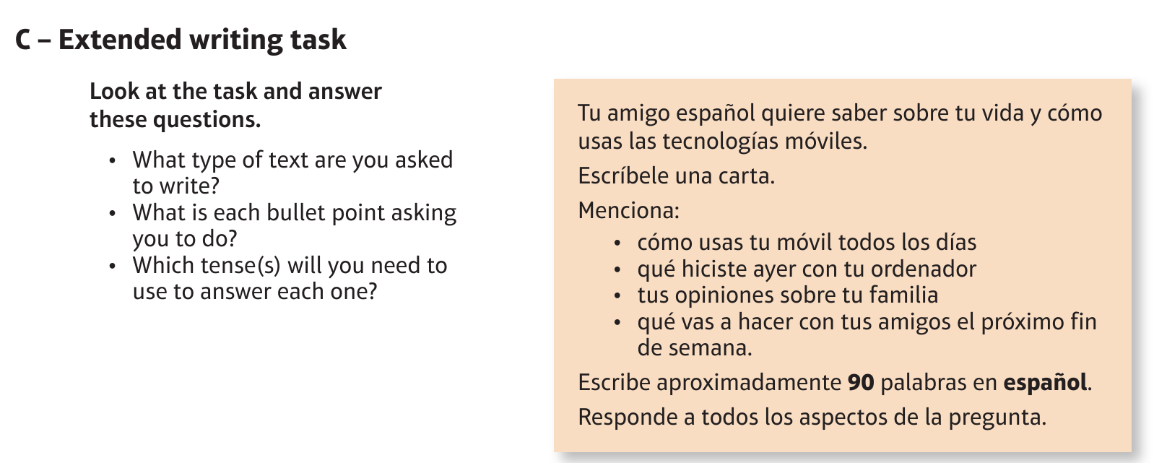
Foundation Technology: la nueva tecnolgía

Slide 10
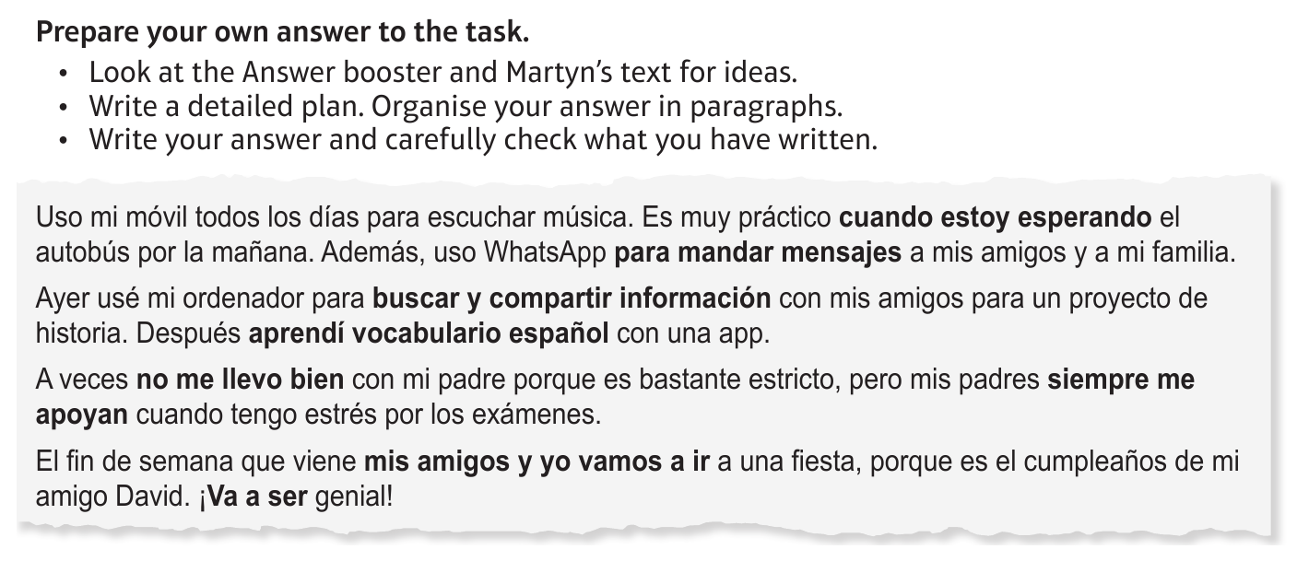
Foundation Technology: la nueva tecnolgía

Slide 11
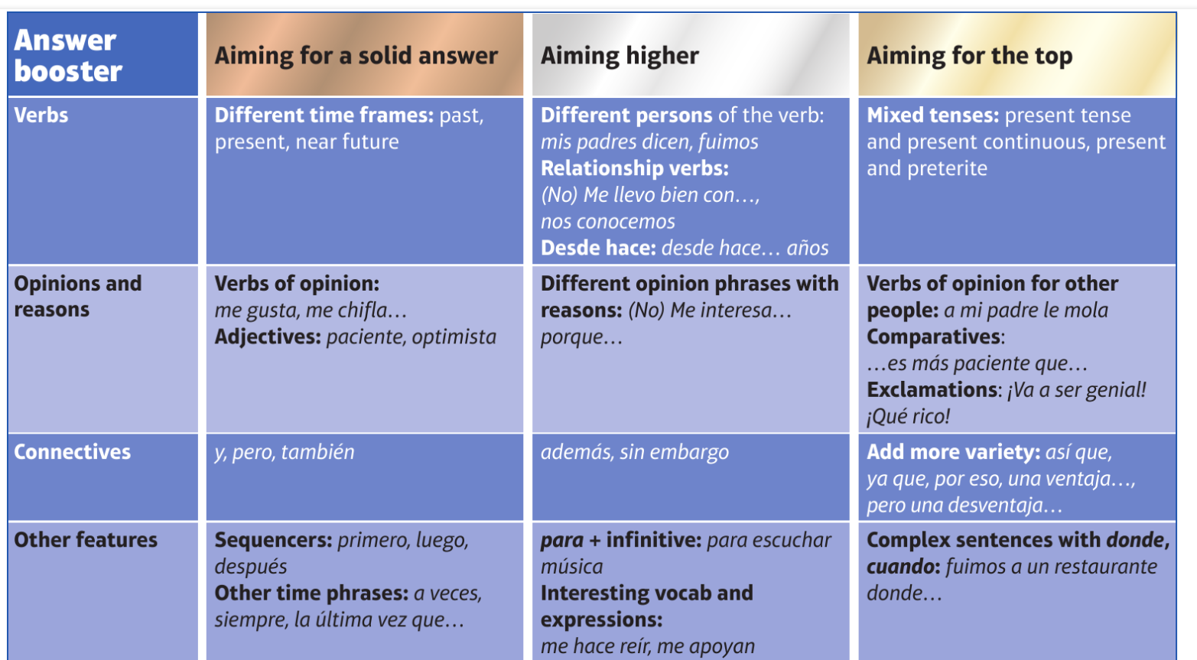
F

Slide 12
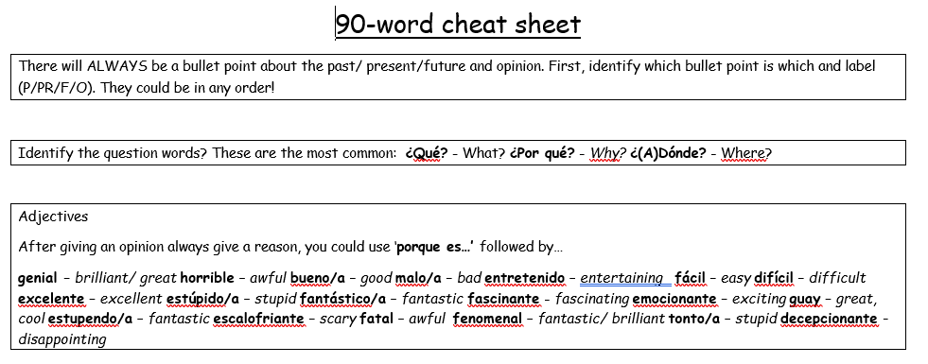
90 word 'cheat' sheet pg. 1

Slide 13
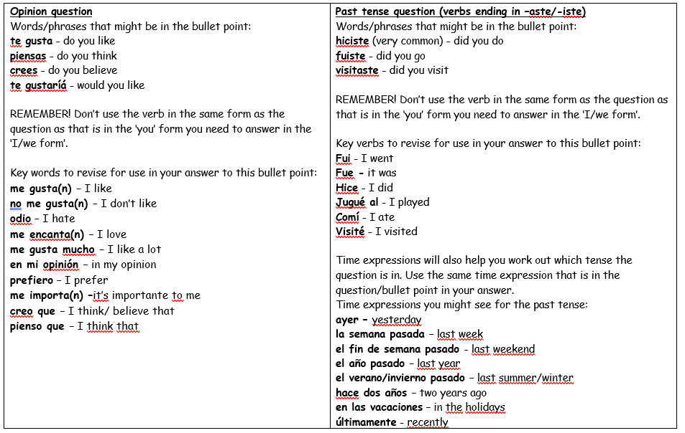
90 word 'cheat' sheet pg. 2

Slide 14
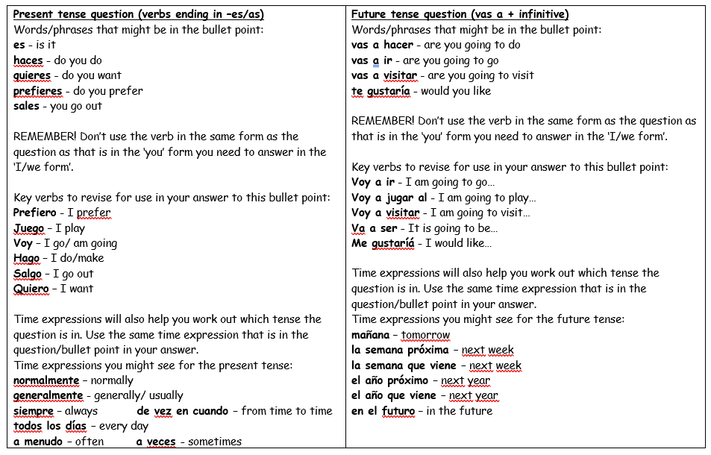
90 word 'cheat' sheet pg. 3

Slide 15
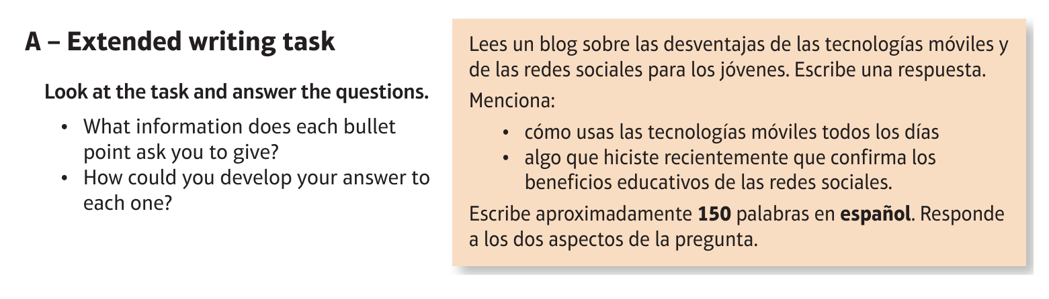
Higher Technology: la nueva tecnolgía

Slide 16
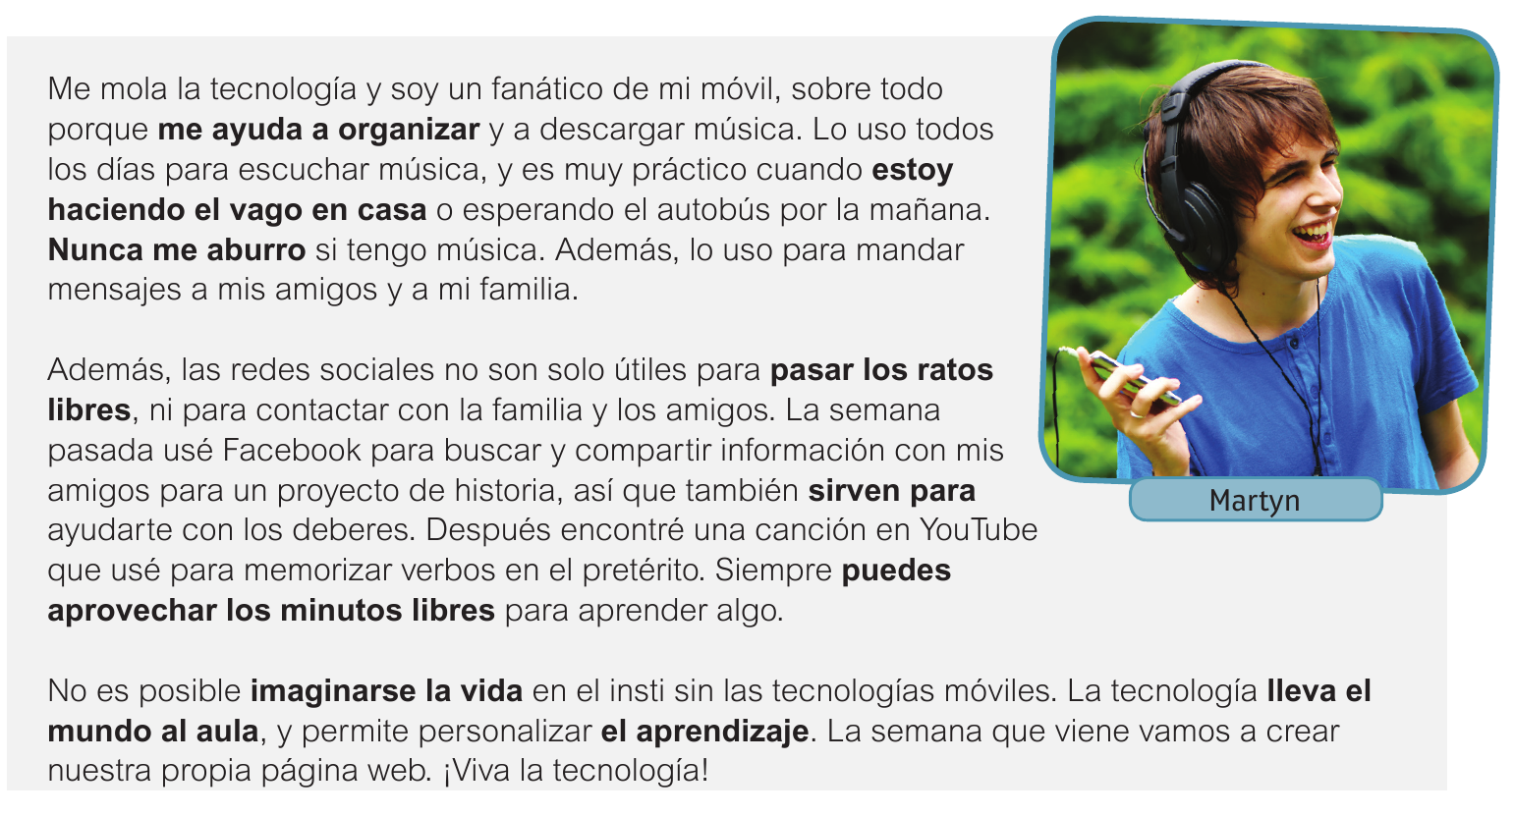
Higher Technology: la nueva tecnolgía

Slide 17
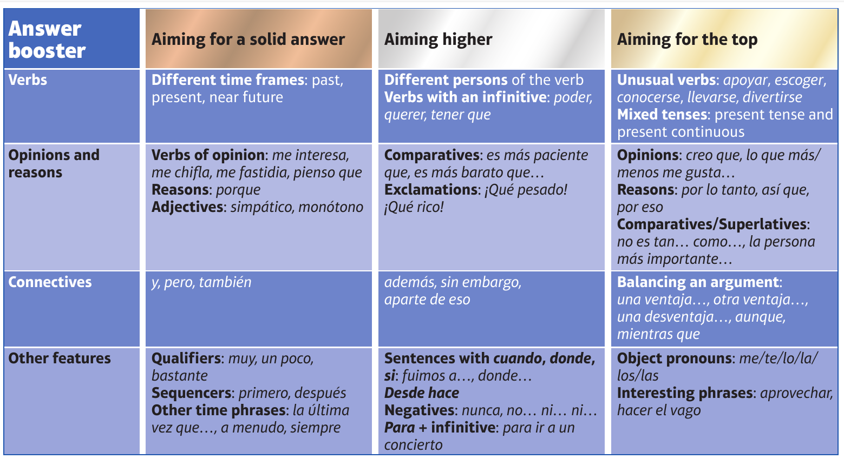
H

