Slide 1
Welcome to Geography A Level
Discussion:
1. Why do you want to study A Level Geography?
2. What was your favourite topic you studied at Key Stage 4 and why?
3."What do you think are the biggest challenges facing our planet today, and how can geography help us understand them?"

Slide 2
A Level – Full Course
Content Overview | Assessment Overview
Landscape Systems – Glaciation - Earth’s Life Support Systems Geographical Skills | Physical Systems (01) 66 marks 1hr 30mins | 22% of A level
Changing Spaces; Making Places Global Connections – Global Migration and Human Rights Geographical Skills | Human Interactions (02) 66 marks 1hr 30mins | 22% of A level
Disease Dilemmas Hazardous Earth Geographical Skills | Geographical Debates (03) 108 marks 2hrs 30mins | 36% of A level
Independent Investigation | Investigative Geography(04/05) 60 marks Non Examined Assessment | 20% of A level

Slide 3
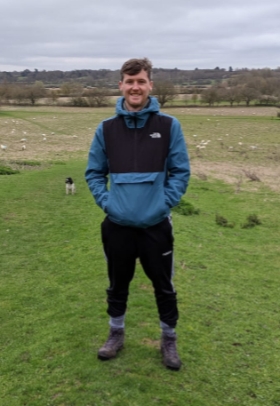
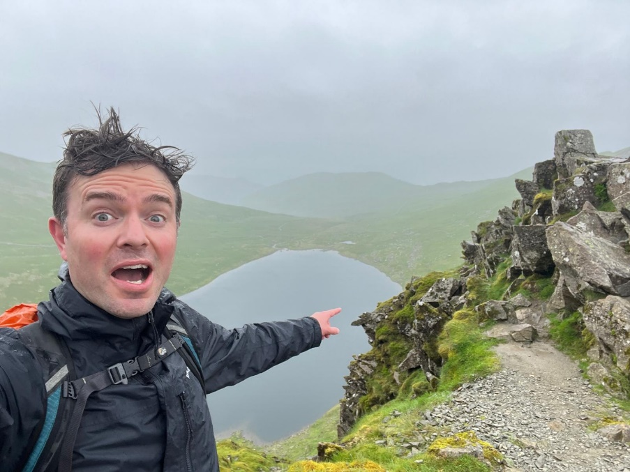
Who will teach you?
Mr Taylor Rowe
Human Geography BA
Hull University
Teaching all human units
Mr Twigg
Geology and Physical Geography BSC
Liverpool University
Teaching all physical units

Slide 4
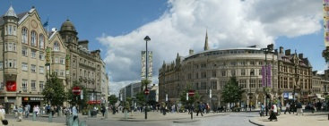
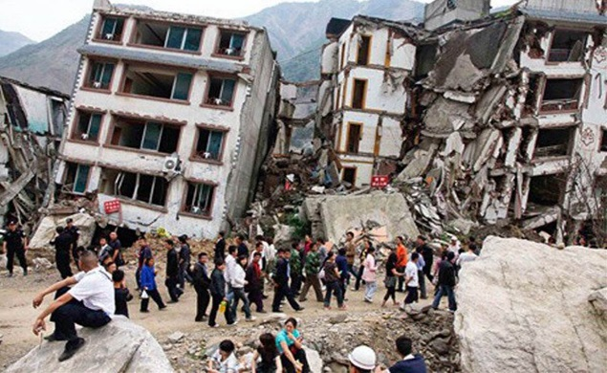
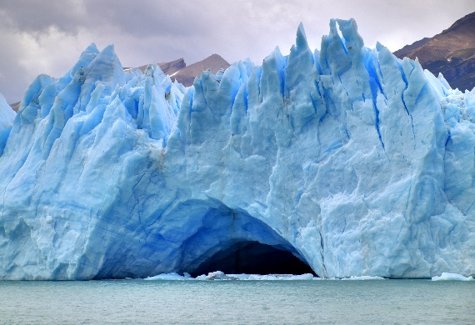
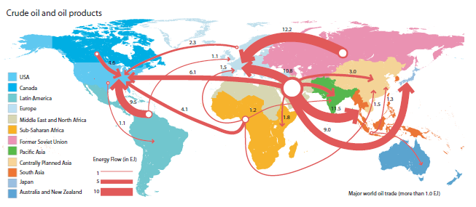
What will I Study?
All topics will be studied and examined at the end of the two years.
Field Work is a crucial element and you will complete at least 4 days over the two years (more about this in a moment!).
Geographical Skills are also key and will form an integral part of your learning.
There is also a 3000-4000 word Independent Investigation which you will begin in the Summer Term of Y12 – so no need to panic or worry for quite a while!

Slide 5
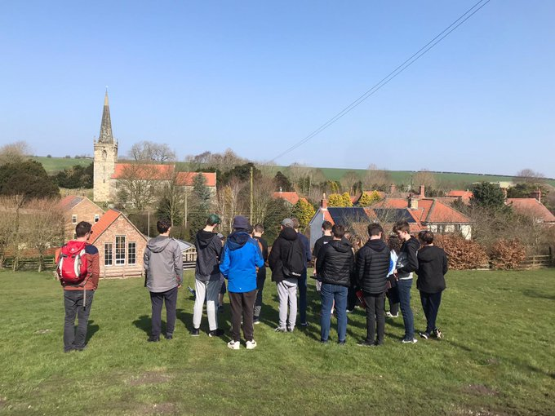
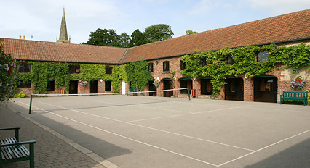

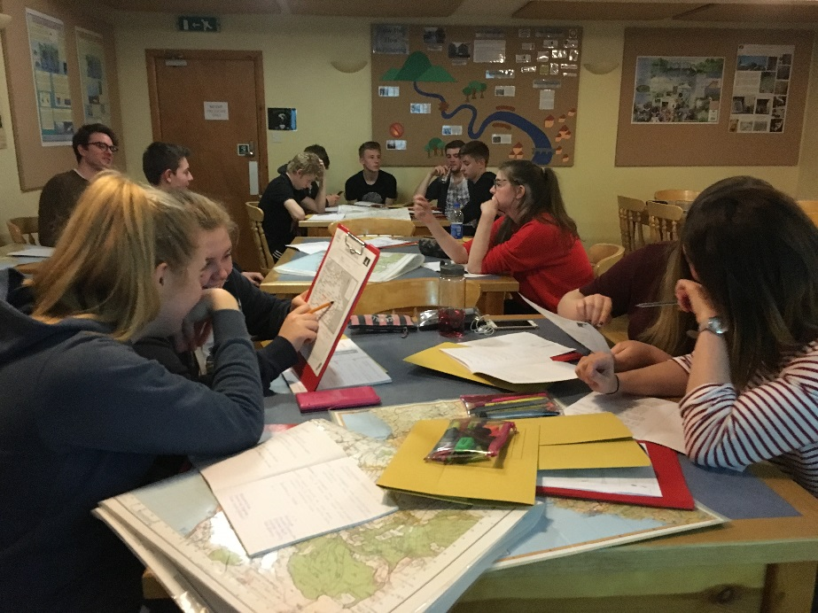
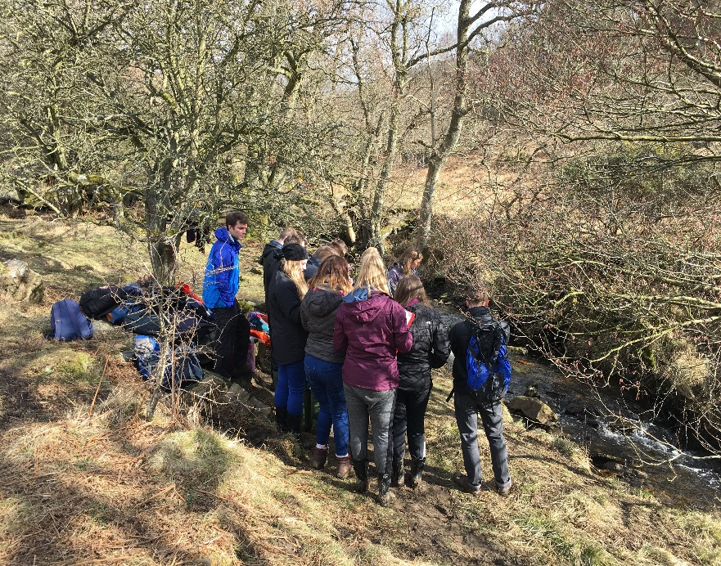
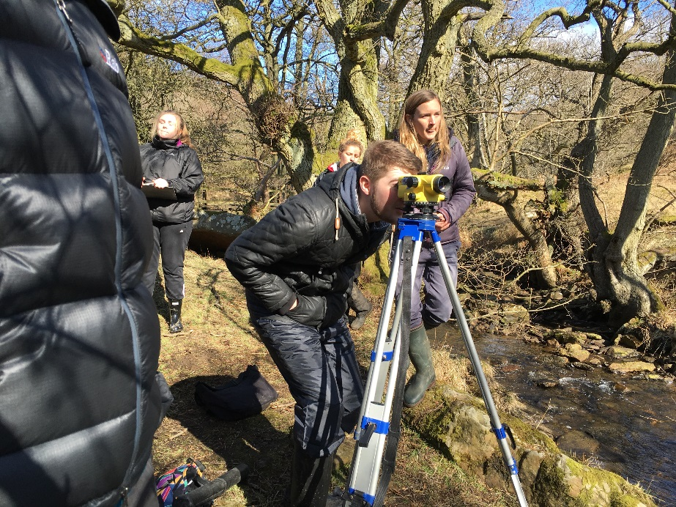
Field Work – Y12
Monday 23rd – Wednesday 25th March 2025
Please make a note of this

Slide 6
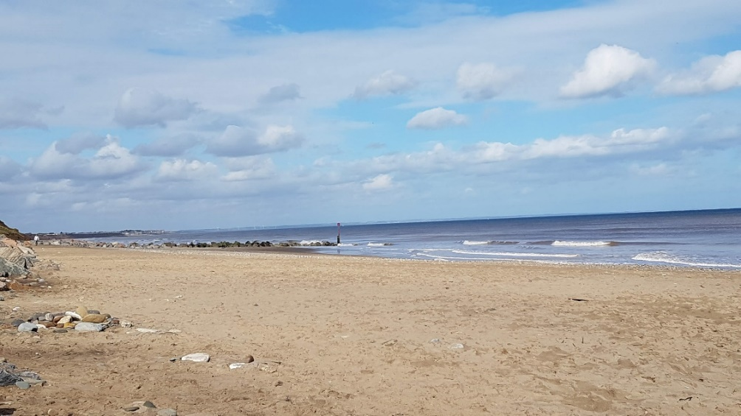
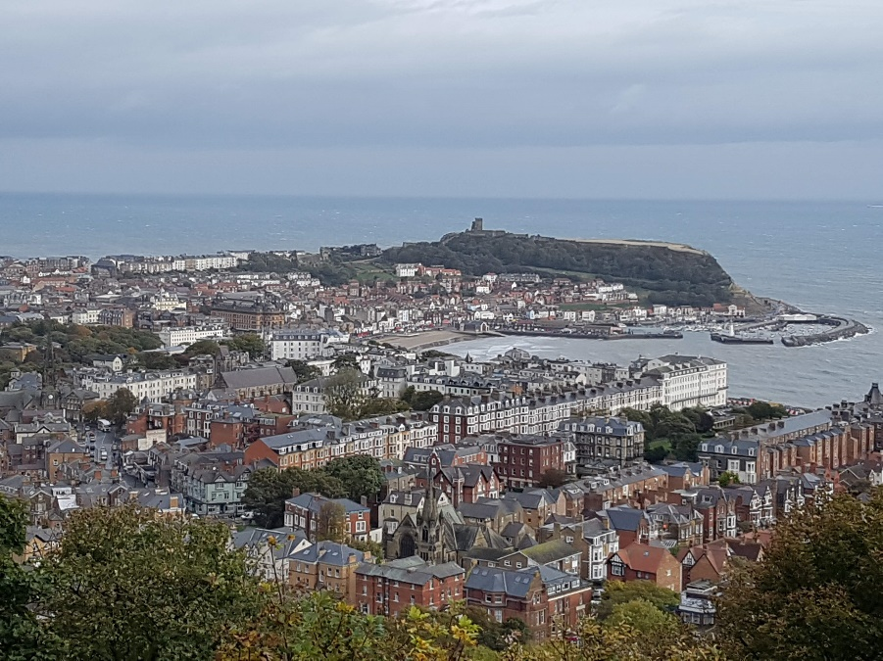
Non-Examined Assessment
You will undertake an independent investigation, producing a written report of 3000–4000 words.
You will define a question or issue relating to the compulsory or optional content.
Your investigation will incorporate fieldwork data (collected individually or as part of a group) and own research and/or secondary data.
Your report will evidence independent analysis and evaluation of data, presentation of data findings and extended writing.

Slide 7
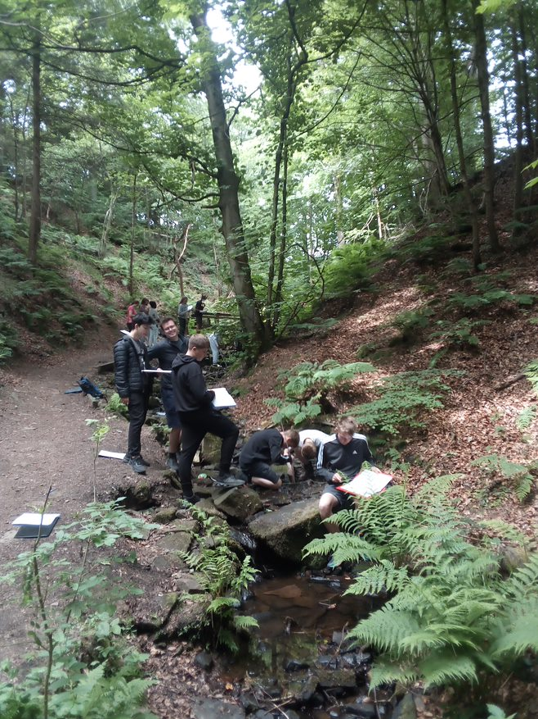

Skills and ‘Thinking Like a Geographer!’
Link
What skills do we need you to have?
https://timeforgeography.co.uk/
Working in groups:
Write down all the ways in which people can think like a geographer! – what skills do you need?
How will you think like a geographer?

Slide 8
+ Take care of your well-being!
Tips for being successful at A Level…
Organise your work & time– your notes need to be organised so you can use this as a revision tool, develop a study plan
Understand the spec – Take some time to read this and familiarise yourself with the key themes
Active Learning – Take good notes, be active in discussions, discuss with classmates outside of lesson
Stay updated on Current Events – Stay informed about current geographical issues and events – download a news app
Seek Feedback – regularly seek feedback from your teacher whether it is on content or about an essay
Complete lots of extra work outside of lessons – Read books, watch documentaries, listen to podcasts, practice exam questions etc.

Slide 9
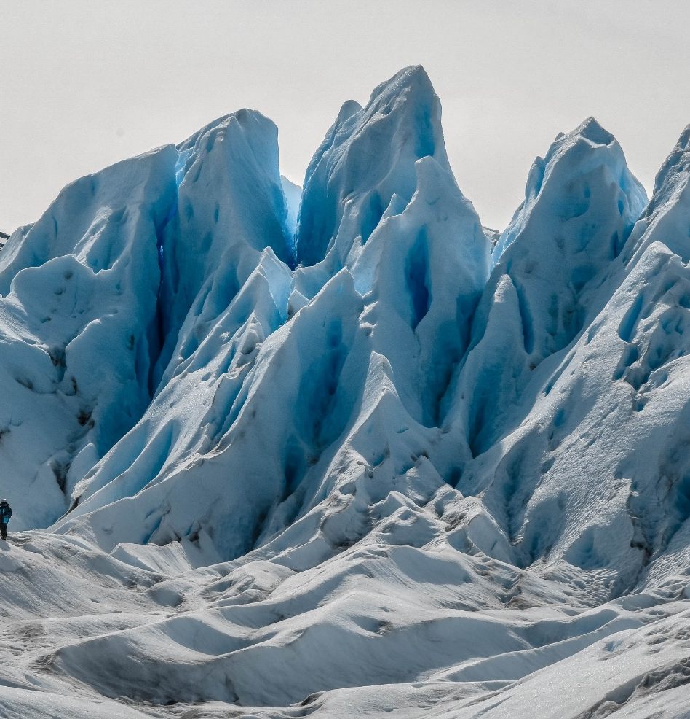
FIRST TOPICS - Landscape Systems - Glaciated Landscapes
“Life is like a landscape. You live in the midst of it but can describe it only from the vantage point of distance.” – Charles Lindbergh
This topic introduces learners to the integrated study of Earth surface processes, landforms and resultant landscapes within the conceptual framework of a systems approach. An understanding of Earth surface processes, together with their associated transfers of energy and movements of materials underpins the landscape systems topic.

Slide 10
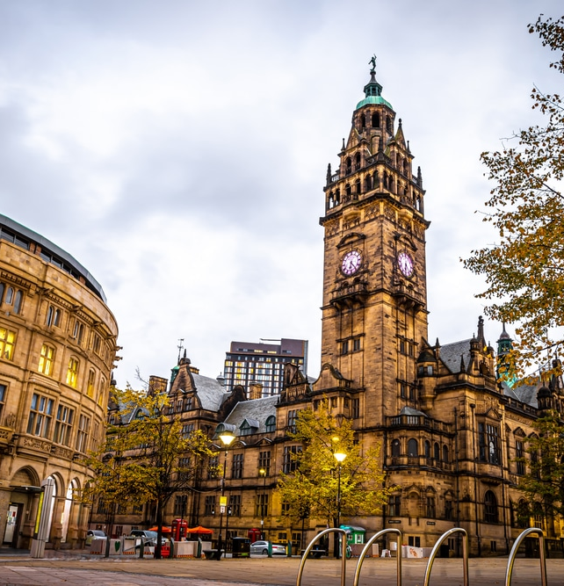
FIRST TOPICS - Changing Space; Making Places
““Our lack of thinking about place and space risks turning challenges into crises.” – Royal Town Planning Institute,
People shape and connect with places, which reflect the history, culture, and diversity of a nation. From rural areas to megacities, places are dynamic and interconnected, influenced by globalisation. Changing Spaces; Making Places encourages learners to explore local environments to understand global issues, examining how flows of people, money, and resources shape places. It investigates the links between people, the economy, and society, and how these form places. Learners also explore placemaking projects at various scales, considering how places are represented and given meaning.

Slide 11

What do you already know about the first two topics of Year 12?
"In what ways do people’s identities and experiences shape how they perceive a place, and how might these perceptions change over time?"
"How can we think of a glacier and its surrounding landscape as a system? What might be the key inputs, processes, and outputs involved?"
Notes:
The subjective nature of place and differences in perception due to identity (age, gender, religion, etc.).
The emotional attachment people have to places.
How globalisation and time-space compression might alter our connection to and understanding of place.
Inputs (e.g., snowfall, energy from the sun)
Processes (e.g., ice formation, glacier movement)
Outputs (e.g., meltwater, sediment transport)

Slide 12
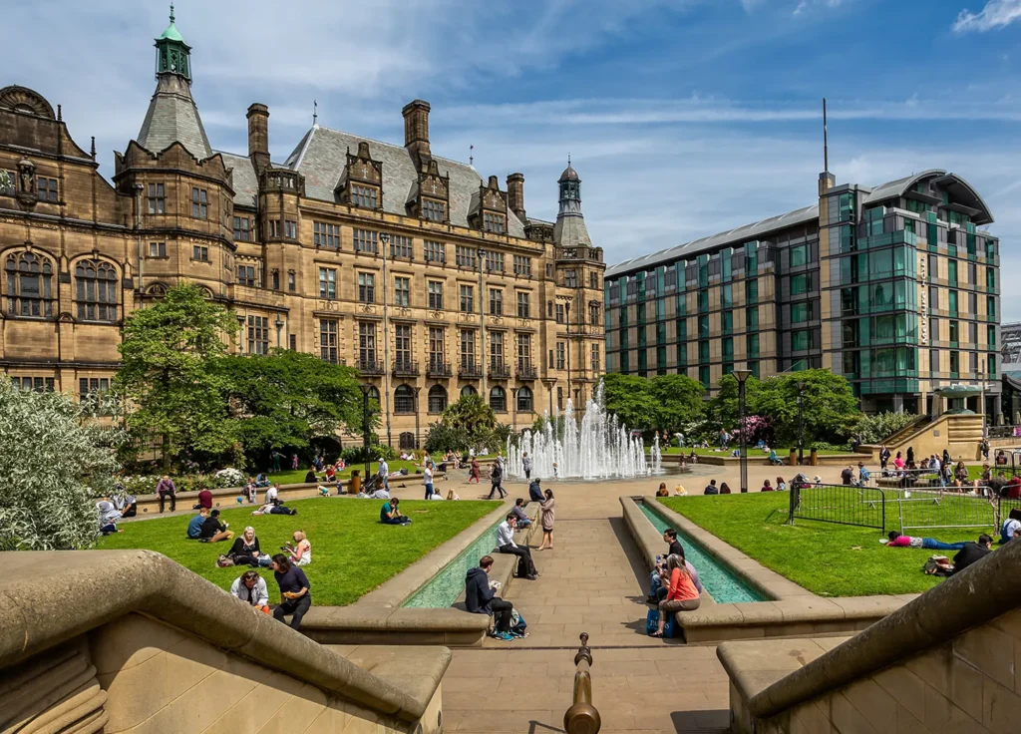


How might age affect your view of Sheffield city centre?

Slide 13
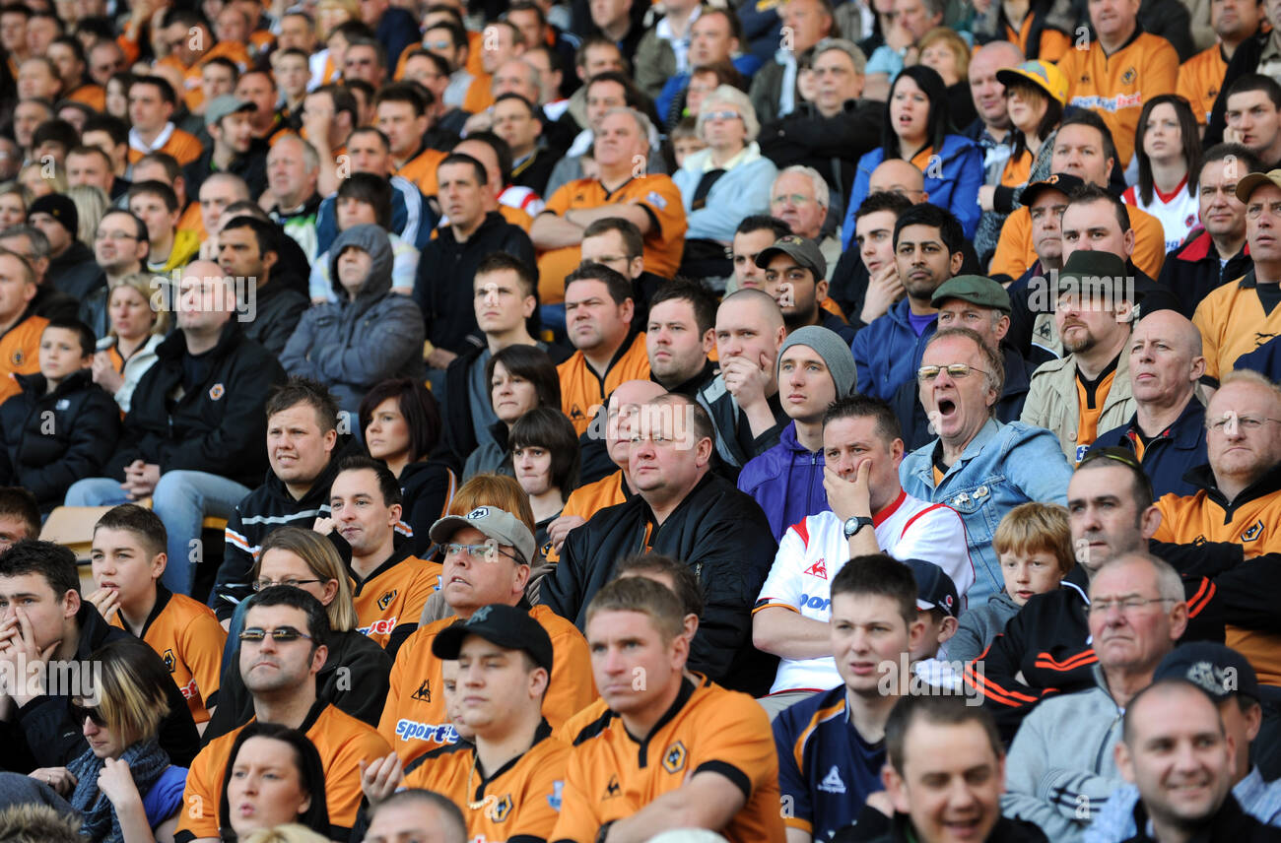


How might gender affect your perception of this place?

Slide 14
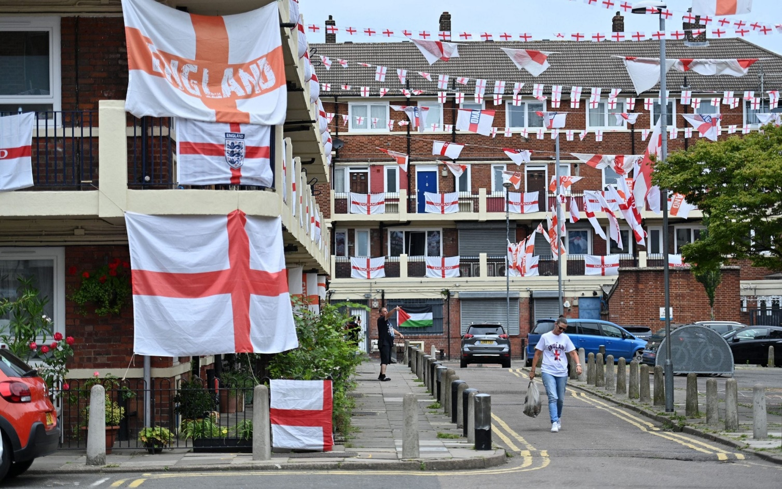

How might your cultural background affect your perception of this place?

Slide 15
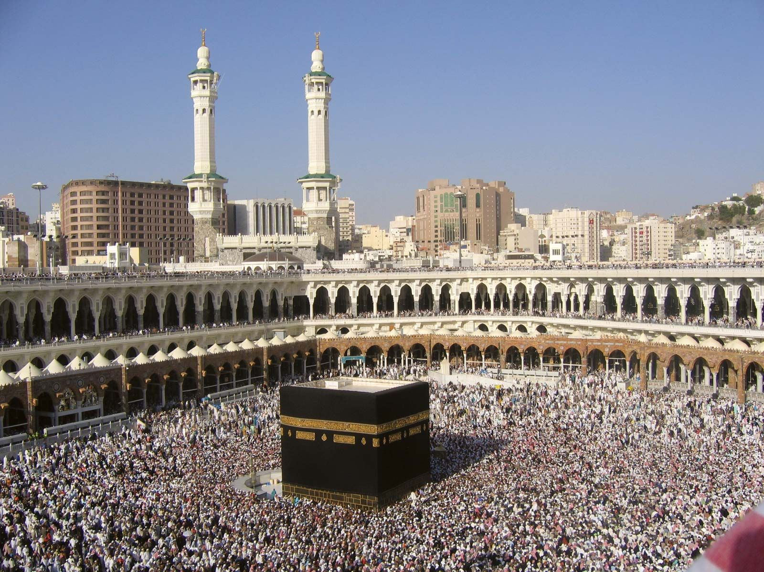

How might your religion effect your perception of this place?

Slide 16
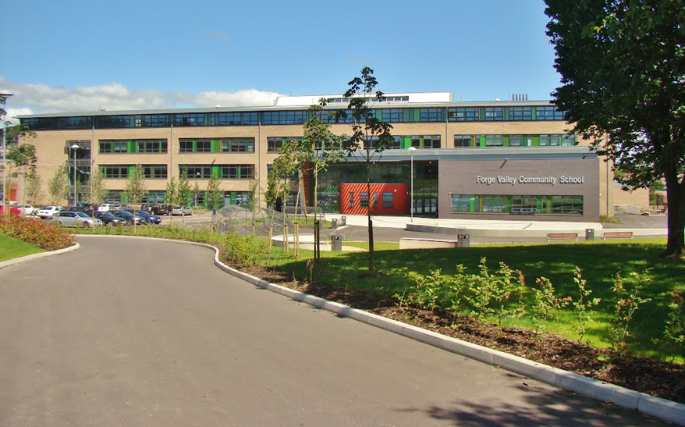

How might your role affect your perception of this place?

Slide 17
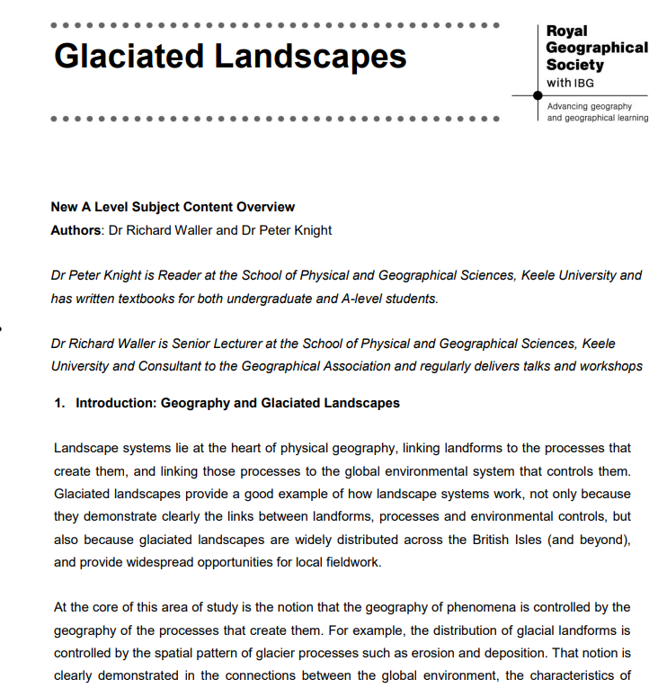
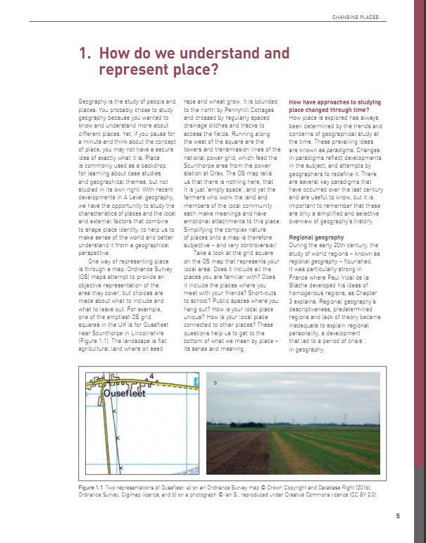
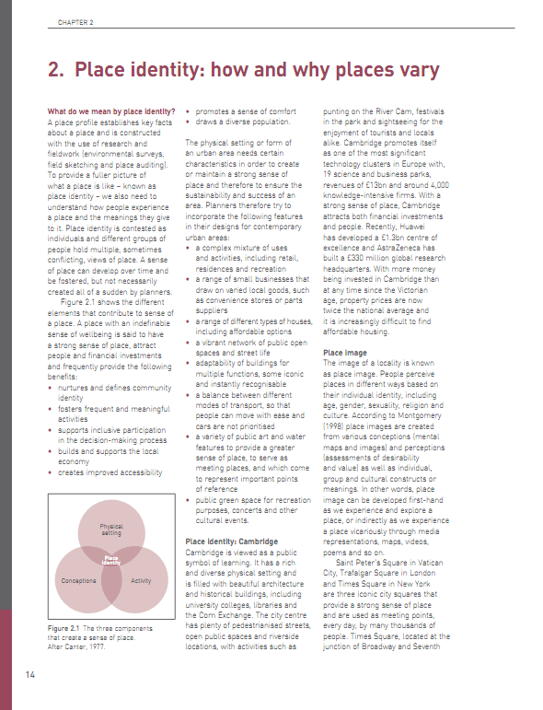
HW For September – Due first lesson
Glaciated Landscapes
Read the text ‘Glaciated landscapes’ and make notes using the Cornell notes making method
Watch https://www.dailymotion.com/video/xjzpey and answer the questions on the sheet provided
Changing Space; Making Place
Read the two chapters from Changing Spaces Top Spec Geography and make notes using the Cornell notes making method – there are also questions in the activity box you can answer
Watch https://www.youtube.com/watch?v=azSK-d1VHPc and summarise how places vary at different ends of Britain's income divide then read the article and summarise how places differ across Kensington, London and the issues that arise from this
And finally………have a great summer ☺ We look forward to seeing you all in September!
Etaylor-rowe@forgevalley.Sheffield.sch.uk
etwigg@forgevalley.sheffield.sch.uk

Slide 18
Cornell Note Taking
Cues:
2. Complete second.
Put any key words or ideas from the text here.
Notes:
1. Complete this section first.
Summarise each paragraph in a sentence.
This is an effective method of organising your notes and allows you to test your recall of the reading at the end.
It is called the Cornell method.
https://www.youtube.com/watch?v=ErSjc1PEGKE
Summary:
3. Complete this section last.
Write an overall summary of the text from memory.

