Slide 1
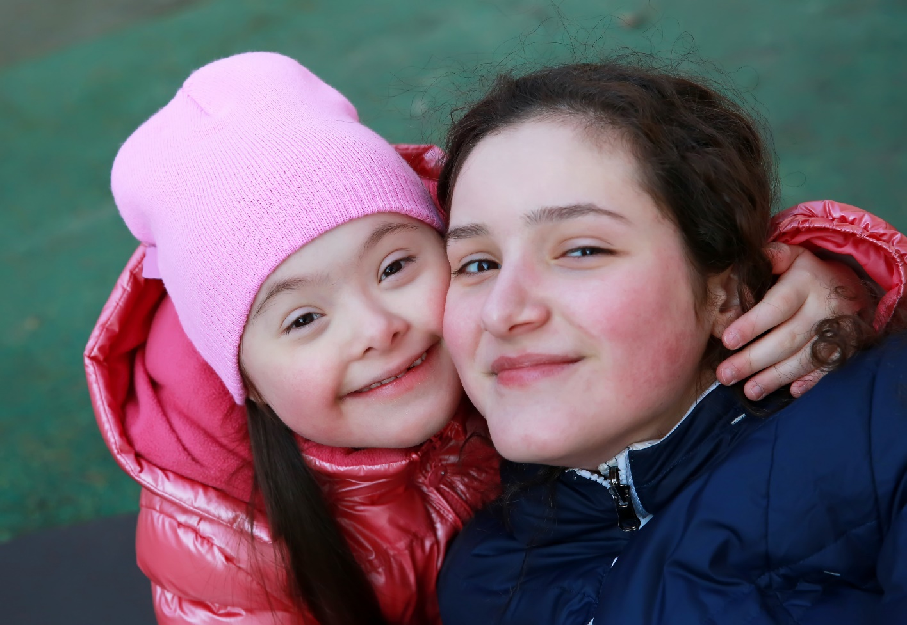

Supporting young carers in our sixth form
Notes:
Good morning.
We're holding a special assembly today, about young carers.
Today’s assembly is really important – I’m going to be telling you about young carers. This is something we’re really keen to help people with at this school so, after you’ve listened if you think you might be a young carer or you know someone else who is, please do come and talk to us so we can find out what you need to make life easier.

Slide 2
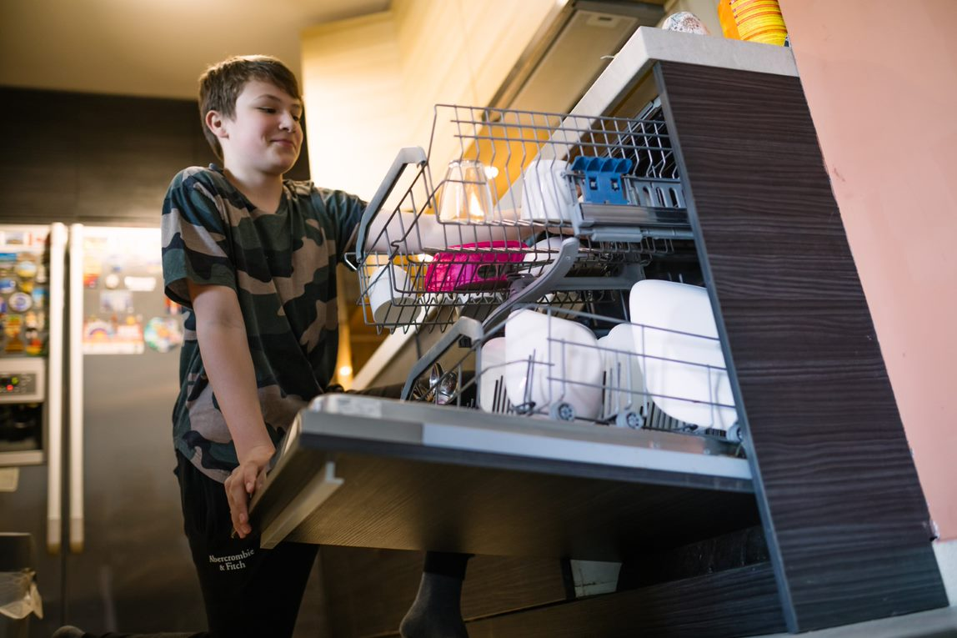
Who are
young carers?
Notes:
So, first of all, a question...who is a ‘young carer’? Has anyone got any ideas? (respond to answers)

Slide 3
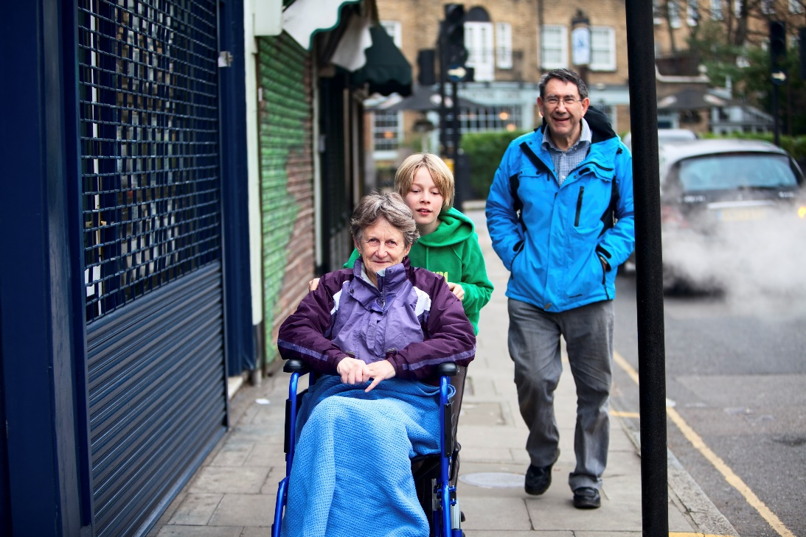
Who are young carers?
A ‘young carer’ is the name for a child or young
person who looks after, or helps to look after,
someone in their family who:
  is physically ill
  has a mental health problem
  has a disability
  has a drug or alcohol problem.
Notes:
A ‘Young Carer’ is someone under the age of 18 (or 18-25 if they're a young adult carer) who looks after, or helps to look after, someone in their family – this might be your mum, dad, brother, sister, grandparent or other family member. Sometimes young carers are helping more than one person in their family.
This might be because they have:
A long-term physical illness, such as cancer, epilepsy, or pain conditions for example (you can ask them for suggestions)
Mental health difficulties. Things like depression or anxiety, schizophrenia, bi-polar disorder, and many others
More detail: These kind of illnesses affect how people feel or behave, so people might be very sad a lot of the time, or feel too tired to get out of bed, or worried or anxious, their moods might change. .
A physical or learning disability which might affect how they move or communicate or behave.
Or issues with drugs or alcohol misuse and this affects how they manage day-to-day.
If you have time, you can go into more detail about each of these conditions

Slide 4

How many young carers are there in Sheffield?
Notes:
Now often people don’t tell anyone they’re a young carer because they're worried about what people will think. But there are lots of young carers in Sheffield. Can anyone guess how many? (respond to answers – higher, lower etc)

Slide 5
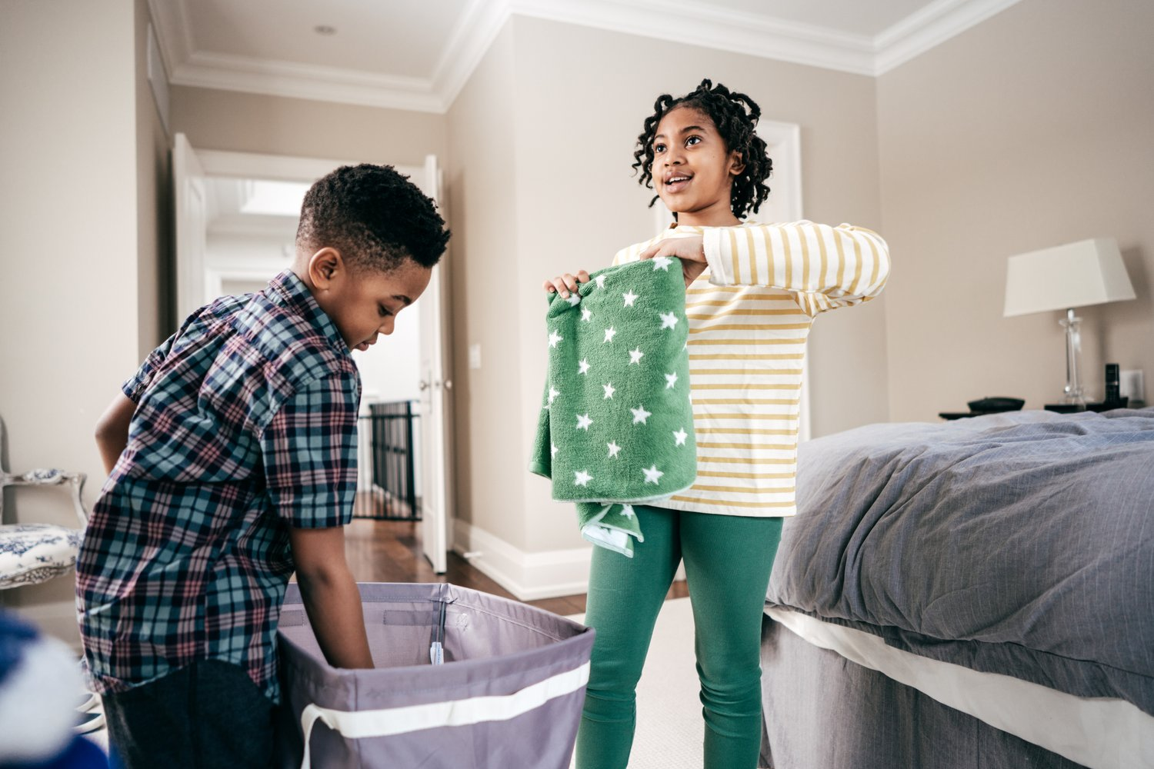
Young Carers are not alone!
1 in 12 children and young people are young carers
This means over 7000 young carers in Sheffield!
The average age of a young carer is 12.
Notes:
The answer is we don’t really know because so many young carers haven't told anyone about what's happening at home.
But according to a BBC study in 2010, 1 in 12 children and young people are carers (that's caring for someone for more than 15 hours a week)
...which means over 7000 young carers in Sheffield!
Anyone good at maths? Can you work out how many there might be in your year group if there are X students in your year group?
How about in school? (there are X students in the school)
Is that more than you thought?
So if you're a young carer, you're not alone
We know some of the young carers in this school already and give them lots of support to help them manage at school, but we know there are many more who we don’t know about , which is another reason why we’re doing this assembly today.

Slide 6

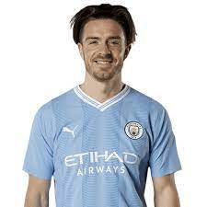
Jack Grealish – Footballer for Premier League club Manchester City and the England national team was a young carer
He helped care for his younger sister who has cerebral palsy.
They are very close and he calls her his
best friend
Notes:
Who can tell me who this is?
That's right. Jack Grealish is a very famous footballer and he was also a young carer to his sister who has cerebral palsy – a disability that affects movement and balance.
Now, Jack supports disabled young people and young carers around the country.

Slide 7
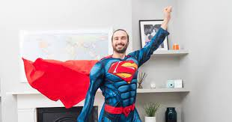
Joe Wicks – Fitness coach and TV presenter – was a young carer
Joe grew up with his mum who had mental health difficulties, and his dad who had addiction issues.
Joe said: Often, I felt like I was a parent myself, and was frequently exhausted, often falling asleep in class, and having to fit in
revision around hospital visiting times.
Notes:
Who can tell me who this is?
Well, Joe Wicks is a fitness coach and TV presenter who was a young carer for his mum who had bipolar disorder and schizophrenia – which are quite serious mental health conditions - and his father who had depression and an addiction to drugs.
Joe said: Often, I felt like I was a parent myself, and was frequently exhausted, often falling asleep in class, and having to fit in
revision around hospital visiting times.
Joe now supports a charity that helps children of parents who have a mental illness.

Slide 8
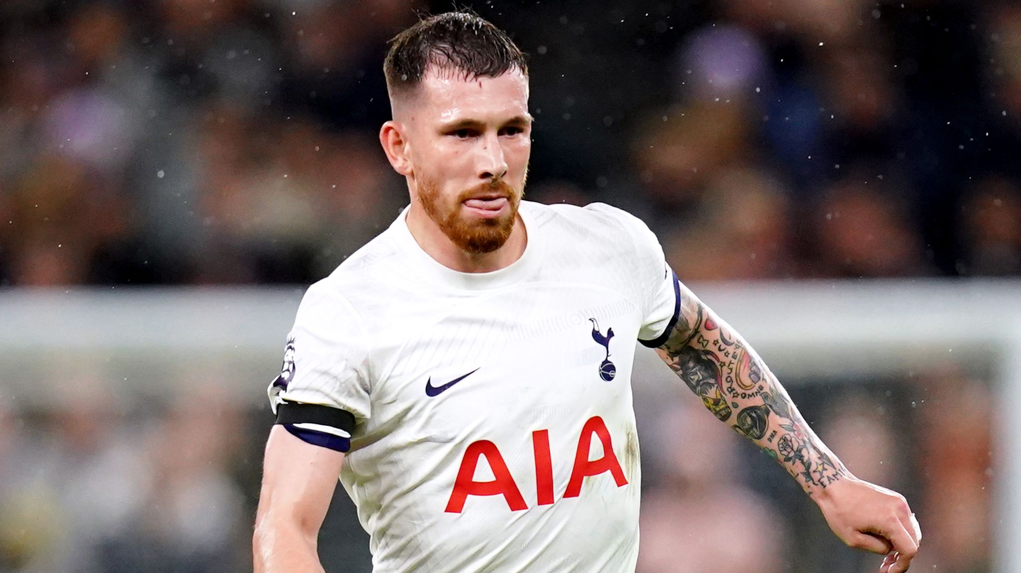

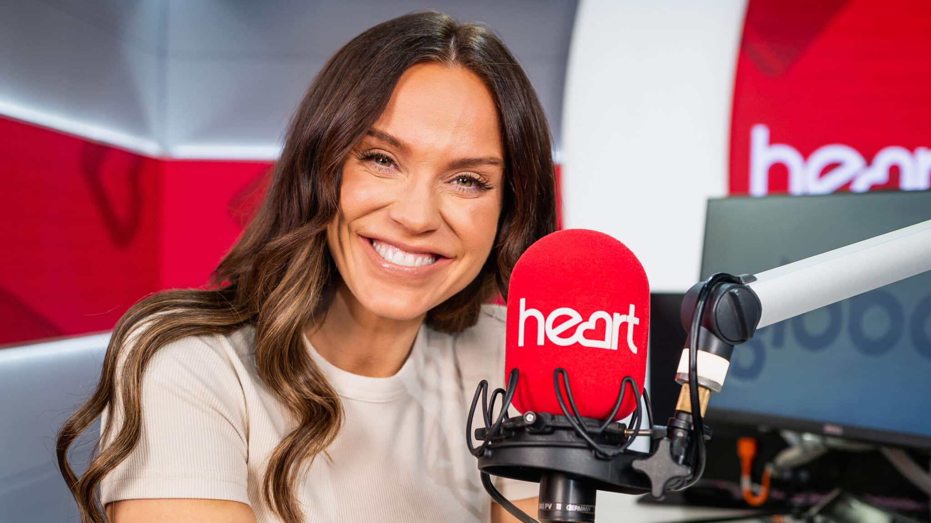




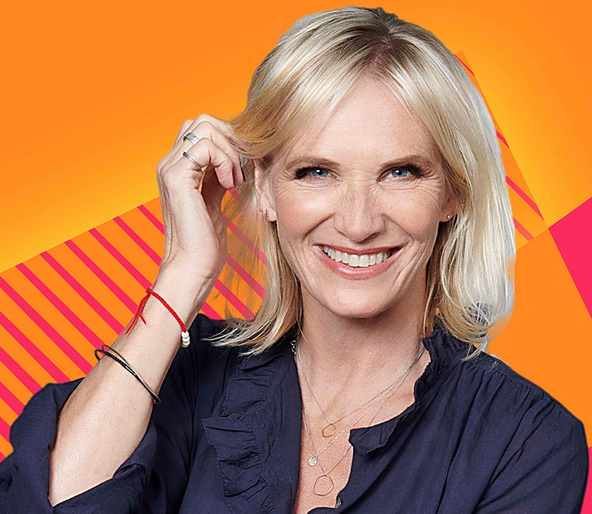
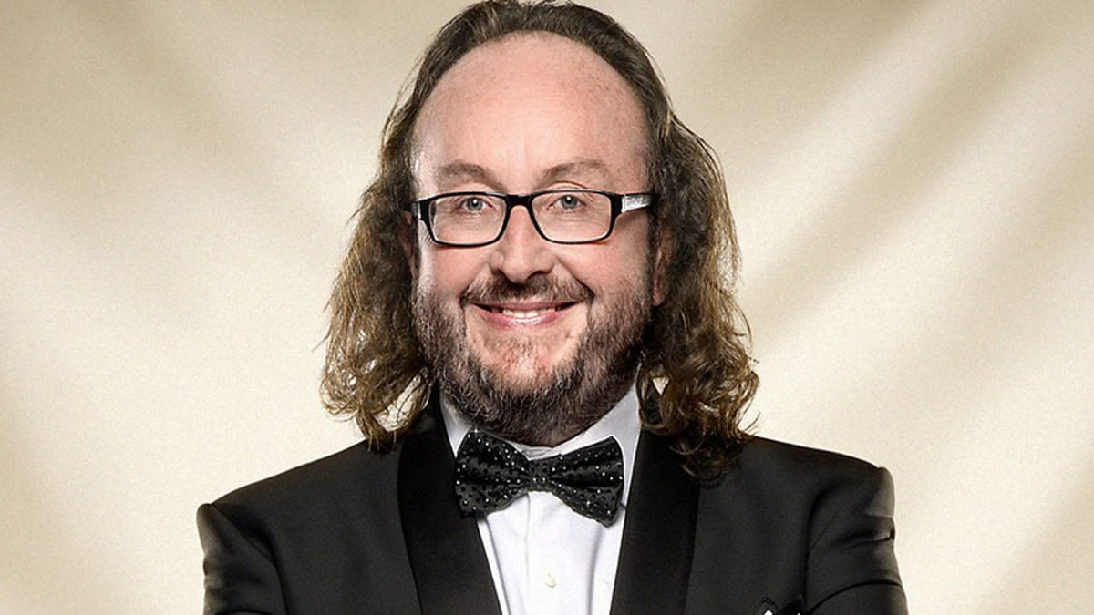

Slide 9
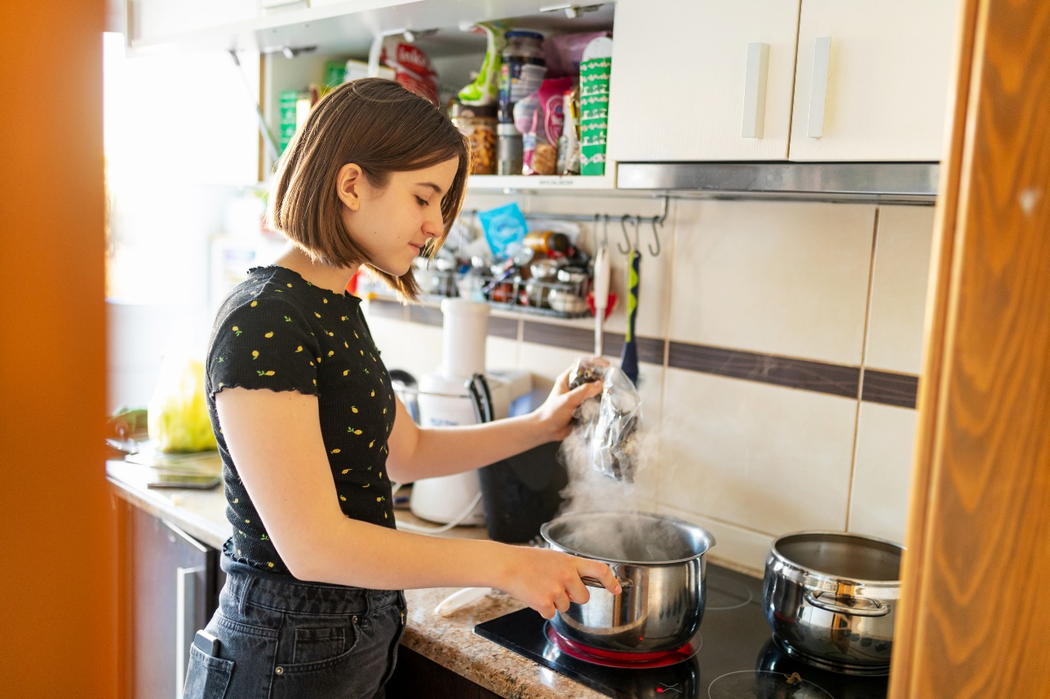
Who are young carers?
Anyone can become a young carer at any time
Caring can go up and down – people can be fine sometimes but need a lot of care at other times
Sometimes you might be helping to look after someone but not think you are a ‘young carer,’ but you can still get help
Even if you’re not a young carer, you can help other young carers by being a good friend
“I wouldn’t say that my caring role impacts on my life, I’d say that it is my life”
Notes:
Optional slide:
You might be listening to this and thinking ‘that’s not me, I don’t need to listen to this’. But it is important to listen for a few reasons.
Sadly illnesses and disability can affect families at any time. Hopefully it won’t happen to you but it could, so it’s always good to know about how to get help.
Some illnesses are up and down so people can be fine a lot of the time, but go through bad patches which can be really hard.
You might also be listening to this and have never thought of yourself as a carer because it's what you've always done and not realised it was called caring or that you could get help and support.
Another reason to listen is so that we can understand and be supportive to other young people in our school who are young carers. So everyone in this whole year/school can help and be a friend to each other.
More detail: In a survey completed by a national carers organisation, a massive two thirds of young carers said they had experienced bullying at school because they look after someone who is ill or disabled in the family! So, even if you don’t think this affects you at all, this assembly is still important because we want our school to be a really good place for all our carers and, to make that happen, we need everyone in the school to understand and be supportive to all the young carers and to our teachers who are carers for people in their families.
So everyone in this whole year can help by being a good friend and looking after people who are carers.

Slide 10
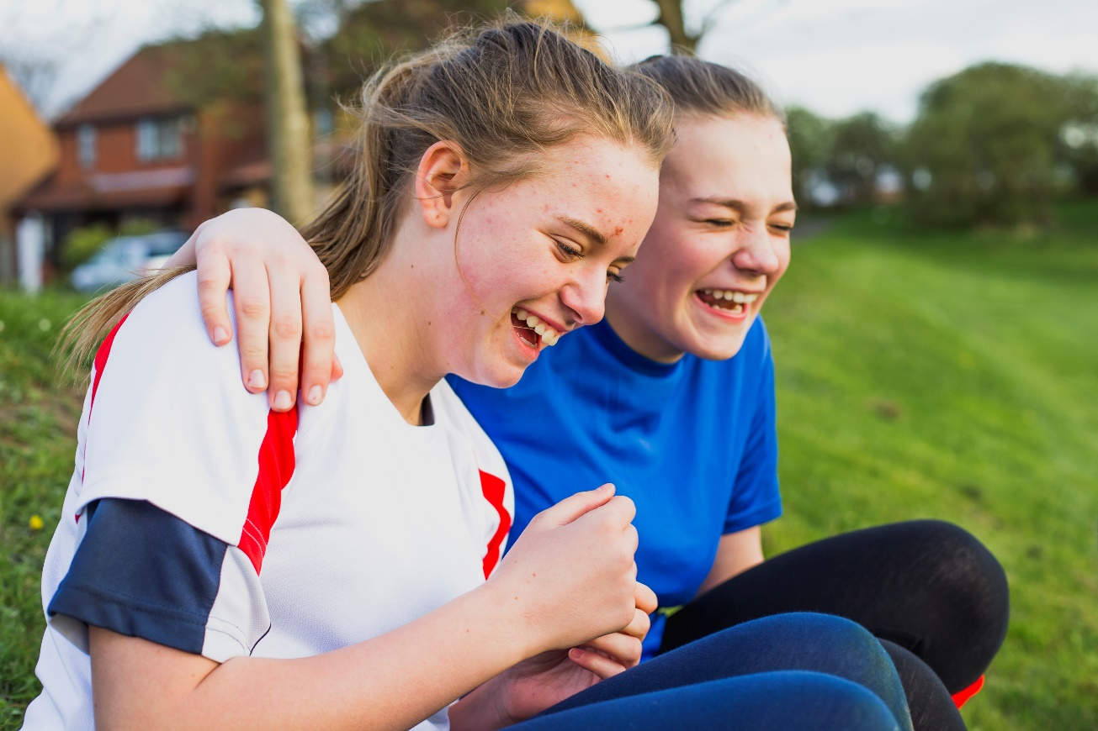
What do
young carers do?
A young carer may be helping in lots of ways, including:
  Housework, shopping and cooking
  Looking after younger brothers or sisters / taking them to school
  Helping someone get washed or dressed or move around
  Listening to someone’s problems / keeping them company
  Helping someone take their medication
  Going to hospital and doctors visits with them
  Paying household bills
Notes:
So, what kind of things do you think young carers do? (respond to answers)

Slide 11

Missing school
Being late for school
Feeling very tired / falling asleep in class
Not being able to concentrate at school
Not being able to get homework/ coursework done
Can’t join in activities after school or go out much
Hard to make friends
Bullying
Feeling really worried, frightened, angry or sad
How can
caring affect you?
Notes:
Joe said he had difficulty staying awake in class...
What else do you think might be difficult for a young carer and how might school life be for them? (respond to answers)

Slide 12
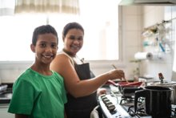
Good things about being a Young Carer
Feeling close to your family and getting to spend lots of time with the people you love
Feeling proud because you are doing a good job looking after your family
Gaining lots of strengths and skills that will help when you're older, like...
Understanding, kindness and compassion
Hardworking – young carers are often used to be being busy so they might work really hard
Skills like cooking, making phone-calls, paying bills
Being responsible
Resilience and coping strategies
Understanding health and how to stay healthy
Notes:
Young carers love the person they care for though, and young carers we know have said that they want to do it, and there are lots of good things about being a young carer too...
Things like feeling close to your family and spending time with them
Feeling proud because you're doing a good job caring for them
And learning lots of great skills.
What skills do you think a young carer might have?
(wait for answers and then click the next section and read out)

Slide 13

How can you get help?
Notes:
So, this is the most important bit about today’s assembly.
Has anyone got ideas of what you could do if you or someone you know is a young carer to get some help? (respond to answers)

Slide 14
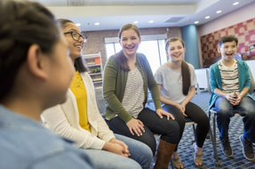
How can you get help?
Speak to someone!
Caring for someone is something to be proud of.
But it can be hard and sometimes everyone needs help.
If no one knows, no-one can help!
The Young Carer Lead at our sixth form is Miss Lyon. They understand some of the issues of being a young carer.
Notes:
The most important thing, is to speak to someone about it. If no one knows, no-one can help!
You and your family wont get in any trouble – we just want to make sure you are all OK.
In our school, we have a Young Carer Lead who understands the issues that young carers face. They are XXX so they are somebody you can talk to. Or you can choose to talk to somebody else you feel comfortable with – that might be your form tutor or another teacher, Head of Year, Safeguarding lead, or anybody else. Everything you share will be in confidence, unless they are worried about yours or someone else's safety.

Slide 15
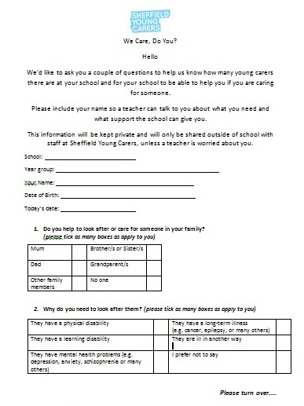
Young Carers Questionnaire
We want to know about all the young carers in our sixth form so we can help them.
To help with this, we will be carrying out a
young carers questionnaire soon.
You and your family won’t get in any
trouble if you are caring at home – we will
just make sure you are getting
the help and support you need.
Notes:
Optional slide – if doing the identification process in school
Our school already give lots of support to the young carers that we know about. We want to help others who we don’t
know about yet too.
We're going to be doing an activity with you so you can let us know about your caring using that, even if you don’t want to tell anyone face-to-face.
So soon we will be doing questionnaires in class.
Its really important you know that – if you are a carer – your family won’t get into any trouble for this, but it's your chance to get the support and recognition you deserve to make balancing school and caring manageable and make sure you can get help if you need it, either now or in the future if things get harder for you and your family.

Slide 16
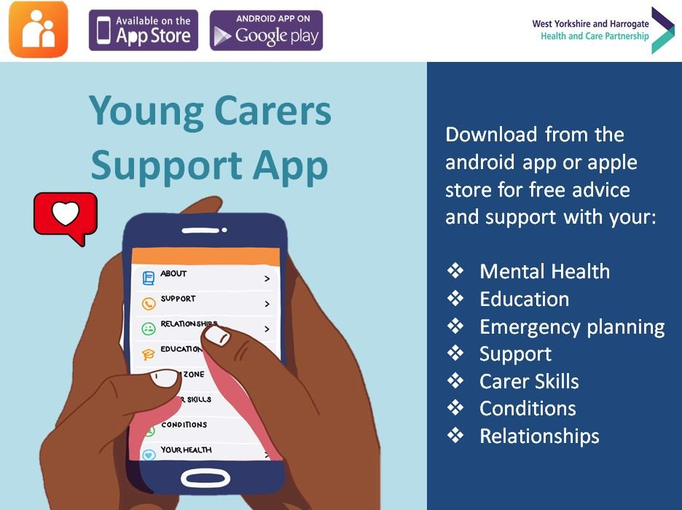
Support elsewhere
Support from SYC
Home visits or phone call to meet the carer
One-to-one support based on the needs and interests of you
Evening group programme to learn new skills and get peer support from other carers
Advocacy and signposting
Social groups, trips, activities to give you a break from caring
Up to a £300 grant
Carers card
They do have a waiting list though, so remember, we can support you in school too.
MeWe website: https://me-we.eu/booklet/
Young Carers Support App (available on Google Play Store and the Apple store)
Notes:
Optional slide:
Another way to get help is online. A really good place for young carers is MeWe website which has a booklet made for young carers, by young carers to help you know how to take care of yourself, while caring for another person.
There is also a Young Carers Support App you can download which has lots of information on it to help you feel less alone and find out where to get support.

Slide 17

Thank you for listening
Any questions?
Notes:
Thank you all for listening so well today.
If, after that, you think you might be a young carer or you know someone else who is, please do come and talk to XXX (YC LEAD) so we can find out what you need to make life easier.
Has anyone got any questions?
Remember, young carers are doing something amazing - its something to feel really, really proud of.
They often just want a bit more support and for people to understand what being a young carer means, which I hope we've shown you today.

