Slide 1

Reading
Parent Workshop
10th March 2022

Slide 2
Aims of session:
  Introduce The Simple View of Reading
  Share an example early reader
  Outline Blanks Levels of Questioning
  Understand more about phonics and the Success for All approach
  Know how to best support your child’s reading at home

Slide 3
Data 2020-2021
79% of pupils across the Academy either met or are on track to meet KSEPs in Reading
Reading is the third highest achieving subject (out of 17 subjects)

Slide 4
Reading Action Plan 2021/2022
Autumn | Review our approach to teaching phonics and ensure there is a consistent approach across the Academy Establish links with Reading/English Leads in other local special schools Reading learning walks and informal observations
Spring | Roll-out a systematic approach to teaching phonics Support and training for all class-based staff Review existing reading schemes and source phonetically decodable reading books
Summer | Devise an Academy reading booklet to share with all stakeholders Promote parental involvement and engagement in reading

Slide 5
“Reading is the gateway skill that makes all other learning possible.”
Barack Obama

Slide 6
Reading is a complex skill but it is widely accepted that reading has two basic components: word recognition and language comprehension.
This is called The Simple View of Reading.

Slide 7
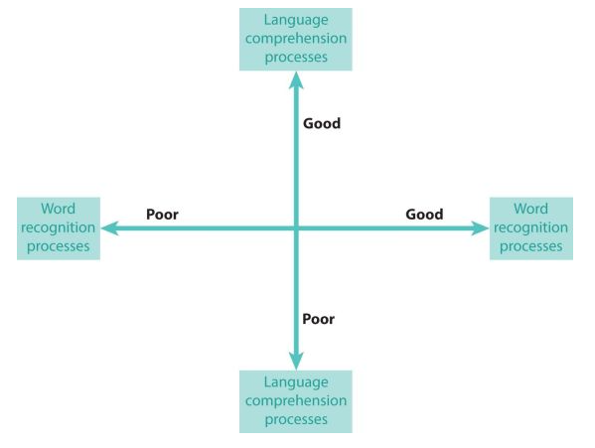
The Simple View of Reading (Gough and Tunmer, 1986)
Word recognition or Decoding: the ability to read unfamiliar words by saying the sounds corresponding to the letters in the words and blending the sounds together
Language comprehension:
the way we make sense of words and sentences and the wider language we hear or read

Slide 8
A good reader needs good word recognition and good language comprehension and both these components need to be taught.
Early readers should be taught to decode through phonics.
Good reader

Slide 9
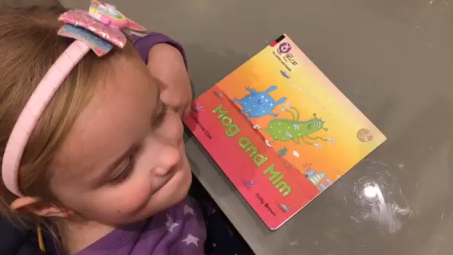
Component 1: Word recognition or Decoding

Slide 10
Component 2: Language Comprehension
Blanks Levels of Questioning is a questioning framework to encourage the development of language and vocabulary as well as reasoning and comprehension skills.
There are four levels of questioning which move from concrete questions to more abstract ones.
(Blank, Rose and Berlin, 1978)

Slide 11
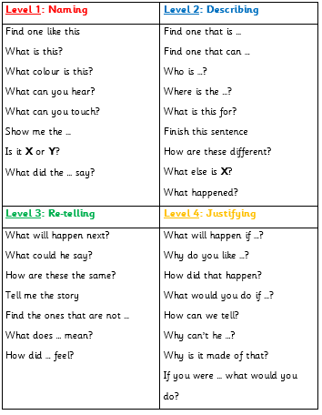
Concrete thinking. Responses can be short or nonverbal e.g. pointing
Questions at this level will ask students to look at and describe different features of an object
Students need to reason and draw on past experiences to solve, predict and explain
Students need to use their own knowledge to make basic predictions and generalisations

Slide 12

An example:
Page | Level | Question
1 | 1 | Find one like this (point to the snail)
1 | 2 | What did the snail look at?
2 | 2 | What does the sea look like?
3 | 3 | What could the snail say when they tell her to sit still?
7 | 2 | Where did the snail sit on the whale?
11 | 4 | What will happen if the waves hit the snail?
12 | 2 | Can you describe the shark?
15 | 2 | How are the snail and the whale different?
18 | 4 | Why can’t the whale move?
22 | 4 | Why did the snail write on the board?
30 | 3 | Where do you think they will go next?

Slide 13
Reading at home
“Children are made readers on the laps of their parents.”
Emilie Buchwald
10 minute quality reading experience each day
Listen to your child read their decodable reading book
Read stories aloud to your child so they hear an expert reader!
Use Blanks Levels to develop comprehension

Slide 14
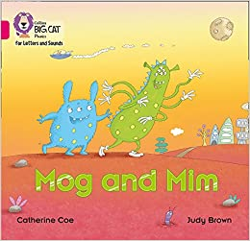
Prompts to support reading
Talk about the front cover
Read the title
Talk about the pictures
Encourage left to right tracking of words
Read the same book several times to develop confidence and fluency

Slide 15
Aims:
Phonics at Foxwood
Phonics Scheme
How can you help? Some quick tips!

Slide 16
Phonics at Foxwood
To empower every learner in phonics, by giving them an opportunity to learn phonics and use it in a way that is most beneficial for them.

Slide 17

Phonics scheme
Success For All

Slide 18
Phonics scheme
Can be adapted for all of our learners.
68 steps which cover all sounds.
- Books that run alongside to consolidate their learning.

Slide 19
How can you help?
Use pure sounds
Use correct terminology
Encourage segmenting and blending of unfamiliar words.

Slide 20
How can you help?
Tune them into sounds around them.
Identify the sounds when they hear them.
Use sensory activities to encourage engagement with letters.

Slide 21
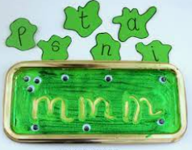
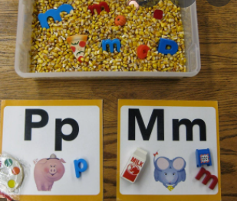
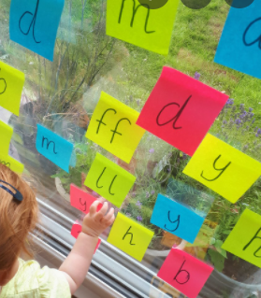

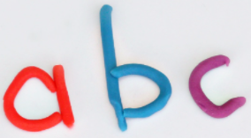
Ideas

Slide 22
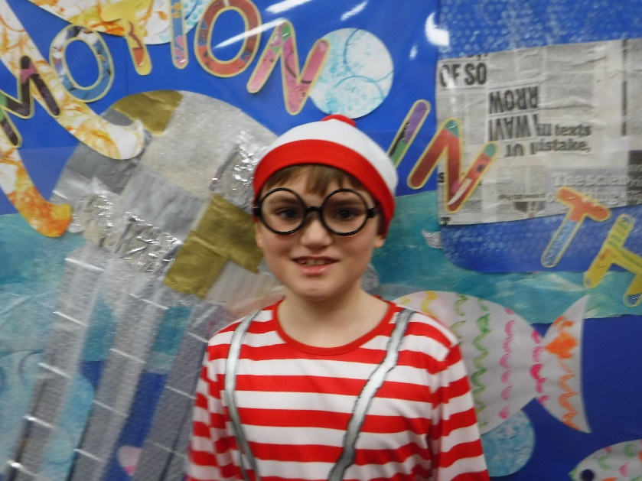
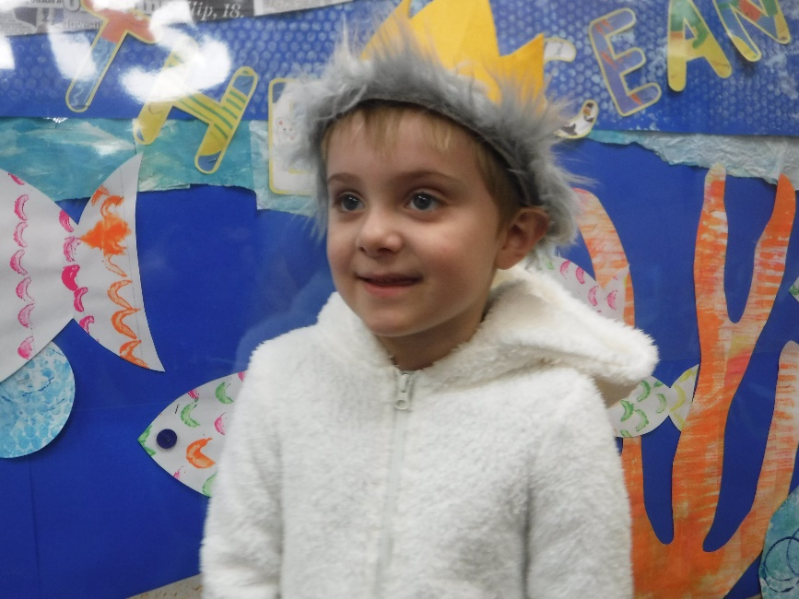
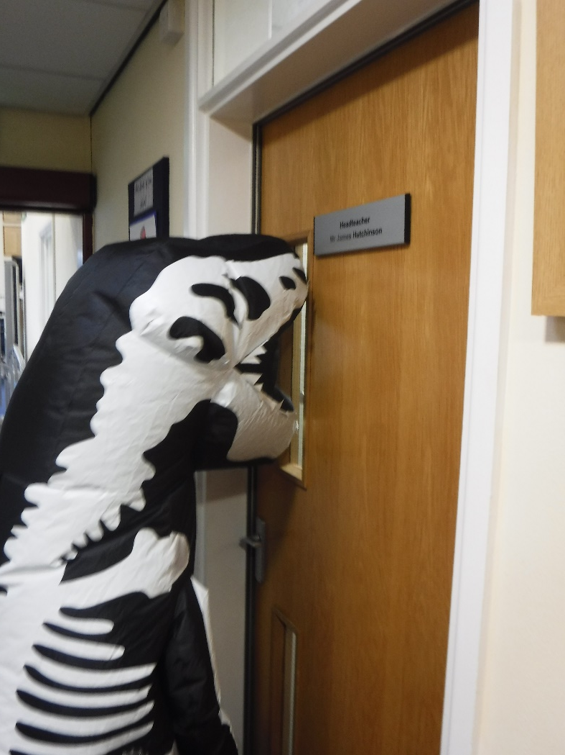
Questions ?

