Slide 1
LEADERSHIP
Skills Experience Reflection

Slide 2
What is the Leadership Award programme?
A year 12 enrichment programme where students take on a substantial leadership role within school in an area of their interest and develop a portfolio evidencing their leadership skills.
Benefits for students:
Gain experience for future applications
Develop transferable skills
Develop self awareness through reflection
Pride in community and sense of giving
something back.
Experience of recruitment process

Slide 3
What should leadership roles look like?
Sixth form leadership roles could be in extra-curricular activities, academic mentoring and tutoring, championing a particular subject or cause, charitable activities etc. Roles do not have to involve leading an activity with younger students, it can also be “taking the lead” on a project or responsibility around school. Roles must:
Be achievable in 1-2 hours a week within students’ non-contact time
Be appropriate for a sixth form student to undertake (considering capability, appropriate supervision, safeguarding and GDPR)
Give the student some genuine responsibility and opportunity to build skills

Slide 4
Your role as staff
All sixth form leadership roles have a staff ‘sponsor’ who will:
Act as key contact for the student across the year
Ensure appropriate supervision and support is in place
Act as a mentor by giving feedback and helping students reflect on their own
leadership
Take part in a short interview for applicants

Slide 5
Student Proposals
As well as staff advertising a role they would like to be filled, students may also propose a leadership responsibility they would be interested in starting.
Leadership role ideas
STEM club student lead
Technical manager for school production
Medical Society President
Head student librarian
Charities Co-ordinator
Sports club student coach
Sustainability champion
Art exhibition manager
Subject student champion
Book club student lead
Further maths student mentor

Slide 6
Recruitment process
Staff identify
Students submit letter of application and are invited for interview
leadership role and
complete role spec
Roles advertised for
students to apply
Roles allocated
Student identifies leadership interest and secures staff sponsor
Student and staff sponsor agree role spec
Student submits letter of proposal and is invited for interview
Students pass on leadership role to the next year group or stay on as mentors
Monitoring checkpoints throughout year
End of year portfolio submission
Initial meeting and roles begin

Slide 7
Example role spec:
Role Title: | “Sing Happy” Student lead
Staff Sponsor: | Mrs Moss
Time Commitment: | Friday lunch times plus approx. 30mins/week prep and planning
General Overview: | Support with the running of a singing for wellbeing group aimed at year 10-13
Key Responsibilities: | Assist with promoting the activity and recruiting members Lead vocal warm ups Select and source music incorporating ideas from members Record attendance
Skills and qualities needed: | Enjoyment of singing (actual talent not essential) Organised and able to keep accurate records Creativity Enthusiasm Communication
The role spec is a brief overview of the leadership role outlining 3-4 key responsibilities and a few skills and qualities you will be looking for in the right sixth form leader.
They will evidence these in their letter of application.

Slide 8
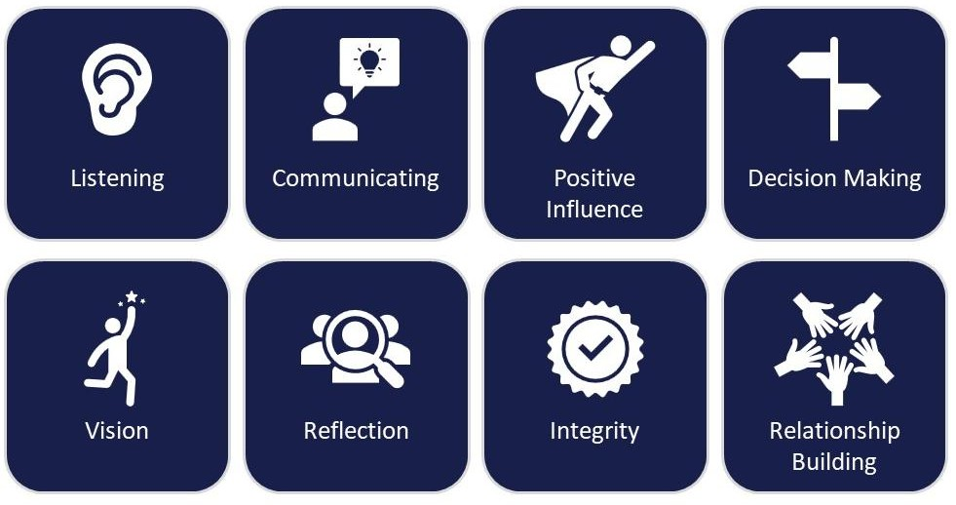
Leadership Skills and Behaviours

Slide 9
1. Listening | 1.1: Active listening I listen actively to others, showing I am listening and understanding. | 1.2: Questioning I question effectively to bring the most out of others. | 1.3: Summarising I clearly summarise the points I have heard.
2. Communicating | 2.1: Public Speaking I speak confidently in front of a group of people. | 2.2: Presenting ideas I present ideas in a clear and logical way. | 2.3: Instructing I give clear instructions.
3. Positive Influence | 3.1: Commitment I show commitment and reliability and see projects through to the end. | 3.2: Being a role model I set a good example of positive behaviours and attitudes | 3.3: Contributing to community I make a positive contribution to the community
4. Decision Making | 4.1: Identifying issues I identify issues that need to be addressed, or problems that could arise | 4.2: Problem solving I find solutions to problems | 4.3: Taking action I make reasoned decisions about the best course of action
5. Vision | 5.1: Goal Orientated I identify clear goals and focus on achieving them | 5.2: Encouraging others I encourage others to work towards a mutual goal | 5.3: Strategic thinking I think strategically to find the best way to reach a goal
6. Reflection | 6.1: Self-awareness I am aware of my own strengths and weaknesses | 6.2: Monitoring I monitor the progress of a project against a plan | 6.3: Evaluation I evaluate completed projects and activities and learn lessons for the future
7. Integrity | 7.1: Honesty I am honest and tell the truth | 7.2: Accountability I take responsibility for the success and failure of a project | 7.3: Respect I treat others with respect
8. Relationship Building | 8.1: Supporting others I support the needs of other people | 8.2: Empathy I show empathy and consider other points of view | 8.3: Team working I work effectively with others in a team

