Slide 1

Careers and Aspirations

Slide 2
Magic Mick
As part of our Fulwell Fringe whole-school project, pupils will be exploring careers linked to performance, both on stage and behind the scenes.
Children were excited to welcome local magician Magic Mick, who led a fun assembly packed with amazing tricks and plenty of laughs. Alongside the magic, Mick shared what it’s really like to work as a professional magician, giving children an insight into how a hobby then begins in childhood can grow into a career.
After the show, pupils were set a challenge of their own: learn a magic trick, which is one of our Fulwell 50 challenges. It was wonderful to see children building confidence while developing new skills. This was a magical visit that truly brought career learning to life!

Slide 3
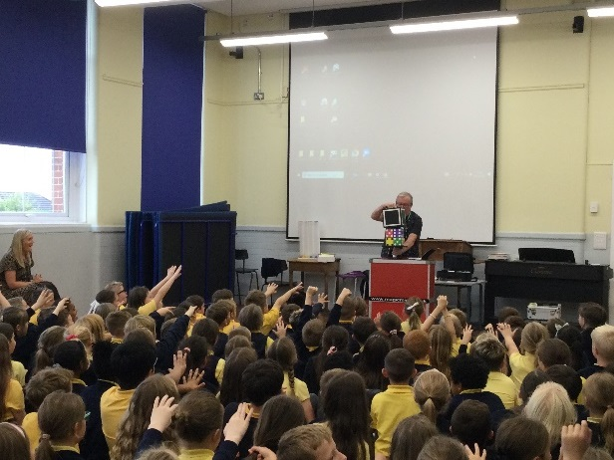
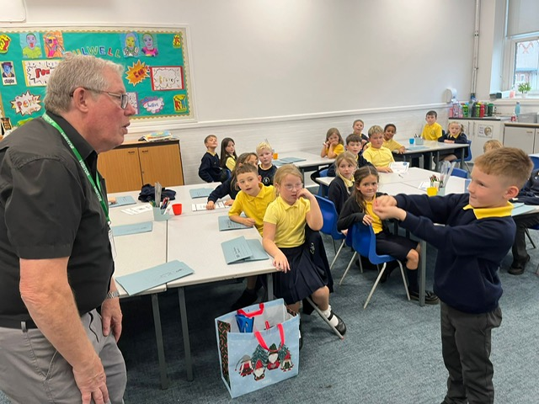
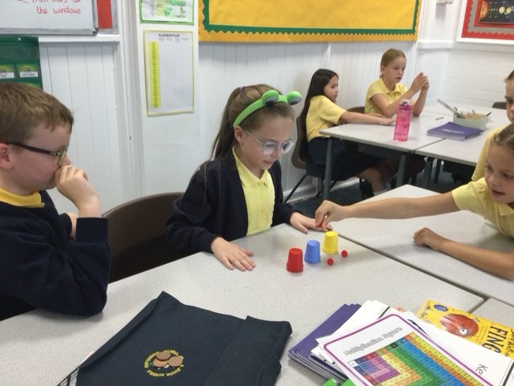
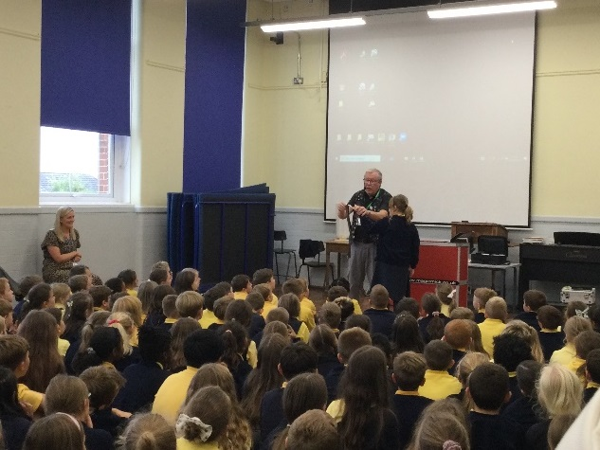

Slide 4
Helen Rutter
Year 5 and 6 were treated to a fantastic author visit from Helen Rutter, who shared her journey to becoming a writer, the inspiration behind her stories, and what life is really like as an author.
Children loved hearing about Helen’s creative process - and some even became proud owners of a signed copy of her book The Boy With BIG Decisions!
Inspired by the visit, pupils went on to plan their own branching stories, where the reader gets to choose how the tale unfolds. It was wonderful to see so much imagination, creativity and confidence on display.
It was such a brilliant way to spark a real buzz for reading and writing, and hopefully inspiring some future authors!

Slide 5
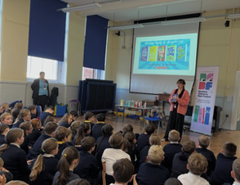
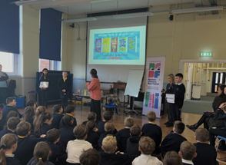

Slide 6
Girl Powered
A team of Year 5 and 6 girls were thrilled to take part in Girl Powered - an exciting robotics event which took place at Komatsu Europe in Birtley. This competition was specifically designed for Key Stage 2 girls, with the aim of sparking curiosity, building confidence, and encouraging greater female participation in STEM subjects.
In the weeks leading up to the competition and throughout the event, the girls worked together to explore robotics, solve challenges, and see first-hand how creativity, teamwork and technology come together. There was plenty of excitement as the robots were tested and improved!
It was a fantastic opportunity for our girls to discover new skills and start imagining future careers in science, engineering and technology. It was a truly empowering day, and a brilliant reminder that STEM is for everyone!

Slide 7
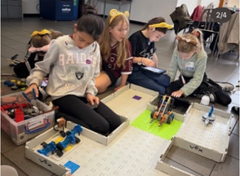
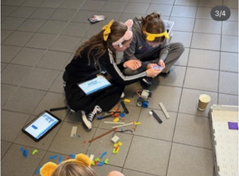
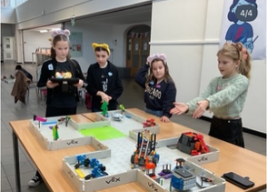

Slide 8
Nissan
As one of our region’s biggest employers, we really value Nissan’s commitment to sharing careers in manufacturing with our children. 30 Year 5 pupils were able to enjoy an exciting visit to the Nissan car plant in Sunderland, seeing this fast-paced workplace first-hand.
The day gave pupils a real taste of working life in a global manufacturing environment. Taking part in hands-on STEM activities, children worked in teams to race against the clock building high-quality Lego cars, learning all about teamwork, reducing waste, and spotting ways to improve their designs along the way.
Pupils also had the chance to safely use some of Nissan’s tools and see first-hand how raw steel is transformed into a finished vehicle on the production line, which was a real “wow” moment. This was a fantastic opportunity for our Year 5s to explore engineering and manufacturing in action, and to start imagining future careers in STEM.

Slide 9
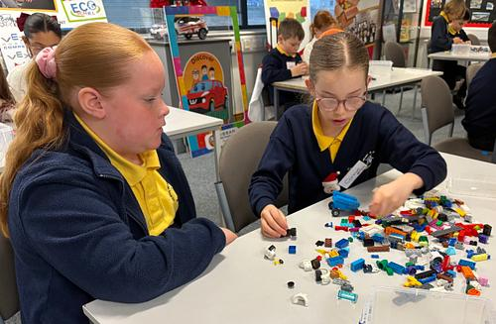
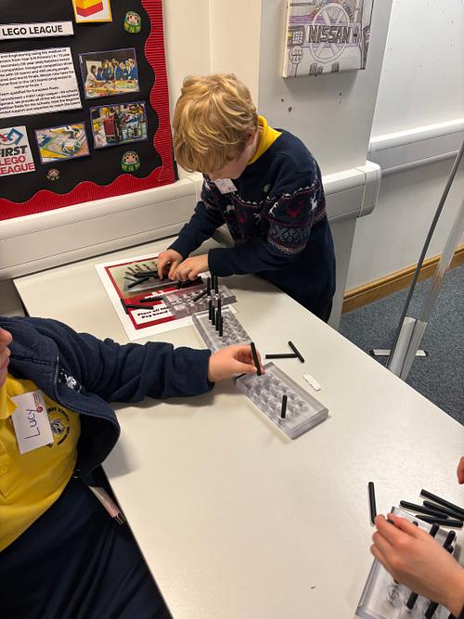
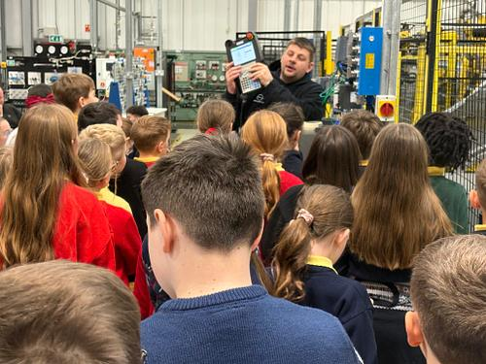
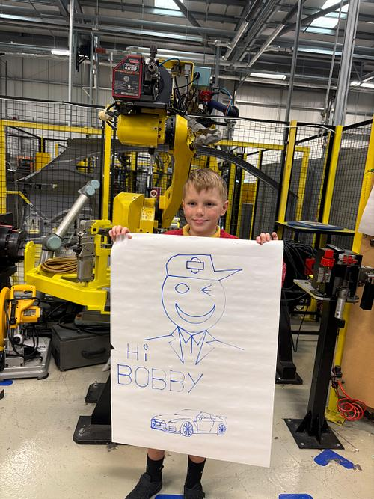
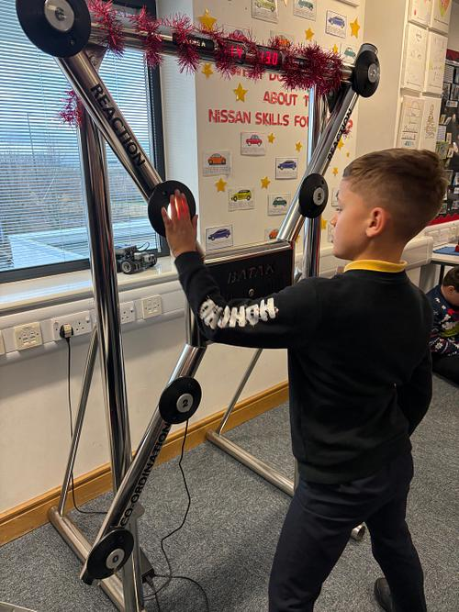
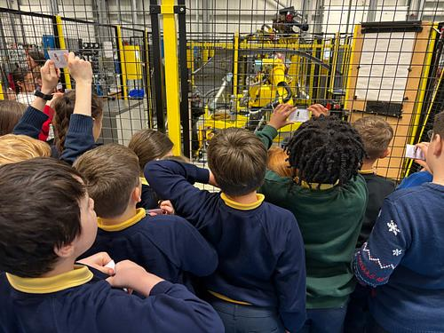
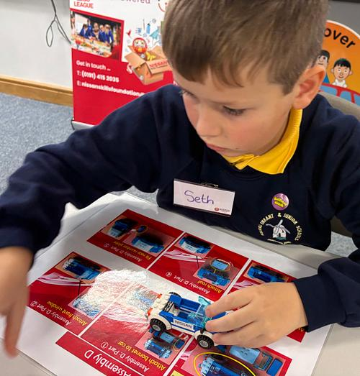
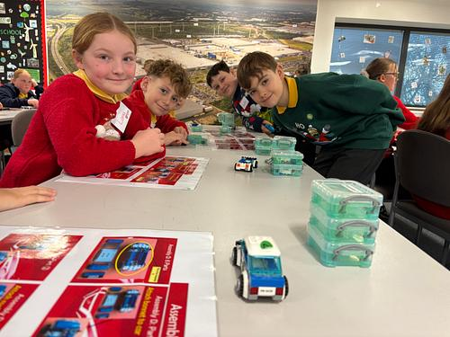
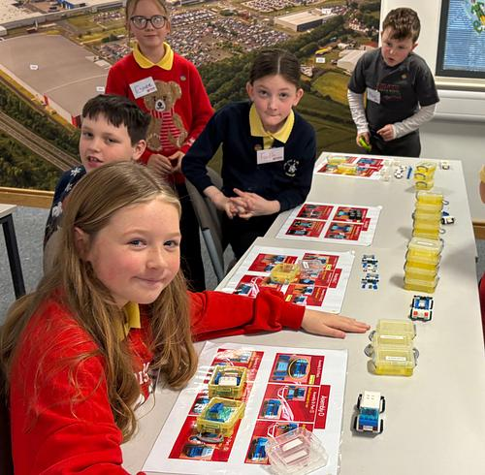
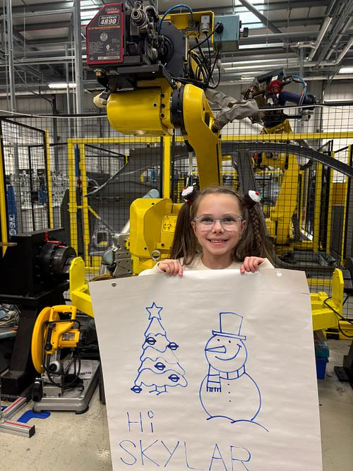
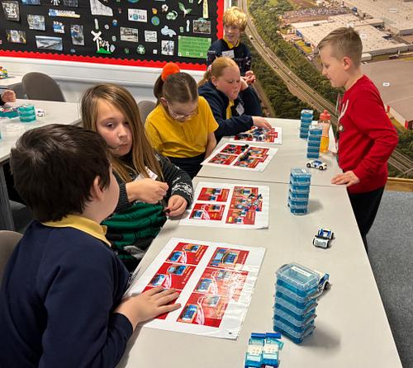
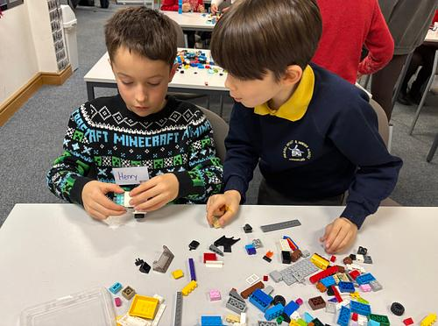
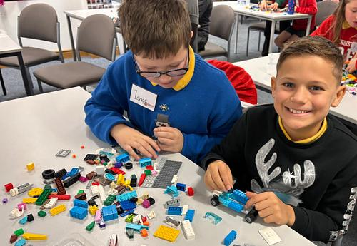

Slide 10
Canford
Year 4 were delighted to welcome Canford Audio into school as part of their science unit about sound. The visit built perfectly on their learning, from how vibrations travel through the air to ideas of pitch and volume.
The children took part in an activity in which they had to think like broadcast engineers. Using a printed football stadium layout, they were asked to predict how many cameras are needed to televise a sporting event and identify where these cameras should be placed. They carefully positioned markers around the stadium before discovering the real number of cameras used. The children were able to put their teamwork and critical thinking skills to great use!
Children then had the opportunity to handle genuine broadcasting equipment used at large-scale events such as sporting events, concerts and theatre productions. This sparked lots of thoughtful questions and curiosity about the wide range of jobs involved in the audio industry, from technical roles to creative careers.
This visit was a fantastic way to help the children connect their science lessons with exciting future career possibilities. Ben and Ian from Canford were so impressed with how engaged the children were and they were really impressed with their questions and contributions.

Slide 11
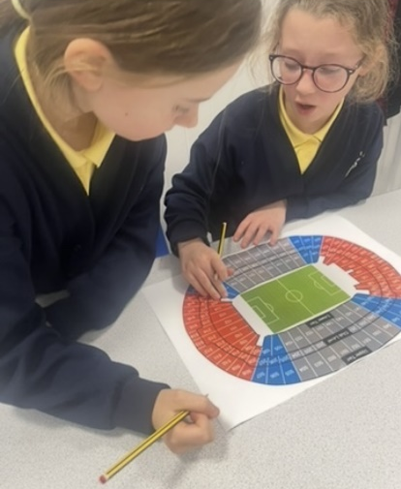
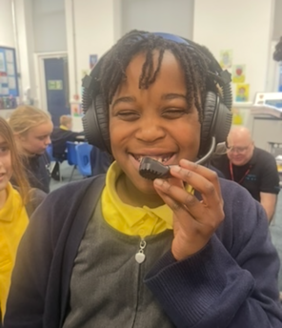
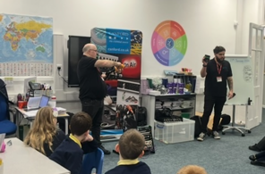
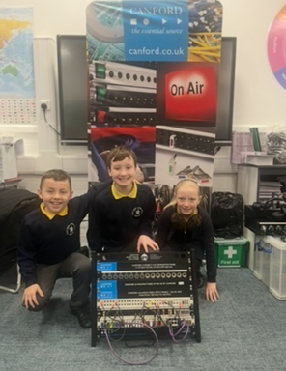
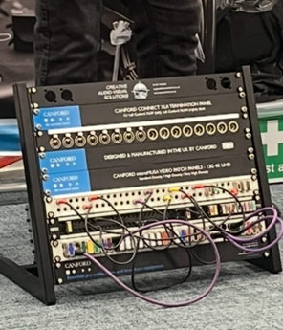

Slide 12
Police workshop
Some very lucky Year 6 pupils with aspirations in law and science took part in an exciting detective and forensics workshop - and what a day it was!
The children became real-life investigators, taking fingerprints, learning about DNA, and carefully collecting evidence from a mock crime scene. There was plenty of teamwork and problem-solving as they worked through clues, and Mrs Dryden was even arrested for theft!
It was a brilliant hands-on experience that gave pupils a true insight into police work and forensic science, helping them see how classroom learning connects to real careers. An excellent day all round - and we may have discovered a few future detectives along the way!

Slide 13
