Slide 1
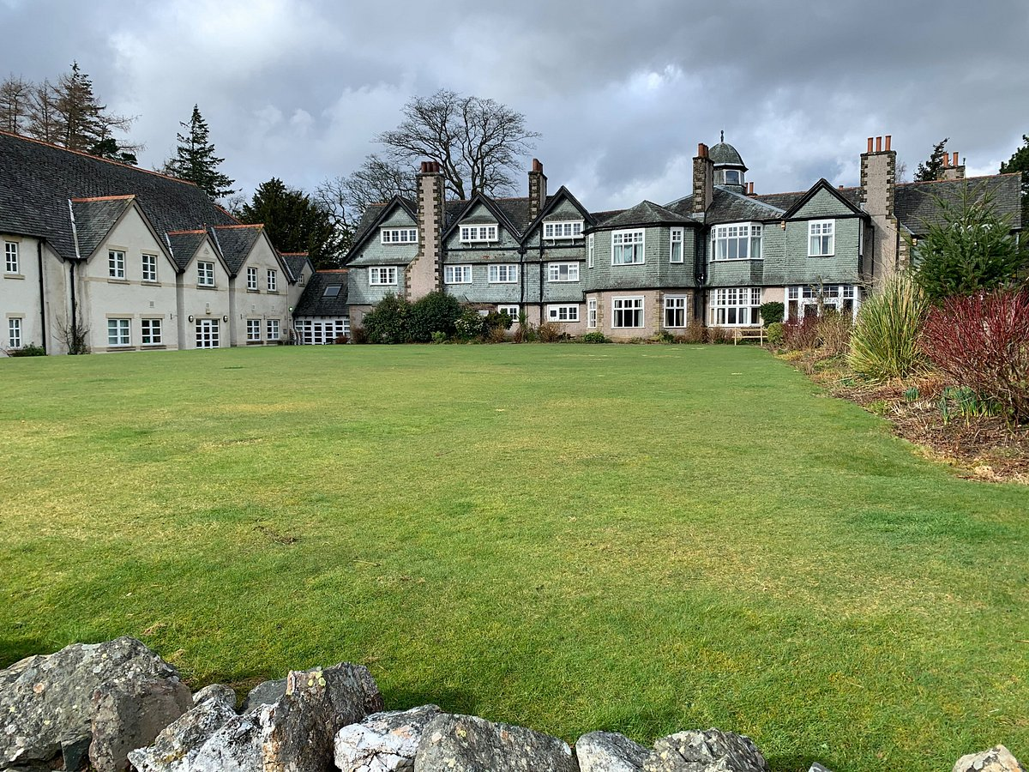
y5 DERWENT HILL RESIDENTIAL
16th – 20th June 2025

Slide 2
Staffing
Group Leader – Miss Birch
Teaching Staff : Mrs Watson-Smith and Miss Burn
Support Staff : Mr Hughes, Miss Cook, Miss Donoghue and Miss Peacock.

Slide 3
Why do we go?
Throughout the five-day course, our children will have a wonderful time and create memories that will last a lifetime. Not only that, but it is also to develop skills that will support them as they go into year 6 and beyond!
Develop resilience through tackling new challenges
Increase personal confidence
Develop personal independence.
Encourage teamwork through trusting and supporting each other
Experience awe and wonder at the natural world and discover new things.
Notes:
Derwent Hill provides a powerful learning experience which helps children to be ready for the challenges of school, work and life. They develop confidence, resilience, personal and social skills and teamwork.
It widens their horizons, develops their character and provides a wealth of experience from which they draw back at home and at school

Slide 4
What is involved?
Canoeing
Gorge walking
A full day’s hill walk
The Big Swing
Orienteering
Night walk
Gladiator challenge
High ropes/ low ropes course
Mine exploration
Rock climbing
Abseiling

Slide 5
Forms
1. Essential personal information – full information should be provided including modified diets: Food intolerances can be accommodated
2. Medical form - Prescribed medication only. Parents to provide medication specifically for Derwent Hill, not what is held in school.
3. Photography & social media permission – we assume that all children will be allowed to be photographed while we are away but if you would like child to OPT OUT, please let us know ASAP.
4. Behaviour contract - Expectation for parents to come and collect their child if a significant issue arises (behavioural or otherwise).
Kit list
Souvenir price list
Sample menu

Slide 6
Advice.
1. Pack plenty of layers – old clothes for the outdoor activities are best.
2. Make sure your child has an empty lunch box and drinks bottle. No food required.
3. Plastic bags for dirty clothes
4. LABEL EVERYTHING!
5. NO phones or electronics are allowed at all. Your child can bring teddy, notebook, reading book etc.
6. Don’t pack anything of significant value.
7. They may bring some money (no more than £10) for souvenirs.
8. Fill in the forms with as much detail as possible – every detail helps!

Slide 7
FAQS
My child is a fussy eater, will there be enough for them to eat?
When and where will we see photos of the children?
How are the dorms and groups organised?
Will I be able to have contact with my child?
Will we get updates throughout their time away?

Slide 8
Final Deadlines
Please complete all the forms in your packs and return them to school as soon as possible.
Deadline to have all forms completed and returned to school is Tuesday 13th May.
All medication needs to be in school by Monday 9th June.

Slide 9
Thank you!
@fulwelljuniors
@FulwellSchool
@fulwelljuniorschool5351
Fulwelljuniorschool.co.uk

