Slide 1
Year Four Multiplication Check (MTC) June 2023
¼ of 48
$\frac{3}{5}$ x 75
$\frac{3}{7}$ + $\frac{4}{5}$
$360 \text{÷}$40 =
300 x 40 =
Information for parents
$4.8$x 30 =

Slide 2
Why are times tables important?
Times tables are fundamental to support children and under pin everything within Maths. It is vital that all children know their multiplication facts up to 12 x 12 by the end of Year 4.
Knowing the multiplication facts up to 12 x 12, will give them the essential knowledge needed to be proficient with Years 5 and 6 curriculum.

Slide 3
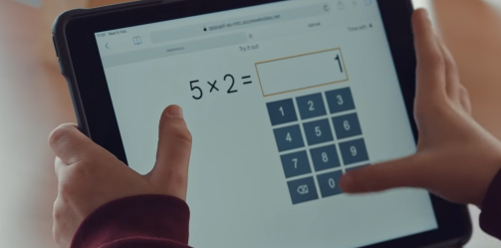
What is the MTC?
The MTC is an online, on-screen digital assessment.
The purpose of the check is to determine whether your child can fluently recall their times tables up to 12 x 12, which is essential for future success in mathematics.
It will be automatically scored, and results will be available to schools once the assessment window closes (end of June).

Slide 4
Access for all children...
There are several access arrangements available for the check, these can be used to support pupils with specific needs. Your child’s teacher will ensure that the access arrangements are appropriate for your child before they take the check in June.
The check has been designed so that it is inclusive and accessible to as many children as possible, including those with special educational needs or disability (SEND) or English as an additional language (EAL).

Slide 5
When is it?
The national multiplication tables check (MTC) is a test for all Year 4 pupils that takes place between the 5th and 16th of June 2023.

Slide 6
Will I find out my child’s score?
Yes.
Your child’s teacher will share your child’s score with you, as they would with all national curriculum assessments. There is no pass mark for the check.
These will be reported in the Summer term.

Slide 7
What does the multiplication check involve?
It is an on-screen check consisting of 25 times table questions.
Your child will be able to answer 3 practice questions before taking the actual check. They will then have 6 seconds to answer each question.
On average, the check should take no longer than 5 minutes to complete.

Slide 8
Example - this is very similar to the MTC.
https://mathsframe.co.uk/en/resources/resource/477/Multiplication-Tables-Check

Slide 9
What can I do to support my child?
We practise our timetables daily at school; we would love for your children to practise with you at home so that they feel confident when completing the test.
The easiest way is to quiz your child. 8 x 6 is? What are 3 lots of 5? What is 12 x 12?
Quiz your child at home regularly. This could be when making dinner or on the journey to school. Sneaking in a minute or two at these times can be extremely beneficial.

Slide 10
What can I do to support my child?
Encourage children to play Times Table Rockstars (TTR) as often as possible.
Small 5 minute daily sessions will help children to learn times tables more than one long session a week.
The soundcheck on TTR is very similar to the multiplication check. It mirrors the way the MTC is ran. It also allows children to see which questions they got correct/incorrect.

Slide 11
The focus of the MTC is on accuracy within 6 seconds.
Children should focus carefully on being accurate when typing in their answers and not rushing.
Studio & garage are great to practice recall of facts but be careful, as they’re about speed too.
Jamming & soundcheck are best for MTC practice.

Slide 13
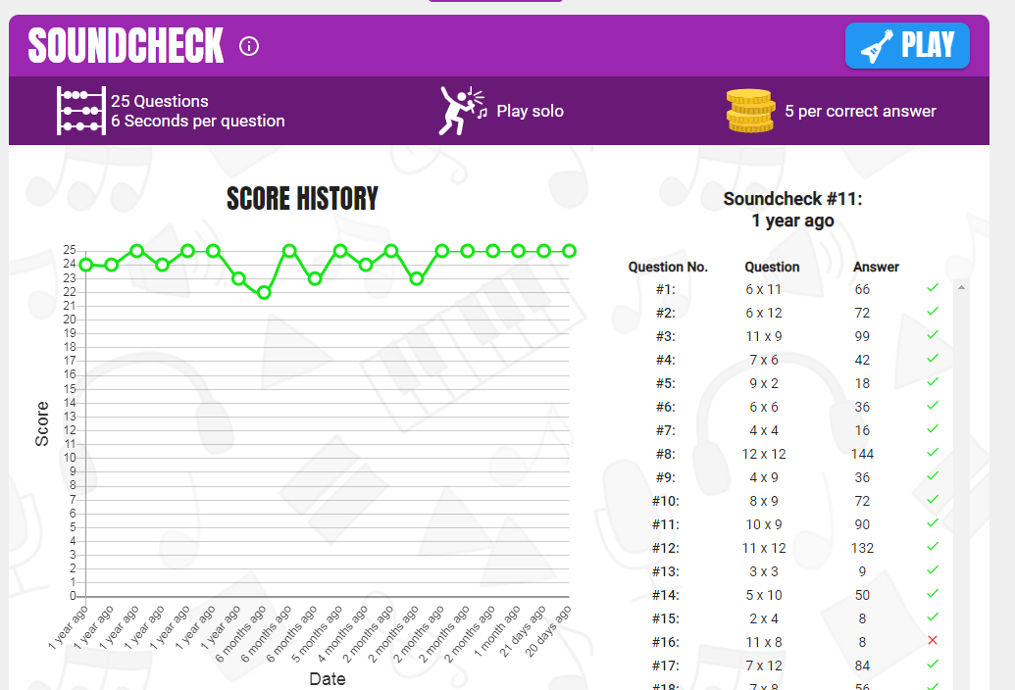

Slide 14
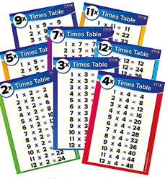
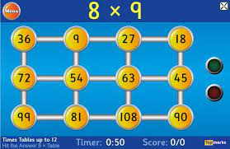
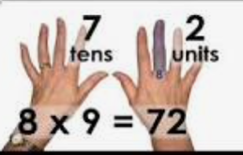
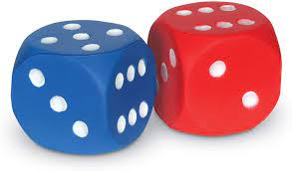
Other ways to practice:

Slide 15
Any times tables practise that the children can do at home will really support them to become proficient in their times tables and help them with their everyday maths learning.
At Fulwell Junior School we have always prioritised recall on times tables and encouraged our children to develop their fluency. The MTC has not changed our approach to times table teaching.
A secure knowledge of times tables is important for much more than just the Y4 MTC. It really supports their maths learning in Y5 & Y6 (and beyond).

Slide 16
Any questions?

Slide 17
We value your support. Thank you for supporting us.

