Slide 1
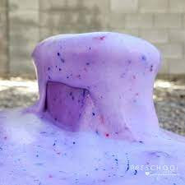
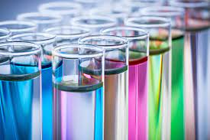
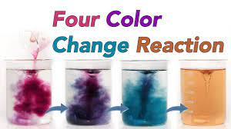
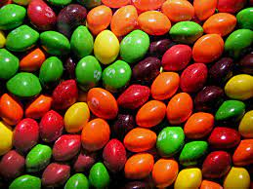
Science Week at FJS 2022
Our Colourful World

Slide 2
Our Colourful World
In school this week we are carrying out lots of fun and exciting science experiments.
We are exploring the theme of colour.
We launched the week with a fantastic visit from Big Science, who provided for many opportunities for ‘awe and wonder’.
We would love you to get involved at home too. Over the course of this week, we will send ideas of science experiments you might want to try at home via Marvellous Me.
If you do get involved at home, we would love for you to share this with us. You can bring in photos, examples or talk to your class about it. You can also tweet us on our Twitter page. We’d love to see your discoveries!
Don’t forget to visit us on Twitter and Instagram to see what we’ve been up to in school!

Slide 3
Our Colourful World
Please remember to ensure that you carry out any experiments at home with an adult.
Do not attempt to do any of these experiments without checking that a grown up is there to support you.
Have Fun!

Slide 4
Our Colourful World
https://www.sciencefun.org/kidszone/experiments/dry-erase/

Slide 5
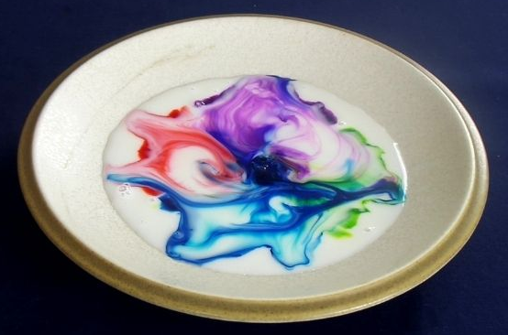
Our Colourful World
https://www.sciencefun.org/kidszone/experiments/milk-art/

Slide 6
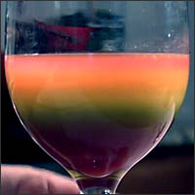
Our Colourful World
https://www.sciencefun.org/kidszone/experiments/rainbow-in-a-glass/

Slide 7
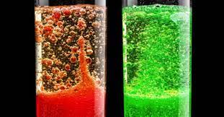
Our Colourful World
https://www.sciencefun.org/kidszone/experiments/lava-lamp/

Slide 8
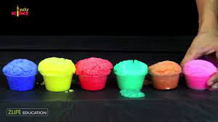
Our Colourful World
https://www.sciencefun.org/kidszone/experiments/snow-fluff/

Slide 9
Our Colourful World
Please remember to ensure that you carry out any experiments at home with an adult.
Do not attempt to do any of these experiments without checking that a grown up is there to support you.
Have Fun!

