Slide 1
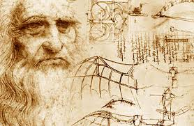

Slide 2
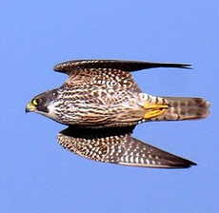
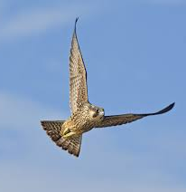
https://www.youtube.com/watch?v=legzXQlFNjs

Slide 3
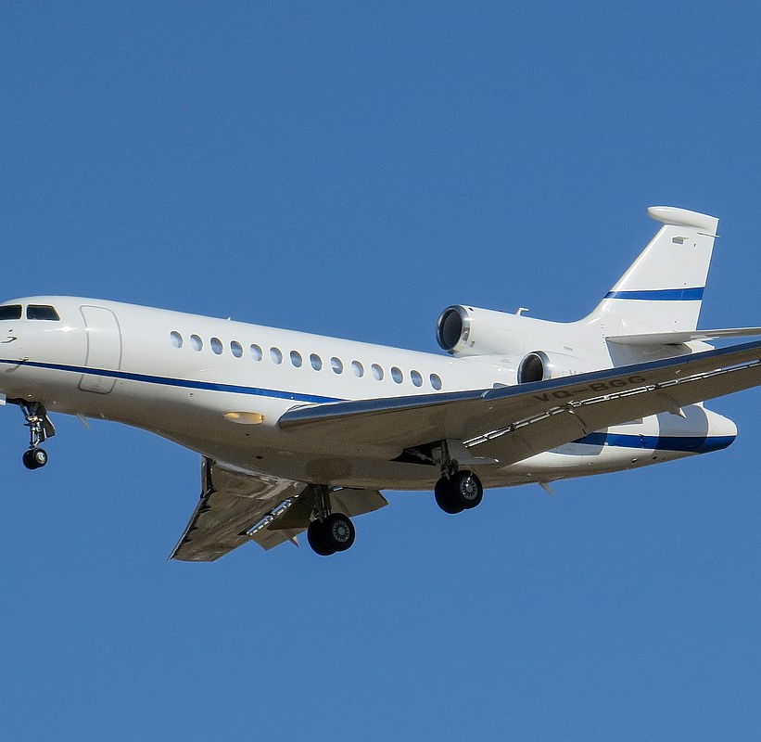
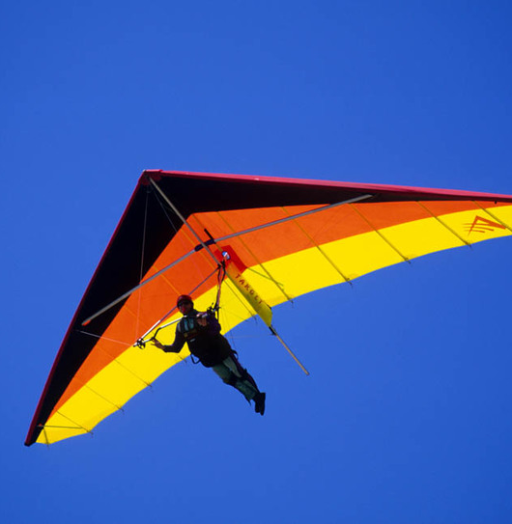
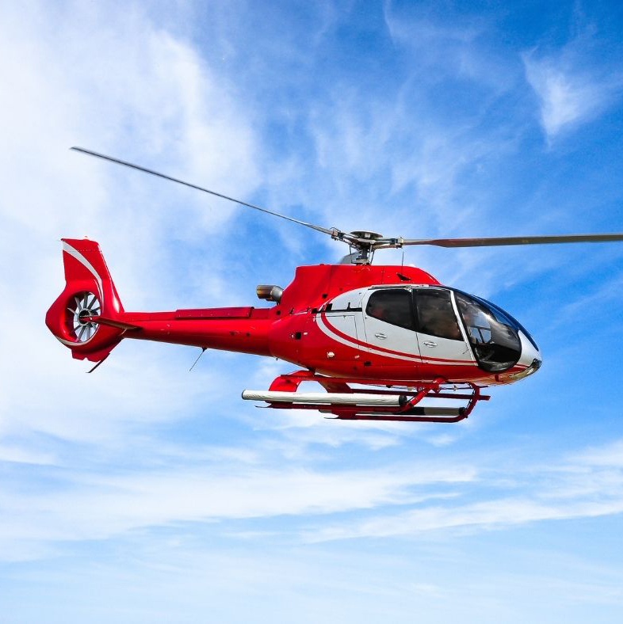
https://www.youtube.com/watch?v=9yVtGHbmN4s
45 seconds

Slide 4
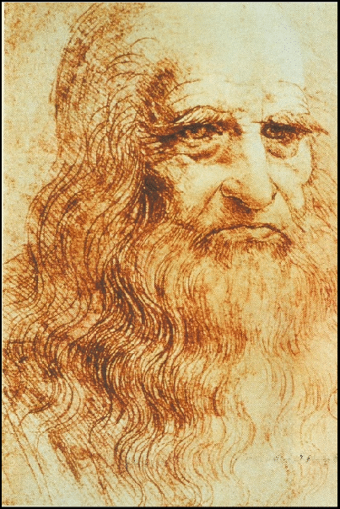
Take Flight
‘’=‘’Study the science of art…Study the art of science. Realise that everything connects to everything else.’
Fulwell Junior School
Whole School Project 2021-2022

Slide 5
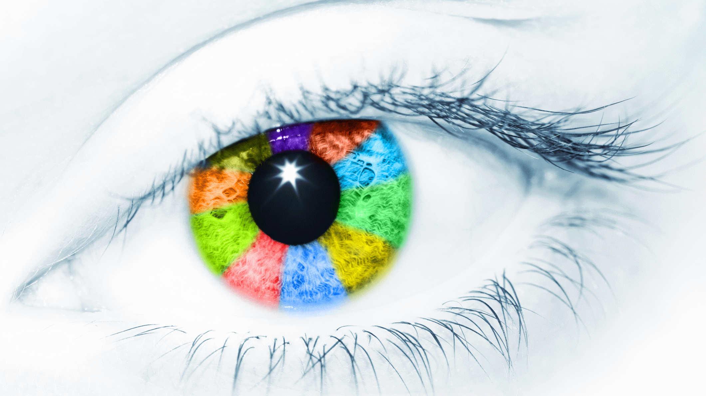
integrity
discovery
excellence
world of work
confidence
endeavour
respect
sense of duty
resilience
teamwork

Slide 6
Leonardo da Vinci
Born: 15th April 1452, Vinci, Italy.
He had a curiosity and interest in scientific observation.
He was a skilled artist, fascinated by the human form.

Slide 7
Discover…
Task 1:
Your turn to discover more about Leonardo and his talents and fame.

Slide 8
Explore…
One of the many things Leonardo was famous for was his ideas and fascination with flight…
Task 2:
Explore your own ideas and thoughts about how birds take off, fly and land.

Slide 9
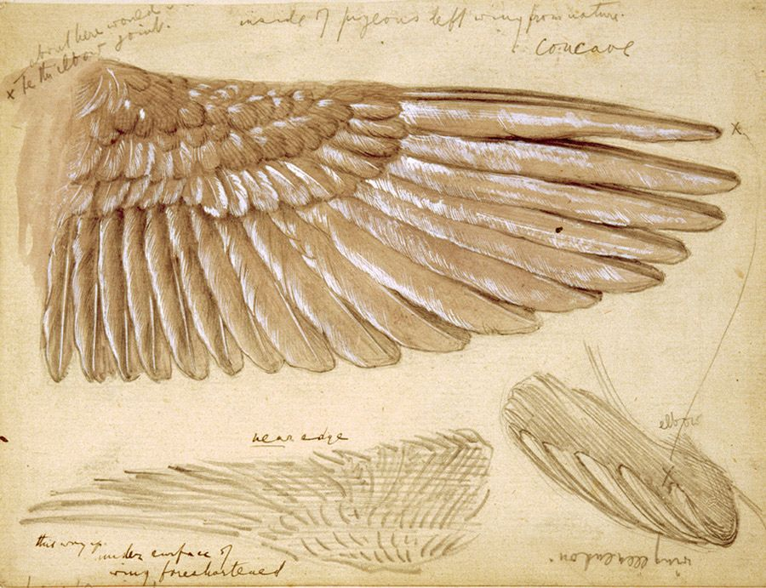
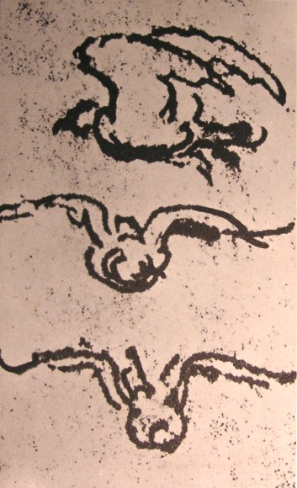
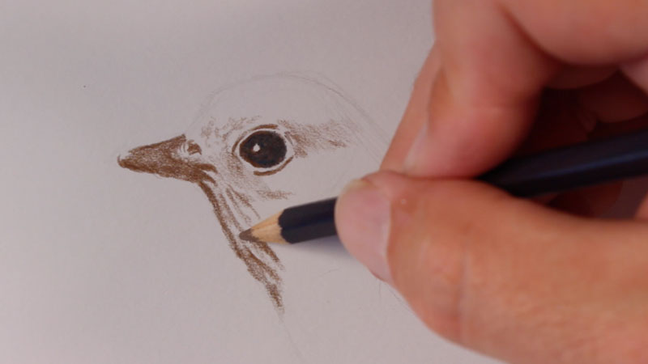
Observe…
We are going to be working like Leonardo this week, making observational drawings and sketches to
help us understand more about how birds fly.

Slide 10
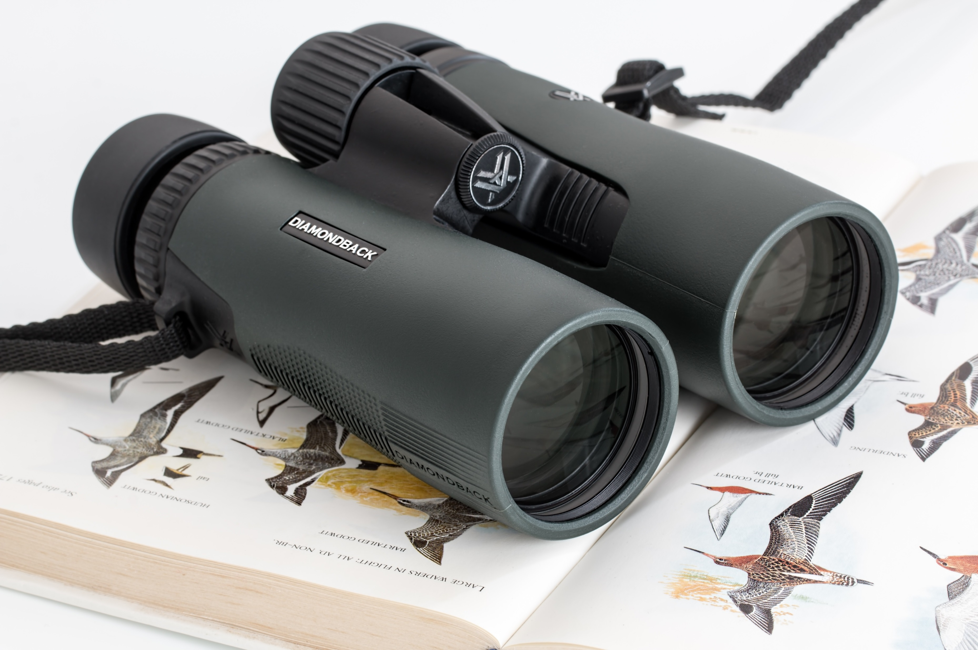
Investigate…
…the bird population at Fulwell Junior School.

Slide 11
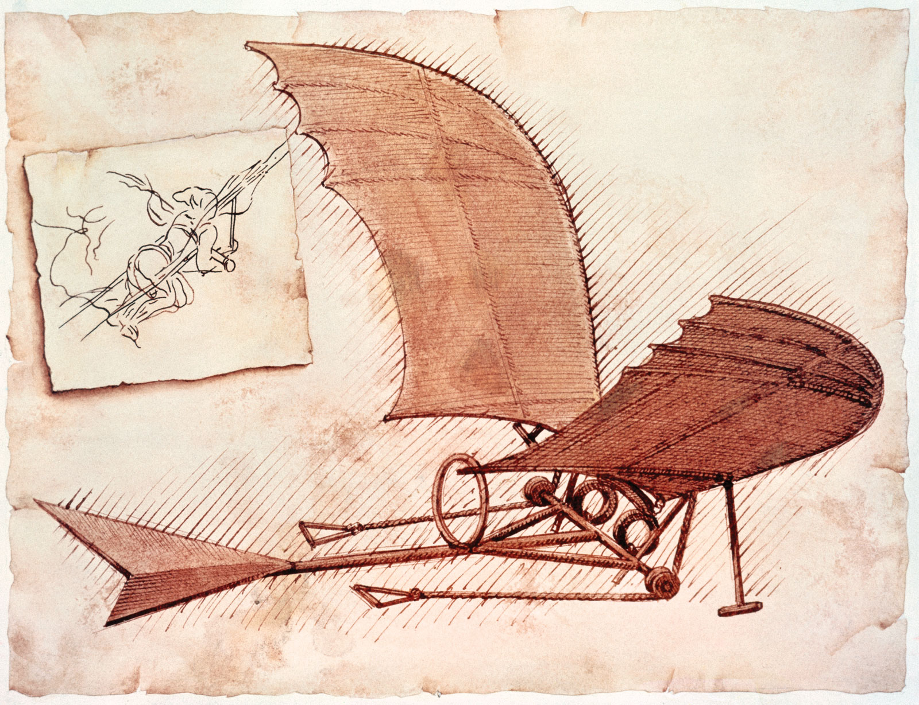
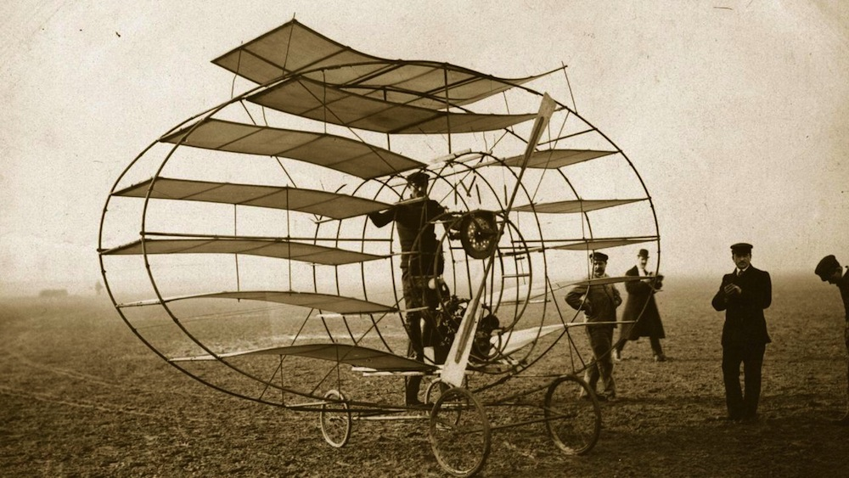
Apply…
…using everything we’ve learnt from our observations and investigations to create our own flying ‘machine’!

