Slide 1

Year 4 Multiplication Check (MTC)
June 2025
Information for parents
N. Dryden

Slide 2
Year 4 Multiplication check
The MTC is an online, on-screen digital assessment which consists of 25 times table questions. The check is statutory for all pupils in Year 4.
The check will take place the week commencing 9th June 2025. We will complete a practice weeks prior to this.
The purpose of the check is to determine whether children can fluently recall their times tables up to 12 x 12, which is essential for future success in mathematics.
Notes:
We use the information that the check gives us to target support going forward.

Slide 3
Year 4 Multiplication Check
Before taking the actual check, children will be able to answer 3 practice questions.
They will then have 6 seconds to answer each question.
On average, the check should take no longer than 5 minutes to complete.

Slide 4
The Importance of Times Tables
Times tables are the building blocks for so many concepts within Maths. It is vital that all children know their multiplication facts up to 12 x 12 by the end of Year 4, as this will provide them with the knowledge they will need to be proficient with the curriculum in Years 5 and 6.
Notes:
The check has not changed the way we deliver the teaching of times tables or the importance we place on it – we have always deemed times table fluency to be a vital part of children’s learning.

Slide 5
Accessing the check
The check has been designed so that it is inclusive and accessible to as many children as possible, including those with special educational needs or disability (SEND) or English as an additional language (EAL).
There are several access arrangements available for the check which can be used to support pupils with specific needs. Your child’s teacher will ensure that the access arrangements are appropriate for your child before they take the check in June, and children will have the opportunity to practise the check with these arrangements in place.

Slide 6
Results
The check is automatically scored, and results will be available to schools once the assessment window closes (end of June).
You will be informed of your child’s results in the Summer term.
There is no pass mark for the check.
Notes:
However, we do aim for 25/25.

Slide 7
Supporting your child
We routinely practise our times tables every day in school, and any additional practice children can do with you at home will only help to make them feel more confident when it comes to completing the check.
Sneaking some snappy questions into your daily routine can be extremely beneficial – on your way to school, while you’re waiting for dinner or while the bath is running!
It also helps to vary the way you fire questions – do you know what 8 x 6 is? What are 3 lots of 5? What is 12 x 12? What are three fours?
The aim is for children to recall the answer instantly (rather than having to count in steps of 7, for example).
Notes:
Talk about games – dice, playing cards, hit the button.

Slide 8
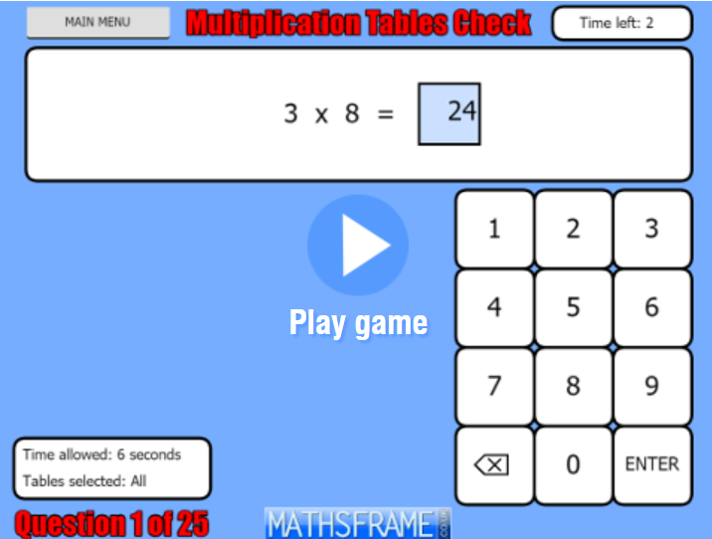
Online resources
This game has a very similar format to the MTC.
https://mathsframe.co.uk/en/resources/resource/477/Multiplication-Tables-Check

Slide 9

Online resources
We use Times Tables Rockstars as part of our weekly homework, and so children are used to practising their times tables using this. Please encourage children to play as often as possible.
Small 5-minute daily sessions will help children to learn times tables more than one hour long session a week.
The soundcheck on TTRS is very similar to the multiplication check. It mirrors the way the MTC is ran, and we use this a lot in school already. It also allows children to see which questions they got correct/incorrect, which guides them towards which times tables they need to work on.

Slide 10
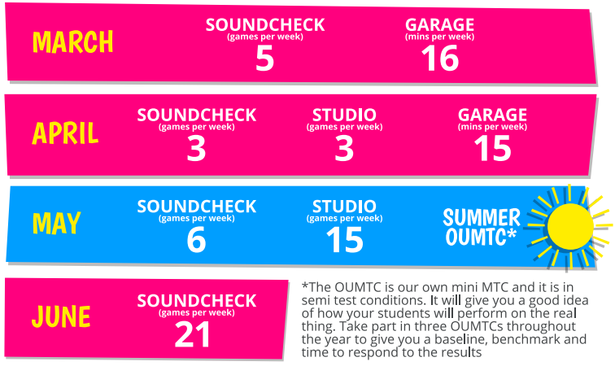
Recommended schedule
The Times Table Rockstars algorithm determines which questions need to be practised.
Children answer as many questions as they can, as quickly as they can, to achieve a “Rock Status”.

Slide 11
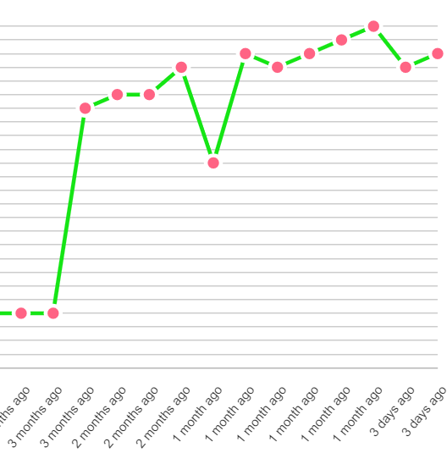
Online resources
This graph demonstrates the impact regular play on Times Tables Rockstars has on times table fluency.

Slide 12
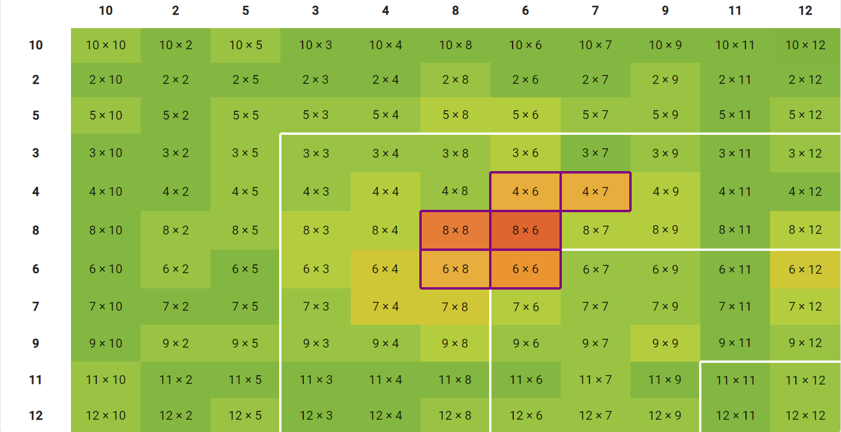
Online resources
Times Tables Rockstars also provides a “heatmap” for each child, so that they can see what their strongest and weakest times table facts are.

Slide 13
Thank you so much for your time and support.
Does anyone have any questions?

