Slide 1
https://www.youtube.com/watch?v=BxGpi0racMc

Slide 2
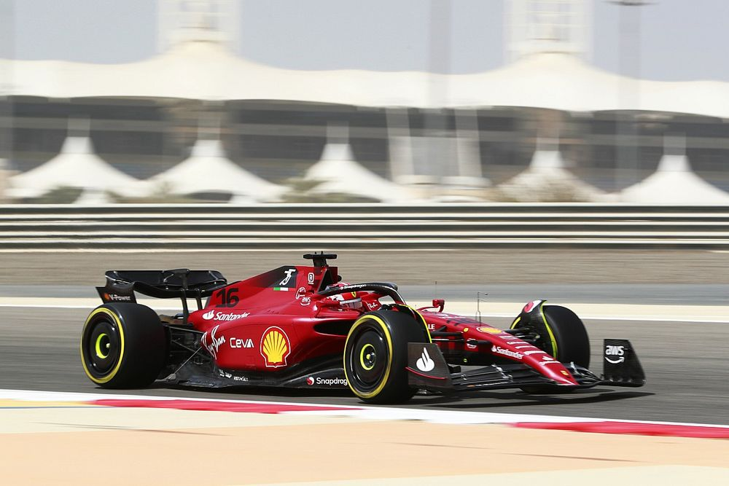
Notes:
Discuss who has seen F1 before? Would F1 be classed as an individual or team sport? What roles are involved in F1?

Slide 3
Fulwell Formula II
This is your chance to put your mind to the track...

Slide 4
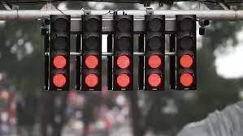
READY…
Notes:
After Easter we have the opportunity to participate in Greenpower….

Slide 5
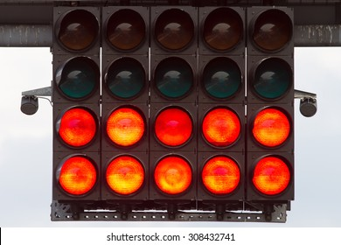
STEADY…
Notes:
Greenpower is a STEM challenge that gives us the opportunity for a team of young engineers to build, design and race an electric car.

Slide 6
GO!!!
Notes:
We are looking for a team of aspiring engineers for our very own Fulwell Formula team. This is FIRST time this opportunity has arisen at FJS.

Slide 7
https://www.youtube.com/user/OfficialGreenpower

Slide 8
How to apply:
Round 1:
Application - Why do you want to be a part of our team? Deadline: Thursday, 20th April 9am
Round 2:
You will be asked to take part in a discussion with Mrs Haswell and Miss Watson.
Round 3:
You will take part in a practical task showing your ability to work as a team.

Slide 9
The final team will be selected and announced by Monday 24th April

Slide 10
We will then take part in a regional event at Gateshead Stadium on 28th June.

