Slide 1
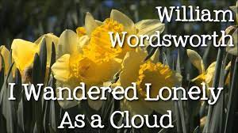
Fulwell Junior School
Enrichment Friday-Poetry
26th March 2021- Week 11

Slide 2
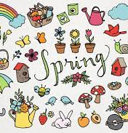
Linking our learning…
This week as part of our Whole School ‘What is Pink?’ Enrichment Week we have been investigating styles of poetry including Haiku linked to Cherry Blossom and Japan.
Your challenge this afternoon is to plan and write your own Springtime poem.
Use the images and ideas on
the next few slides as your
inspiration.

Slide 3
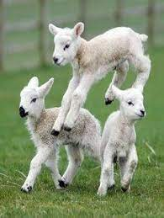
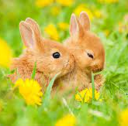
New life…

Slide 4
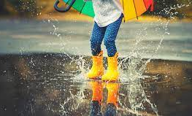
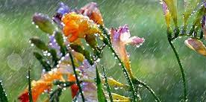

Slide 5
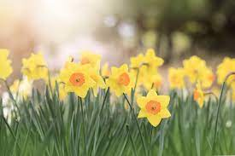
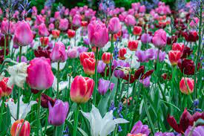
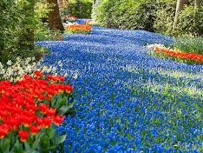
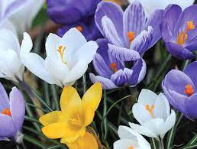

Slide 6
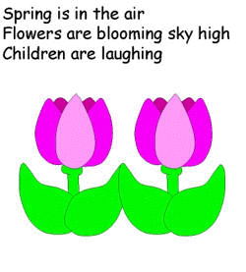
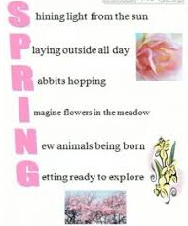
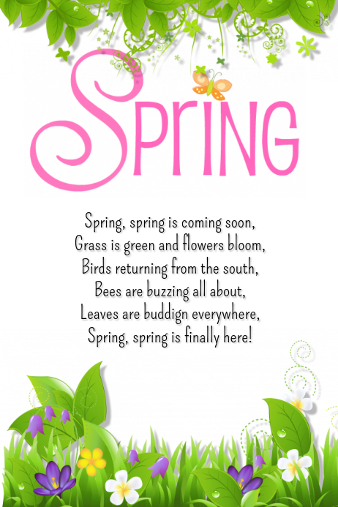
Your Poem can be…
Descriptive free verse
Rhyming
Acrostic
Haiku
Remember you can decorate this.

Slide 7
We would love to see your final poem. If you'd like to share please email Mrs. Hill or Mrs. Humphries. fulwell.junior@schools.sunderland.gov.uk Have a great Easter Break…see you on the 12th April!

