Slide 1
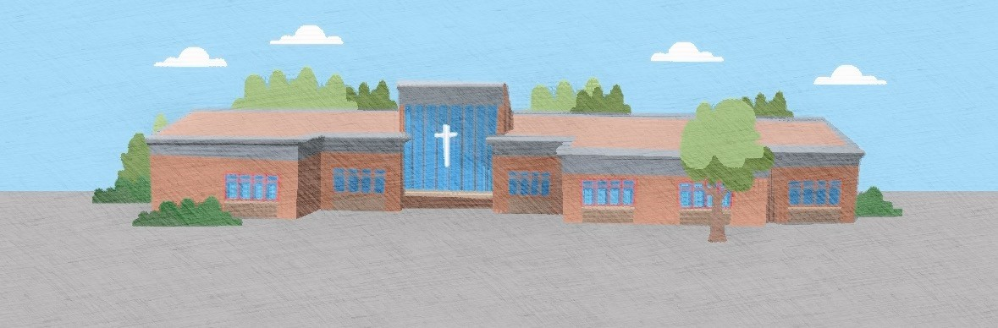
Welcome to Year 6
Mr. Marr, Mrs Cogley, Mrs. Petryk & Mr Earley

Slide 2
Daily Routines
Our school day begins at 8:45.
We finish school at 3:30.
Our morning break is at 10:45 for 15 minutes.
Our lunch is from 12:30 – 1:15.

Slide 3
Curriculum
In Year 6 we cover all the subjects in the national curriculum at different times of the year.
Our English text for the first half term is:
The Wonderful Wizard of Oz - L. Frank Baum (Copies for children in school)
Later in the year we will study and read.
Where the River Takes Us – Lesley Parr -
If you wish to purchase one of these books online that is fine. Please don’t feel obliged but if your child has their own, they can use this in class during English lessons on the text.
Each term you will be sent a curriculum news with details of knowledge to be taught for each subject.

Slide 4
Assessments & SATS
Each half term we will have an assessment to analyse pupil attainment.
We will let the children know their results in school.
These results will be reported to you in our school reports and after each assessment week we carry out.
At the beginning of teaching a new maths unit pupils will encounter a pre-assessment to see what knowledge the children have and which areas may need extra support.

Slide 5
Homework Expectations
Each Monday the children will receive their weekly homework.
This will include one maths task, one English task and spelling.
We will also send home weekly spellings on Monday and test them the following week.

Slide 6
PE days and physical activities
P.E days are Monday and Tuesday.
Every day the children will have 15 minutes of additional physical movement to refresh concentration and provide a brain break from learning. This may happen in one 15 minute block or some days broken down into smaller sessions perhaps three 5 minute blocks over the day.
No earrings to be worn. If pupils are able to take them out independently then they can participate in the lesson.

Slide 7
Learning in Nature & Forest School
In addition to school uniform the children may wish to bring an extra coat in especially in the winter months when it is more wet and colder. If the children are wearing shorts they may wish to have a pair of trousers to slip over the top to protect their legs from branches and nettles.

Slide 8
Stationary
In Year 6 there is stationary provided for the children.
On occasion the children like to have their own stationary from home. In this instance please may we request that it is named.
If the children bring in their own pencil case, we kindly ask that this is taken home at 3:30 and brought in the following day.

Slide 9
Playtime snacks
The children are welcome to bring in a healthy snack from home.
Please can you ensure that this does not contain nuts.

Slide 10
Residential
Borwick Hall
Payment plans will be available and posted onto Dojo. We usually take a deposit for the trip as a sign of commitment.

Slide 11
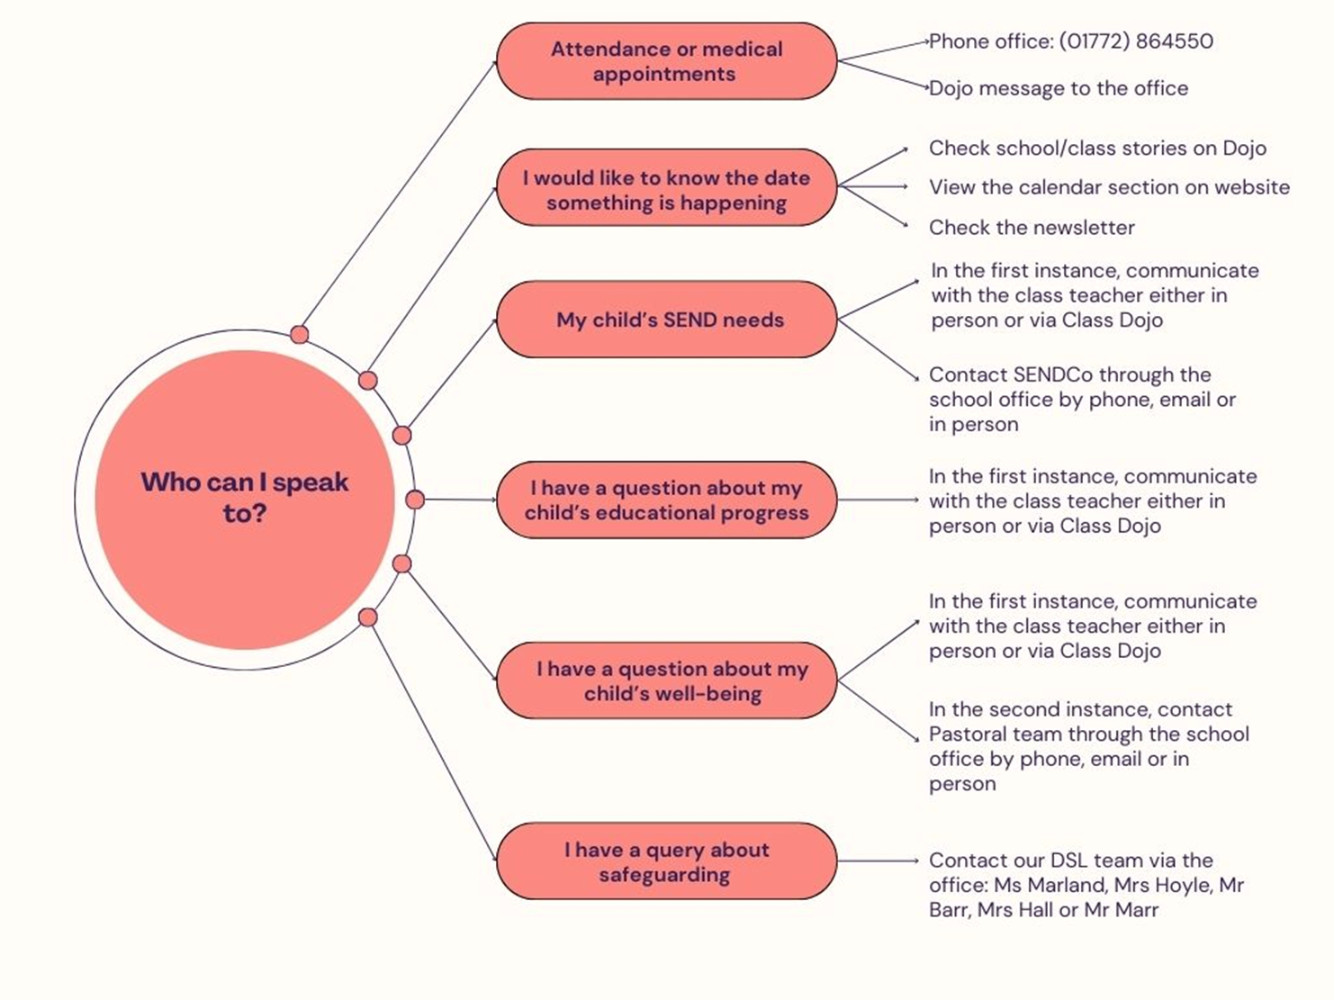
Communication
To contact your child’s teacher you may use Dojo. These messages may not be responded to immediately as they may be in lesson time.
Dojos are monitored and responded to in school hours between 8:30 and 4pm. If your query is of a more pressing nature please email or call the office to leave a message for your child’s teacher.
Absences and illnesses can be emailed to Mrs Peacock or Mrs Pantlin to the email:- bursar@st-peterscofe.lancs.sch.uk or phoned through the school office 01772 864550. Mrs Peacock and Mrs Pantlin are also available on Dojo.

