Slide 1

Archbishop of York
Youth Trust Challenge

Slide 2
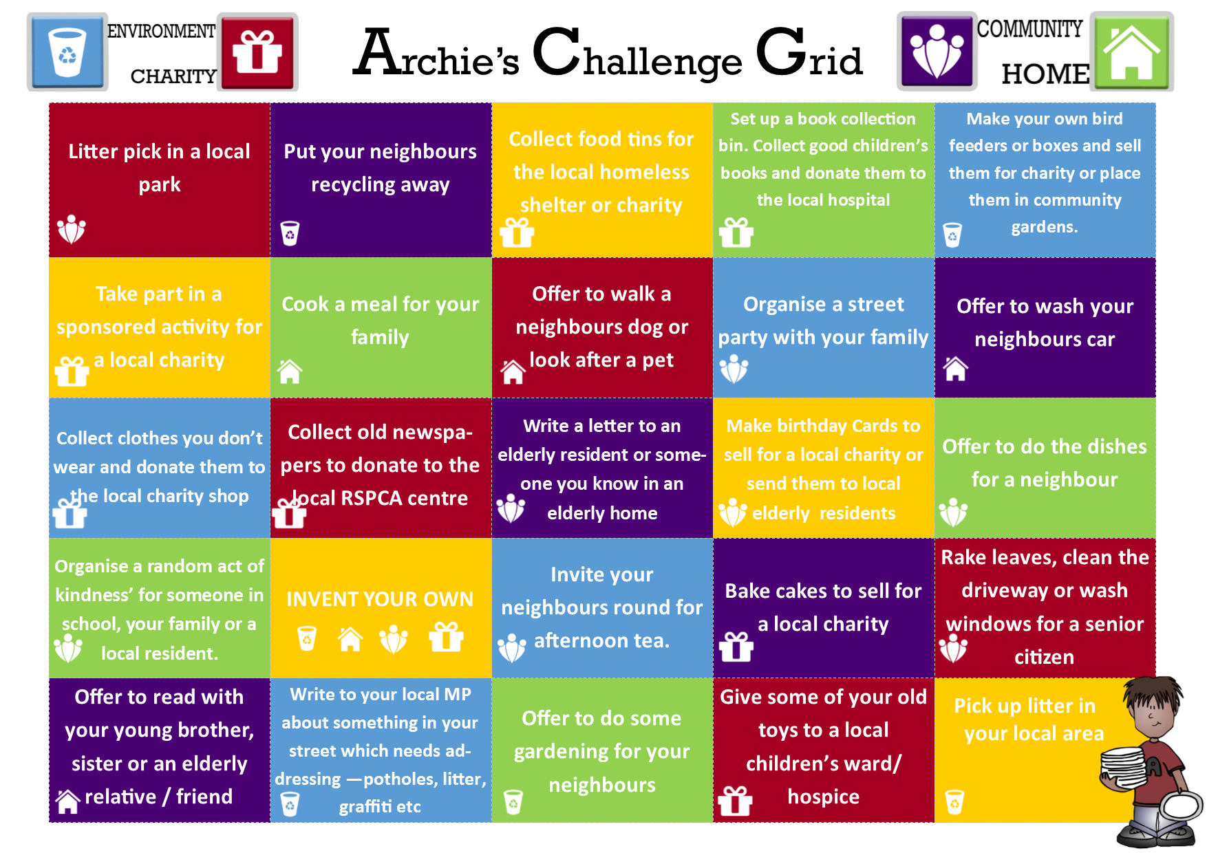
Archie’s Home Challenge Grid

Slide 3
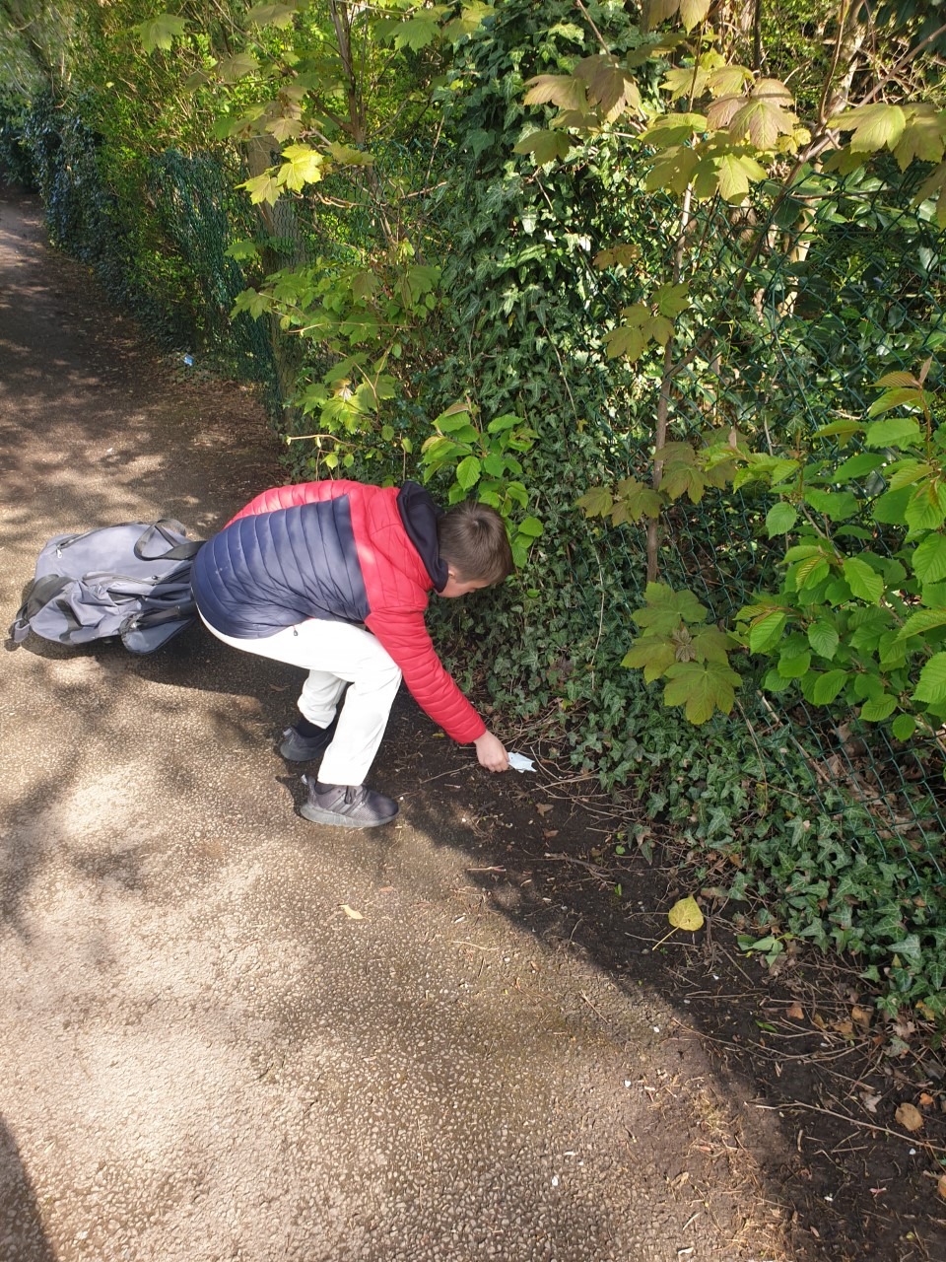
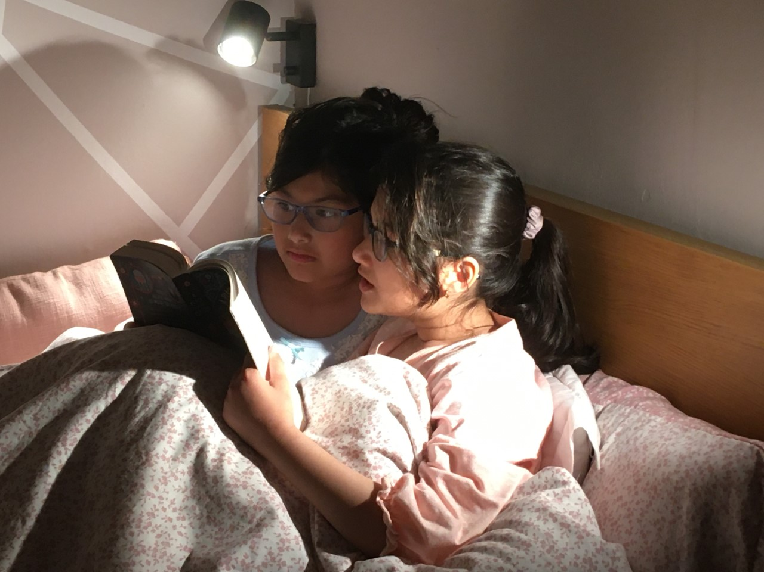
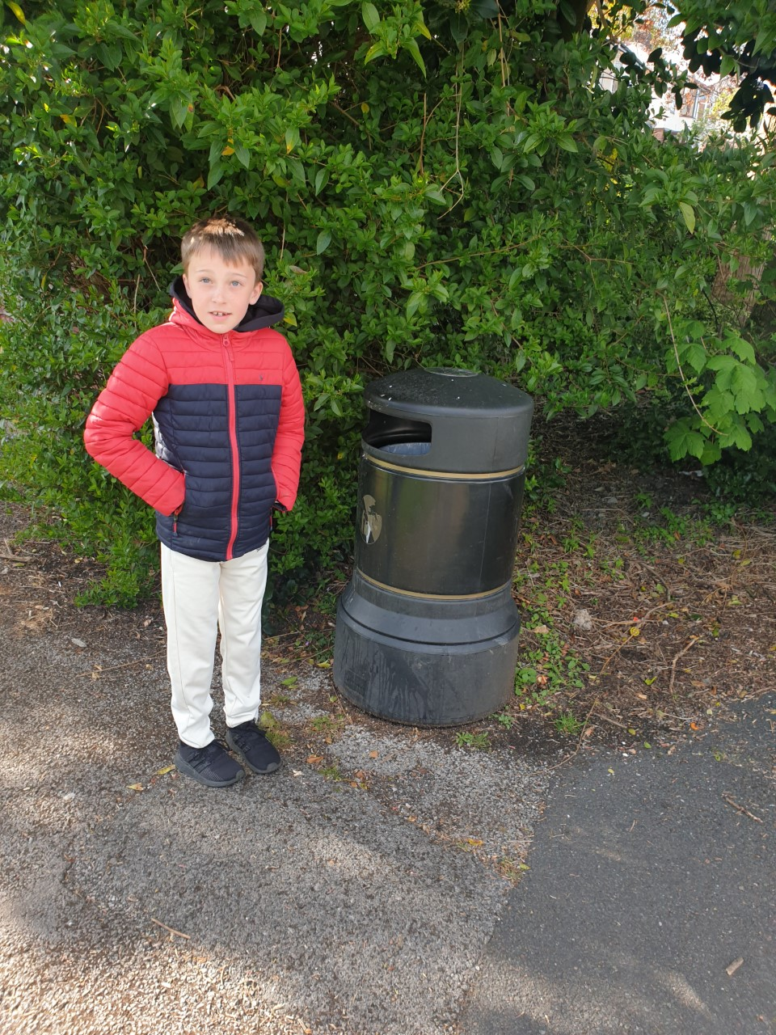
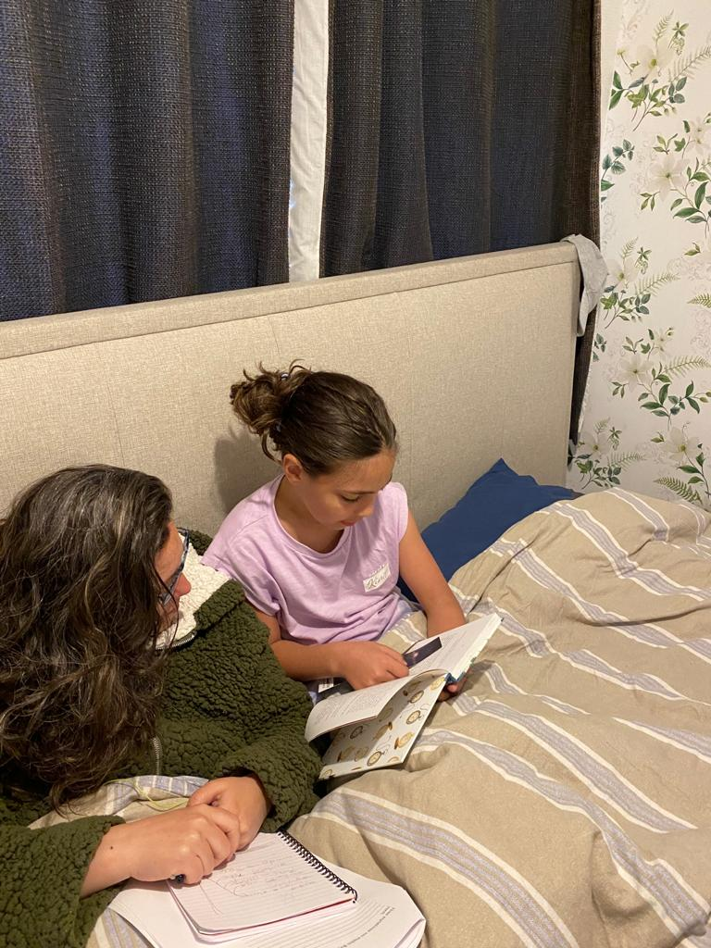
Archie’s Home Challenge Grid
I read to my little sister.
I chose to read to my elderly auntie.
I decided to collect litter in the local park.

Slide 4
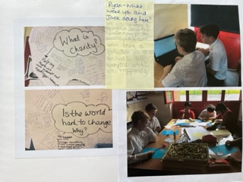
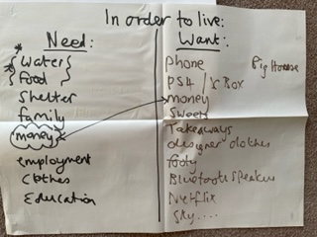
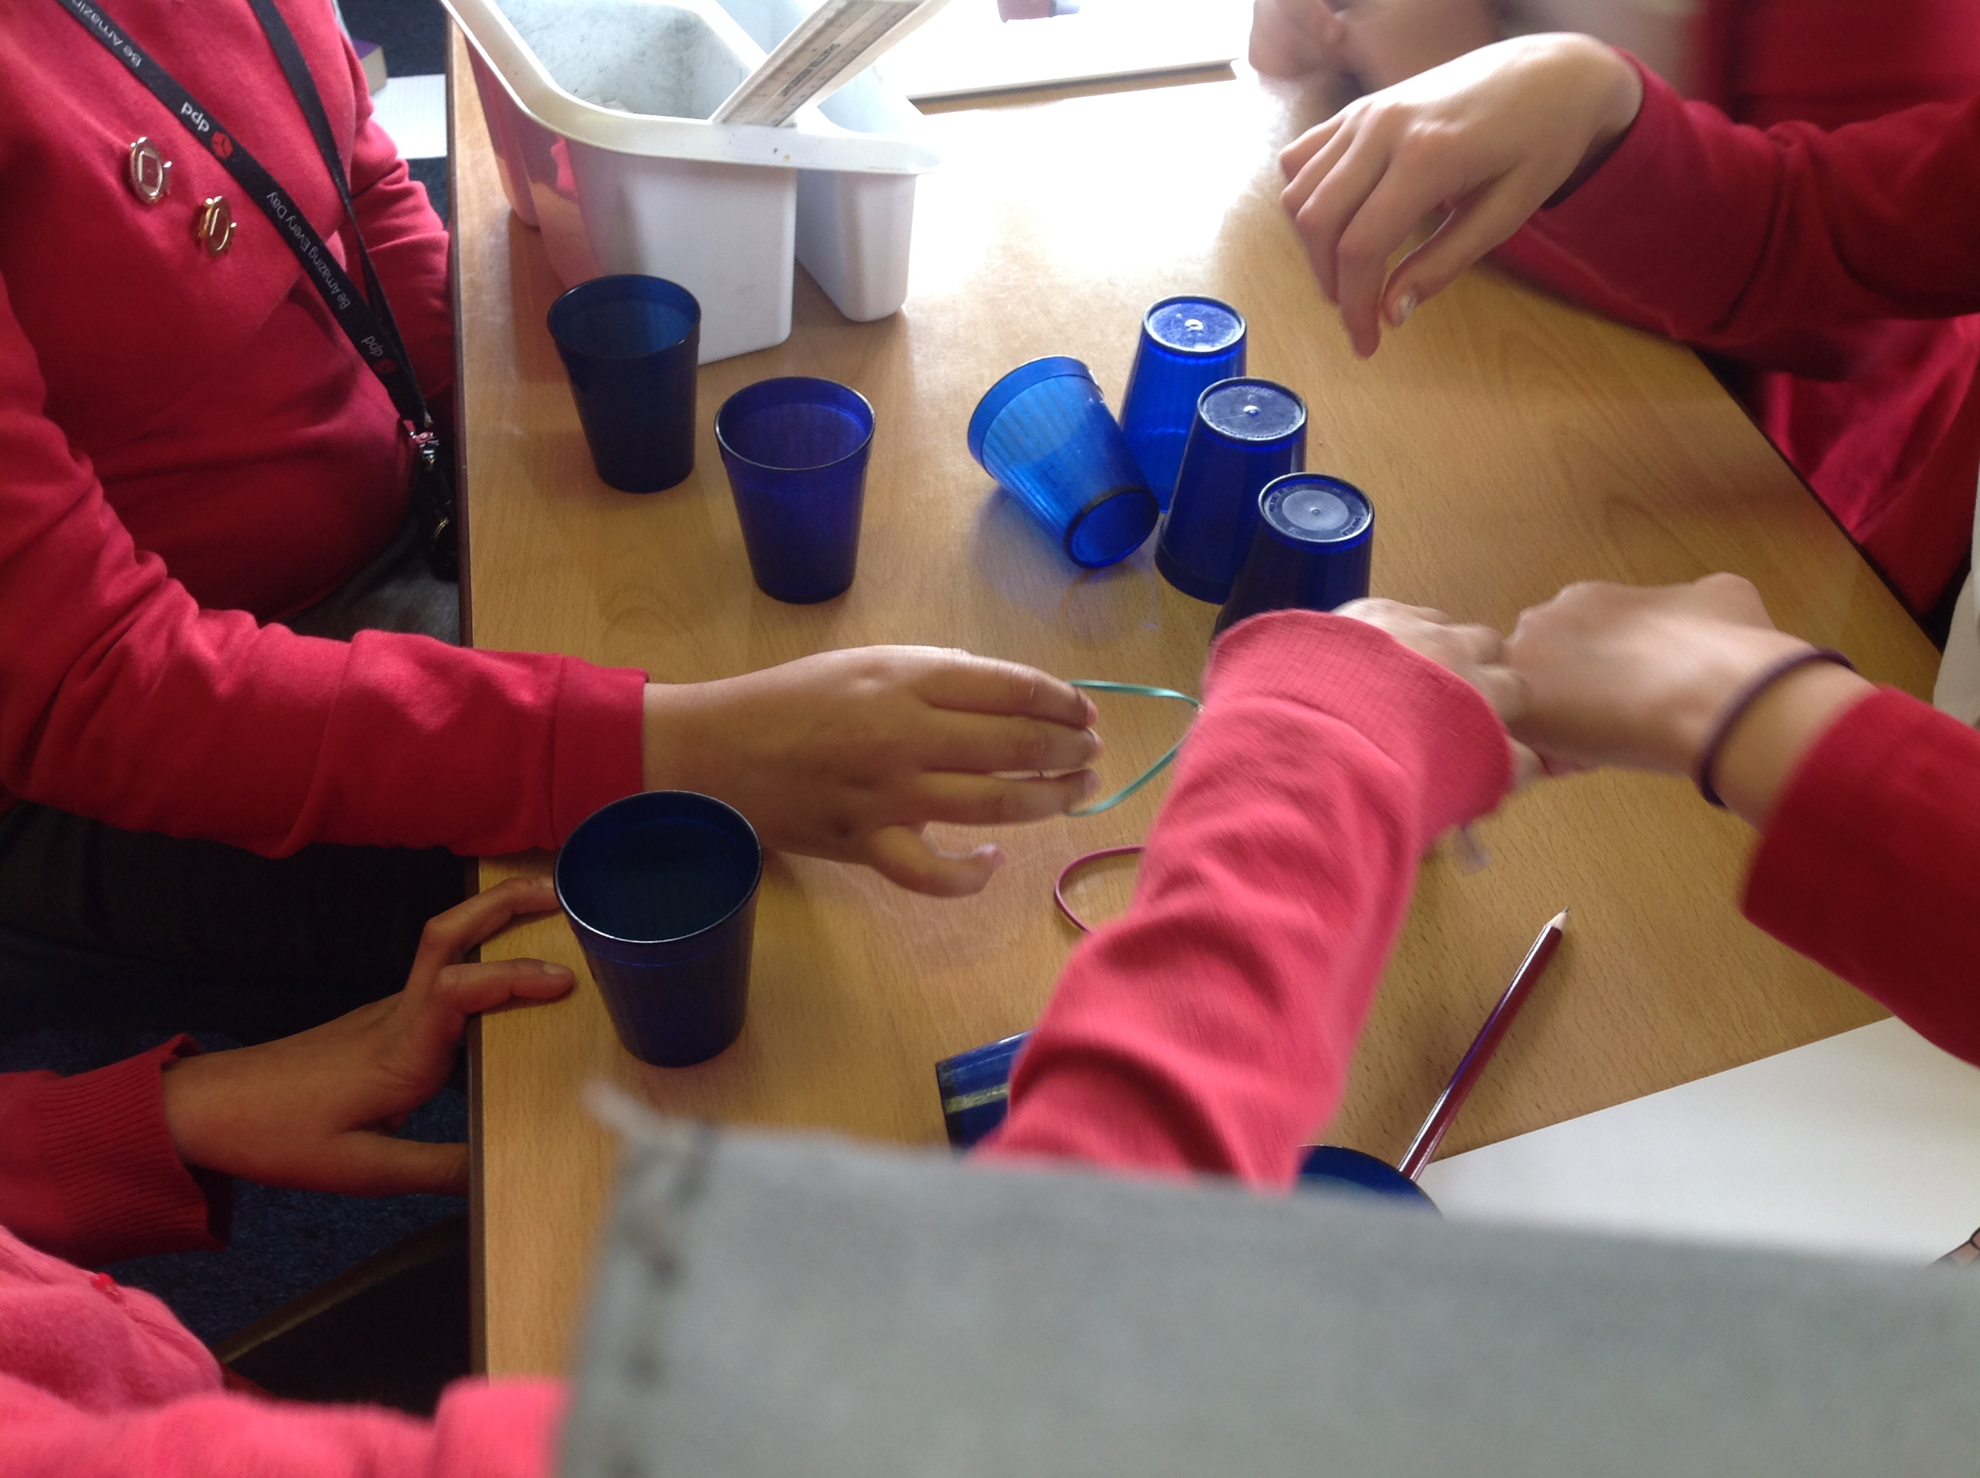
What is it to be charitable?
We discussed the difference between Needs and Wants. We held discussions to understand what is meant by charitable. We considered how we can make a difference in the world.
Finally we began to develop our leadership skills by working together to complete the cup challenge.

Slide 5
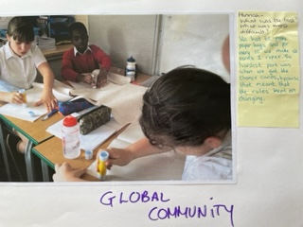
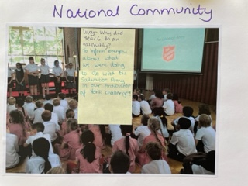
We learned about global and national communities.

Slide 6
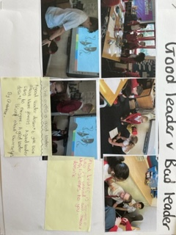
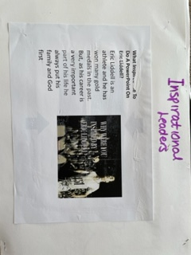
What it is to be a leader?
We learned about what it is to be a good or bad leader.
We learned about inspirational leaders, Eric Liddell, Rosa Parks, Desmund Tutu and may others.

Slide 7
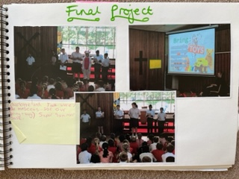
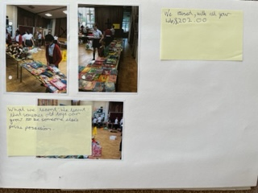
We raised money for the Salvation Army,
We organised a bring and buy toy sale and cake sale. We recycled old toys and books.
We showed are leadership and organisational skills
We led an assembly to involve all children. We sent letters to parents, organised a rota for the classes to come to the sale.
We raised £220.25 – for the Salvation Army food bank.

Slide 8
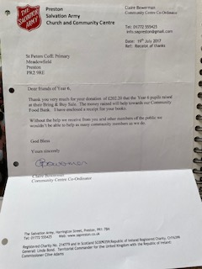

We received a letter from the Salvation Army to say thank you for our donation.
We have continued this and over the years we have supported the Rosemere Cancer Centre, by raising money for the café area, to brighten it for patients.

