Slide 1
All About Health !
(MW, ZA,BA)
Notes:
All aBout Health by Miles raeef And zack Raeef

Slide 2
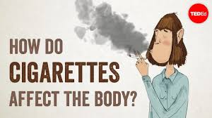
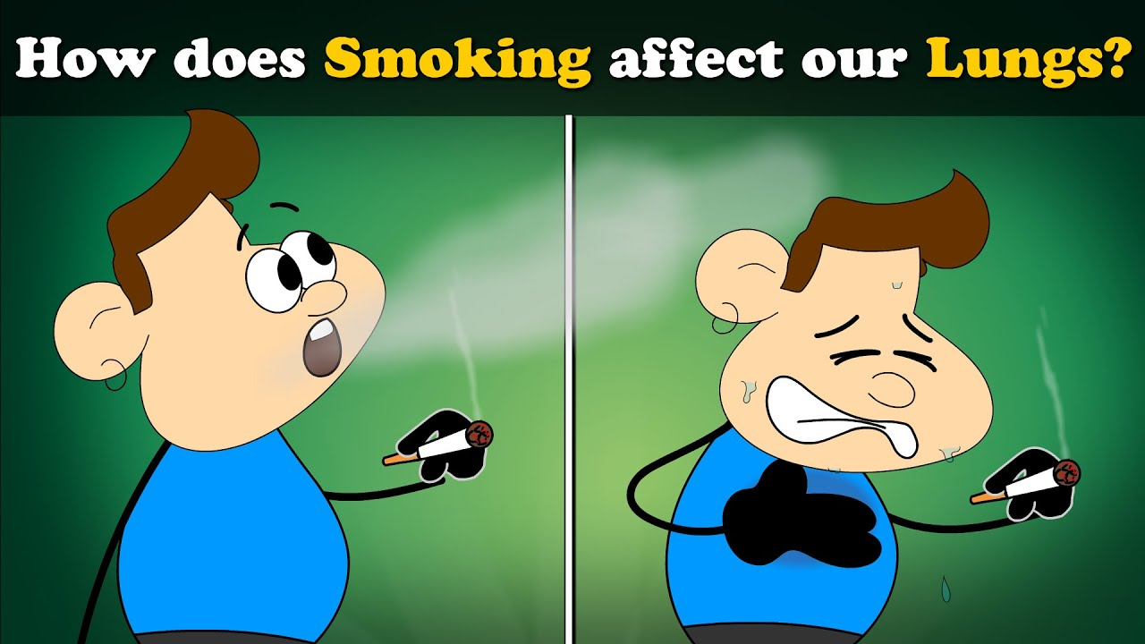
How smoking can affect you?
Notes:
Your Lungs and Breathing Smoking causes serious damage to your lungs which affects your breathing and how active you can be. Smoking makes dealing with everything from coughs and colds and COVID and pneumonia and lung cancer harder. RW

Slide 3

Smoking
Smoking causes serious damage to your lungs which affects your breathing and how active you can be. Smoking makes dealing with everything from coughs and colds to pneumonia, COVID 19 and lung cancer harder to deal with. Smoking can cause lots of tar because it can stick to you lungs and this will mean your lungs and heart have to work harder to breath. This is not good especially if you get any other illness.
Notes:
Smoking can causes lots of tar because it can stick to your lungs

Slide 4
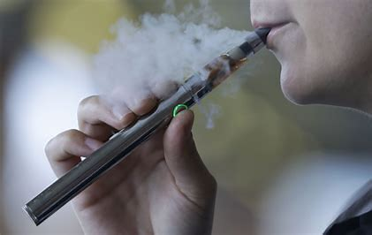
E-cigarettes
People thing these are safe, but this can still make you poorly and they can make you breath smell and your teeth sometimes change colour. This is not good for our oral hygiene.

Slide 5
What did we learn?
Smoking is an addiction like eating too much chocolate.
Smoking can seriously damage your lungs, heart and your teeth.
People think E-cigarettes are healthy because they have different fruit flavours – this is not true, because they still have nicotine in them.
Our advice to you is
DO NOT SMOKE – STAY SAFE BY KEEPING YOUR HEART AND LUNGS HEALTHY.

