Slide 1
Slide 1
A Review of
Behaviour
How things changed
By School Council
Notes:
These can be changed to reflect your school’s specific rules.

Slide 2
BE SAFE
Be ready
Being safe in my class was not to forget to wash you hand for 2mins because of COVID. We also said no rocking on chairs, because we didn’t want any accidents. (Y2)
Giving everyone a turn and speaking when others are speaking. (Y4)
These are the 3 titles of our behaviour in school. We all decide in our classes how to do this. In my class we said that being ready, was about being ready to learn, with our eyes at the front and ears ready to listen. (Y3)
BE RESPECTFUL

Slide 3
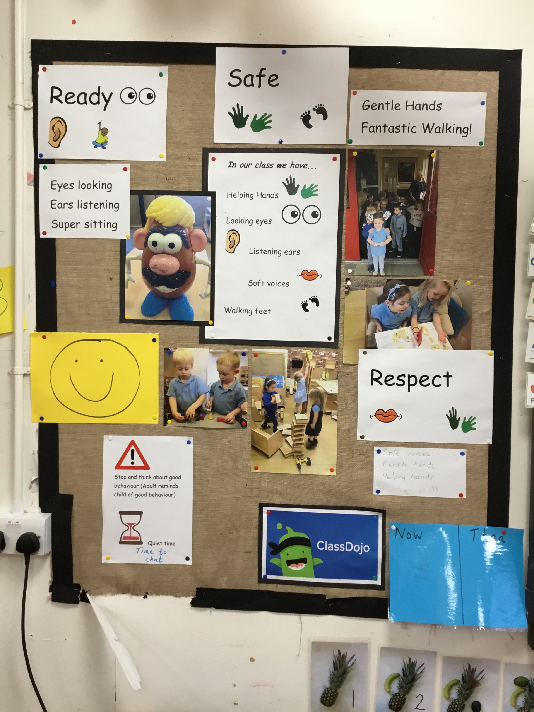
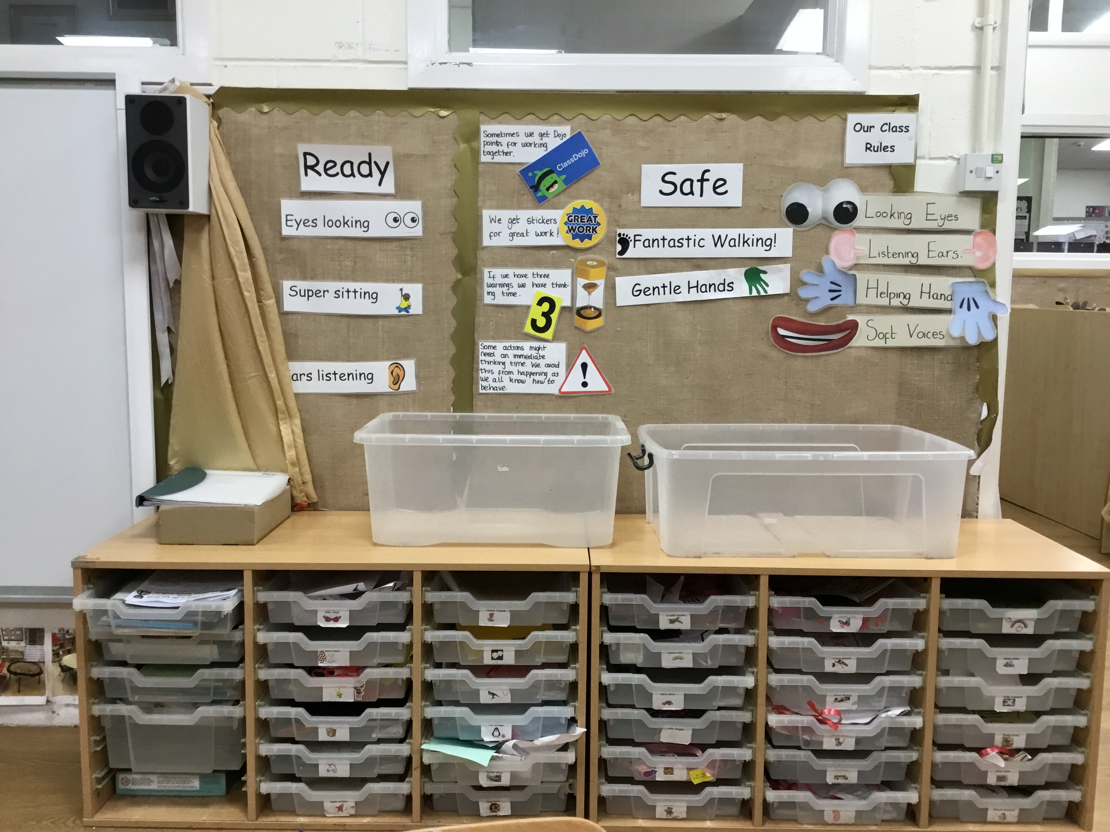
Slide 3
This is what we do in nursery and our teachers help us.
We use pictures to help Mr Potato head learn how to be good in school.
We have to share and be kind to have friends. (ET)
We have kind hands to keep safe.
We have listening ears to be ready.
We take turns and share to show respect.
(Voices from Reception)

Slide 4

Slide 4
BE SAFE
When we move into a new class after the summer holidays, we get to think about our new class rules. We talk about the rules we had in our last class and what we want under the headings in this class. We then vote for which is the best we think.
Our rule for being safe is not to run in the classroom, then we don’t hurt anyone. (Y3)
Our rule for being safe is not to rock on your chair, then you don’t fall off and hurt your head. This happened to one of the teachers children and they were scared. (HP)
Year one rule for safe.

Slide 5
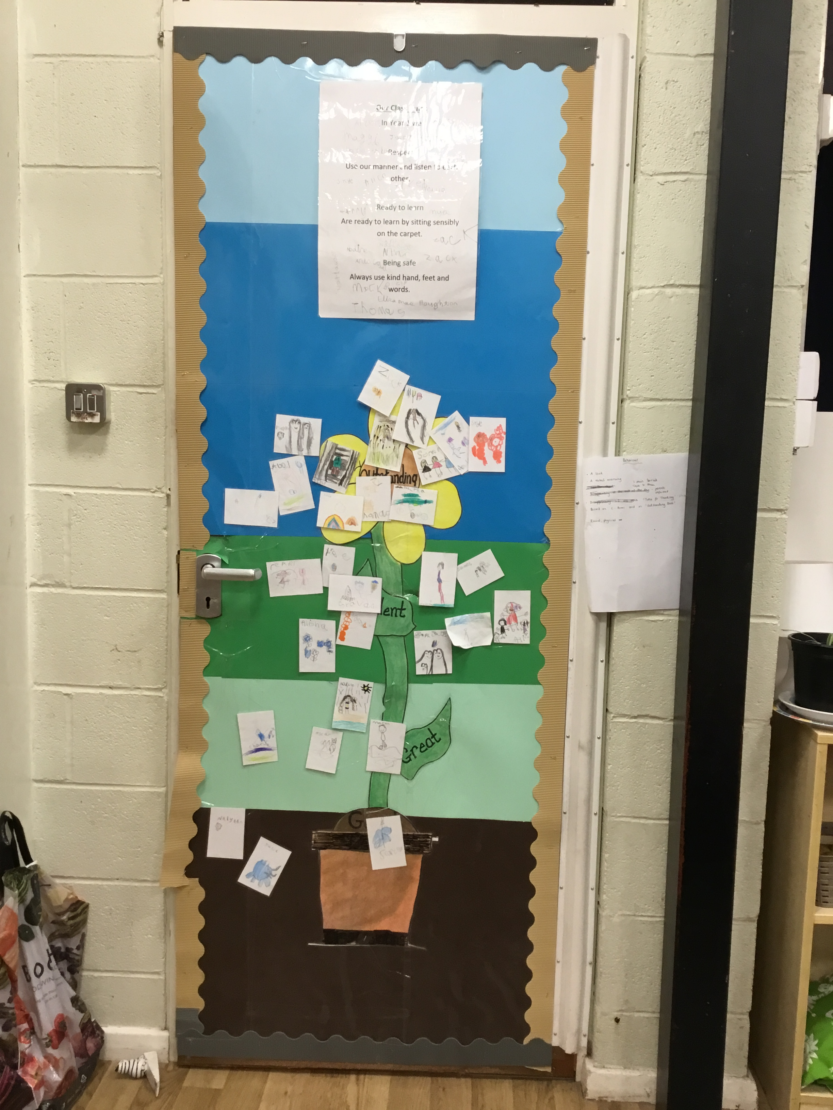
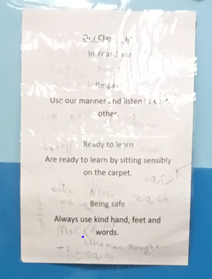
Slide 5
BE RESPECTFUL
In our class we all sign our rules as well and they are on our wall. We made our faces to move up our board to get the outstanding card. I like this and I like helping my friends to get to the top as well. (PT)
It is important to have rules to stay safe and care for everyone. I know that even grown ups have rules to follow. (JK)
Notes:
*Change this verbiage to the language your school uses.

Slide 6
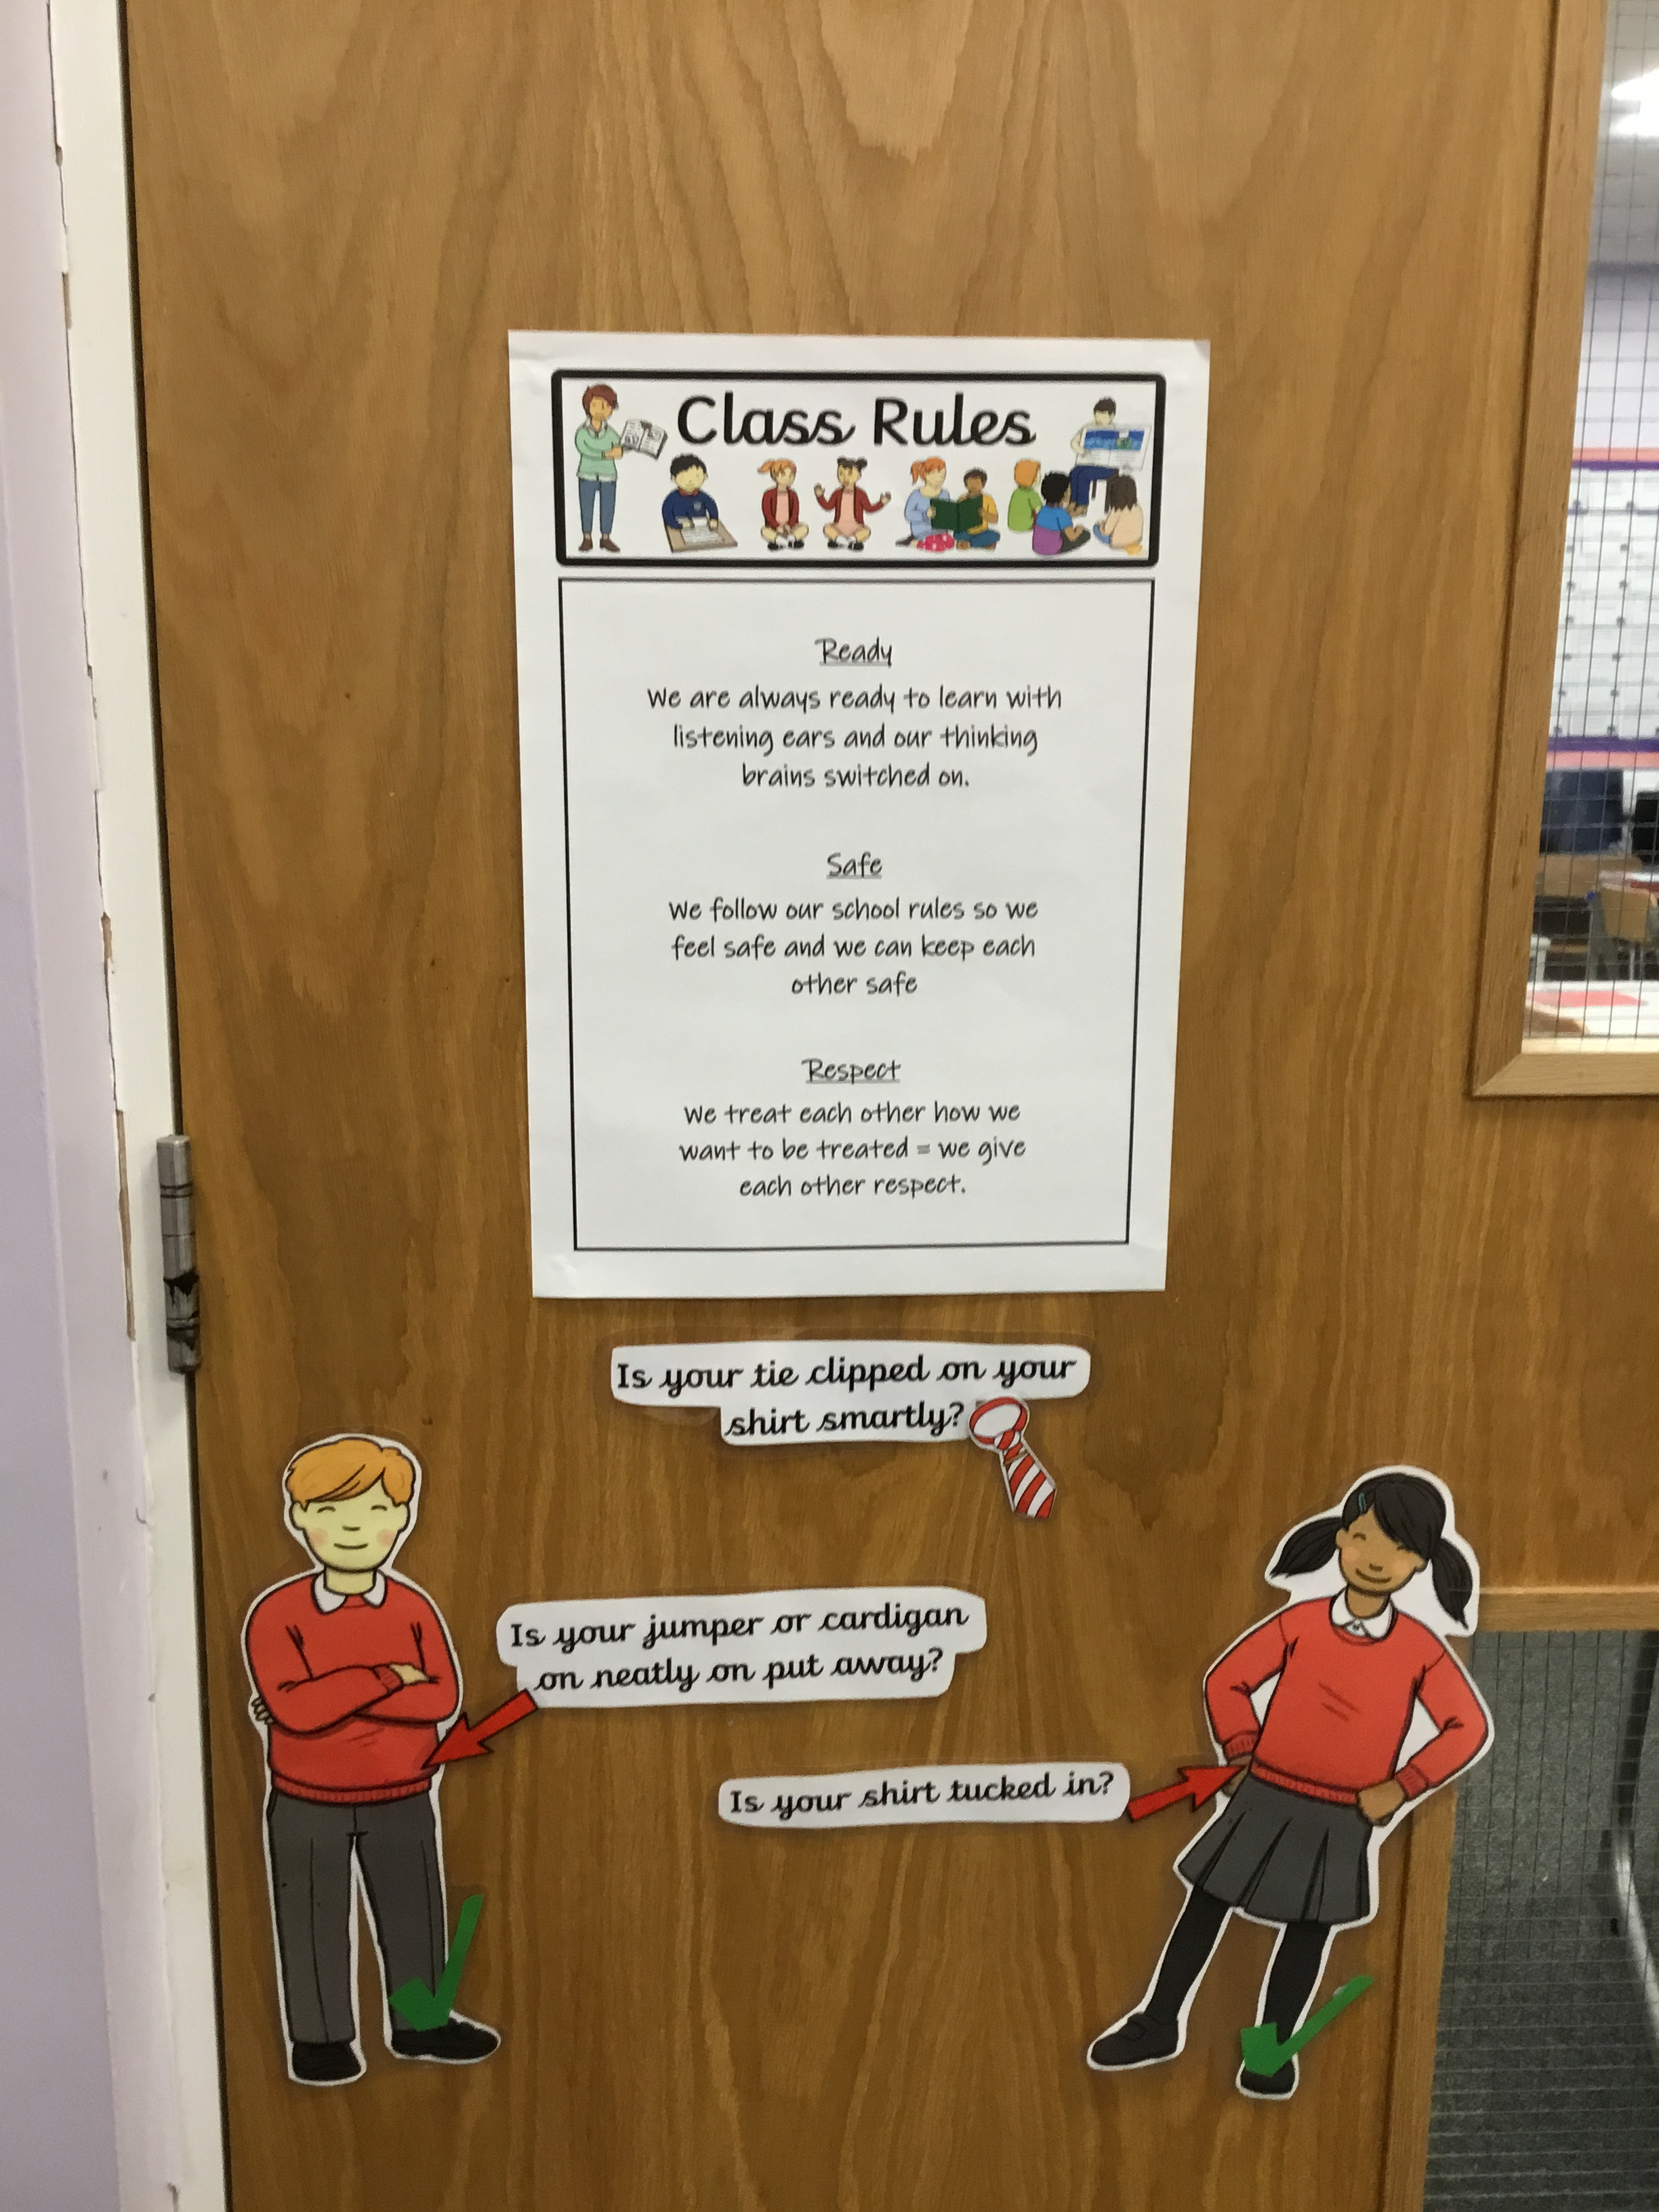
Slide 6
BE ready
In year 5, we have made a class rules charter. We know it is important to be ready, then we will learn more and be able to do more as we get older. (VP)
Now everyone is following the rules I get to concentrate and finish my work, because know one messing around, or shouting out. (CL)

Slide 7
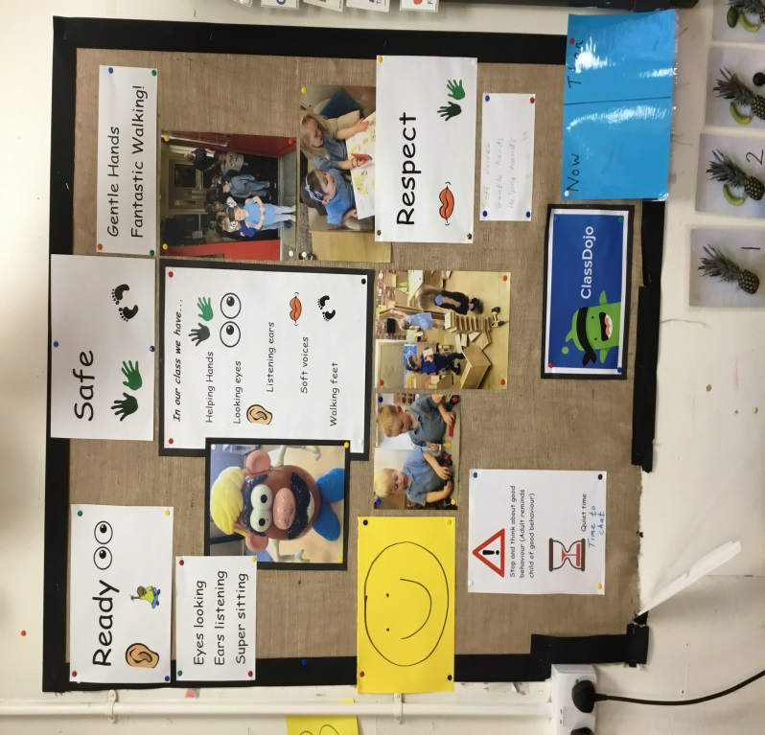
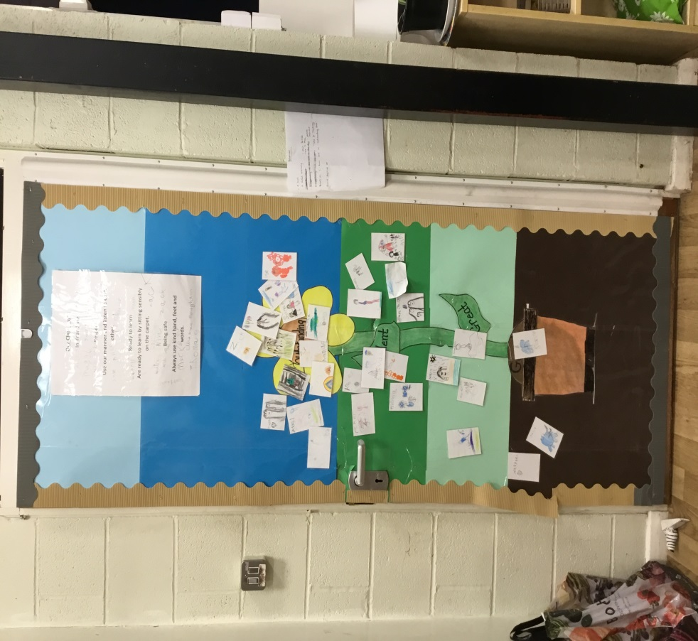
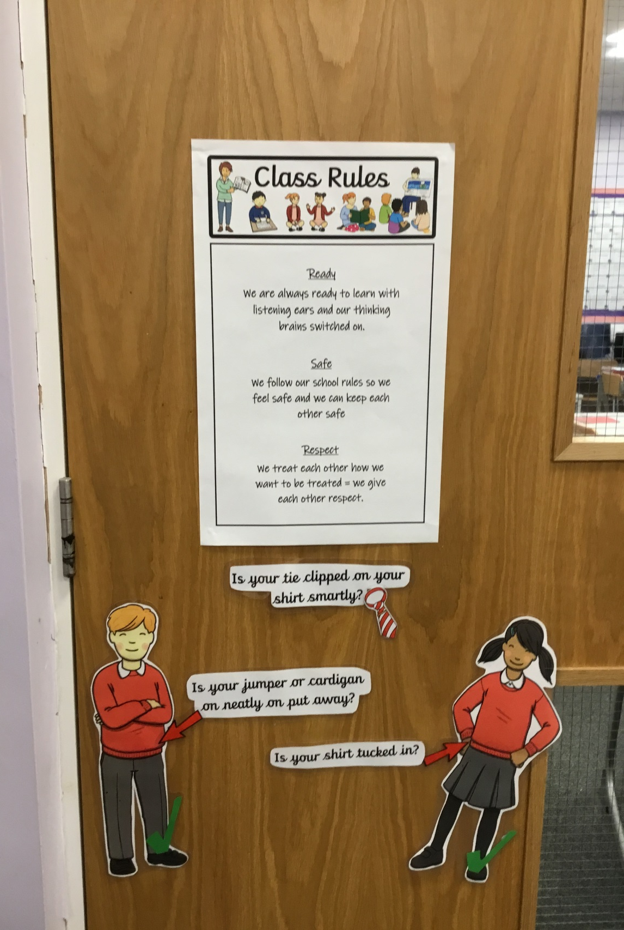
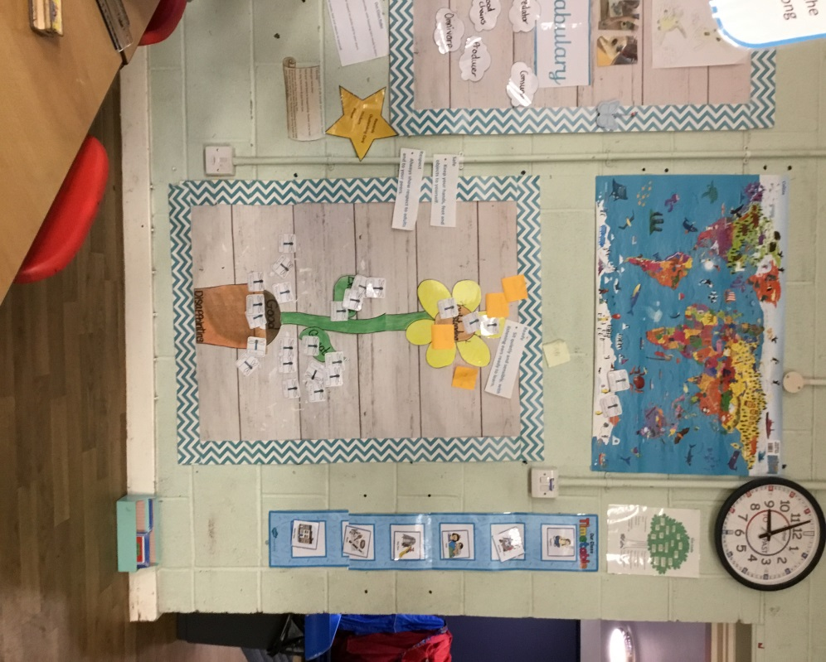
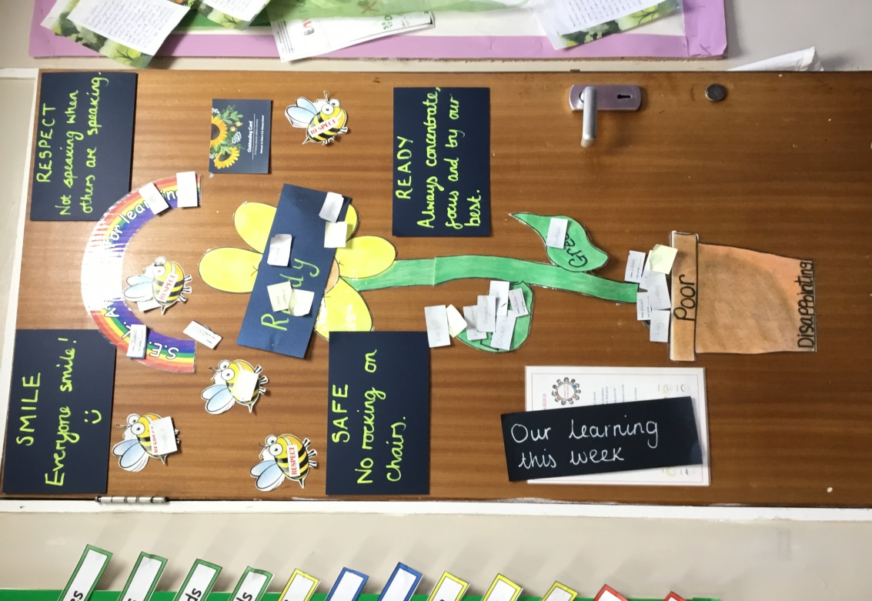
Some of our behaviour charts in school.

Slide 8
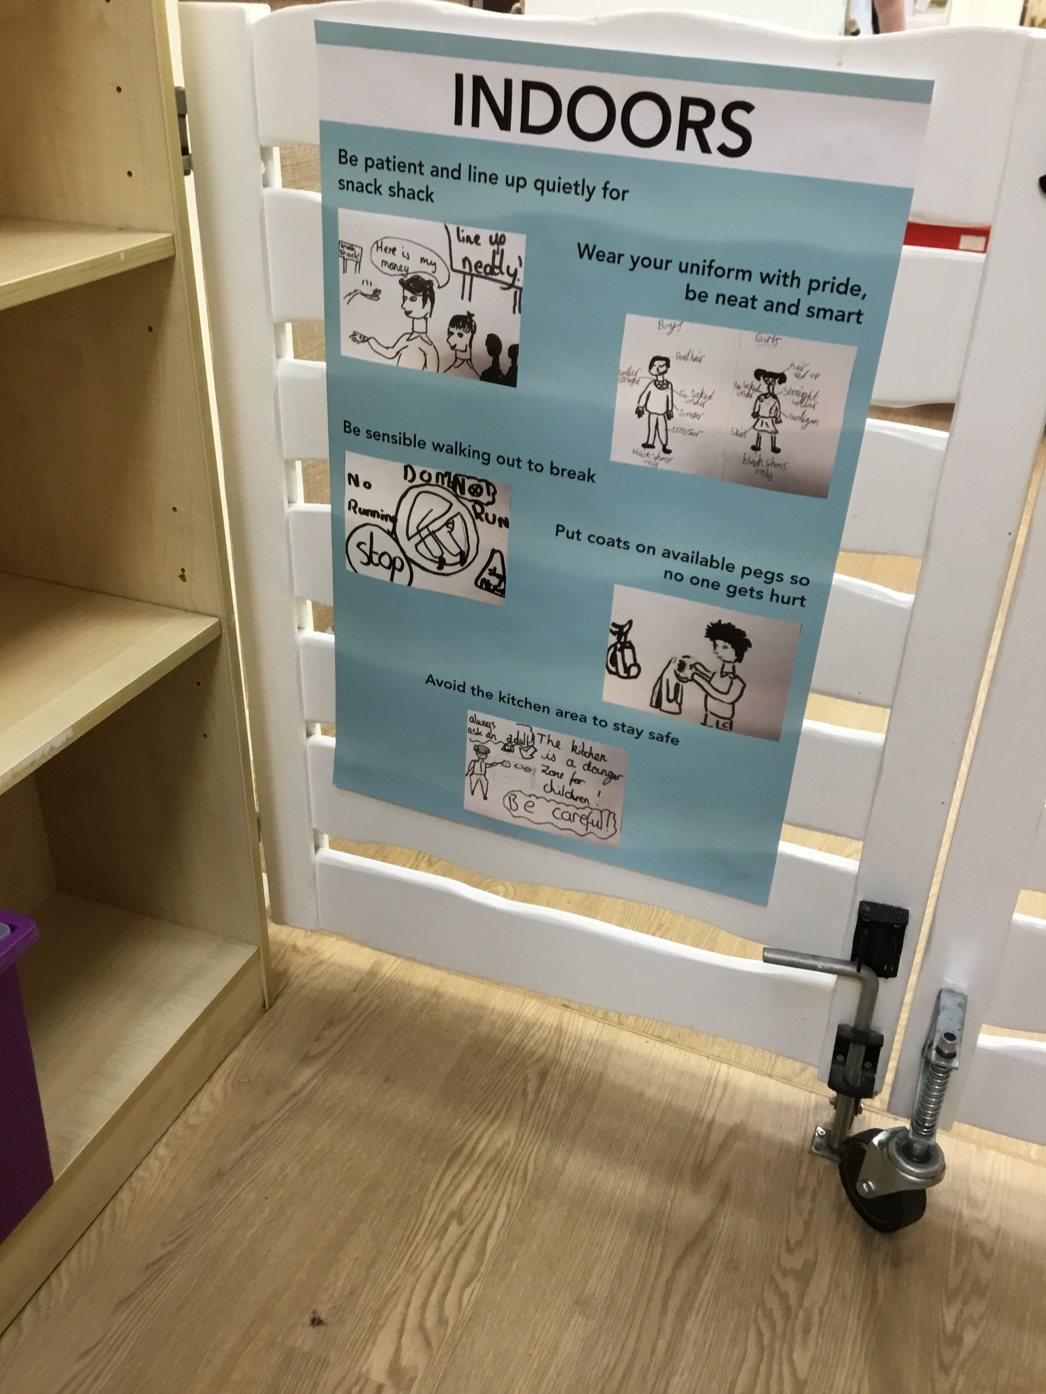
Slide 7
We met as a school council and we wrote some rules for when were not in the classroom and we shared them with everyone in an assembly. I was a bit nervous in the assembly, but our teachers helped. (LN)
We thought some uniforms looked messy, so we made a rule about being proud and looking smart. My friend did the drawings for the posters. (MM)
We help each other more, if we see a coat on the floor, we pick it up and put it on a peg. Before not many people did this.
Our teachers sit and chat to us more and there are teachers saying good morning on the yard, that makes me happy.
(LV)

Slide 9
Good Samaritan award.
We have an assembly evert Friday and we have a special award called the ‘Good Samaritan Award’. You get to sit at the front on big chairs and teachers or children say something nice that you have done.
You then get a big certificate to take home. (BD)
I can give an award to somebody if I want, it can be a friend or a teacher. (LH)
I got an award, when my friend fell and hurt his knees. I stayed with him in first aid and then sat on the bench outside instead of playing football. My teachers said that showed kindness, I felt proud.(NP)
I gave on to a teacher, because they had been very kind when I wasn’t happy with everything at home. They made me smile (VP)

Slide 10
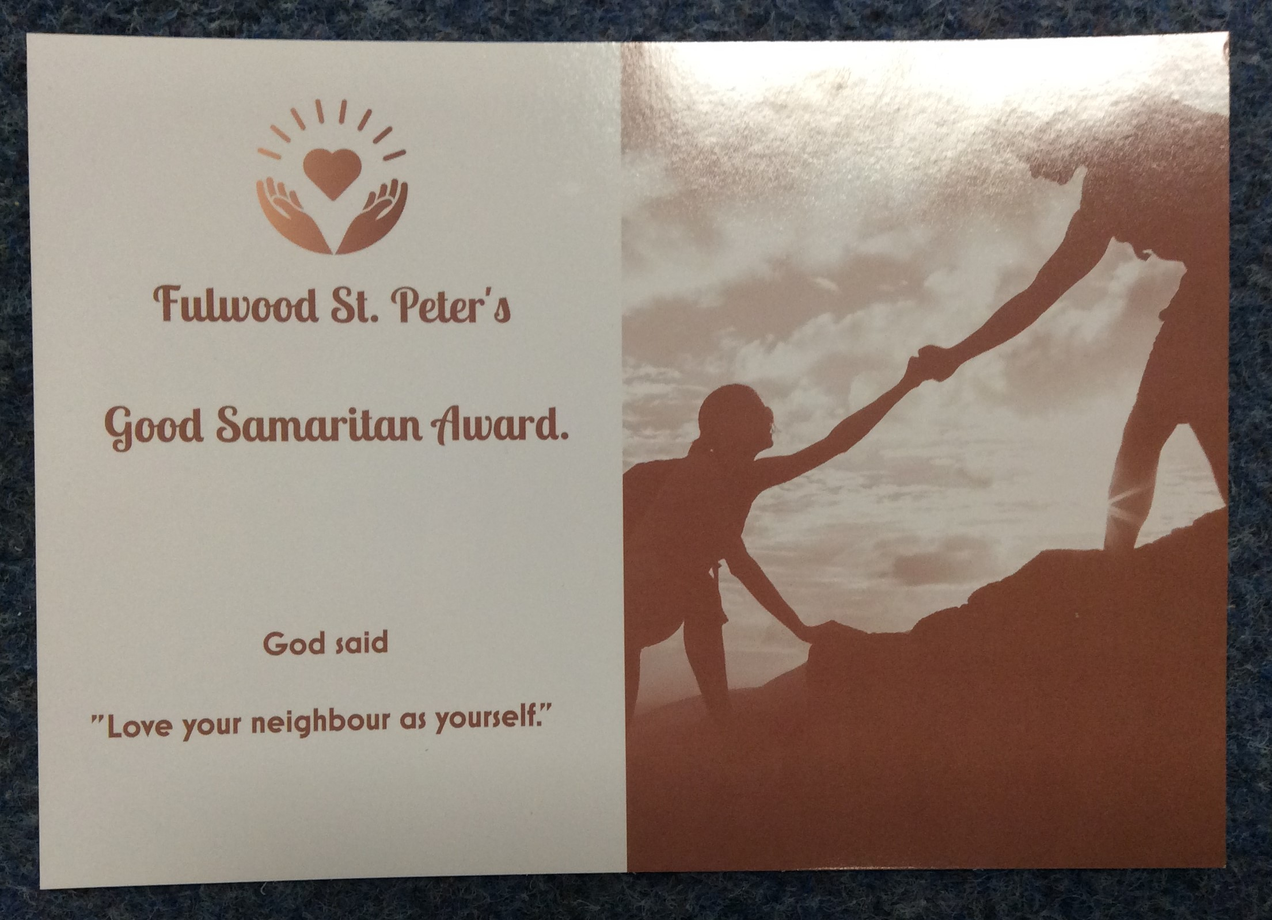
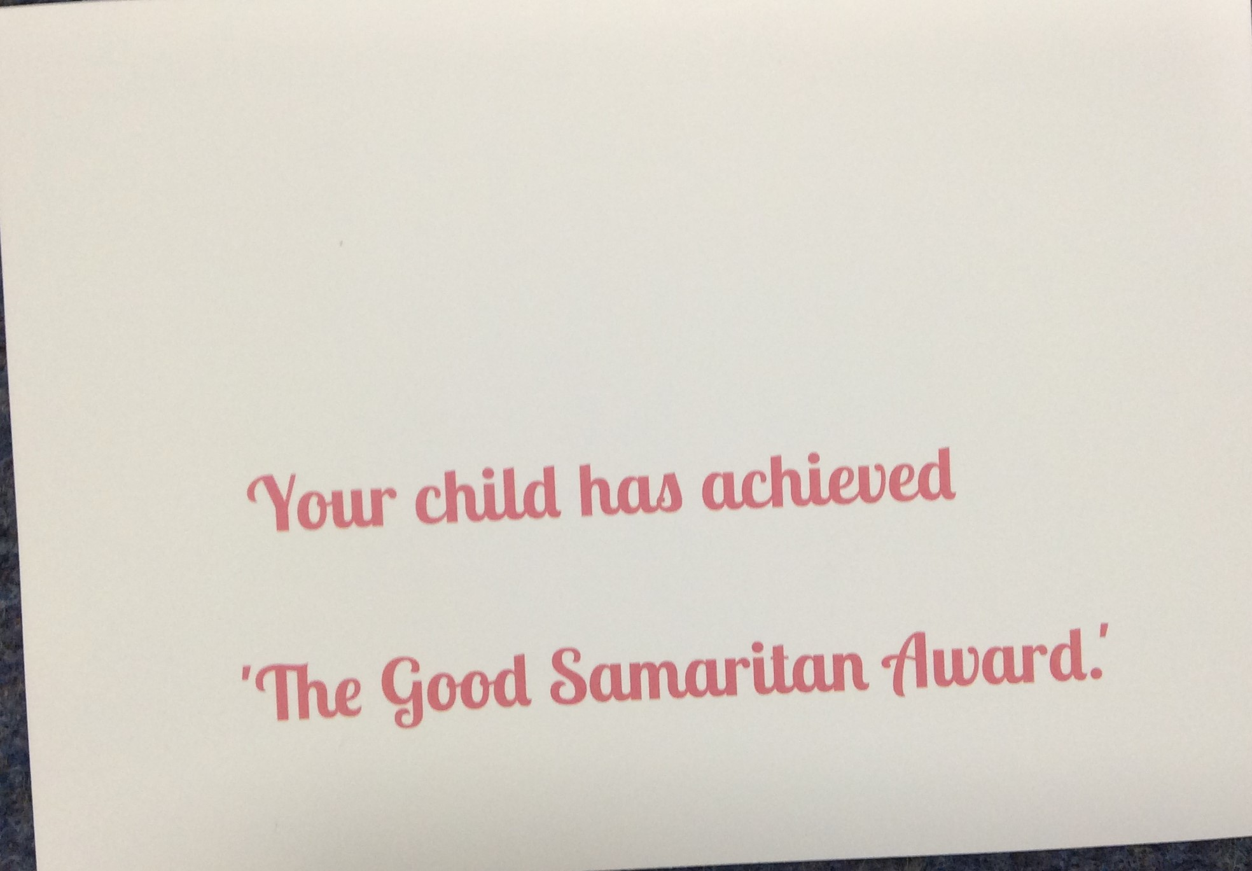
This is our Good Samaritan Award. We like the helping hands. (LNN)

