Slide 1

Fulwood St. Peter’s School PSHE and CITIZENSHIP working for the greater good with the support from our parents and community. By Year 6

Slide 2
In May our Year Six children were introduced to the Archbishop of York Challenge. We had to think of ways of improving our local community with the help of our school family. Our class then voted for the ideas that we had come up with and raising money for the hospital was the top idea. One of our friends had heard about cancer because of a family member and it was decided that this would be our focus. (GO).
We met with the class teacher and the PSHE Lead to think of ways of raising this money. We wanted to help change where people wait and have a coffee before their treatment. Did you know that cancer can effect any one and when we started our project we did not know that this upset so many of our school family. (FBT)
This was a worry and although Year 6 were doing this challenge we thought we would need the help of the School Council to raise this money. We set ourselves a target of £250.00, but we gained loads more than that in the end. (ST)

Slide 3
The first thing we did was held an assembly with all of the school and the help of our teacher. This was to tell the children what our ideas were and how we could raise this money. (AM)
In class we did a lot of research into the logo of cancer and found out that all the dots that make the C are in different colours and that is because each colour represents a different cancer. (JP)
We then wrote a letter to the rest of the school after we had spoken to the head teacher. He allowed us to hold a dress down day and we all got to wear an item of clothing in one of the cancer colours for a fine of £1.00. (AM)
On the day of the collection we talked to our class friends and thanked them for all their help and answered questions about the colours they had worn. (LM)

Slide 4
This is the letter we wrote to ask our friends and families to support our Challenge.

Slide 5
So how did we do?
We had a lot of support from our friends in each class and all of our parents. Our parents found colours for us to wear in school. I wore pink to support breast cancer. (AJ)
My parents let me wear WHITE as my grandparent had died from lung cancer. My parents thought that this was a worthwhile cause and they gave me £5.00 for my donation. (BJ)
We raised a total of £408.51, which was far more than our initial target. We found out that some children had to do chores at home to raise their donation. We thought this was a fantastic idea. (SW)

Slide 6
We relied upon our parents and our wider community to support our school, whilst we raised this money. We spoke to some of the volunteers at the hospital and some of our friends who have had poorly family members. We had an assembly as well to share with the rest of the school what we had achieved. (KA)
We then had to decide who was taking our raised money to the hospital. We thought the fairest way to deciding this we thought was to put all of our names in a hat. (KP).
Two of our parent helpers and our teacher walked with us to the hospital to hand in our donation. They were really impressed with our money and ideas for the waiting area. (LL)

Slide 7
BUT WE DIDN’T STOP THERE!!
The rest of the school also decided that they wanted to take up the challenge and this is what has happened since.

Slide 8
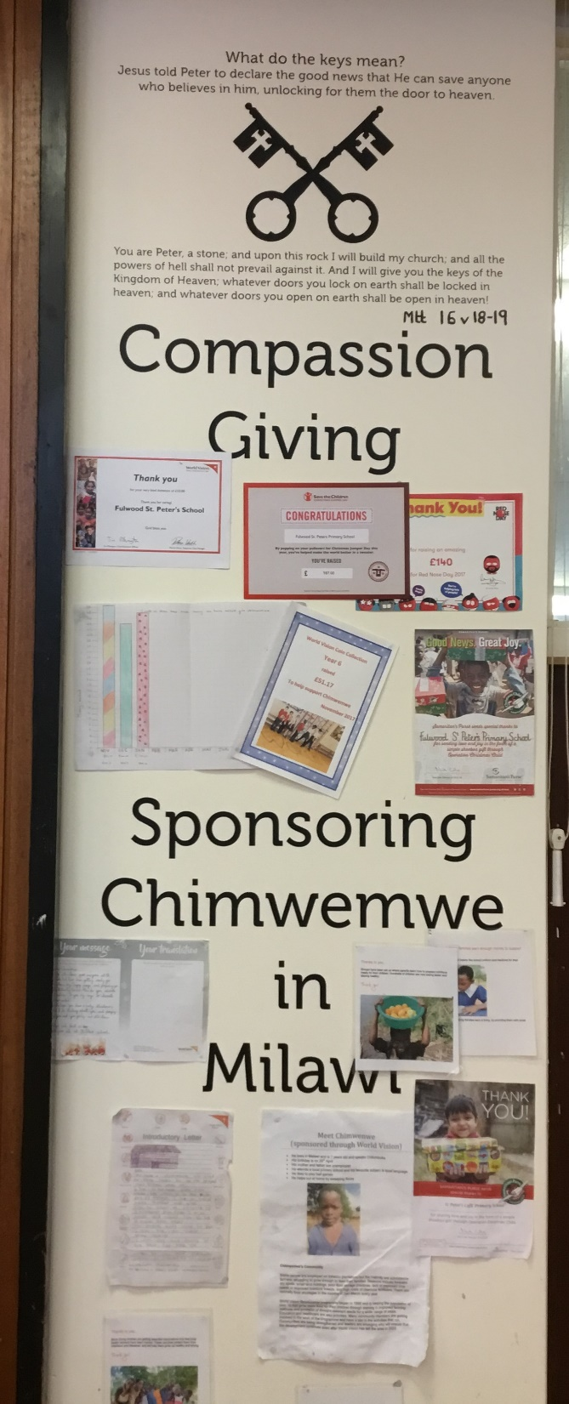
As a school council we decided that we should sponsor a child in a different country. We did this so the child could have access to education. (Y3 - FL)
So we as a school are sponsoring Chimwemwe. He is a little boy the same age as some of our friends in school. He can’t go to school unless some one sponsors him. I was sponsored when I took part in Naomi’s visit by my parents. As the school council we decided that we should come up with some ideas for raising extra money so that Chimwemwe could learn how to read and write because that is important. (Y2 OC)
School Council set each junior class a challenge to raise £18.00 to pay for the next months education for Chimwemwe.
So this is how we went about it. (School Council).

Slide 9
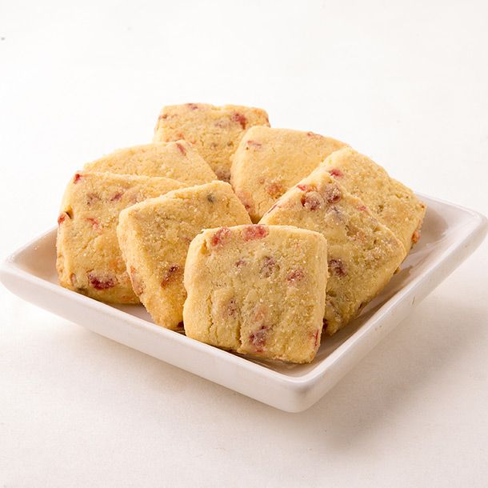
Year 3
We decided to hold a cake bake and healthy snacks bake. We asked our parents and extended family to help. My mum helped me to bake fruit biscuits for the sale. (Joshua Y3)
We designed posters and talked to children in their classes. Children were allowed to bring some money into school, but this could only be a small amount. We asked children to earn their money by doing extra things at home to help because this would be like Chimwemwe. ( Alex Y3)
We raised £44.10 which meant we had raised enough money to educate Chimwemwe for 2 months. We were very pleased with our achievements. (Yr3)

Slide 10

Year 4
We took on the challenge of Chimwemwe through two activities. Children could spend 20p and guess the combination of the lock. We had two boxes with a lock around it. In the first box we had donated art materials from family and friends and in the second box we put chocolate. We could donate this and then our teacher locked the box and put the codes in the safe to keep it safe. (Sophie)
Every break time we went to see the other classes with our box and they could then guess the code from the selection of numbers on the card. Our teacher helped to make up all the numbers because we needed lots of them. (AT)
We held a big assembly to find out who the winner of the two boxes were. MO in reception won the chocolate and his teachers gave the box to his mum. RP won the art box in year 6 and he is very good at art so we were all very pleased. ( FG)
Two of our class sat and added up all the money and we raised £89.50, which we thought was fantastic. We sent a message to all our families to say a big thankyou because Chimwemwe would now be able to be educated for another five months because our teacher made sure the money added up right. (AP)

Slide 11
Welcome to year 5 Challenge
In year 5 we chose to design a quiz based on Christmas. It was going to be the Christmas fair and so we decided that there would be a lot of people from the community there, so we designed a quiz based on Christmas traditions for all ages to complete. There were prizes to be won. We thought colouring books and pencils for younger children and chocolate and biscuits for the grown ups. (RW)
We spent time researching questions and answers and then our bursar helped us to put them into a quiz format for people. We charged 50p to have a go. This was difficult for us because it is hard to make questions for grown ups, but we tried our very best and we were pleased with our results. My parents were proud of me for having a go. (OT)
We raised £51.17 so one of our teachers made up the money and then that meant we had raised £54.00, which meant that Chimwemwe could now have 3 months education. (LN)

Slide 12
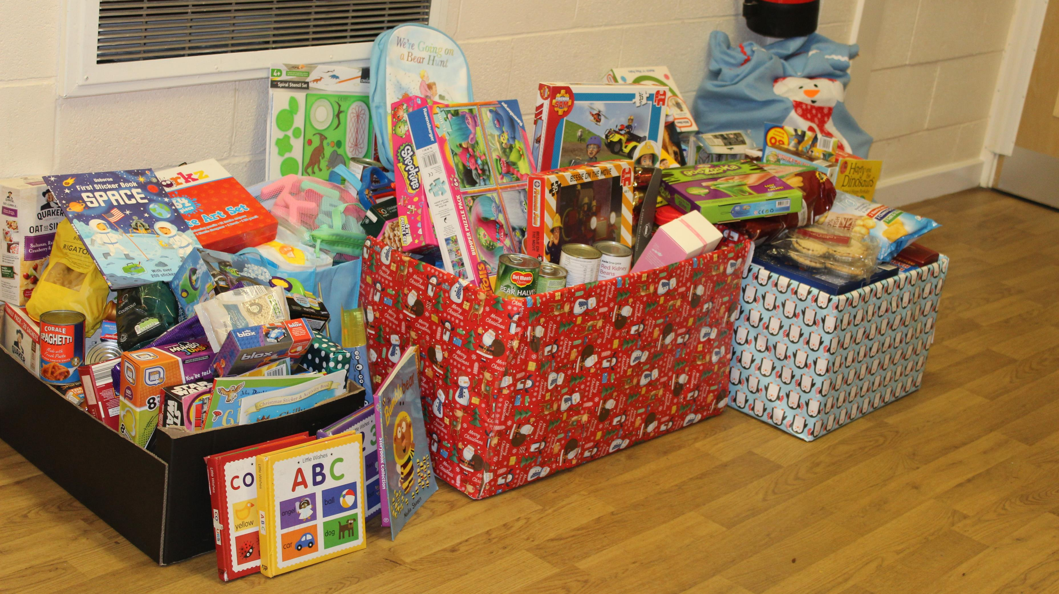
But we didn’t stop there either!
Let me tell you what happened next. Our younger children attended our harvest service which was lead by the Salvation Army. As a school we had to bring in food that would not rot. Darren from the Salvation Army told everyone a story about children and families who don’t have a lot of food. He looked at our collection and said we had enough food to feed 50 families. We all felt happy (LN) Year 2
So we then got our teachers to help us start to collect toys and things for the bathroom ready for Christmas. Year 1 (SP)
Our School Council met again and decided that they wanted to help more children and so we have chosen the children’s Society as a charity until the end of the year. We made a list of people we wanted to help and then we voted. Its good to be a school council person (OOD) Y2

Slide 13
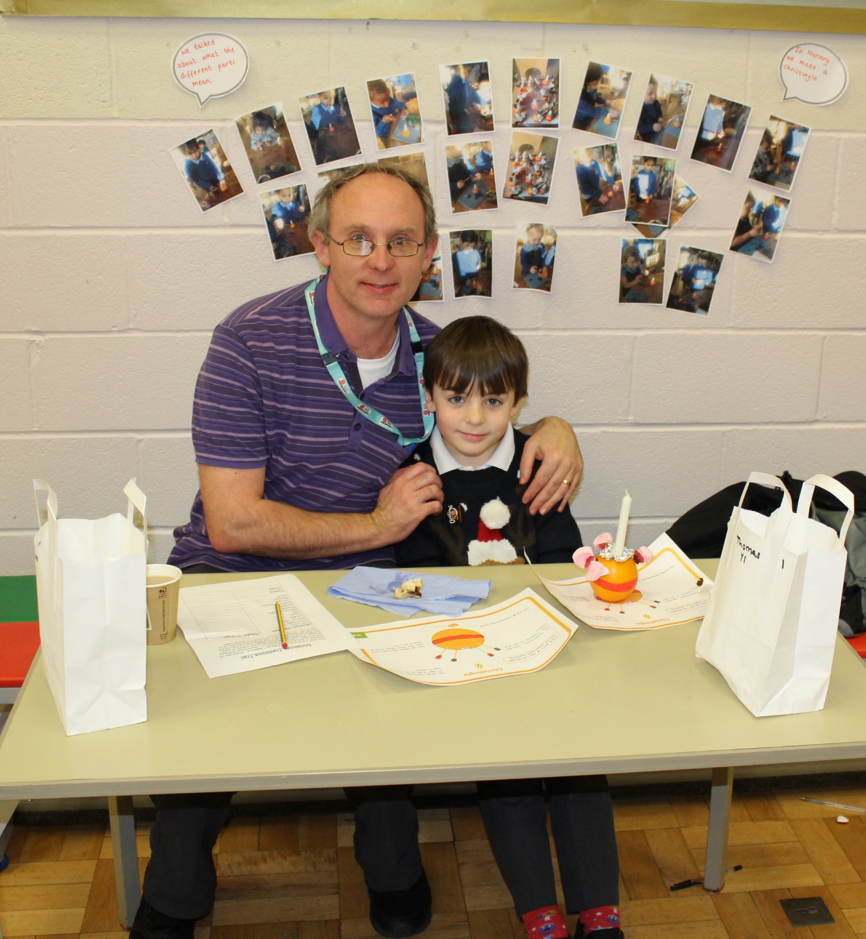
We all joined in….
Our final challenge of the year was to get the whole school involved in raising money for the Children’s Society. We were using our Christmas trail to bring everyone together. (LL Year 3)
Over the last few weeks we have been preparing for Christmas and learning about the Christingle and what all the parts mean. I found out that the red ribbon means Jesus’ blood. (Year 2)
So our worship council helped by our teachers ordered the things we needed to make a Christingle we got to share this with our family and friends. (JP year 4)

Slide 14
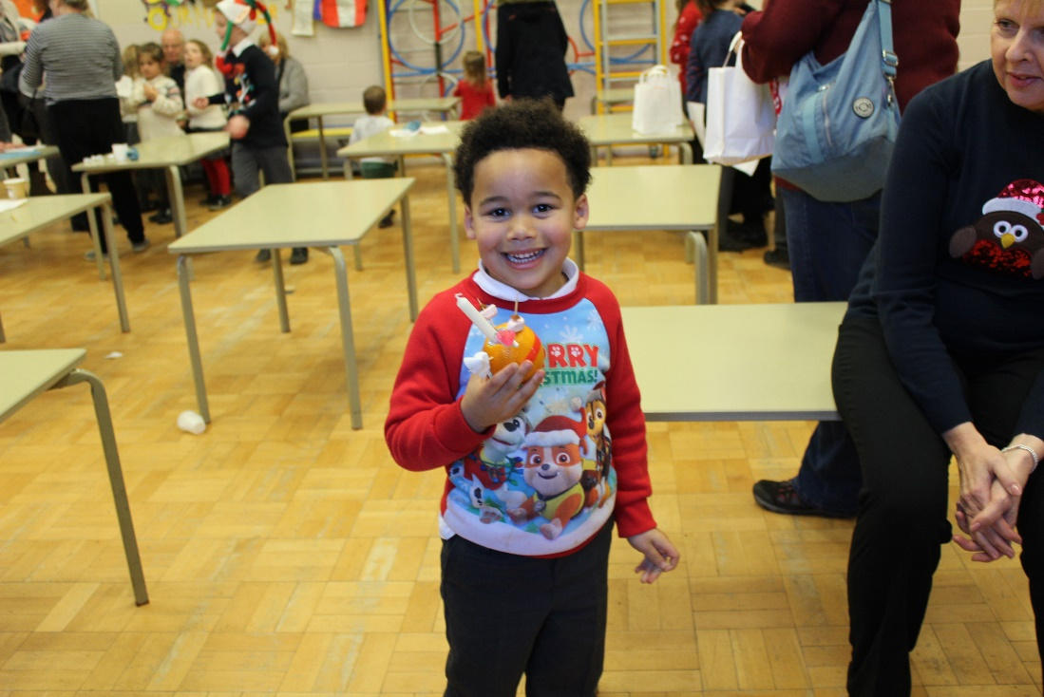
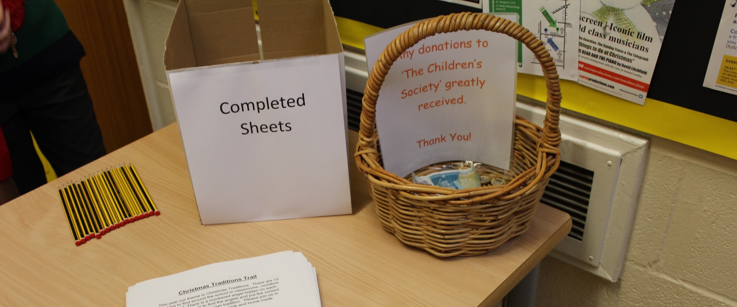
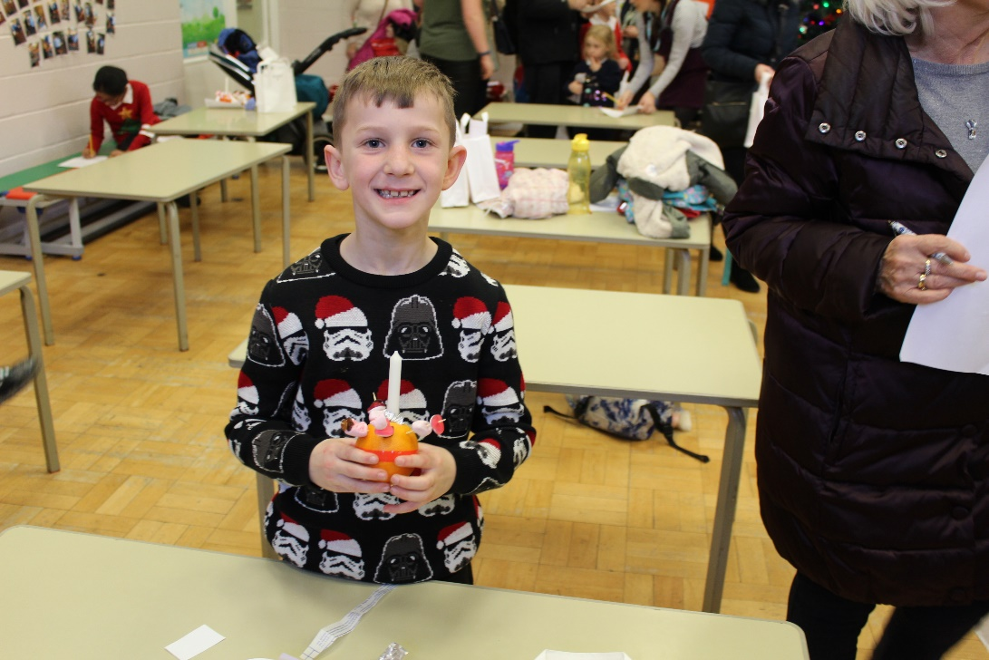
Here are some of the photographs of our school taking part in the treasure trail and the adults who gave up their time to support us. Can you guess what special day it was? Ill give you a clue look at what we are wearing. (VN Year 5)

Slide 15
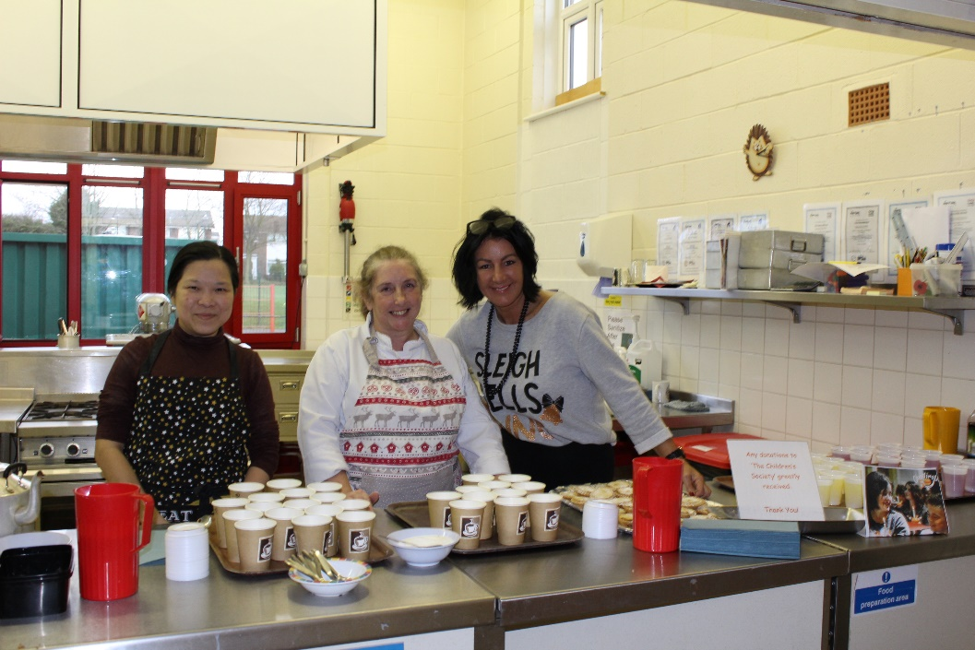
Our parents gave up their time to make hot chocolate and mince pies as well. We all had a fantastic afternoon and we raised a lot of money in total £370.87 we were amazed and very grateful to everyone who helped us raise such an amount. (Reception to Year 6 – Thankyou)
So over the year we have raised together as a school.
Year 6 - £408.51
Year 5 £51.17
Year 4 £89.50
Year 3 £44.10
All our infants -collected toys and food for the Salvation Army.
and we all then raised
£370.87 during our Christmas jumper and Christingle afternoon.
We are very proud of our work.

Slide 16
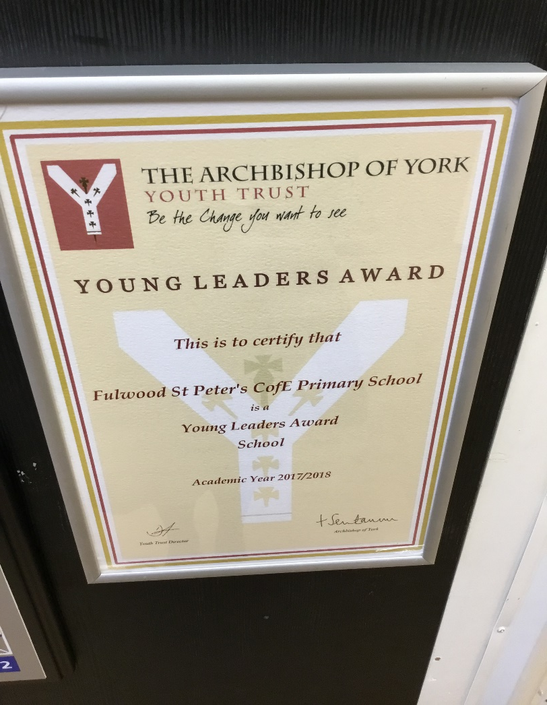
This was our Archbishop of York Challenge Award.

Slide 17
What's next?
As a school we have enjoyed learning about others and thinking of ways to help, so we are going to carry on setting challenges to achieve.
We pledge to carry on educating our friend.
We pledge to choose two charities each year and raise money to help others.
By School Council.

