Slide 1

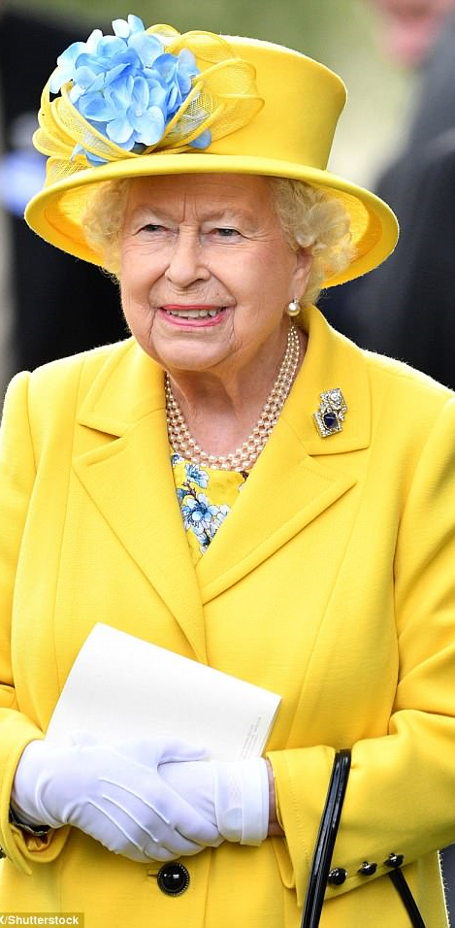
Celebrating the life of Queen Elizabeth II
21st April 1926 – 8th September 2022

Slide 2
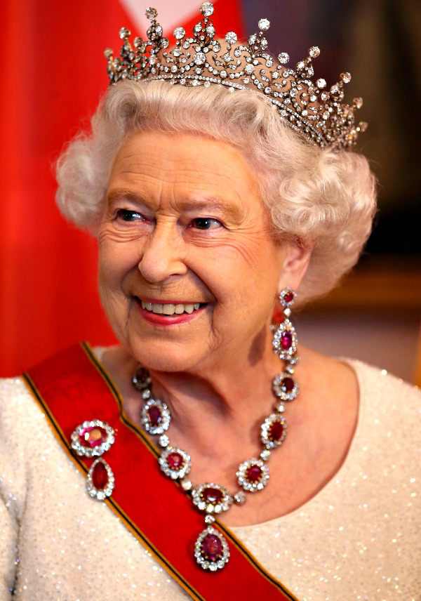
Queen Elizabeth II is the longest reigning monarch in British History.

Slide 3

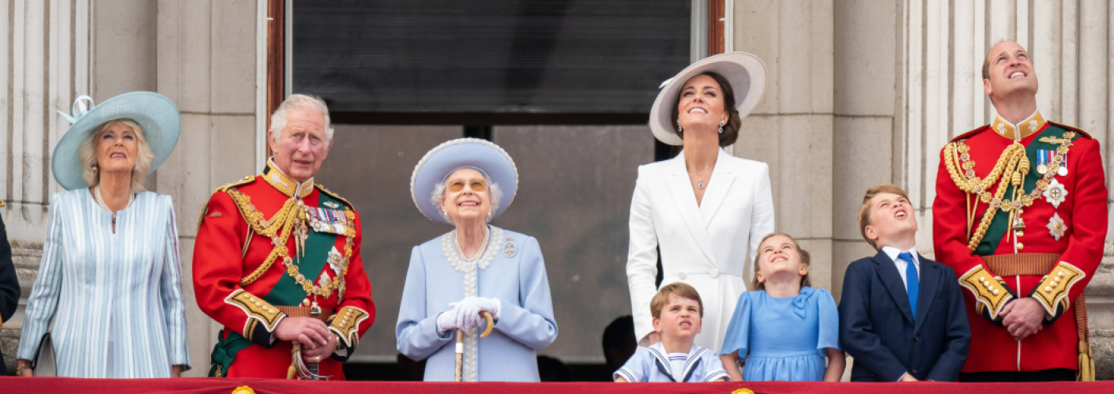
In June 2022 Queen Elizabeth II celebrated her Platinum Jubilee.
Events and street parties were enjoyed throughout the country and commonwealth.

Slide 4
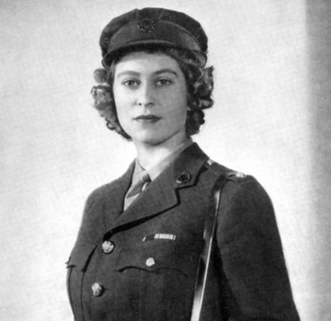
Queen Elizabeth II led an extraordinary life of service to Great Britain and the countries of the commonwealth.
Age 21 she made this promise
“ I declare before you all that my whole life whether it be long or short shall be devoted to your service.”

Slide 5
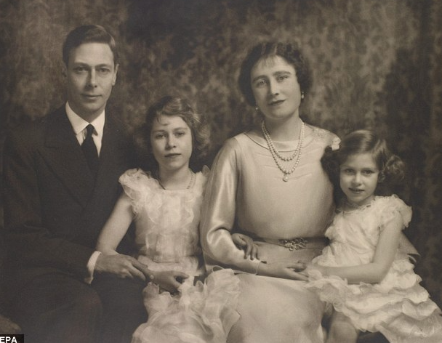
Elizabeth Alexandra Mary was born on April 21st 1926 and became queen on February 6th 1952.
Here she is with her father, King George VI, mother, Queen Elizabeth, and younger sister Margaret.

Slide 6
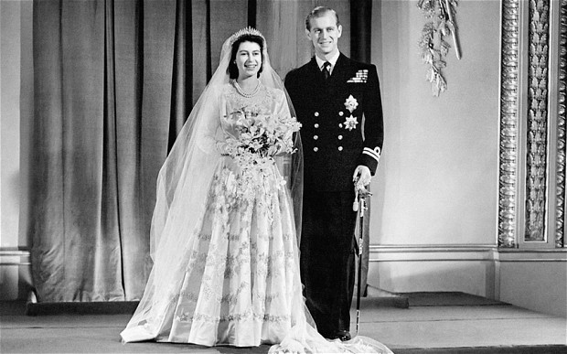
On 20th November 1947 the then Princess Elizabeth married Prince Philip of Greece and Denmark, who was given the title Duke of Edinburgh.

Slide 7
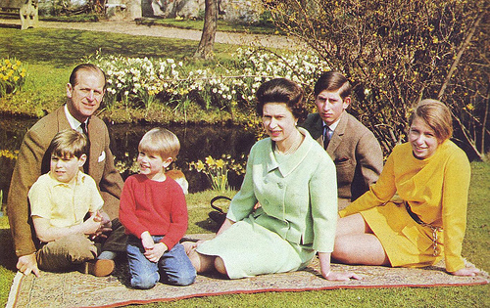
Queen Elizabeth and Prince Philip had 4 children. Charles, Anne, Andrew and Edward.
Notes:
Charles, Anne, Andrew & Edward

Slide 8
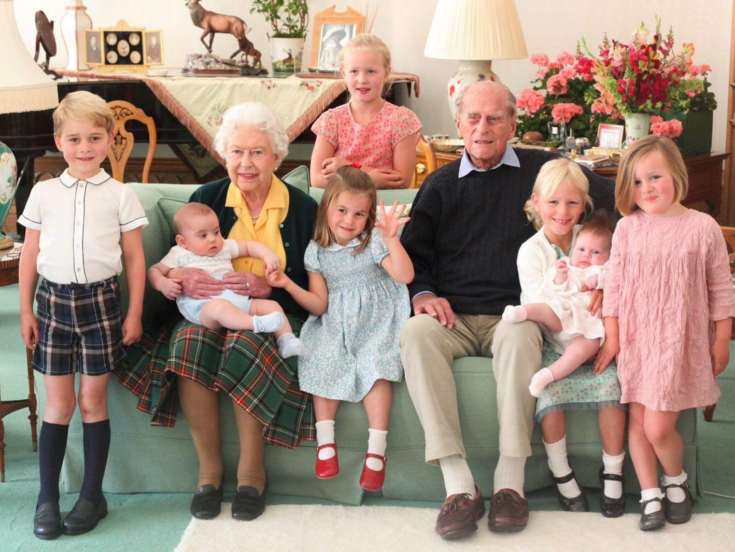
Queen Elizabeth enjoyed spending time with her many grandchildren and great grandchildren.

Slide 9
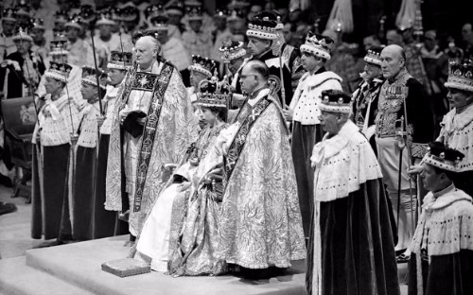
At her coronation she became the head of the Church of England, and she often spoke about the importance of her faith.

Slide 10
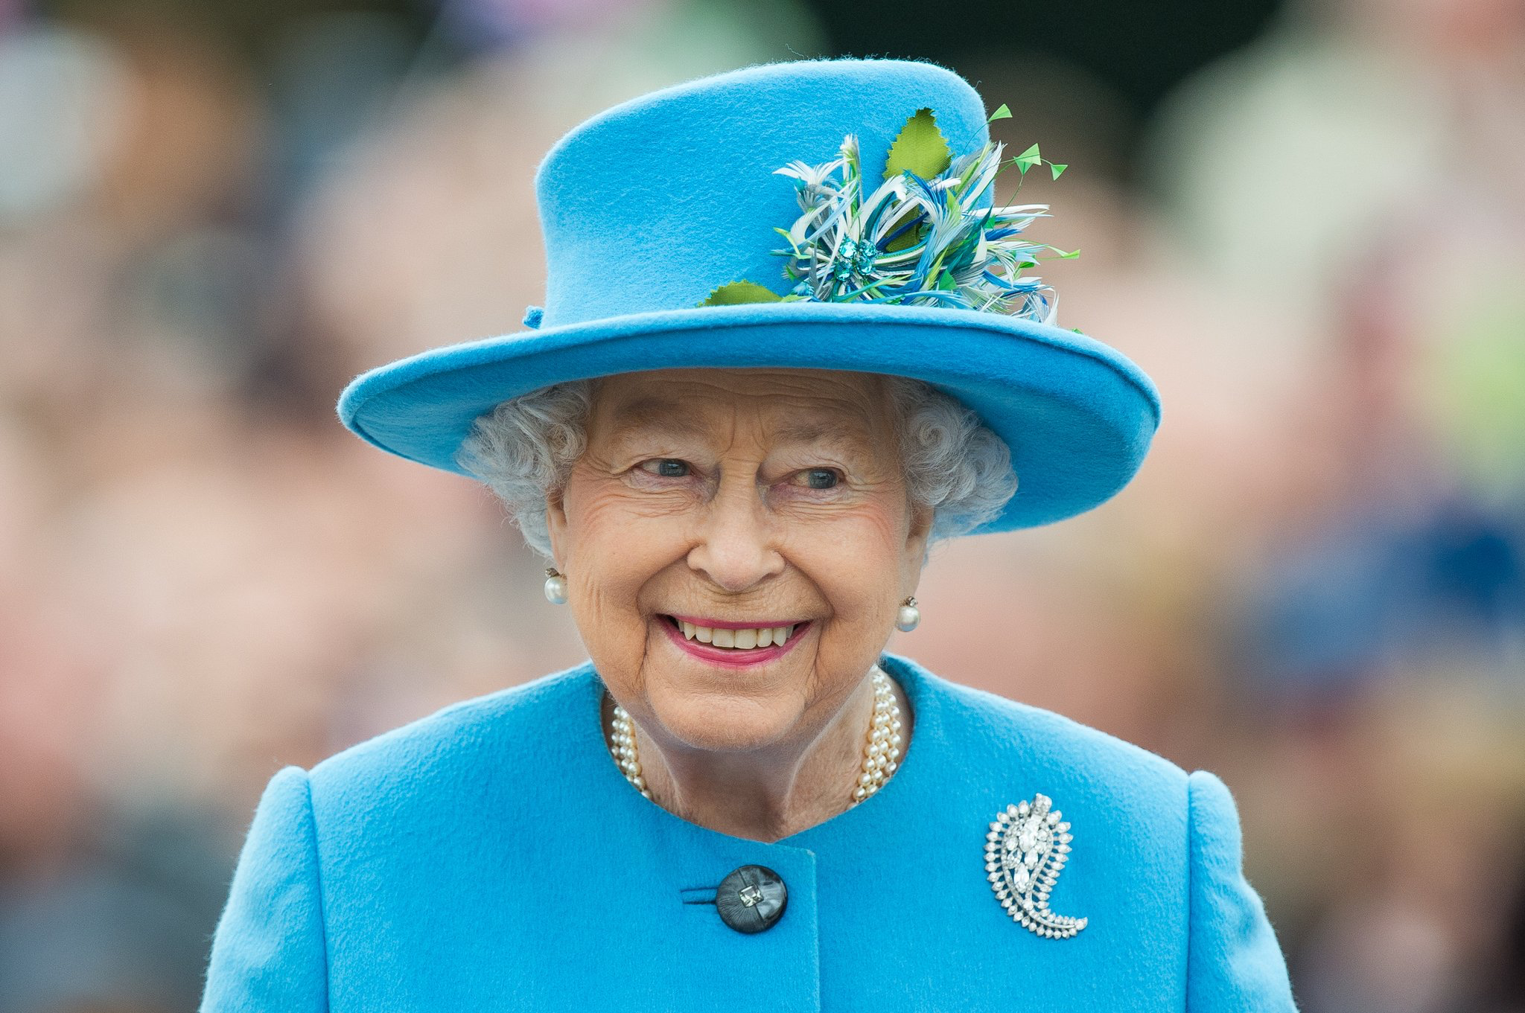
"For me, the life of Jesus Christ, the Prince of Peace, is an inspiration and an anchor in my life.
A role model of reconciliation and forgiveness, he stretched out his hands in love, acceptance and healing.
Christ's example has taught me to seek to respect and value all people, of whatever faith or none."

Slide 11
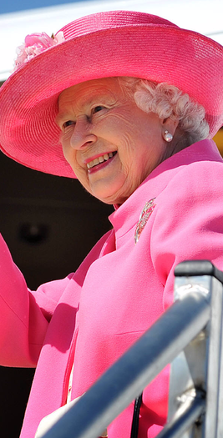
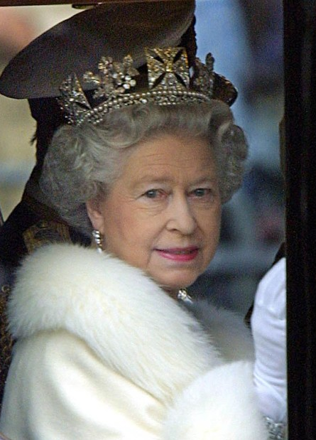
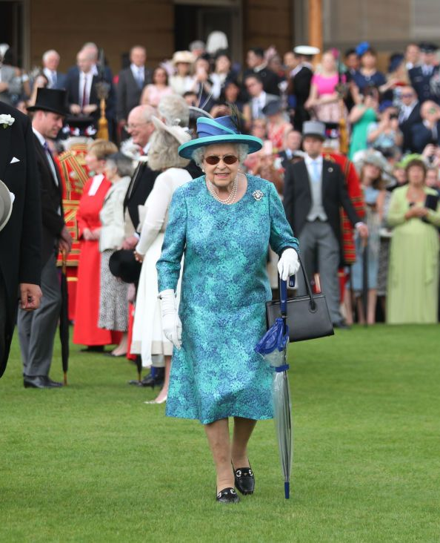
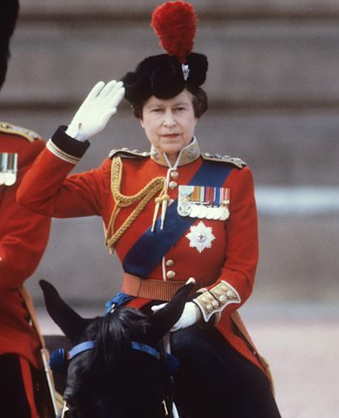
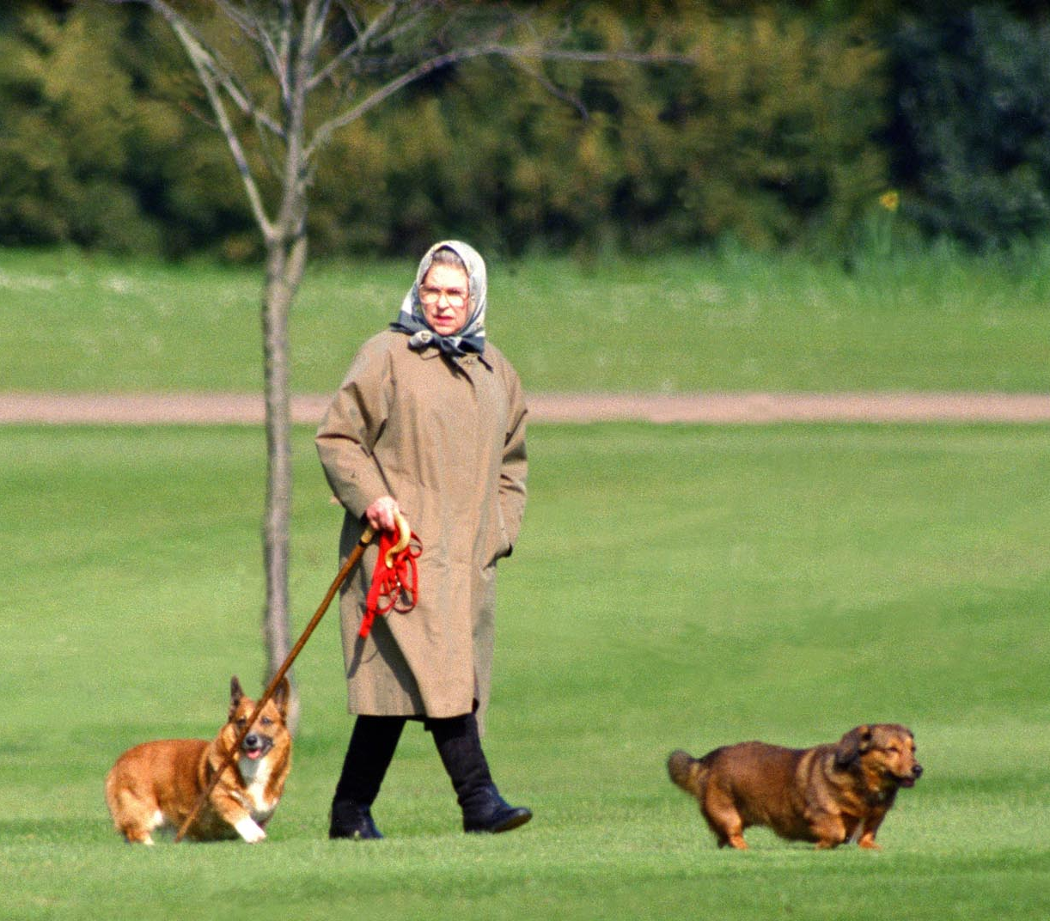
Although today we are sad, the Queen lived a remarkably full and varied life and we must celebrate this.

Slide 12
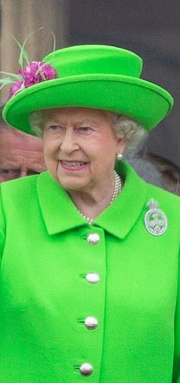
We are grateful for the Queen’s dedication to duty, and service to the people of Great Britain, Northern Ireland and the Commonwealth.
Let us give thanks to God for her example of living out her Christian faith and for the joy that she brought to everyone she met.
We pray that her family are comforted by their happy memories and ask that God will give them peace in their time of grief.

Slide 13
Gracious God, we give thanks
for the life of your servant Queen Elizabeth,
for her faith and her dedication to duty.
Bless our nation as we mourn her death
and may her example continue to inspire us;
Through Jesus Christ our Lord.
Amen

Slide 14
