Slide 1
How we have helped others with the support of our families and our community.

Slide 2
What did we do?
Our School council chose lots of charities that we could help. We then voted in each class and the votes were then counted. It was exciting waiting to see which charities we were going to help.
We decided to help the NSPCC, Children in Need and Children’s Society. Some of our friends also wanted to help older people that could not remember things by learning to knit.
Our big children were going to take part in the Archbishop of York challenge for young leaders. Being a leader is one of our school drivers and how we learn, by leading in teams.
Our teachers put the dates in the school diary and then we could let our classes know.
(By School Council)

Slide 3
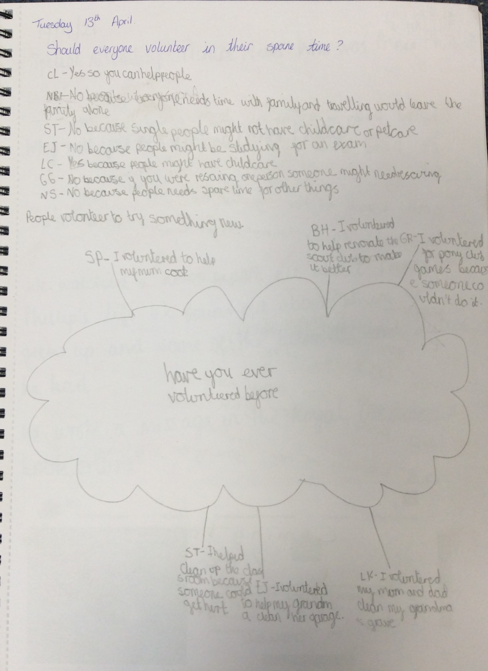
Why should we volunteer?
Here are our thoughts.
Y4

Slide 4

Our charities.
The NSPCC – bring Buddy who is a speech bubble and he comes to an assembly and teaches us how to shout out and get help.
We learn about the pants rule.
We learn about who to turn to if we are worried and who a trusted adult is.
On this day we were allowed to wear one item of green. To match Buddy.
Our friend Chris comes into school and then works with us, because of Covid we had to have our teaches share the teaching. We had to have an assembly in class, but it was still good.
I told my grandad he was a trusted adult when I had tea. (JP)
Watch our Speak out Stay safe assembly at home | NSPCC
Today we raised £100.00. We asked for a donation of 50p or more.

Slide 5
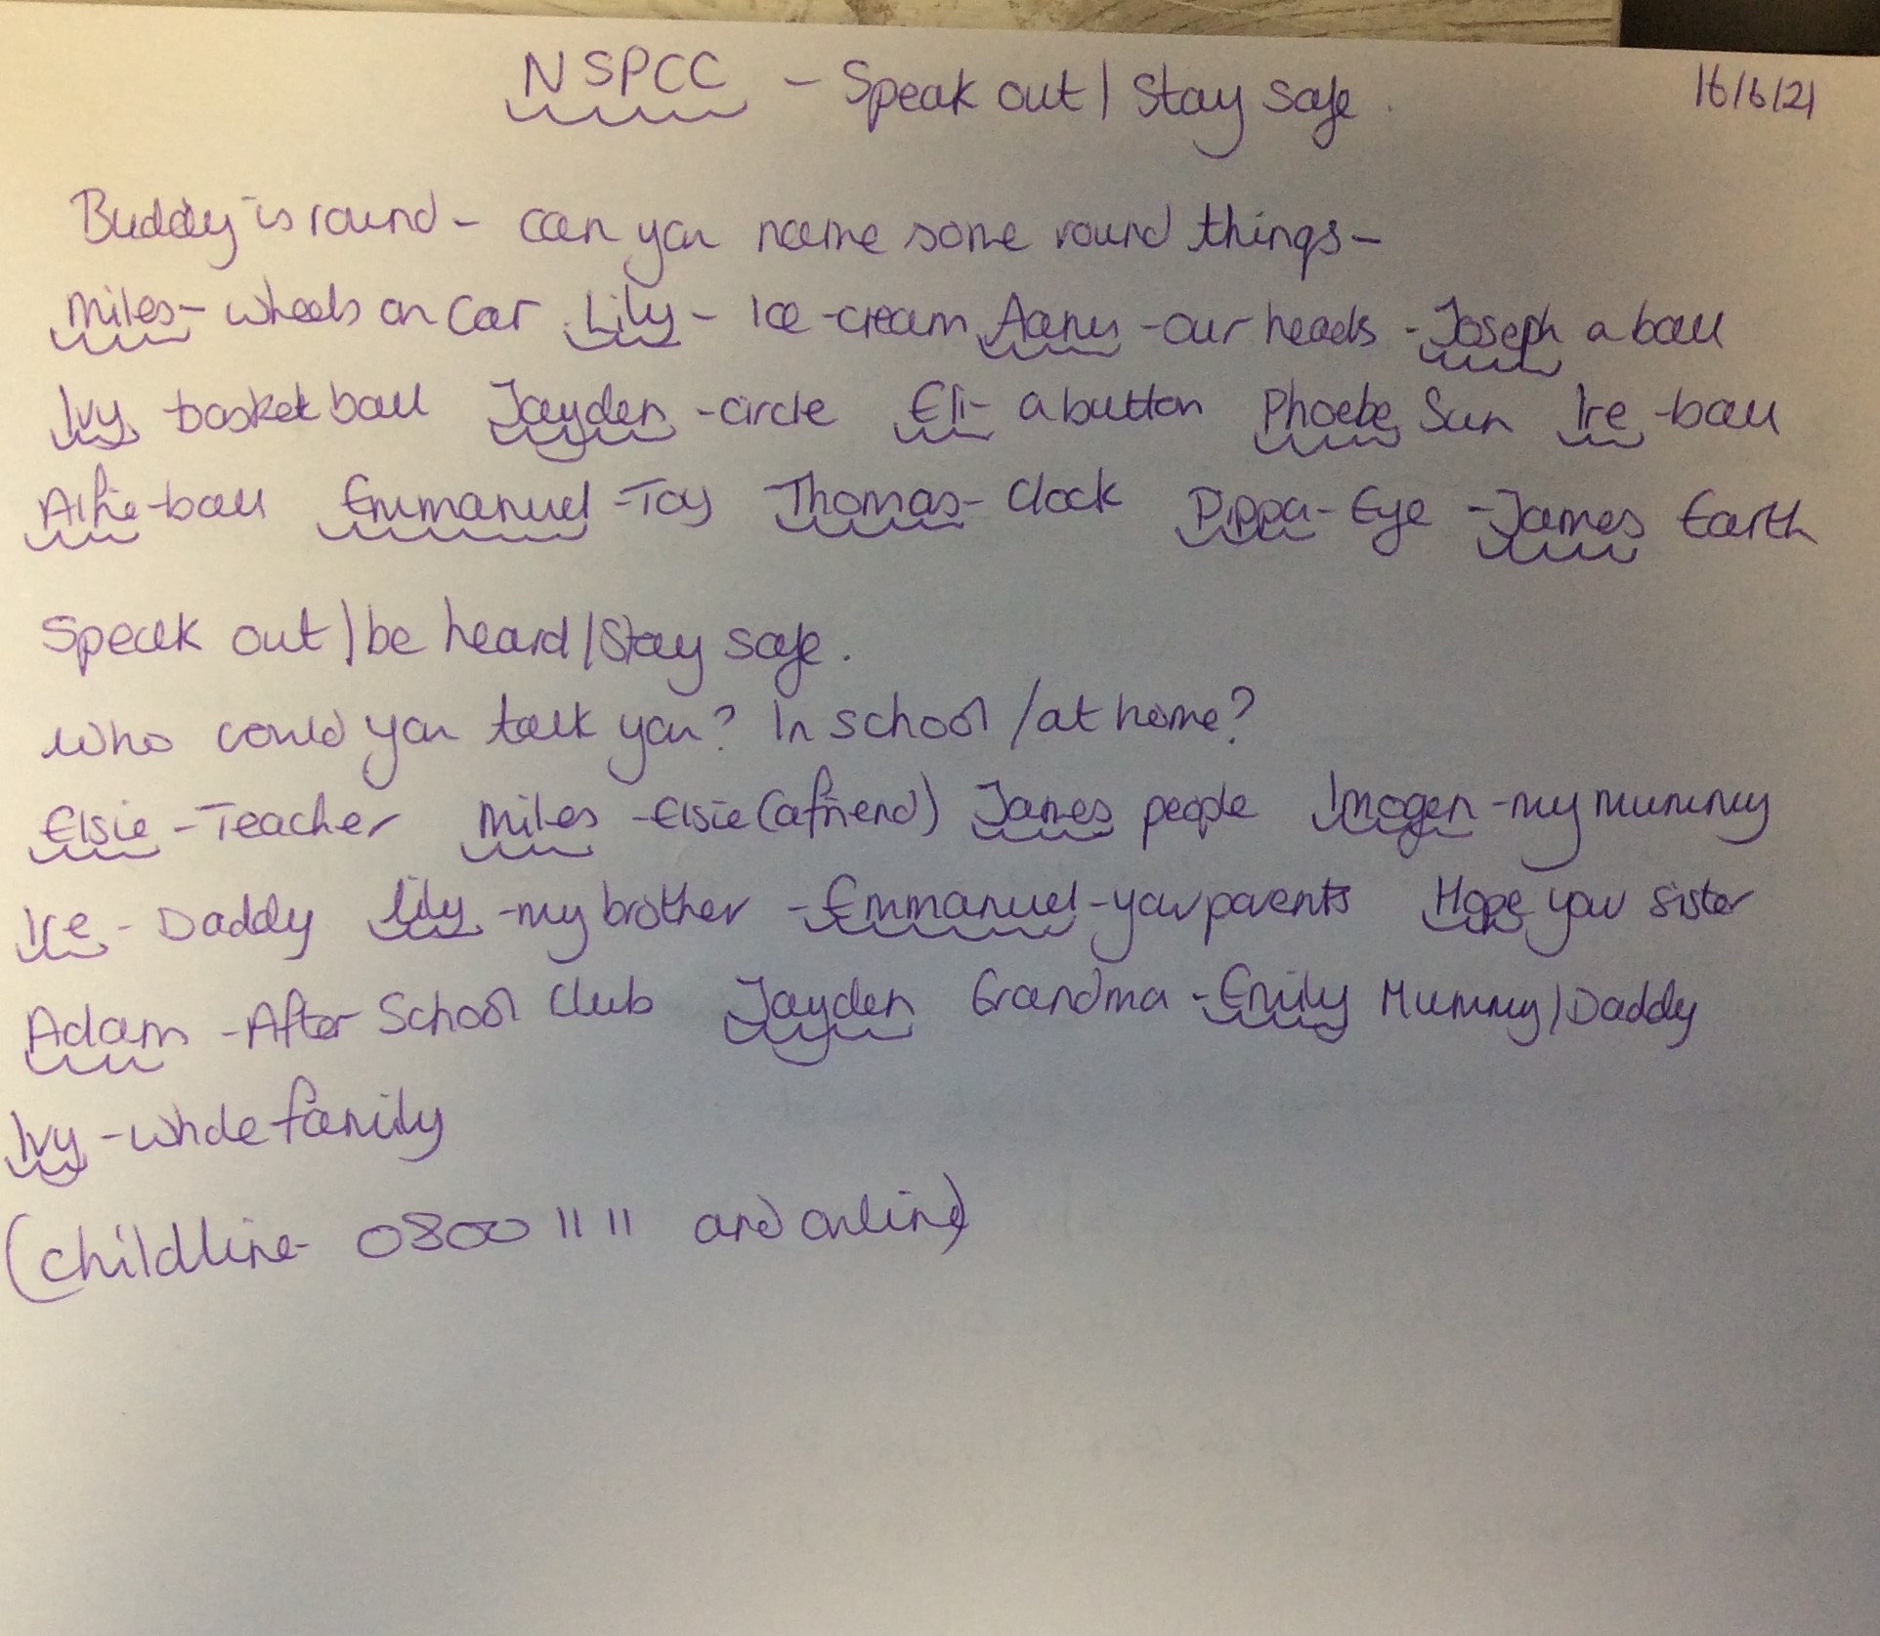
This is some of our views and discussions

Slide 6
COVID LOCKDOWN
But it didn’t end there, because we found out that some people did not have enough food, so we started to bring into school non-perishable foods, like we did at harvest and then. Our teachers contacted church and they came and shared our food parcels with those in need.
We also made parcels for the Mosque leader because they were cooking meals and delivering them to people. (AI)
We didn’t stop there, after watching the news we found out that people in hospital didn’t have visitors because the hospital did not want germs spreading. So we made get well cards for men and ladies. One of our parents took them into work and gave them out. Two weeks later a lady rang the office and said thank you and said it had made her stay in hospital nice because she knew someone else cared. Our teachers shared this and I felt very proud. I don’t know if it was my card or one of my friends. (SP)
We had lots of charities chosen and we were planning our activities and then we had a lockdown.
In Lockdown I came to school because my mum is a nurse and my dad a doctor at the hospital. I was scared that they would be poorly. Our teachers spent time with me and my friends- talking to us and helping us with our work.
We thought about what we could do to make them smile. I remember a very hot day and a big sheet and we made a big rainbow and then wrote messages on hearts and fastened them to the school fence, so people could read our messages. This helped me to feel safe and helpful. (EJG)

Slide 7
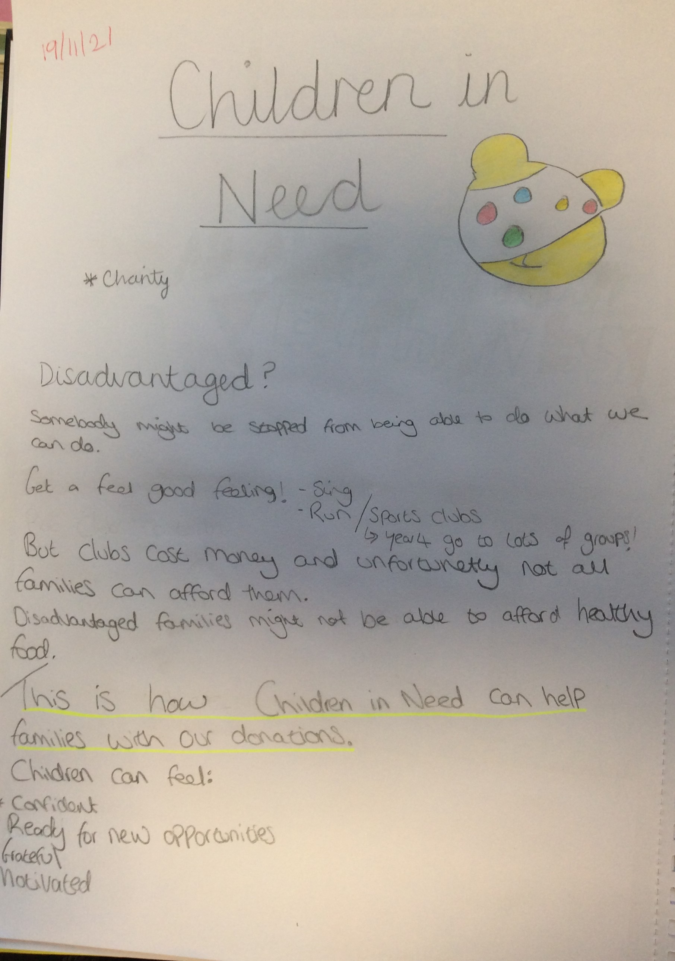
Children in Need
Today we learned about Pudsey Bear and why we have Pudsey Bear. I learned that Pudsey helps poorly children. (Y1)
Here are some of our big friends thoughts. (y3)

Slide 8
Children in Need
We took part in an orienteering game with our buddies. We had to find Pudsey bear and match the spots to get the clues. It was cold outside. We had an assembly and learned about where the money raised would go and who it helped.
I found out that there are activities that some children go to near where I live, because they have to look after their mum.
I found out that they help with toys, learning and buildings. (Y3 pupils)
In the juniors we did orienteering with PE and at each point we had to do different things like star jumps. It was fun but tiring. (OW)
In my class we made cakes and decorated Pudsey one for each in our family for after tea. My teacher put them in a see through bag. I tried not to drop it
(HA)
Here is the link to our pictures and comments
Children in Need | Fulwood, St Peter's Church of England Primary School (secure-primarysite.net)

Slide 9
Christmas Jumper Day
We had a meeting as the School Council, because we wanted to have Christmas Jumper day with our family. Every year we have a Christmas trail in school and we invite our families to look at our decorations and Christmas displays. We also make the Christingles in the hall with hot chocolate and mince pies. Last year that did not happen and we wanted to find a way for it to happen.
We made the decision that we could hold a trail outside and to make it special do this on Christmas Jumper day. We asked for a donation of £1.00 to wear the jumper and then we asked our parents and community to come. We also asked parents to order their Christingles to pick up.
School Council.

Slide 10
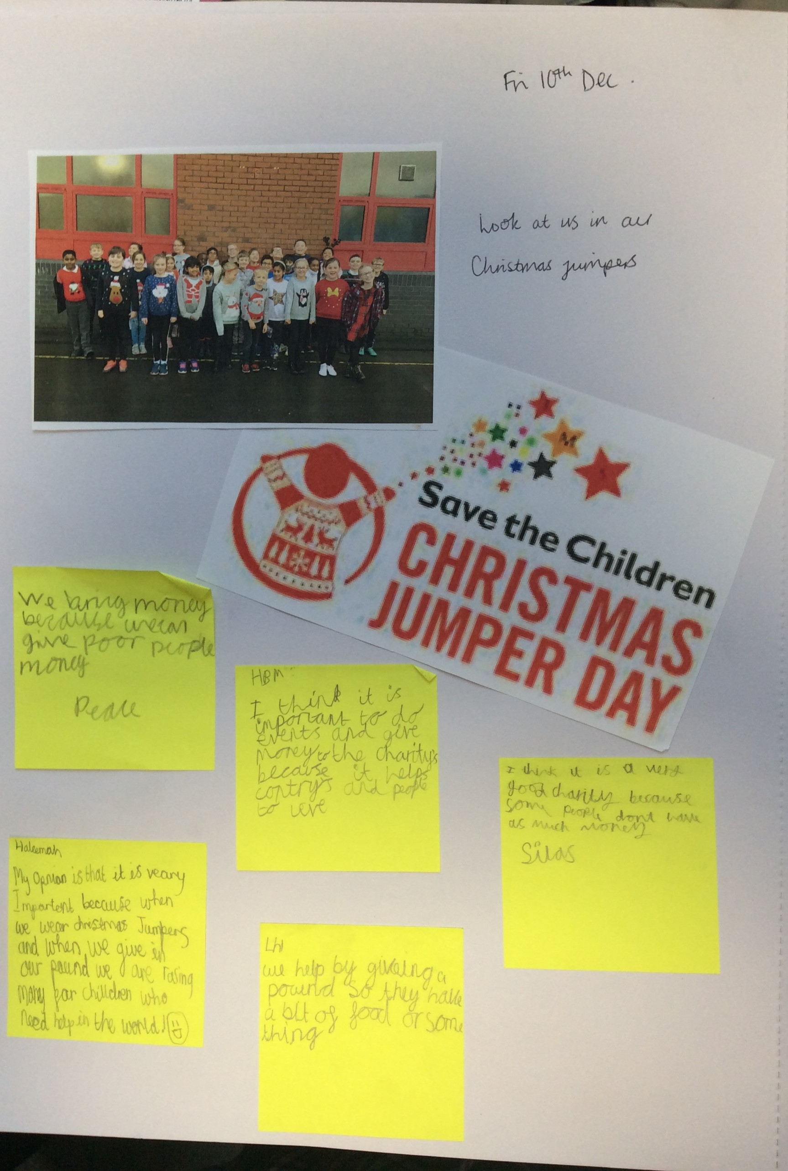
Our thoughts about Christmas Jumper Day.

Slide 11
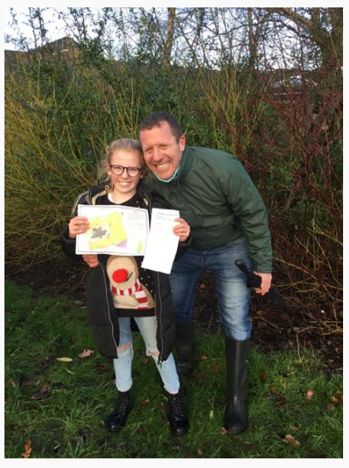
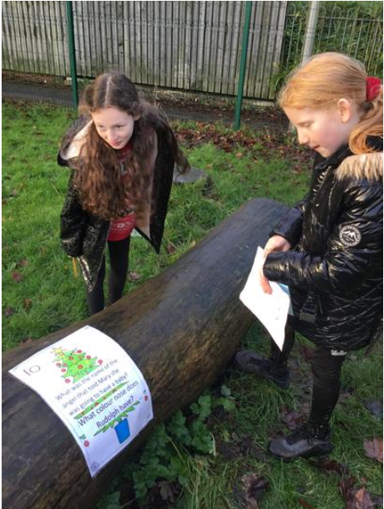
Christmas Jumper Day
It was cold, wet and very muddy, but we had fun altogether.

Slide 12
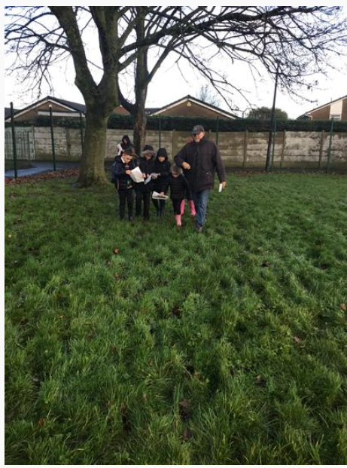
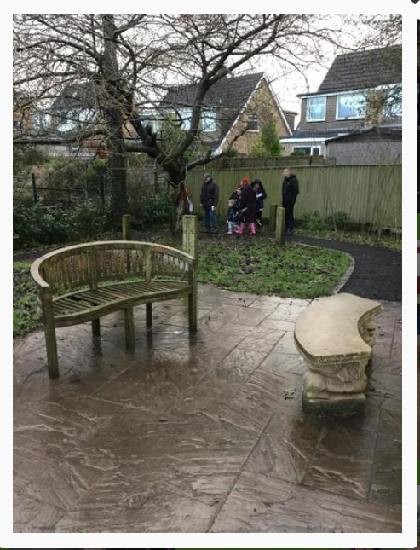
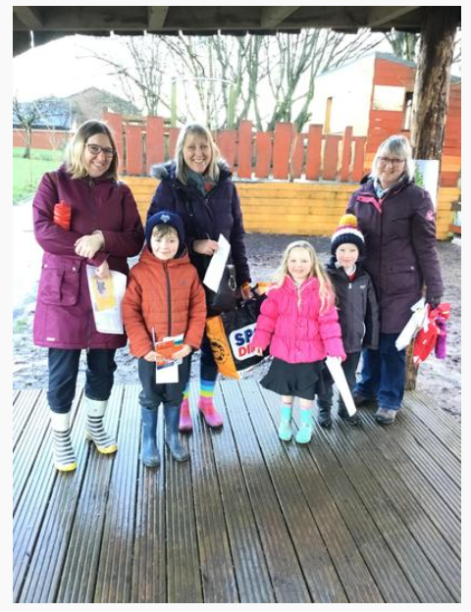
Christmas Jumper Day

Slide 13
Christmas Jumper Day
We raised £165.00.
We got to spend time safely outside with our families and friends- this was a birthday treat, spending time with all my family.
Lots of parents collected their Christingles and took them home.
Our teachers said this had been a great success.
Parents said they had enjoyed the trail and it was nice to be back in school, even though it was outside.
Thank you to everyone that helped make the day special and raise money for Children’s Society.

