Slide 1
Enjoying All that we can offer.
Fulwood St. peter’s C.E. primary School
Hope you enjoy learning more about our wonderful school?
By the School Council and others.

Slide 2
Did you know how important a play leader can be?
Here in school we try our very best to include all our family. Sometimes some children find it difficult to join in. As a play leader it is my job to go and encourage them. It’s not about being bossy! It’s about helping a member of our family have some fun and make new friends.
At the start of the year I found it difficult to make friends. I didn’t like dinner time it was too long and I struggled with friends (year 1)
At lunchtime our welfare teacher brought some big children from juniors and they helped me to play and played with me. They had toys and showed me how to play. (Year 2)

Slide 3
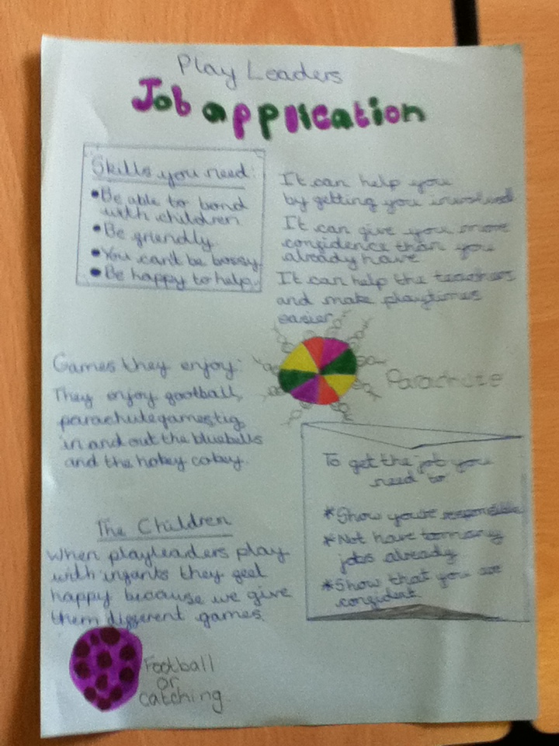
Would you like to be a play leader?
Please read our job description and check if you have these qualities.
(Year 4)

Slide 4
Would you like to be a play leader?
In September we were given the opportunity to be play leaders for our younger children.
I wasn’t a very confident person and I didn’t like falling out with people.
I didn’t think I was the right person for the job because I lacked some confidence, but over the year I have become confident I enjoy my role and love being out with a few of my friends who are also play leaders. I have made some new friends with younger children and also I have become more confident.
It was the dinner lady who asked me and since I have been looking after my little friends I haven’t been in trouble because I have been busy. So being a play buddy as been really helpful to me too.

Slide 5
We all try to have the best attitude to learning.
Having the right attitude is important and we carry this on in class. Each class as the same SEAL attitude to learning chart.
Every morning we all start on good, (this is a the part of the soil of a plant.)
If we have the right attitude we get to move our names up to the next leaf, which his great. Then we move to Excellent and finally we move to Outstanding, which is the sunflower head. We get given a special card to take home to show our parents. All our names are collected and those with the most names at the end of the year will get to go on a trip or have a treat in school. We all enjoy this. If we do something that isn’t positive then we move down the plant pot to the roots!! No one likes disappointing, because that means your parents get to know and it make our teachers and friends upset. The School Council designed our behaviour chart.
By School Council

Slide 6
Who we can turn to…
We are lucky in school we have a worry box in infants and juniors and we can write messages and Mrs. Lister will sort out our worries.
Mrs. Lister is our Learning Mentor and she is always there for our problems.
We can talk to all the adults in school and they do help us with any worries.
Sometimes mum’s and dad’s also come into school to talk to the teachers and Mrs. Lister.

Slide 7
We make our own rules.
Every year we vote for two School Council members in our classes.
We are very important because we listen to our friends in class and we try to improve the school.
Every September every class write their own class rules together and then the School Council write the Code of Conduct .
In my class the number one rule is always to have a smile on your face. I like that rule as it makes me happy and I know that my teachers will help me. (YEAR 4)

Slide 8
This year as School council we have…
Our jobs so far this year have been…
To design our tree house and listened to the views of our class.
Reviewed the healthy schools packed lunch code.
We’ve judged competitions for our Breakfast and Holiday clubs.
We have helped sort out menu’s for new school dinners.
Sorted containers and play equipment for break times.
We have helped other clubs collecting rubbish.
We have held meetings in class and checked our friends are happy.
We have had afternoon tea with the clergy to say thank you.
By School Council

