Slide 1
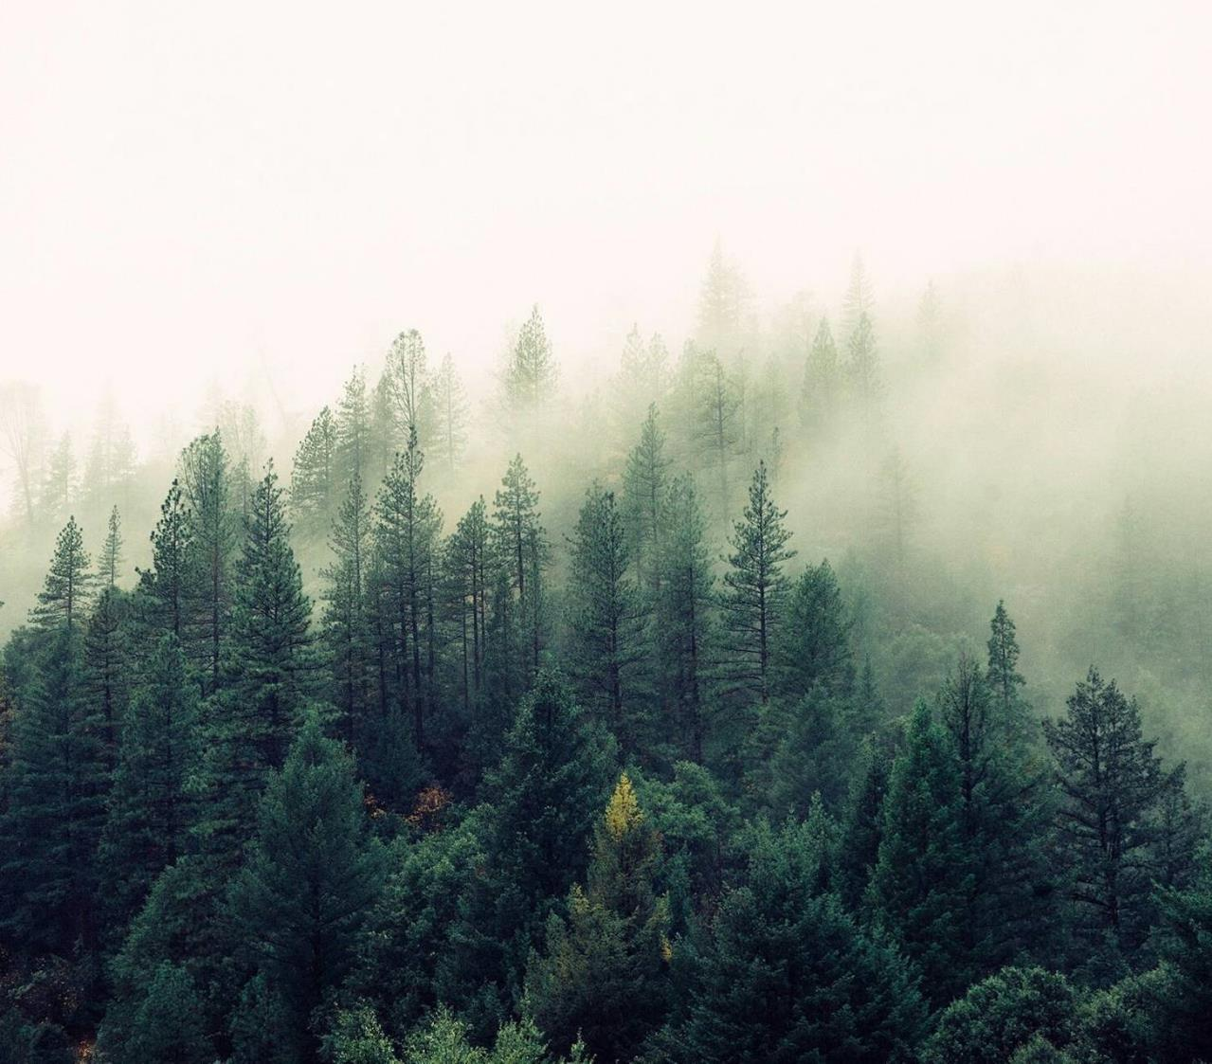
Forest School and looking after the environment.

Slide 2
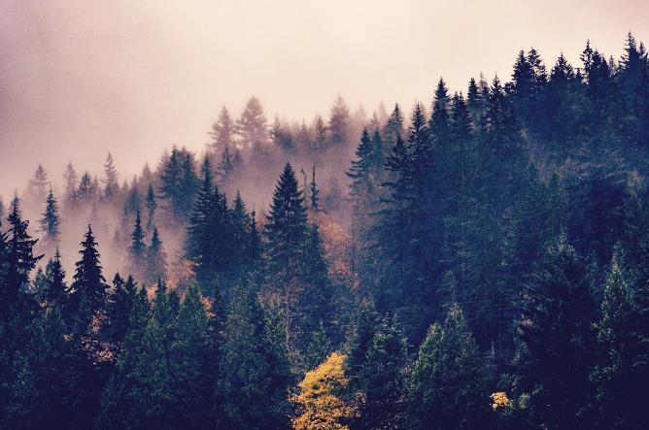
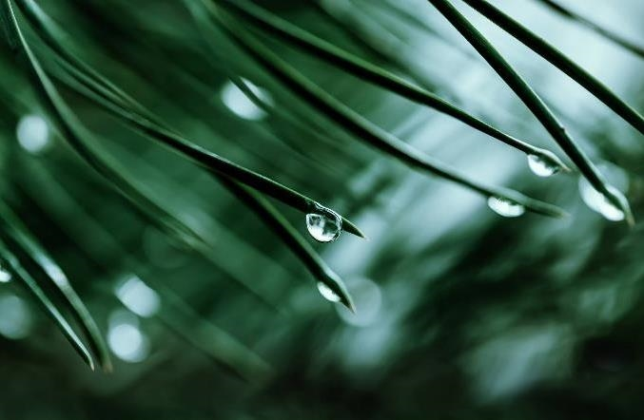
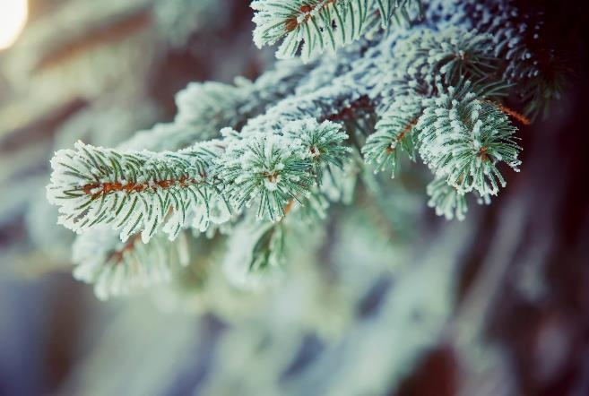
What is Forest School?
We have an area in school that is full of wood, plants, mud and trees. We wear our forest school clothes, waterproofs and wellies. We learn about the environment and make dens for wildlife and survival dens for us. We work in groups and we made a flag that showed our group name, using only sticks and leaves and mud. We had to mix mud, petals and water and make our own colours. We had no paint like in the classroom. (Y2)

Slide 3
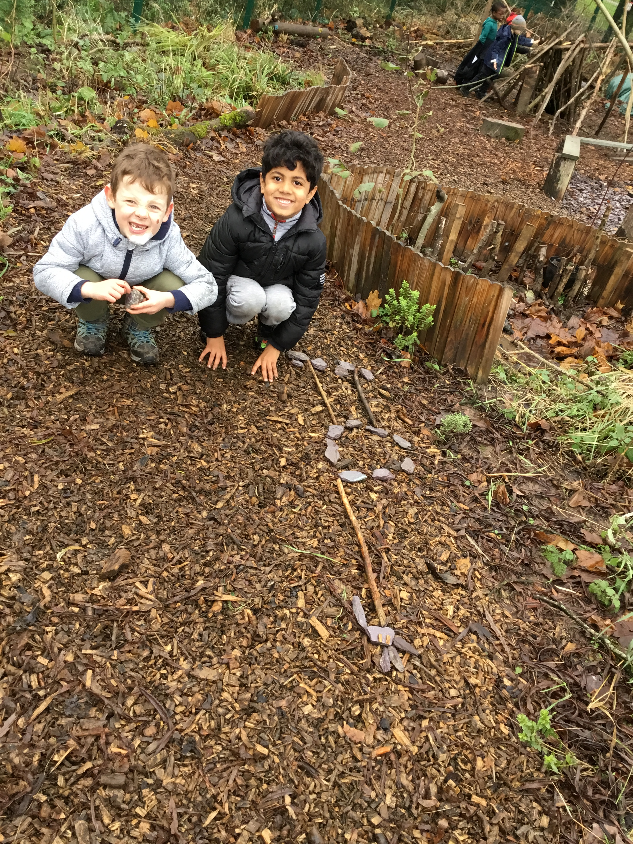
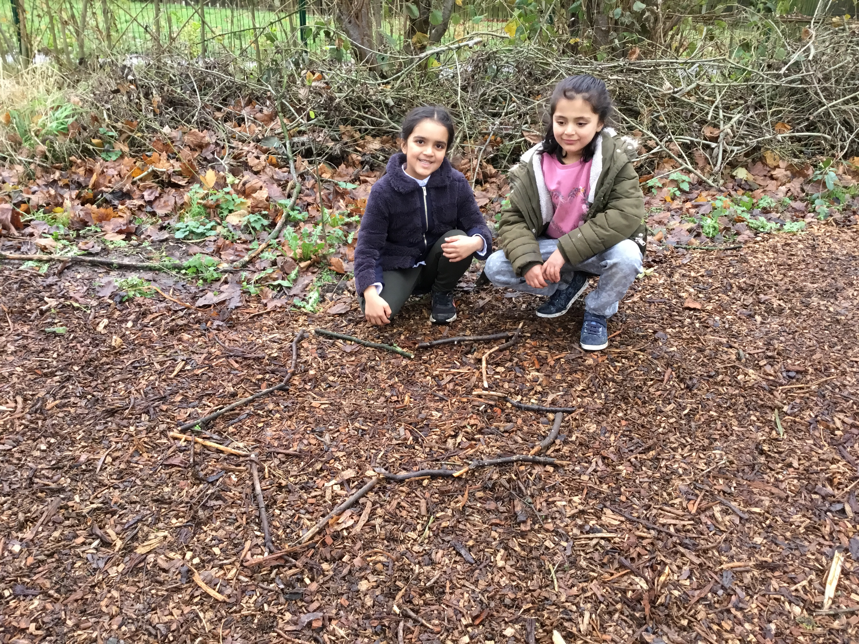
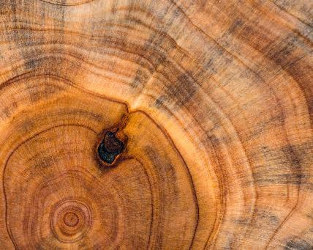
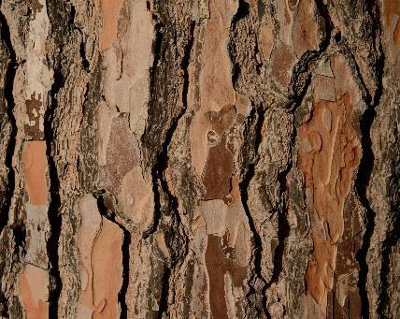
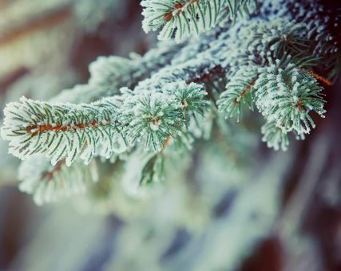
I like forest school because I get to learn outside. (NP)
Forest schools lets me learn outside and I like problem solving. My teacher lets me try out my ideas. (LK)
We made our flag using stones and branches. (TP)
We made a star using old branches from our big twigs pile. We called our group the stars. (ZB)

Slide 4
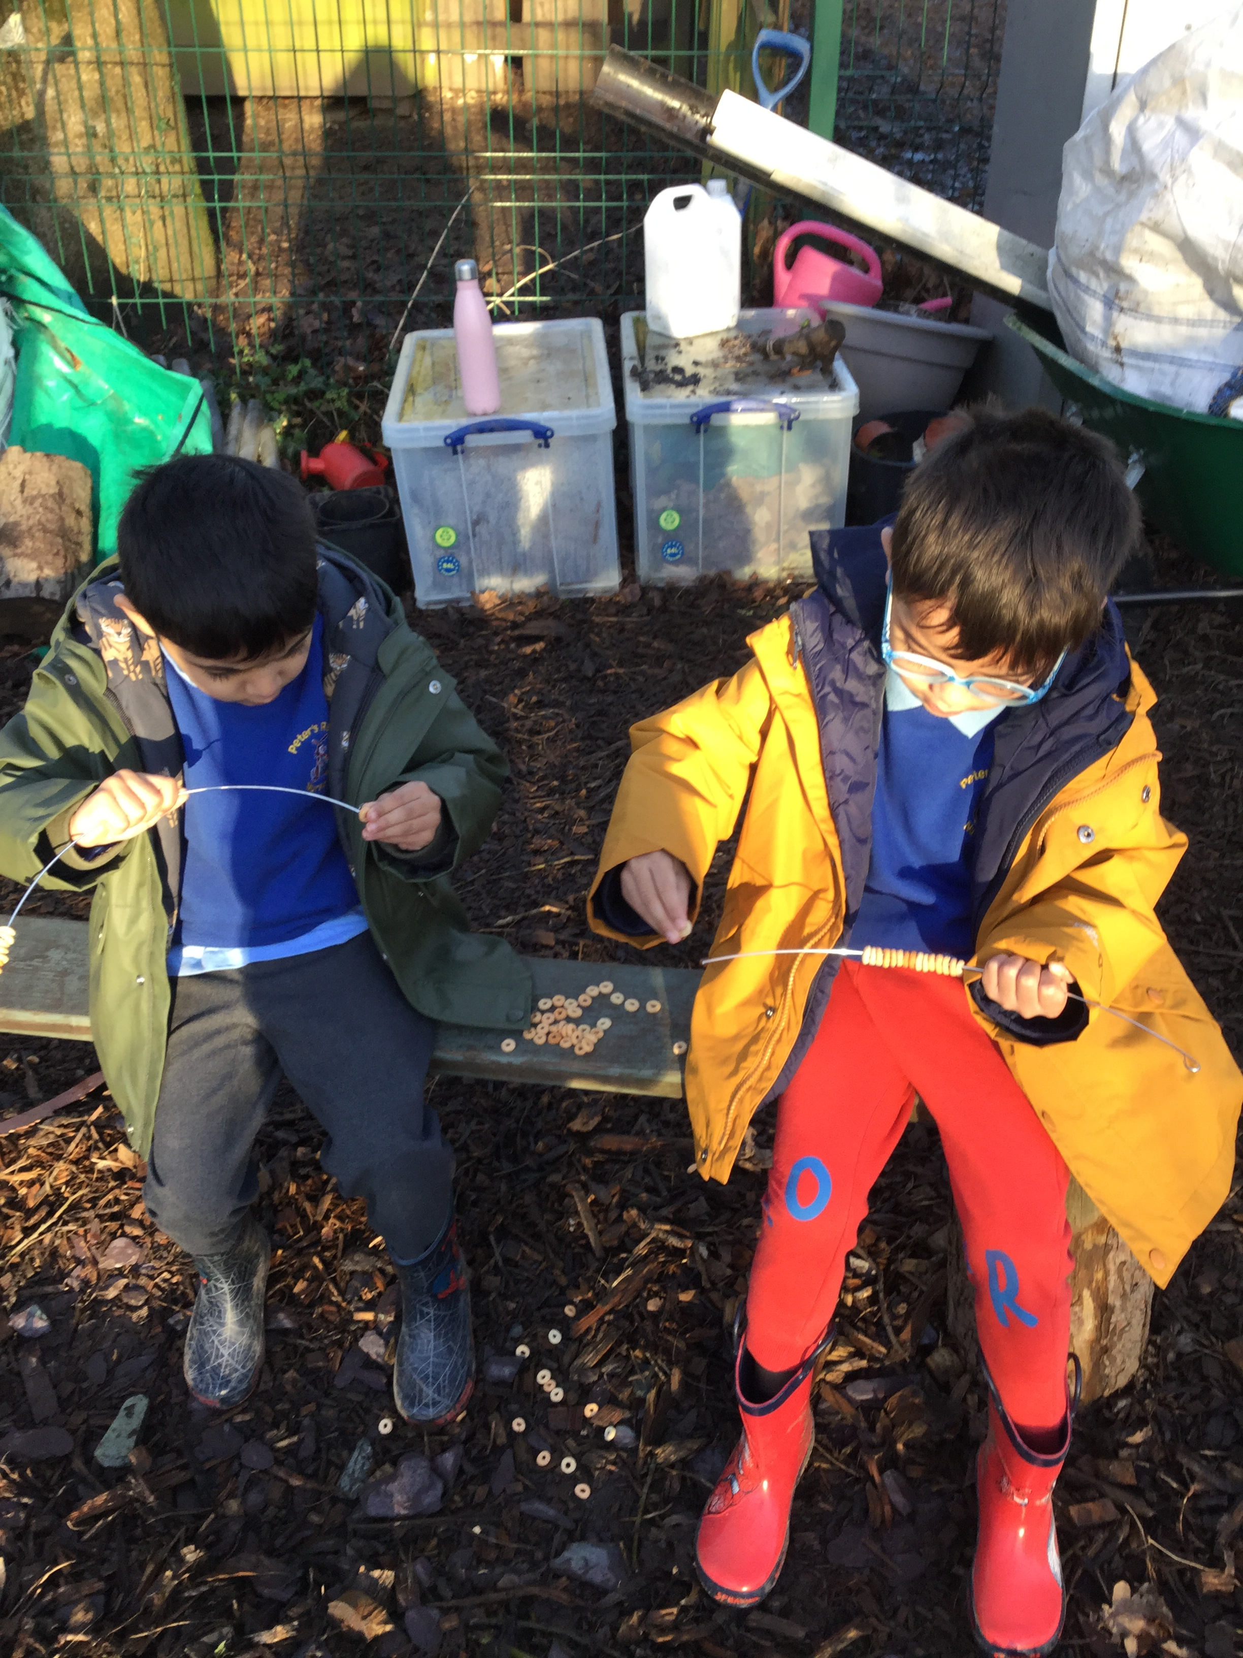
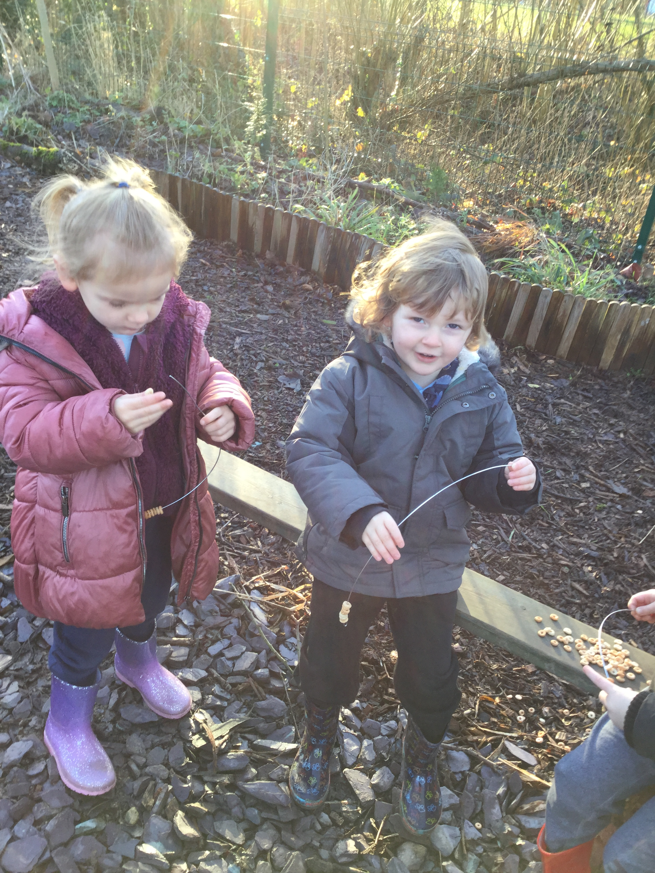
I made a bird feeder with my friend, we tried to make a pattern with the fruit. (BT)
We have been learning about how to make our environment friendly for wildlife.
We made habitats for wildlife, insects and birds.
We took part in the RSPCA bird count. We had to sit very still and quite and listen and look for birds. I counted 4 birds, 2 blackbirds and 2 blue tits. (AB)

Slide 5
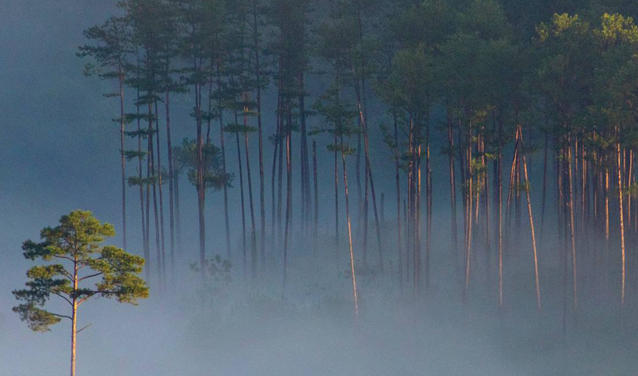
Why not check out our work on the website.
We have some of our work on the website, so you can see the other fun things we have been learning about.
Year 3 | Fulwood, St Peter's Church of England Primary School (fulwoodstpeters.co.uk)

