Slide 1

Healthy Lifestyle
By Angela, Danikah and Anna in Year 5
Notes:
Angela: This presentation is all about having a healthy life.

Slide 2
Healthy Eating
Notes:
Anna: Healthy eating

Slide 3
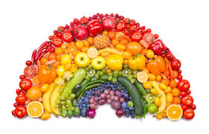
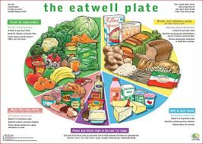
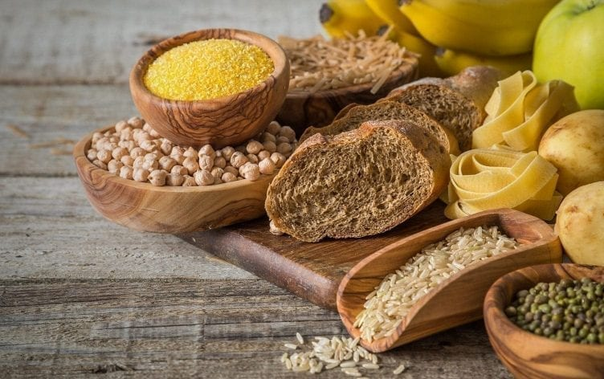
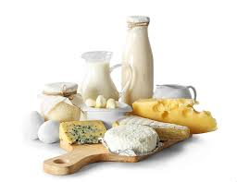
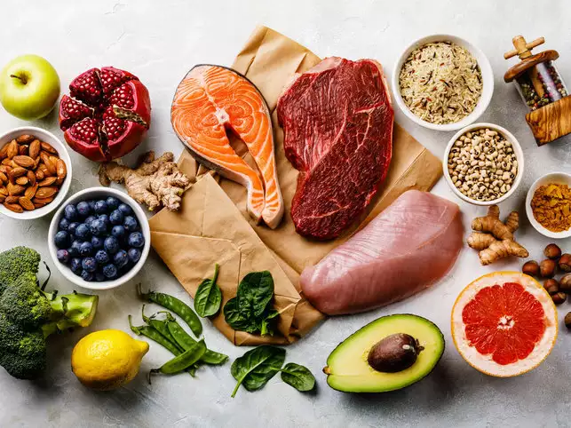
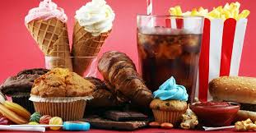
This is the healthy eating plate. You should be eating:
A lot of fruit, some carbohydrates but not too much, A bit of dairy A little bit of protein, And sweets once in a while. BY DB
Notes:
Danikah: This is the healthy eating plate. You should be eating:
A lot of fruit, some carbohydrates but not too much, A bit of dairy A little bit of protein, And sweets once in a while

Slide 4
Eat less salt: no more than 6g a day for adults
Be hydrated drink at least 6-8 glasses a day
Eat more fish including a portion of oily fish
Eat lots of fruit and veg
Cut down on fat and sugar
Here is the success criteria for a healthy diet and way of life. If you think about how we succeed in class this will help you. By AH
Notes:
Anna: We should…

Slide 5
Quiz
How many fruits shall we have a day?
5 fruits a day
What is the most thing you should be having from the healthy eating plate?
Fruits and vegetables
How many glasses should you at least have a day?
6 to 8
True of False, you should eat a sweet every hour?
False
Notes:
Angela=1 Danikah=2 Anna=3 Angela=4

Slide 6

Smoking
Notes:
Anna: Smoking

Slide 7
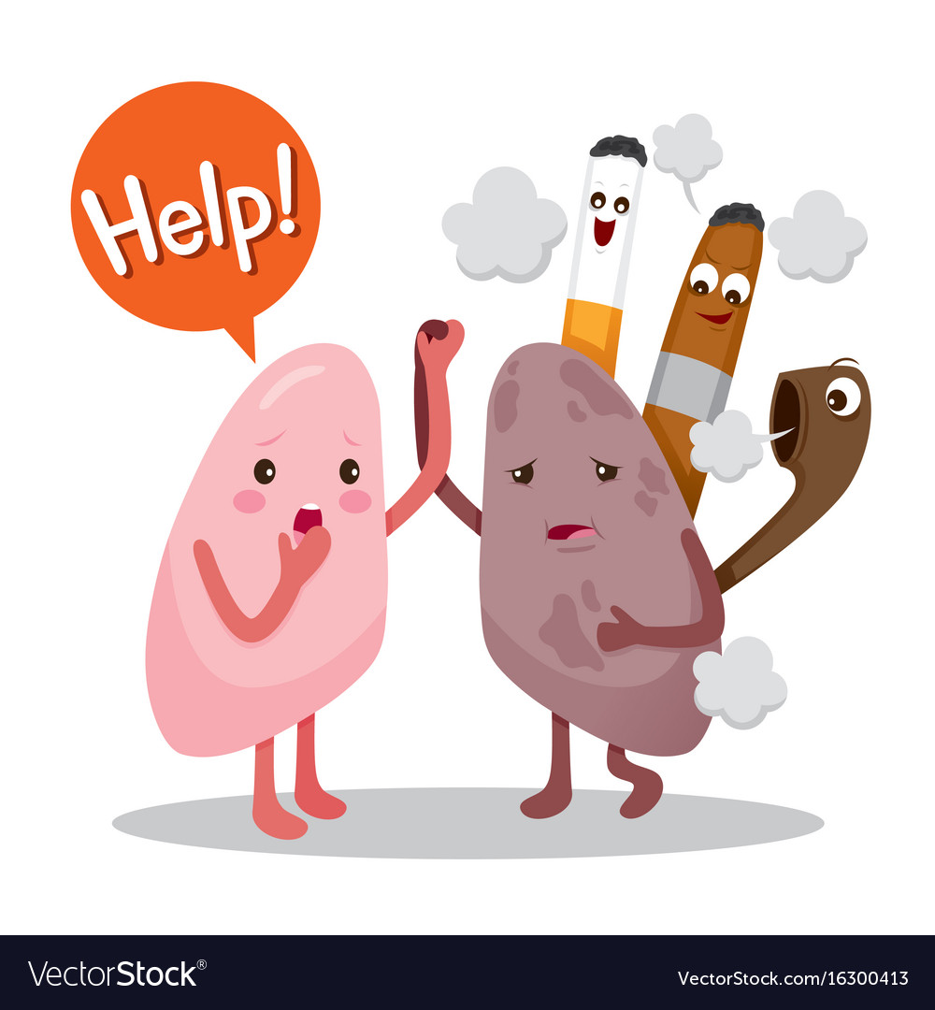
How can smoking affect your lives?
Smoking is very bad for you. It can
effect your lungs and turn your lungs
black. It is bad for your health. It also
Causes 84% of death. If you start to
Smoke it will become addictive so if I
wouldn’t smoke.
Notes:
Angela:

Slide 8
Quiz
1) How does smoking affect your life?
It turns your lunges black and it can effect your mental health.
What is the percentage of death from smoking?
84%
True of False, Smoking will help you live for a long time?
False
Notes:
Anna=1,4 Danikah=2 Angela=3

Slide 9
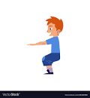
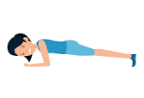

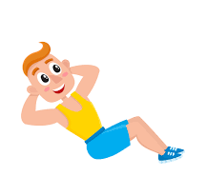
Physical Exercise
Notes:
Anna:

Slide 10
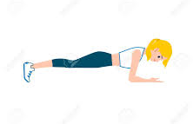
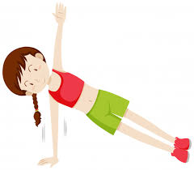
Everyday we should at least have 30 minutes of
exercise a day to keep active. You could do a
Plank, squats, sit-ups, push-ups, running and more.
You could do sports like;
Football
Gymnastics
Netball
Horse Riding
Notes:
Danikah=Everyday we should at least have 30 minutes of exercise a day to keep active. You could do a Plank, squats, sit-ups, push-ups and more. You Could do sports like;
Football, Who does football here? Gymnastics, Who does Gymnastics here? Netball, Who does netball? Horse Riding, Who does horse riding?

Slide 11
Quiz
True or False , you should do 30 minutes of exercise?
True
What sports can you do to keep active?
Gymnastics, football, netball, horse riding.
True or false, We shouldn’t be active?
False
Notes:
Anna= 1 Danikah= 2 Angela=3 Anna=4

