Slide 1


Healthy lifestyle

Slide 2
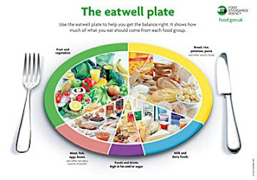

Slide 3

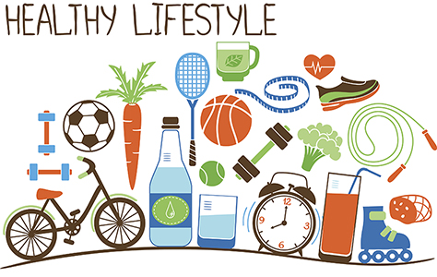
A HEALTHY CHOICE
Welcome to our presentation , were you will learn a lot of valuable information about a healthy lifestyles .

Slide 4
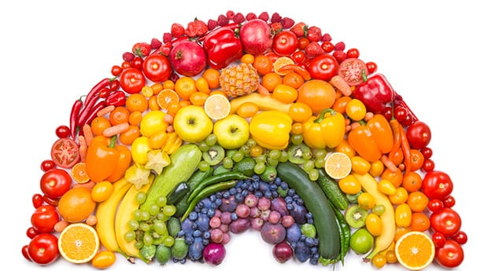

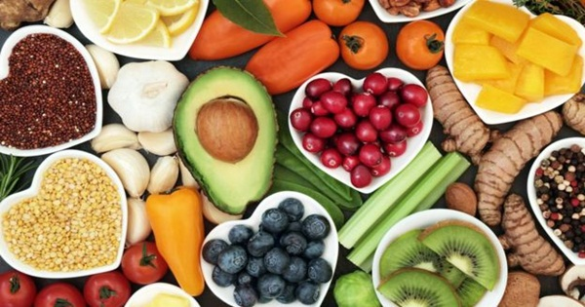
A HEALTHY BALENCED DIET
Children 5-17 years should be doing 1h exercize
18-64 should be doing 15 mins of exercize
What is a healthy lifestyle ??
You should eat are:
Whole eggs
Fish
Salad
Meats
Whole Grains
Nuts

Slide 5
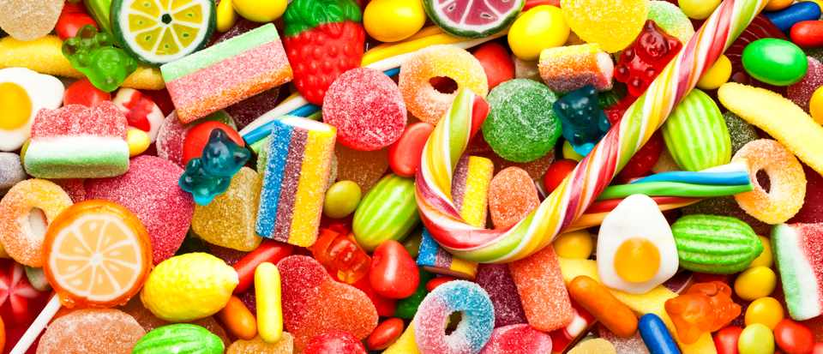
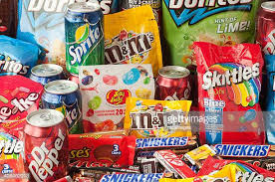
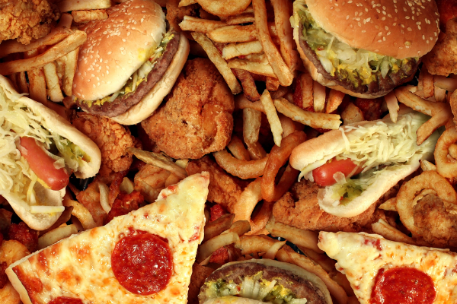
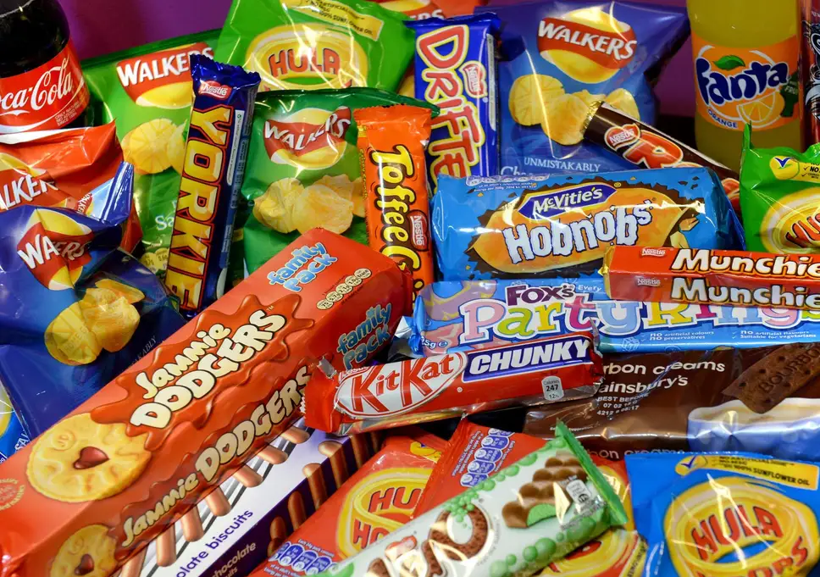
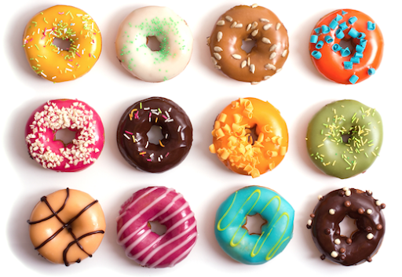
A UNHEALTHY DIET
w
WHAT IS UNHEALTHY FOOD??
Unhealthy foods are things that don’t have natural sugar ,but instead have sugar cubes, which is proper sugar, and is really not good for you:
Chocolate
Sweets
Chocolate cover biscuits / biscuits
Pizza
Take away
Burgers
Anything fried
Crisps
Cakes.

Slide 6
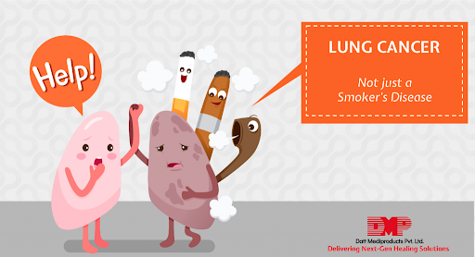
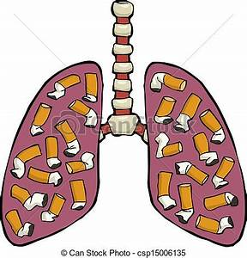
What does smoking do to you??
Smoking causes 84% of deaths. It is not ideal for kids or adults to smoke . The most common illness you can get is lung cancer. Most people can’t stop smoking because of the nicotine . Nicotine makes you addicted because it is a drug . There is a way you can stop and that is gum. This is to make sure people don’t smoke.

Slide 7
How does this make you feel when you are smoking??
This makes you feel rubbish because you have tar going into your body . You should never smoke because you can die and you wouldn’t like how you feel because you are always having a bad day everyday.

Slide 8
Mental health
Mental health can be very common . Most people have emotional health, it is important part of overall health . People who are emotionally healthy are in control of their thoughts feelings and behaviours . They are able to cope with life's challenges . What challenges have you come across…? If you have solved any of your problems you are very good in control. What didn’t you know before this slide ?

Slide 9



If you do any of the physical exercises below each day believe it or not you will be very fit in only a few months if you have the correct mindset. Press ups running sit ups burpies swimming
Physical exercise

Slide 10
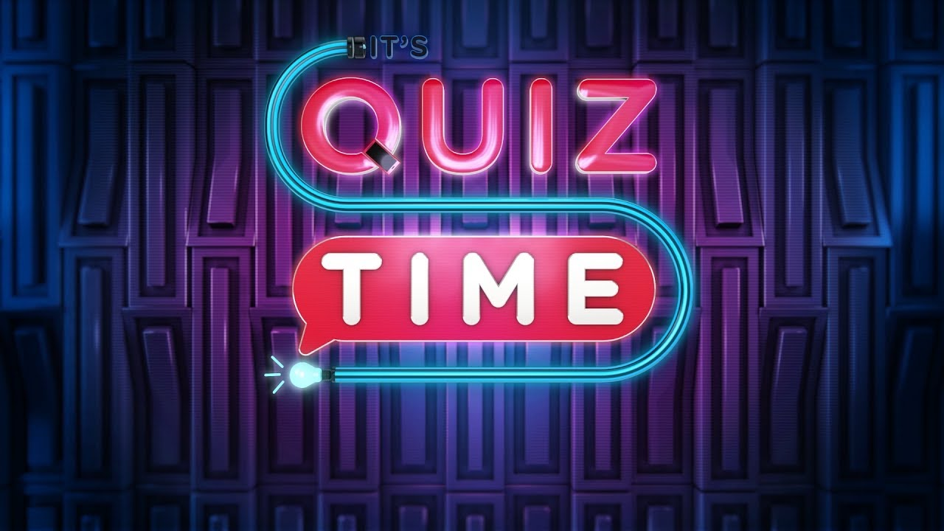
QUIZ
WHAT IS THE MOST AMOUNT OF EXERCIZE FOR KIDS ??(5-17)
1 HOUR
TRUE OR FALSE, MENTAL HEALTH IS COMMON??
True
TELL ME TWO UNHEALTHY FOODS
CHOCLATE, SWEETS, CHOCLATE COVERED BISCUTES/BISCUTES, PIZZA,TAKE AWAY, BURGERS, ANYTHING FRIED, CRISPS, CAKES

