Slide 1
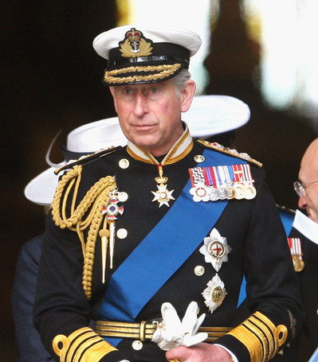
King Charles III
Supreme Governor of the Church of England
Notes:
At the moment the Queen died, the throne passed immediately and without ceremony to the heir, Charles, the former Prince of Wales.
He will be known as King Charles III.
That was the first decision of the new king's reign. He could have chosen from any of his four names - Charles Philip Arthur George.
Charles was officially proclaimed King on Saturday 10th September. This happened at St James's Palace in London, in front of a ceremonial body known as the Accession Council.

Slide 2
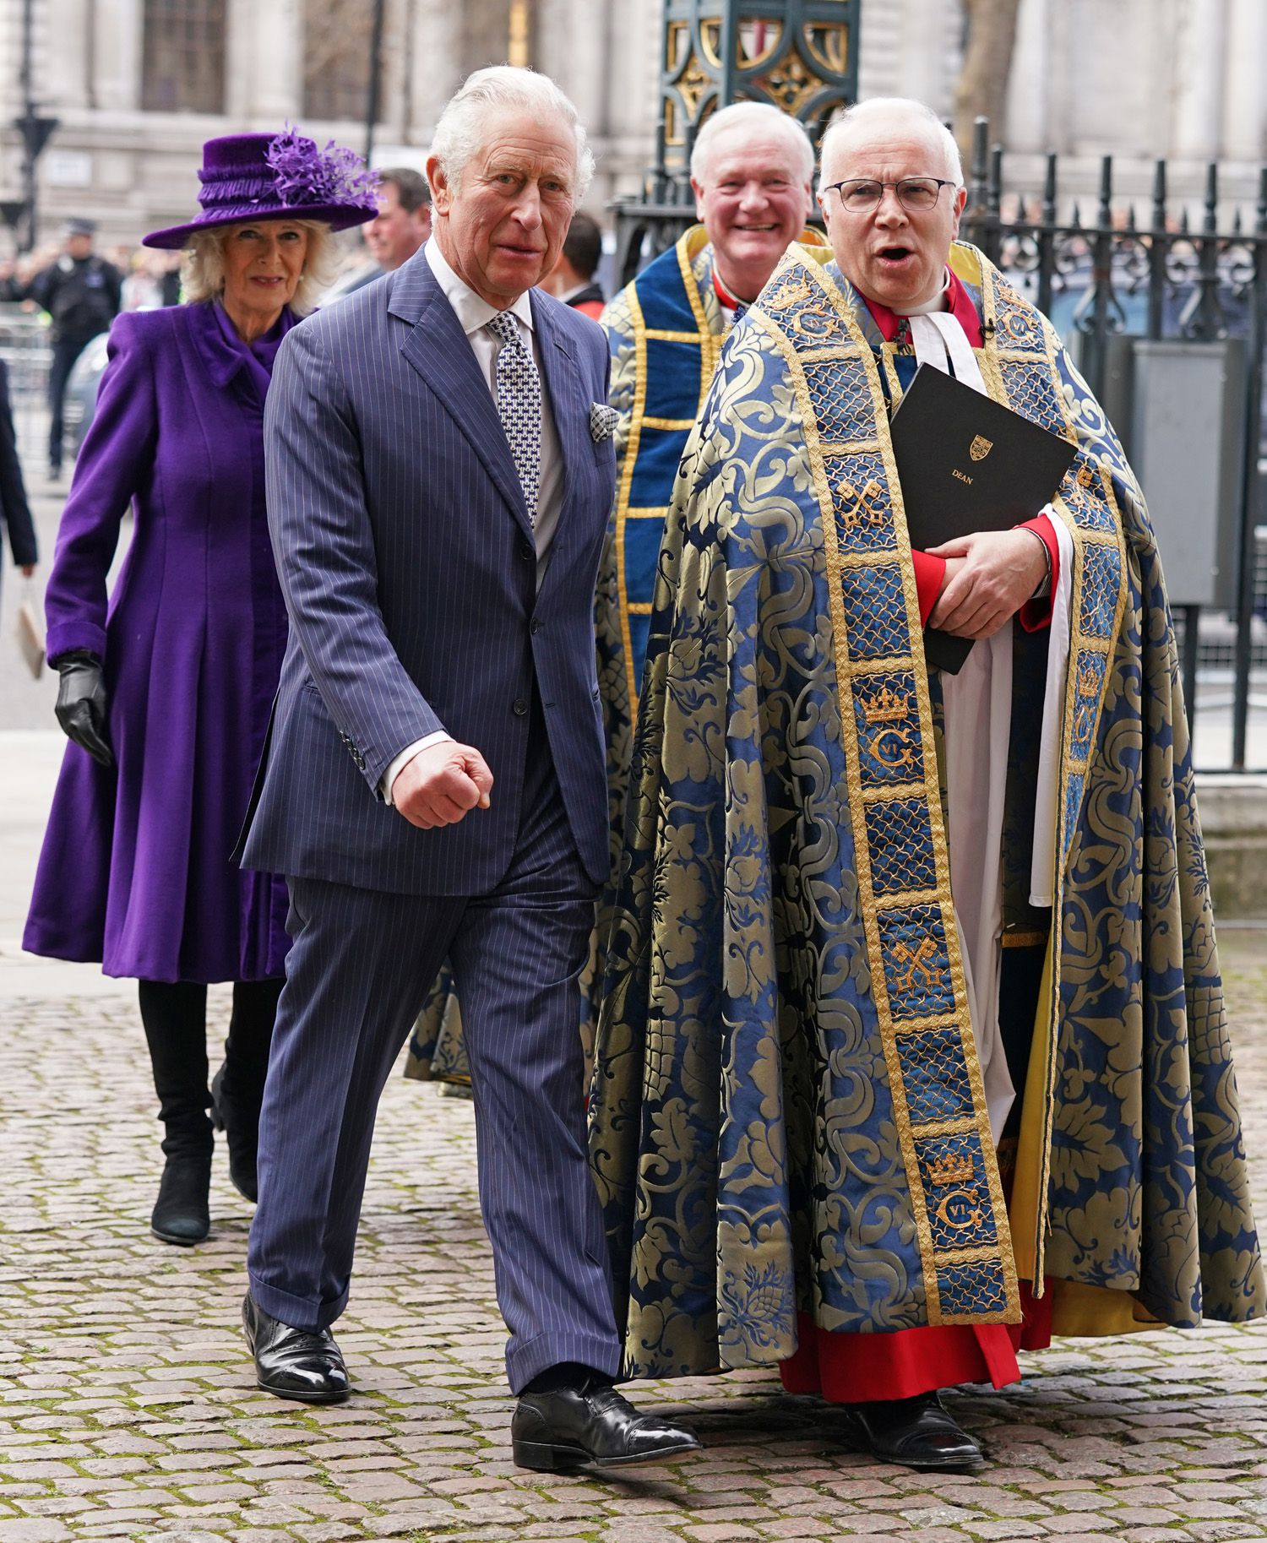
Defender of the Faith
“The role and the duties of Monarchy also remain, as does the Sovereign’s particular relationship and responsibility towards the Church of England – the Church in which my own faith is so deeply rooted.”
King Charles III

Slide 3
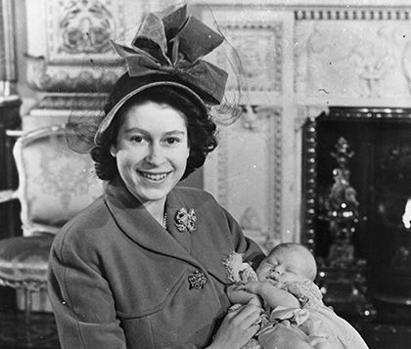
Charles Philip Arthur George
14th November 1948

Slide 4
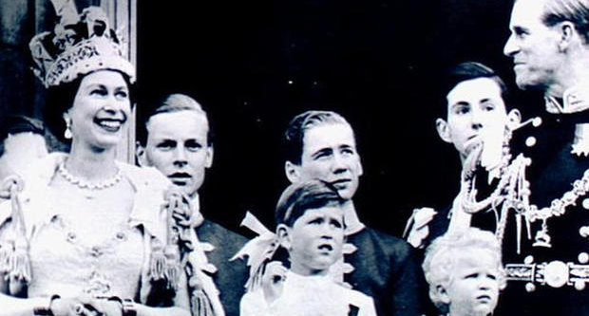

Slide 5
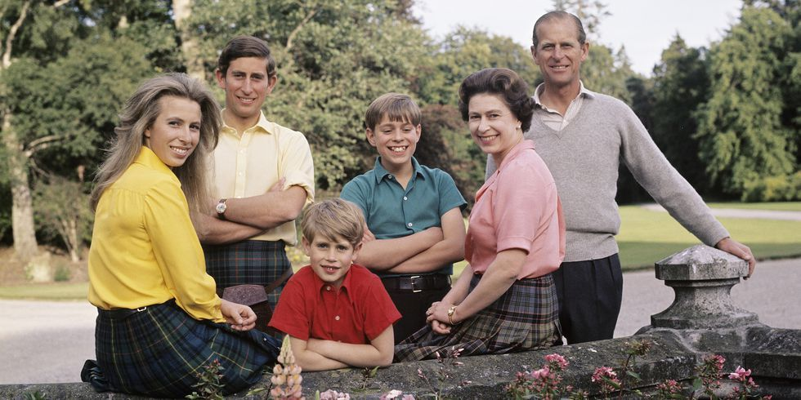

Slide 6
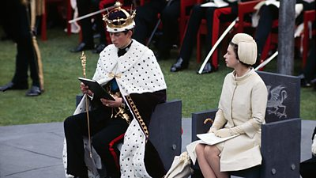
Charles was invested as Prince of Wales
on 1st July 1969

Slide 7

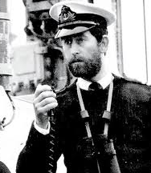
King Charles served in the Royal Airforce and Royal Navy from 1971-1976

Slide 8
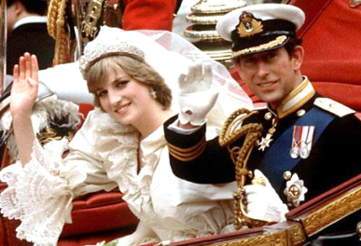
Prince Charles
married
Lady Diana Spencer
29th July 1981

Slide 9
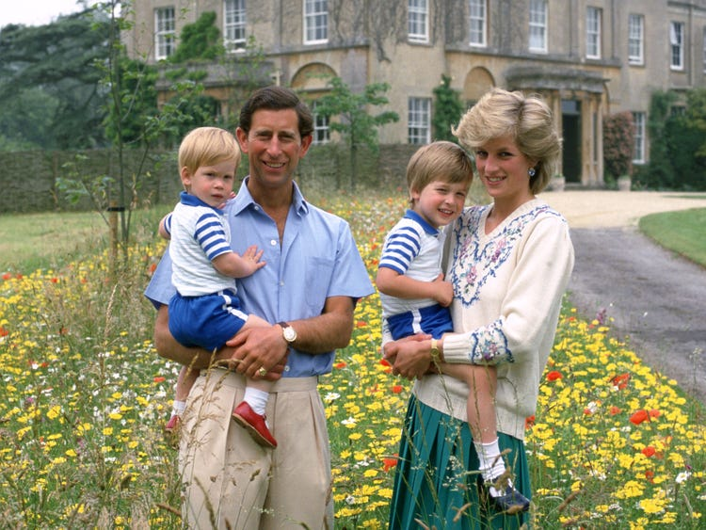
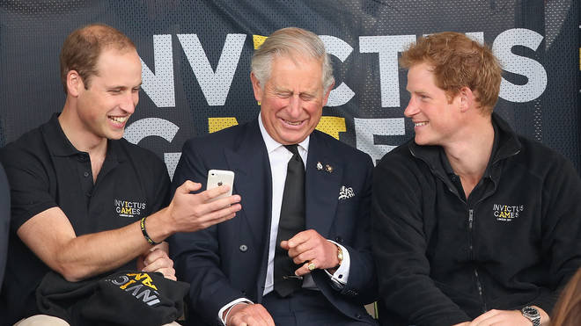
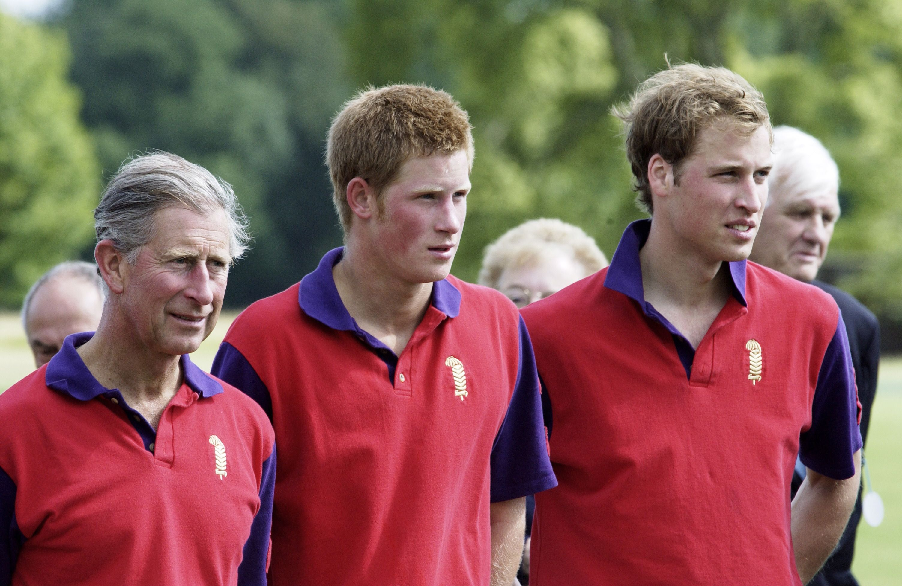
Charles with his two sons William and Harry

Slide 10
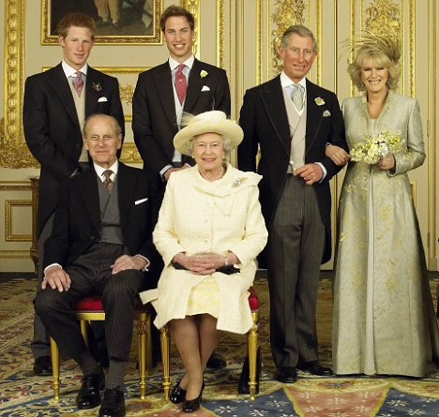
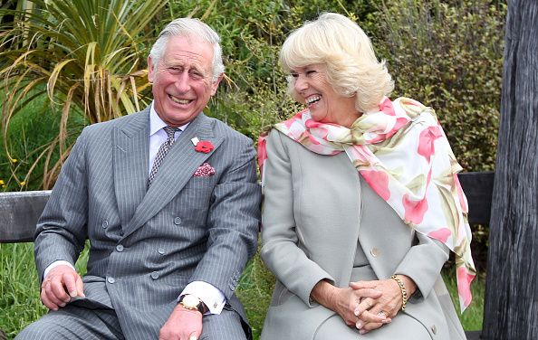
Prince Charles married
Camilla Parker-Bowles
9th April 2005

Slide 11
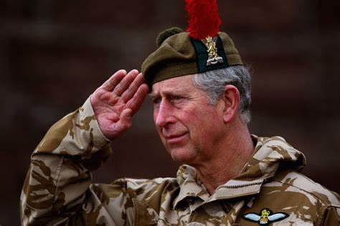
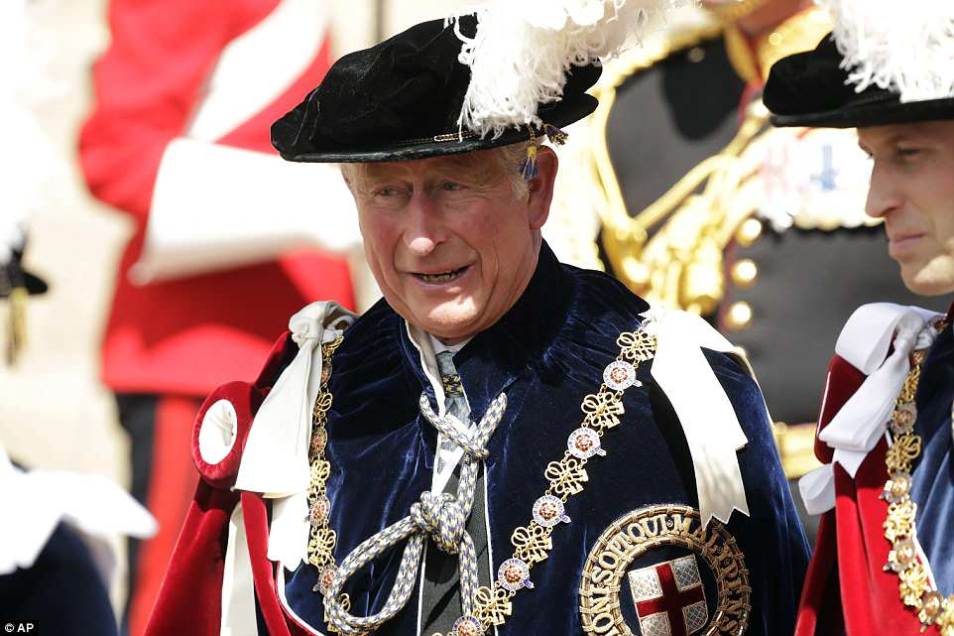
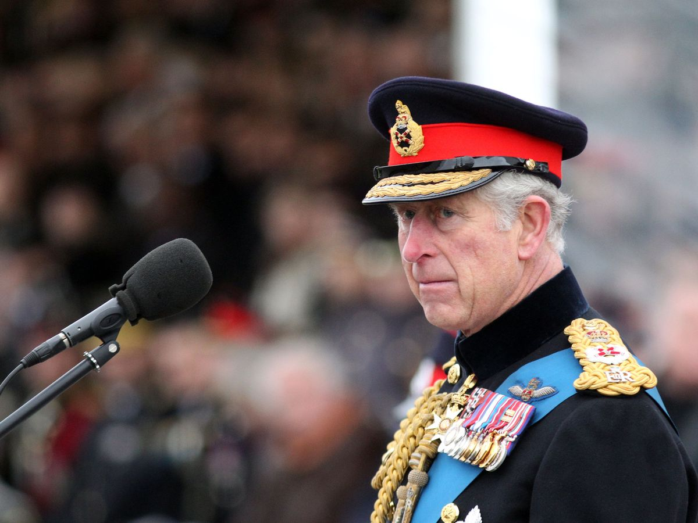
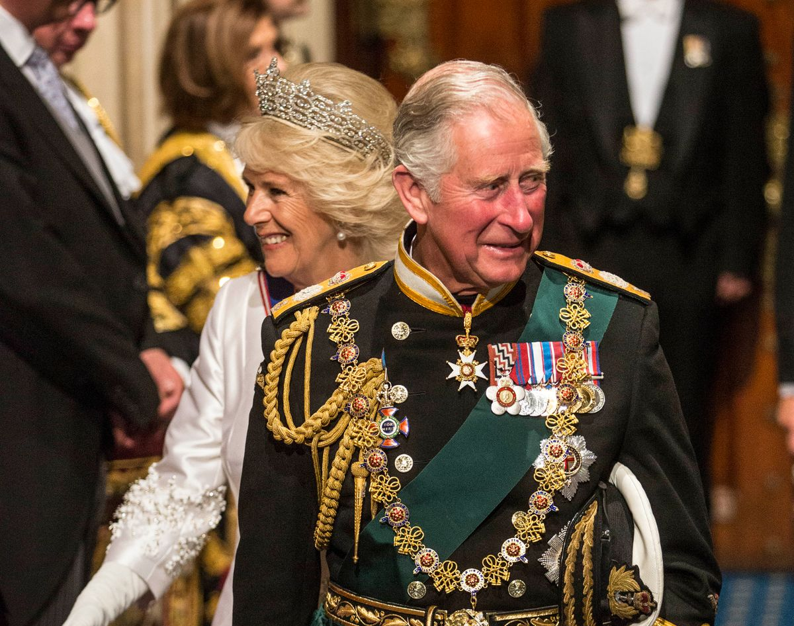
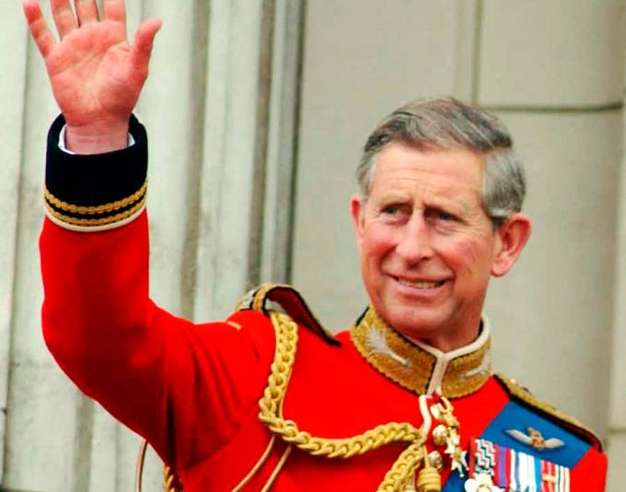
Notes:
Commander-in-Chief of Britain's Armed Forces

Slide 12
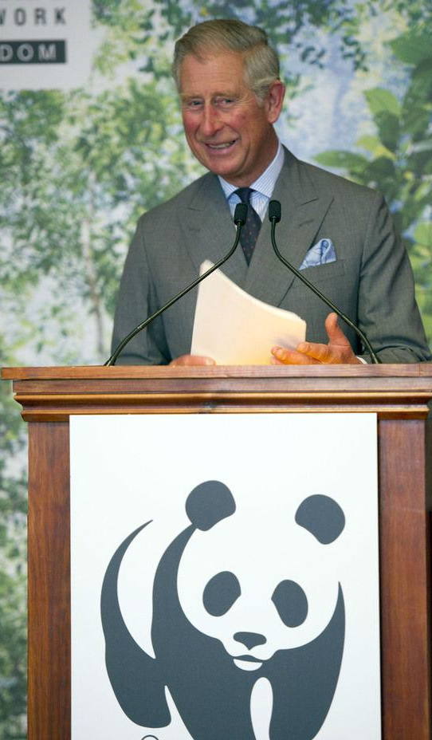
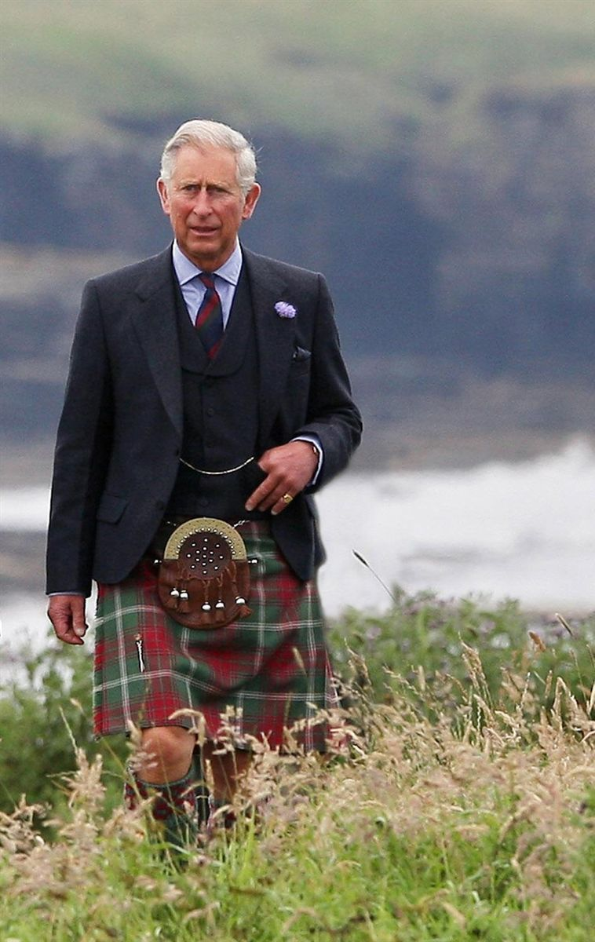
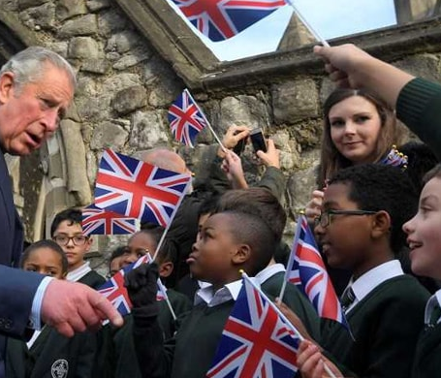
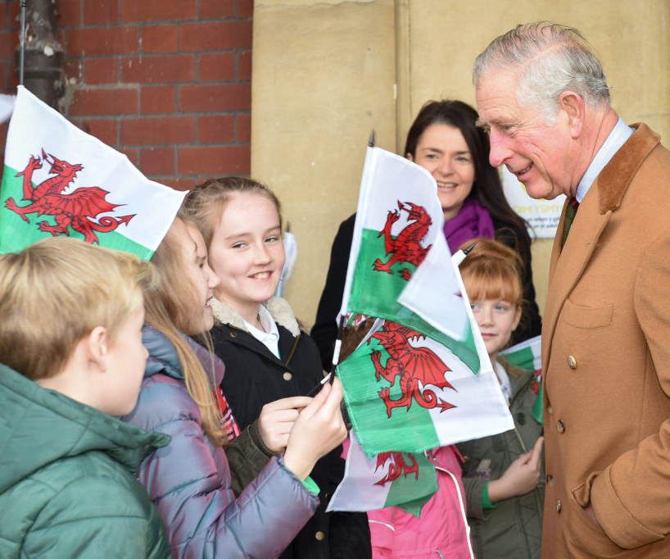

Slide 13
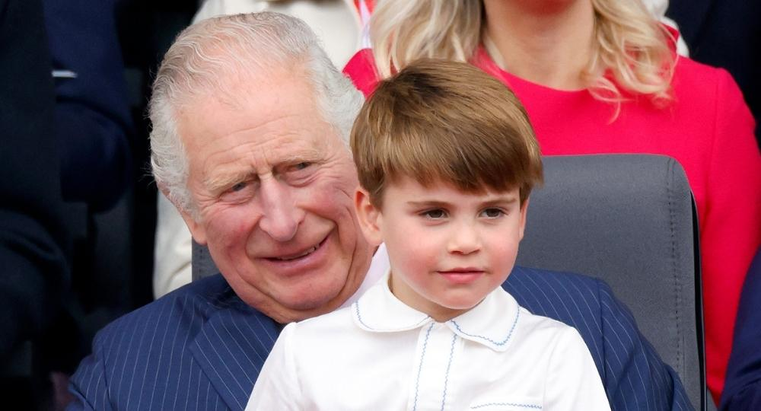

Slide 14
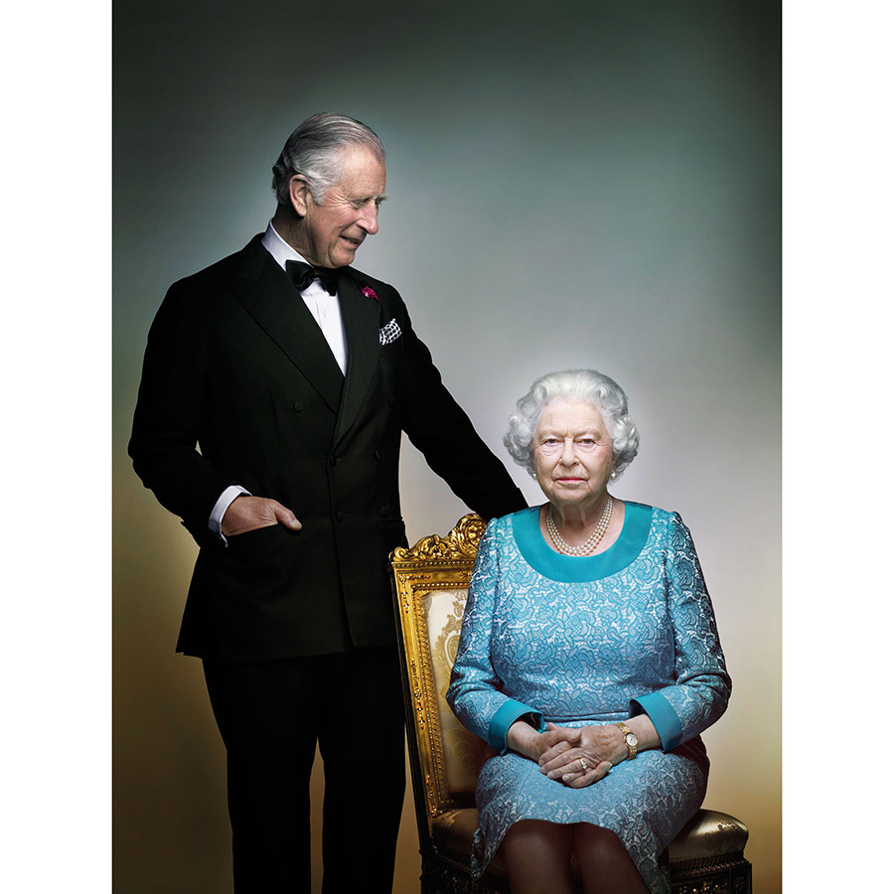
“Her Majesty The Queen – my beloved Mother – was an inspiration and example to me and to all my family, and we owe her the most heartfelt debt any family can owe to their mother; for her love, affection, guidance, understanding and example.”
King Charles III

Slide 15
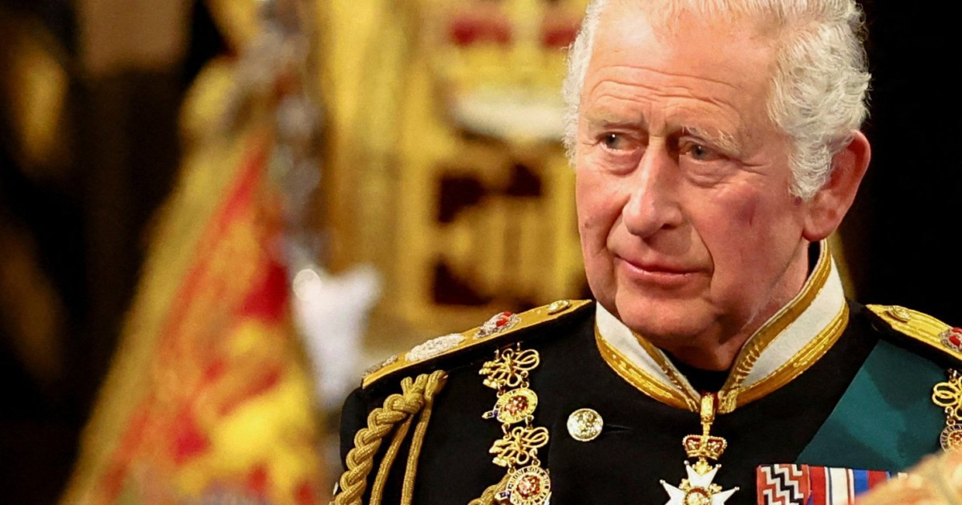
“ I too now solemnly pledge myself, throughout the remaining time God grants me, to uphold the Constitutional principles at the heart of our nation. And wherever you may live in the United Kingdom, or in the Realms and territories across the world, and whatever may be your background or beliefs, I shall endeavour to serve you with loyalty, respect and love.”
King Charles III

Slide 16
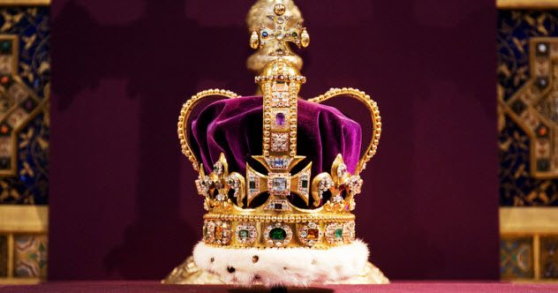
The Coronation
Notes:
The symbolic high point of the accession will be the coronation, when King Charles is formally crowned. Because of the preparation needed, the coronation is not likely to happen very soon after Charles's accession - Queen Elizabeth succeeded to the throne in February 1952, but was not crowned until June 1953.
For the past 900 years the coronation has been held in Westminster Abbey - William the Conqueror was the first monarch to be crowned there, and Charles will be the 40th.
It is an Anglican religious service, carried out by the Archbishop of Canterbury. At the climax of the ceremony, he will place St Edward's Crown on Charles's head - a solid gold crown, dating from 1661.
This is the centrepiece of the Crown Jewels at the Tower of London, and is only worn by the monarch at the moment of coronation itself (not least because it weighs a hefty 2.23kg - almost 5lbs).
There will be music, readings and the ritual of anointing the new monarch, using oils of orange, roses, cinnamon, musk and ambergris.
The new King will take the coronation oath in front of the watching world. During this elaborate ceremony he will receive the orb and sceptre as symbols of his new role and the Archbishop of Canterbury will place the solid gold crown on his head.
Words taken from BBC website

Slide 17
Everlasting God, we pray for our new King.
Bless his reign and the life of our nation.
Help us to work together
so that truth and justice, harmony and fairness
flourish among us;
through Jesus Christ our Lord.
Amen.
Notes:
A Prayer for the new King, Charles III - The Association of English Cathedrals

