Slide 1

Lego Therapy

Slide 2
Who does Lego therapy?
We have been using lego therapy to help my friends and some of my autistic friends.
We take part in lego therapy once a week and there are 3 of us in a group.
"It's fun – it helps me build Lego" - SP

Slide 3
How does it help autistic children?
I found out that lego therapy helps me to describe the piece and where it needs to be put. (PP)
I have learned to take my turn and follow instruction, but I also need to listen to my friends.
Did you know – that some autistic children struggle to understand what they might think in their mind, can’t be seen by others, that’s why we need to follow instructions carefully. (WA)
"We all work as a team to build stuff" - J

Slide 4
Is it just for autistic children?
No. Lego therapy also helps children who find speaking difficult and children who find writing or holding things in their hands hard. (AB)
It helps me because I find when I write my hand aches and I have some fiddle toys to help my hands as well. (HB)

Slide 5
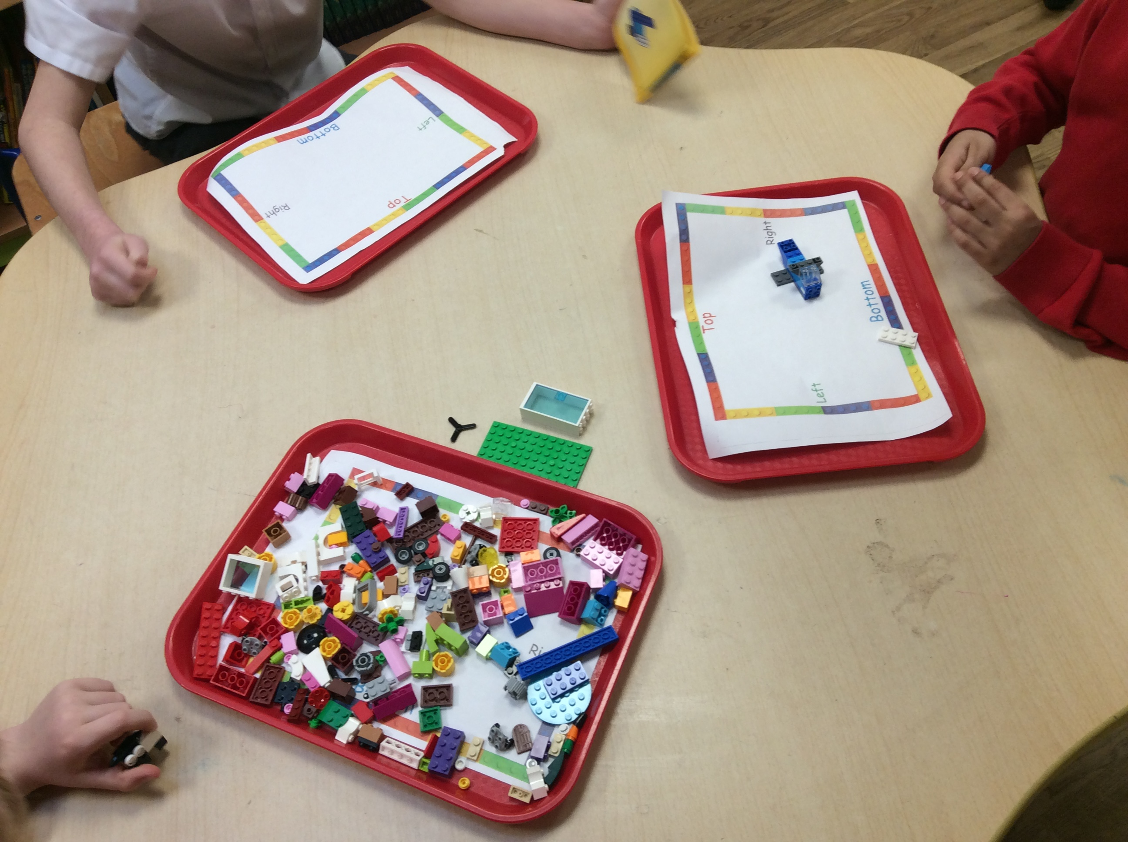
Why a group of three?
The main activity involves three important roles:
The Engineer
The Supplier
The Builder

Slide 6
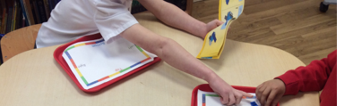
1. The Engineer
The engineer has the instructions and is in charge of the building plan.
The engineer tells the supplier and builder what to do but cannot touch the bricks or show them the instructions!
"When I was the Engineer I had to give out clear instructions." – I really wanted to help- KL

Slide 7
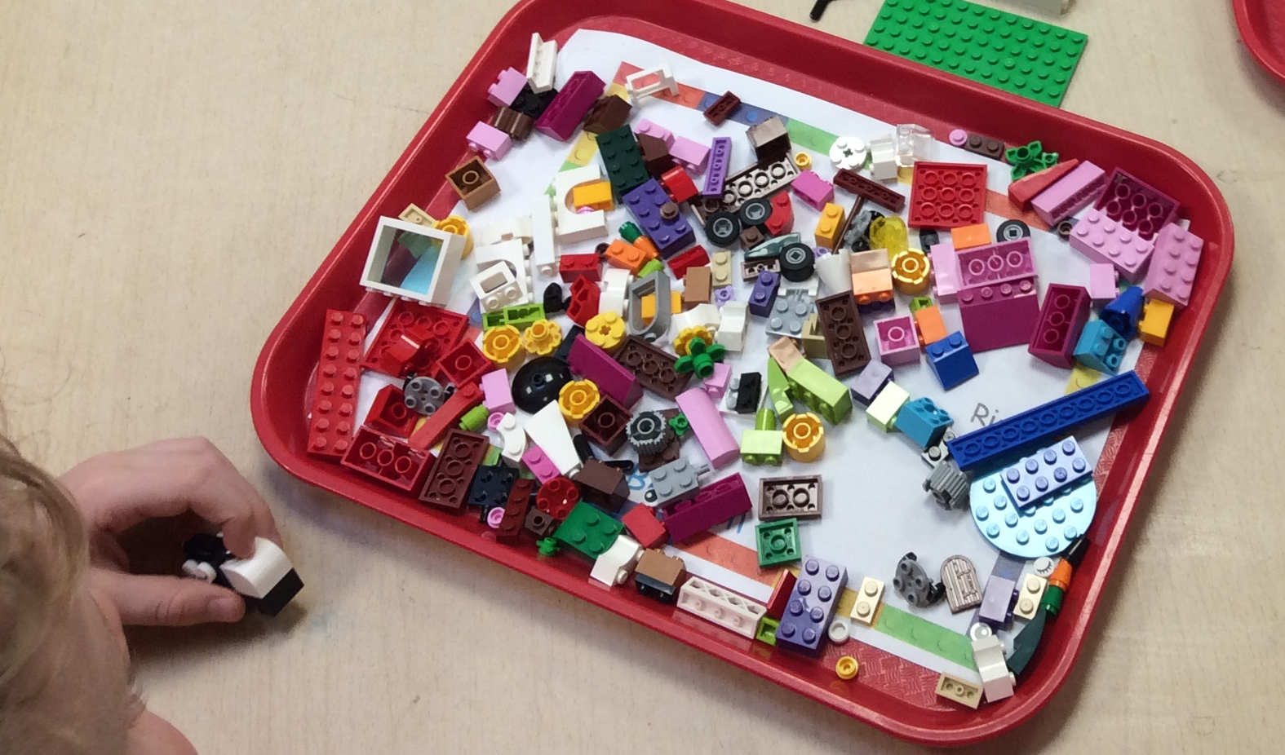
2. The Supplier
The supplier has all the Lego.
They are told what Lego pieces to select from the Engineer and then they pass them to the builder.
“When I was the supplier I listened. I didn't sort them – it makes me focus on searching for bits and that's more fun." - Jl

Slide 8
3. The Builder
The builder takes the pieces from the supplier and builds the model following the engineer's instructions.
But they aren't allowed to see the instructions!
"As a builder I had to listen and put the pieces where I was told. I had to concentrate" - MM

Slide 9
Do you do anything else?
There are other games we play:
What piece am I thinking of? A lot of Lego is put onto the table. We then take it in turns to describe one piece and the others try to point to it.
Identical build - We all have the same set of bits and you work behind a screen or a big book. We take turns to build an object and tells the others what to do. We then see if they are all identical. They are usually close to identical but we haven't achieved identical yet – there is always some piece that's not quite where it should be – but we are getting better. (SV)
Task cards - tasks such as 'Build something using exactly 20 pieces' or 'build a creature using the Lego given (can the others identify it?)’. This is fun, because when I am the first builder I have to think about what I will build, with only a few pieces of lego. (PH)
Free build – We get to play with the lego and make what we want.
"It's really nice, Time to talk to friends" - LB

Slide 10
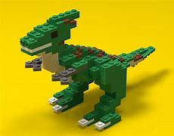
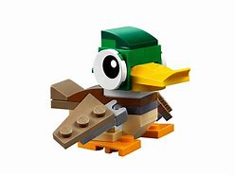

Lego Therapy
We hope you learned a lot about lego therapy and how it helps me to make friends and not feel anxious.
We sometimes play lego therapy in golden time as well. (SN)

