Slide 1
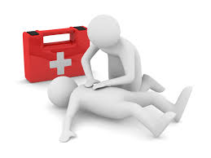
Mini Medics Visit from Sian
By Joseph, Thomas, Mary and Elspie

Slide 2
What happened?
On Tuesday 17th April Year4 had a visit from Sian who came to tell us about what to do in emergencies to do with first aid. We were told about the recovery position as well. We got to do a lot of fun activities. Sian came for the full afternoon.

Slide 3
The recovery position
Kneel besides them.
Remove glasses if wearing any.
Take the hand nearest to you and bend it at a right angle.
Take their other hand and bring it across their body (nearest to you) and hold.
Lift up the leg towards you onto their side

