Slide 1
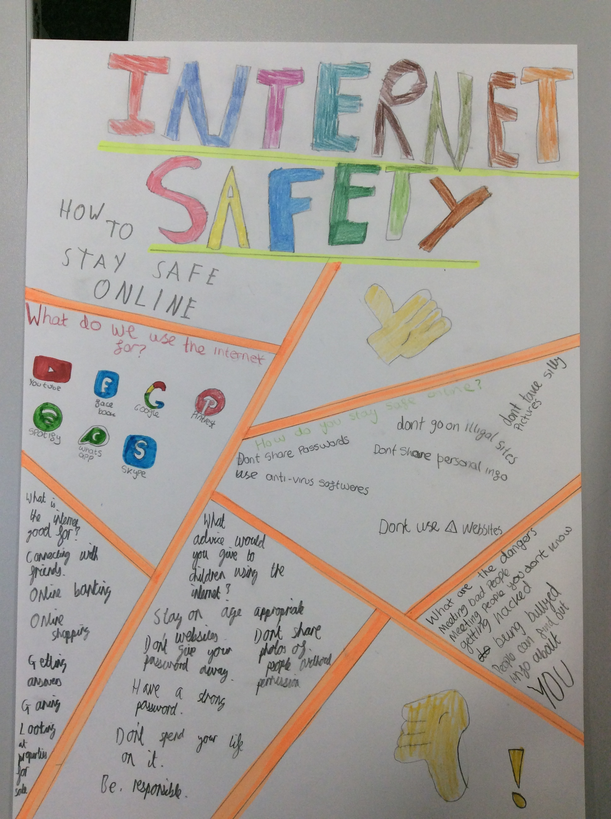
Online safety

Slide 2
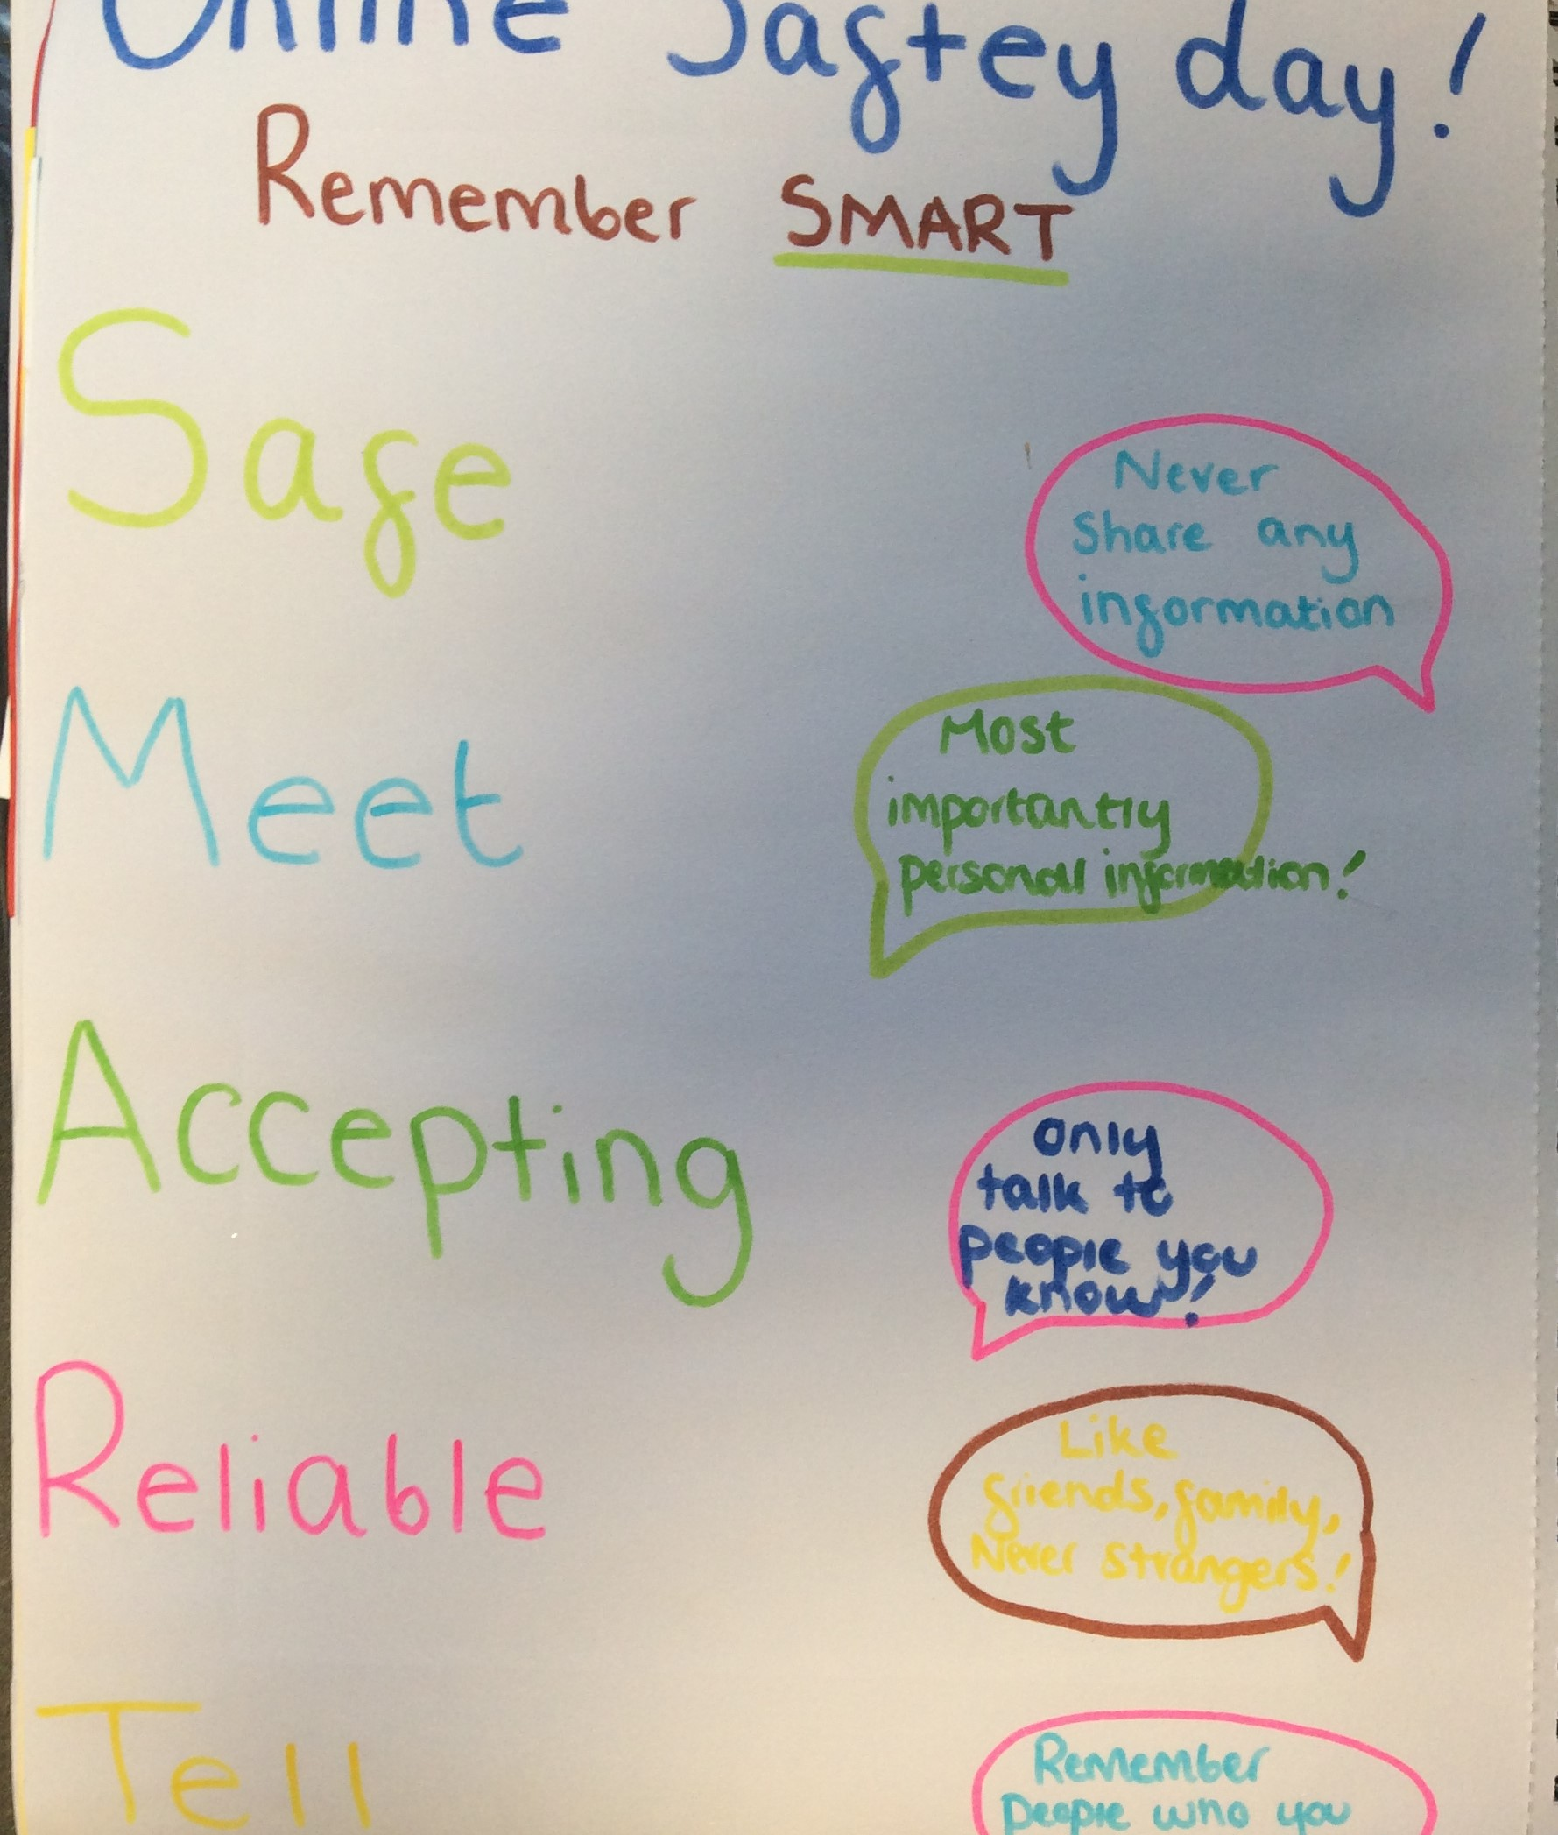
Online safety
Our thoughts
We have had lots of online lessons helping us to stay safe. We created words to help us remember SMART- that means keeping safe, (LB)
We made SMART posters to help us to remember keeping safe and the types of reliable information that we should not share (MP)

Slide 3
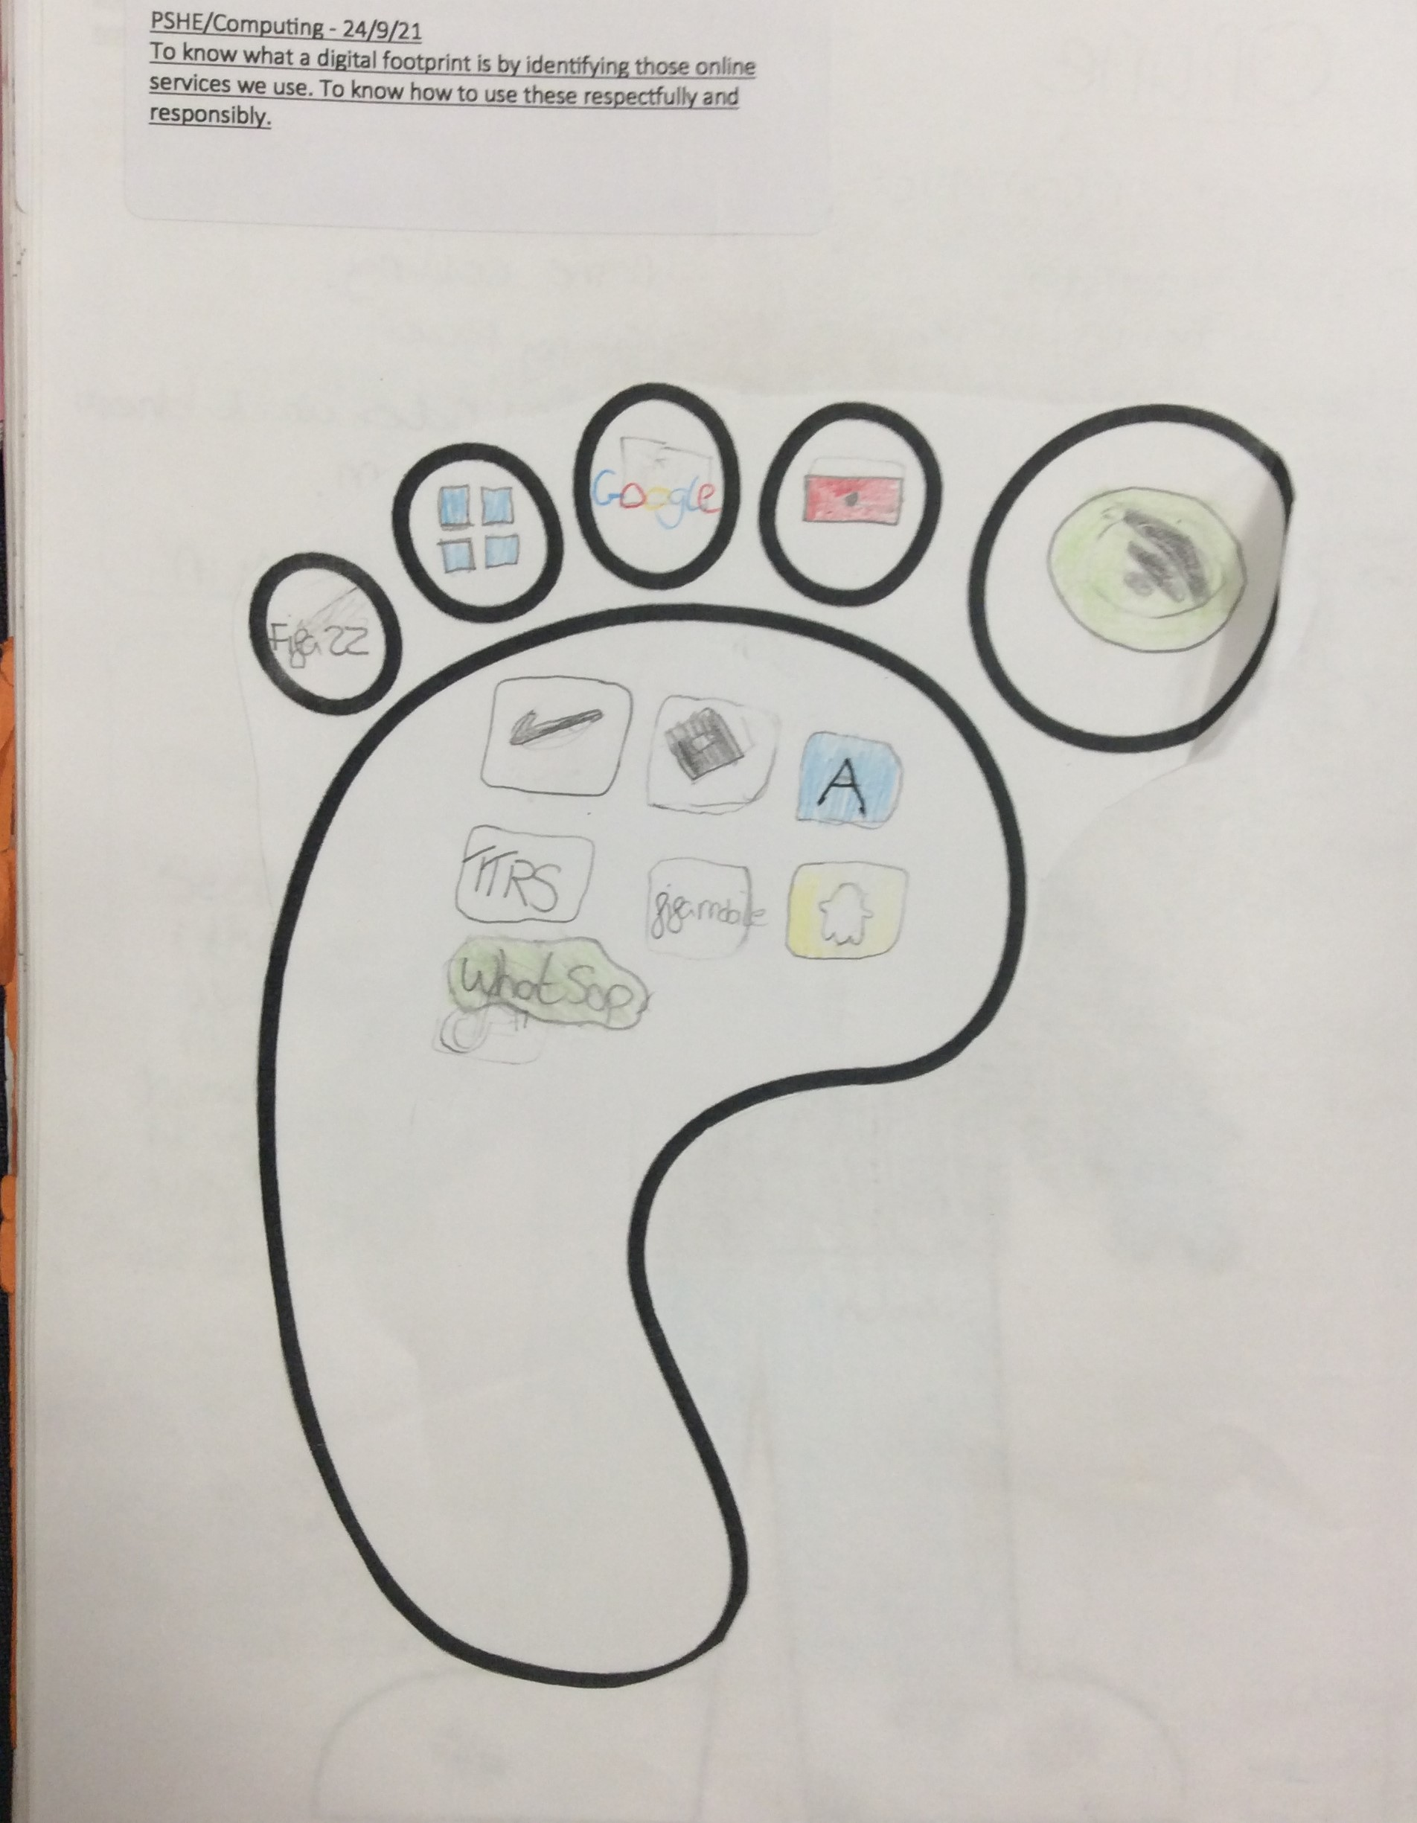
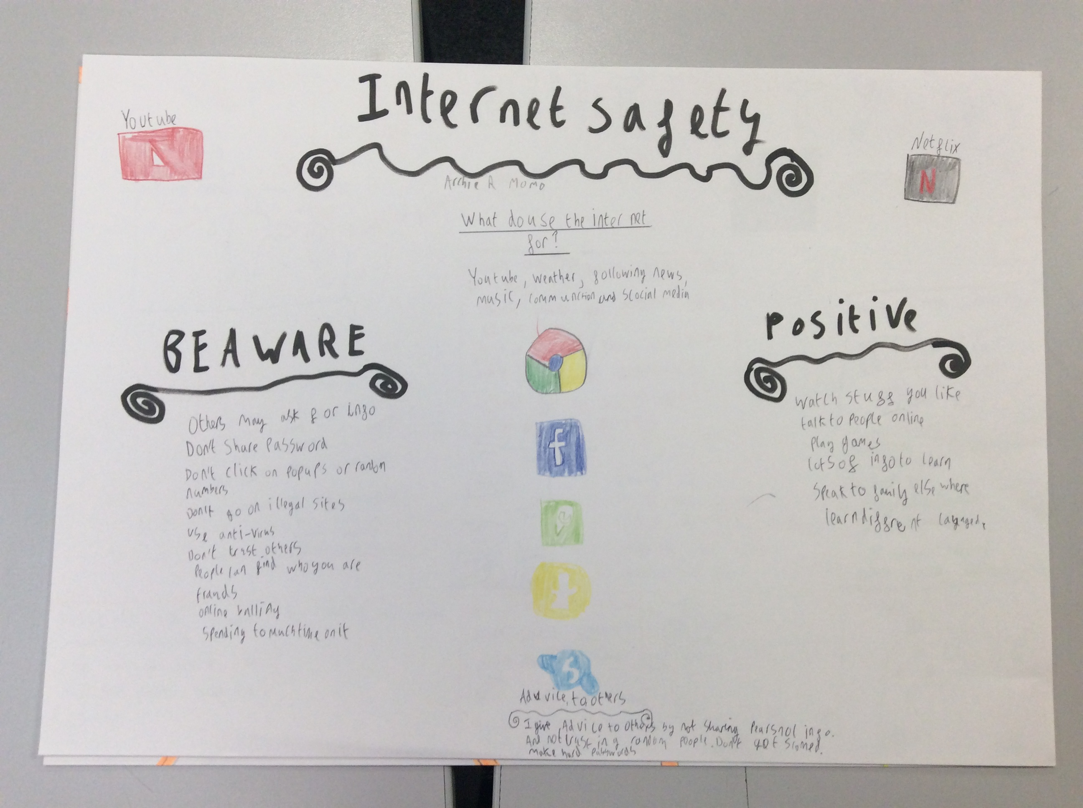
Online safety
We created an online footprint like a carbon footprint. This showed me I used my phone and ipad too long. I also was allowed to have WhatsApp.
I now know I am too young and this my mum has changed. (AB)

Slide 4
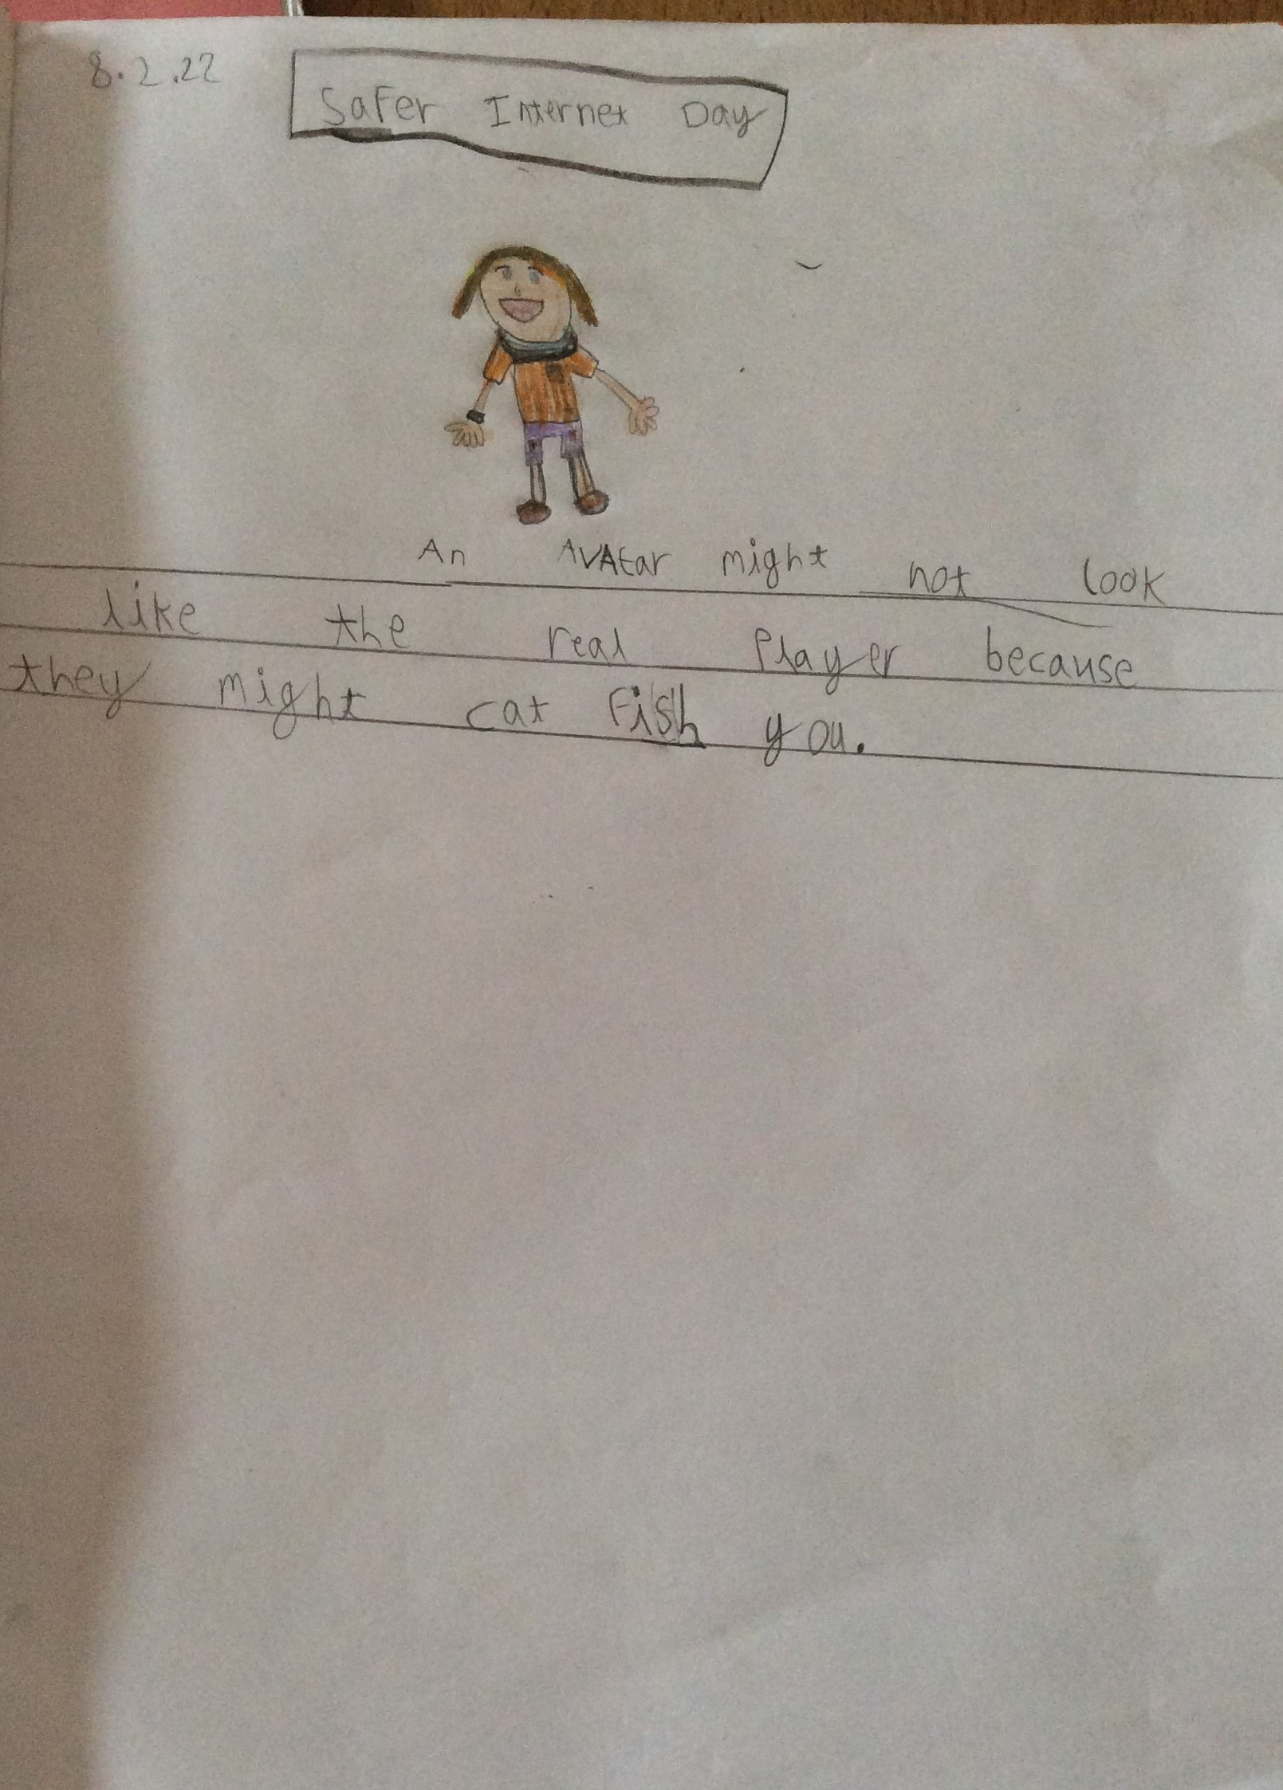
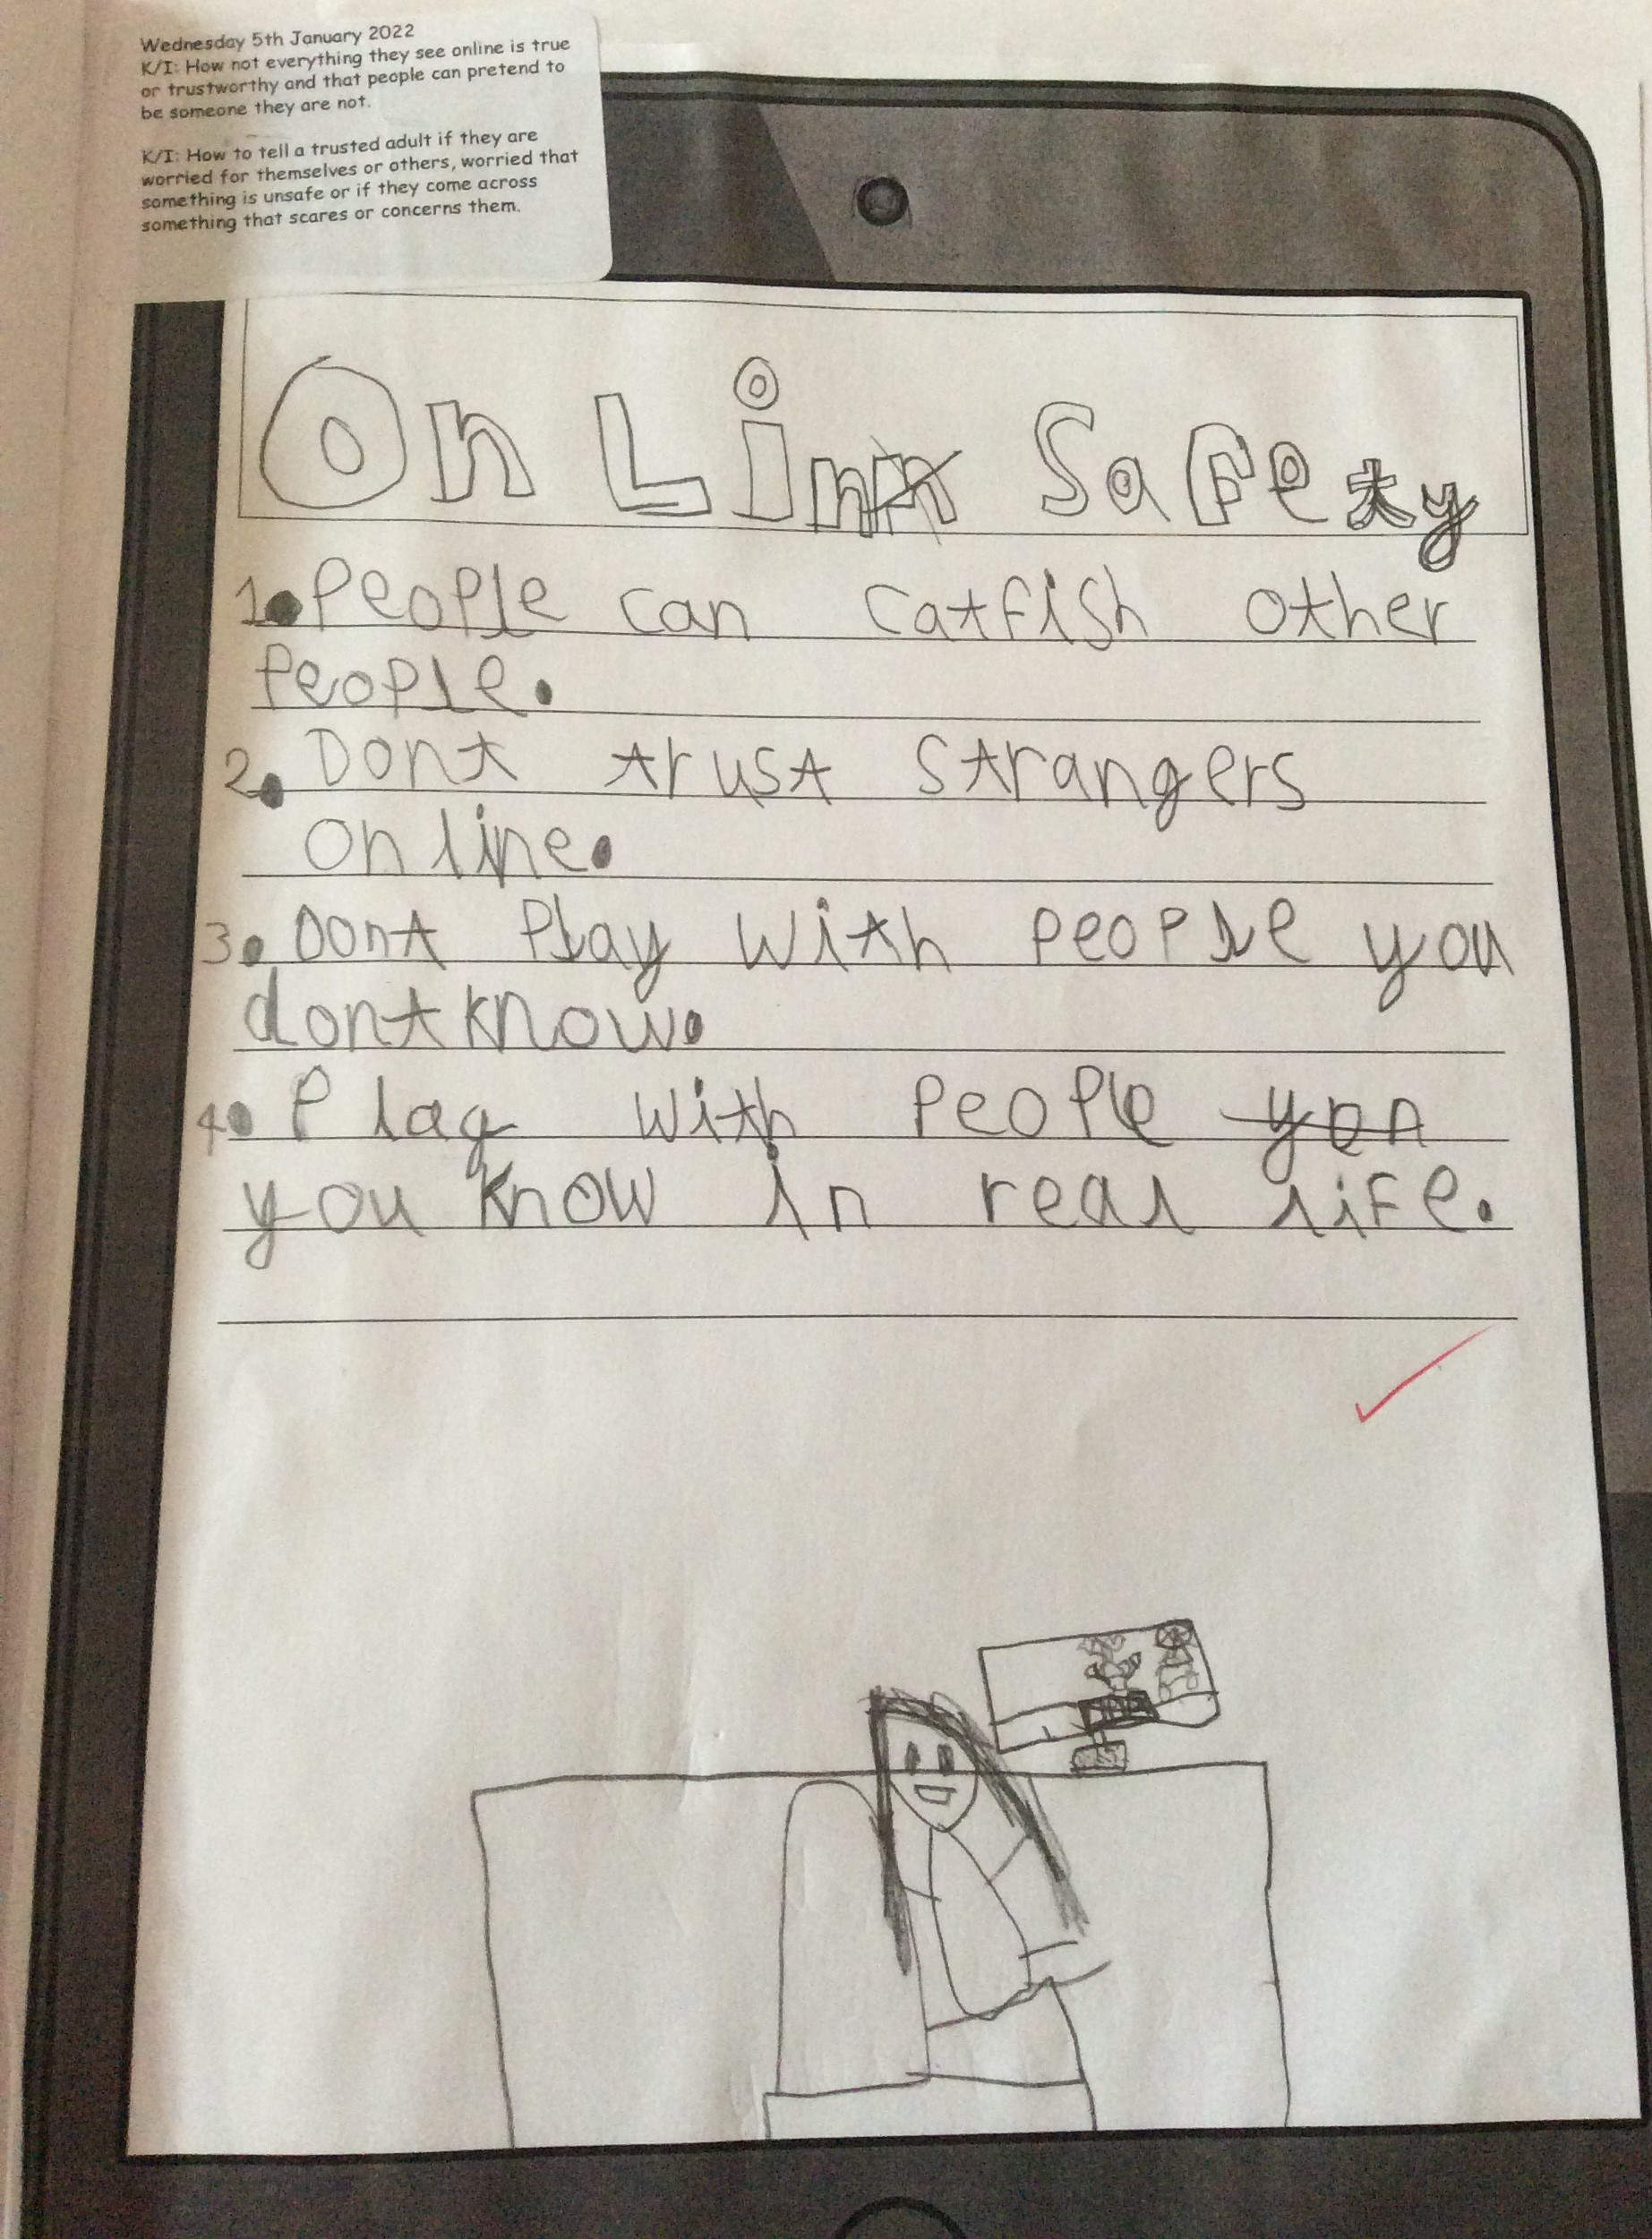
Online safety
We made our own avatar, but didn’t use our information. Really it is best to only play on games that mum and dad say are safe. (BT)

Slide 5
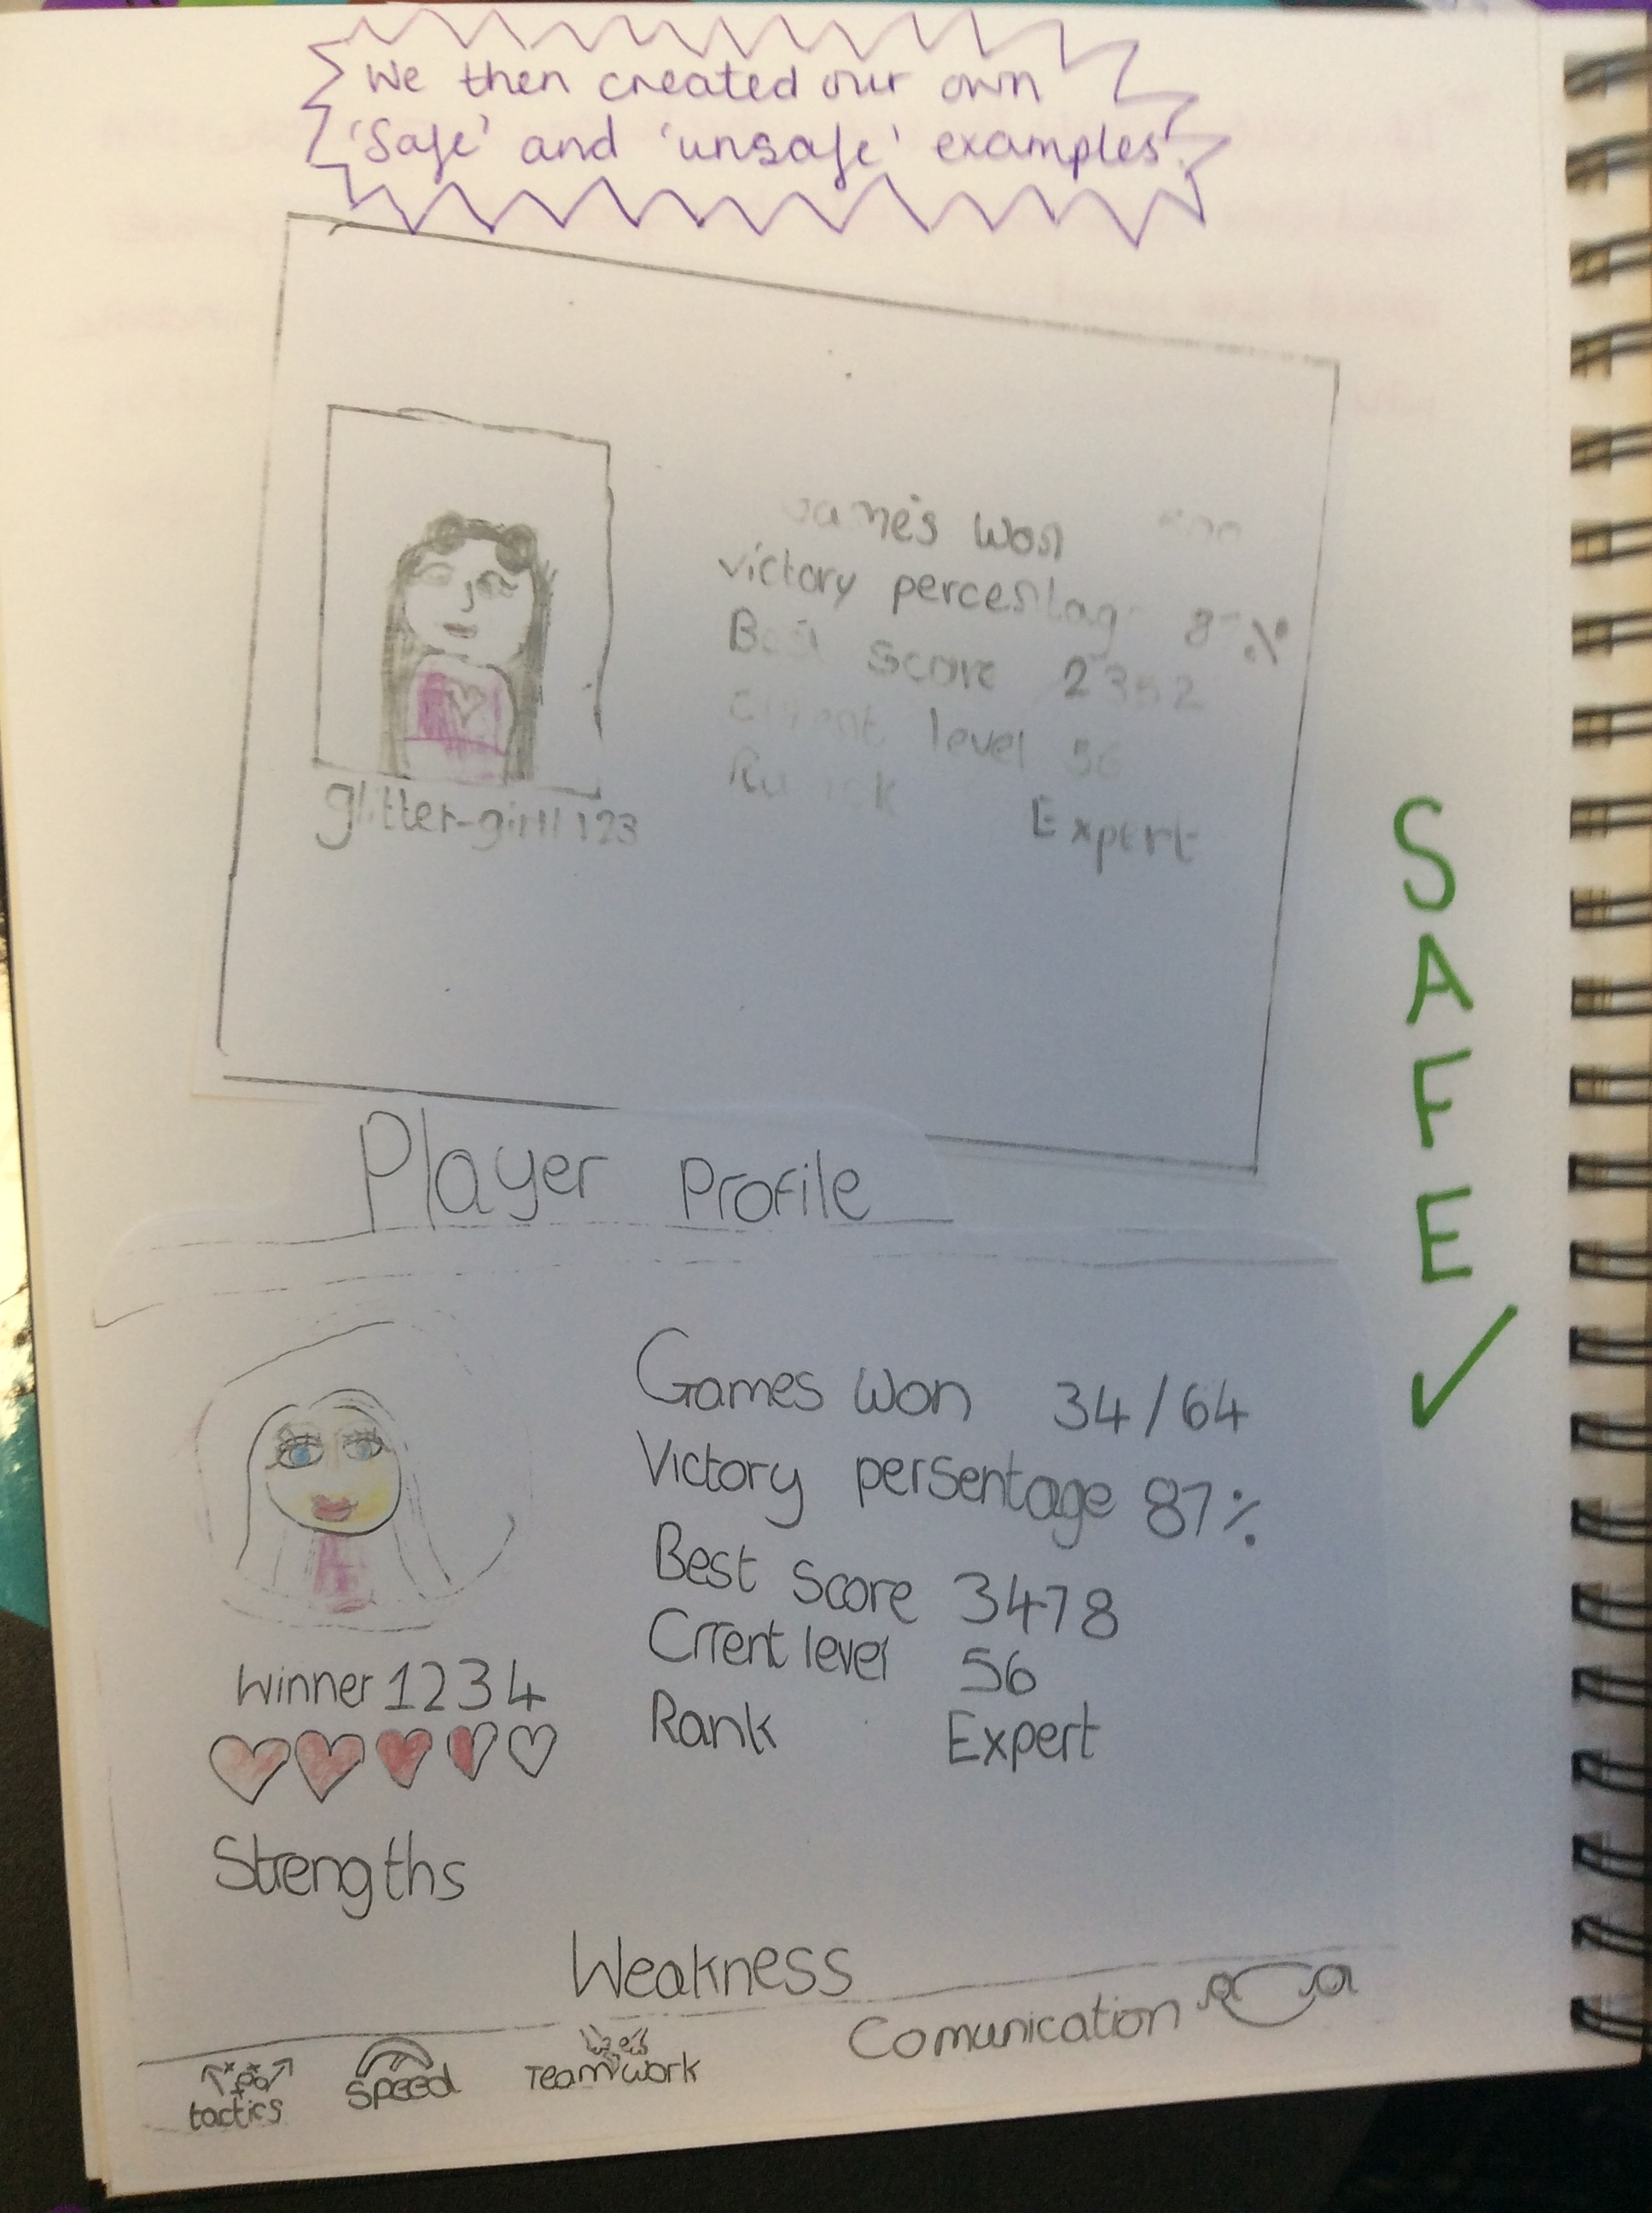
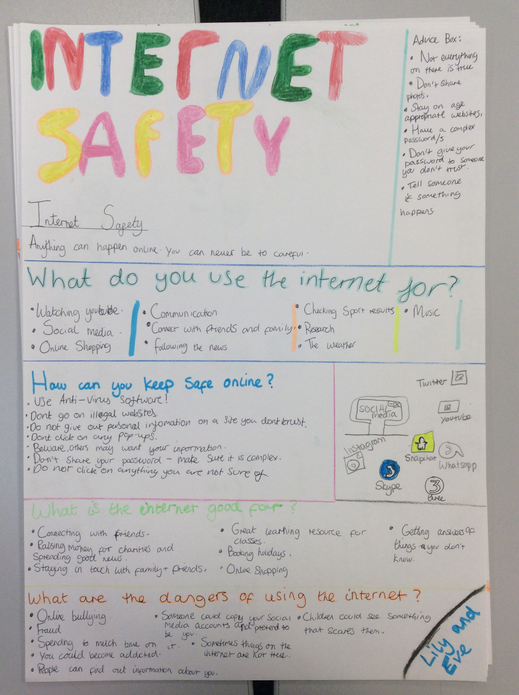
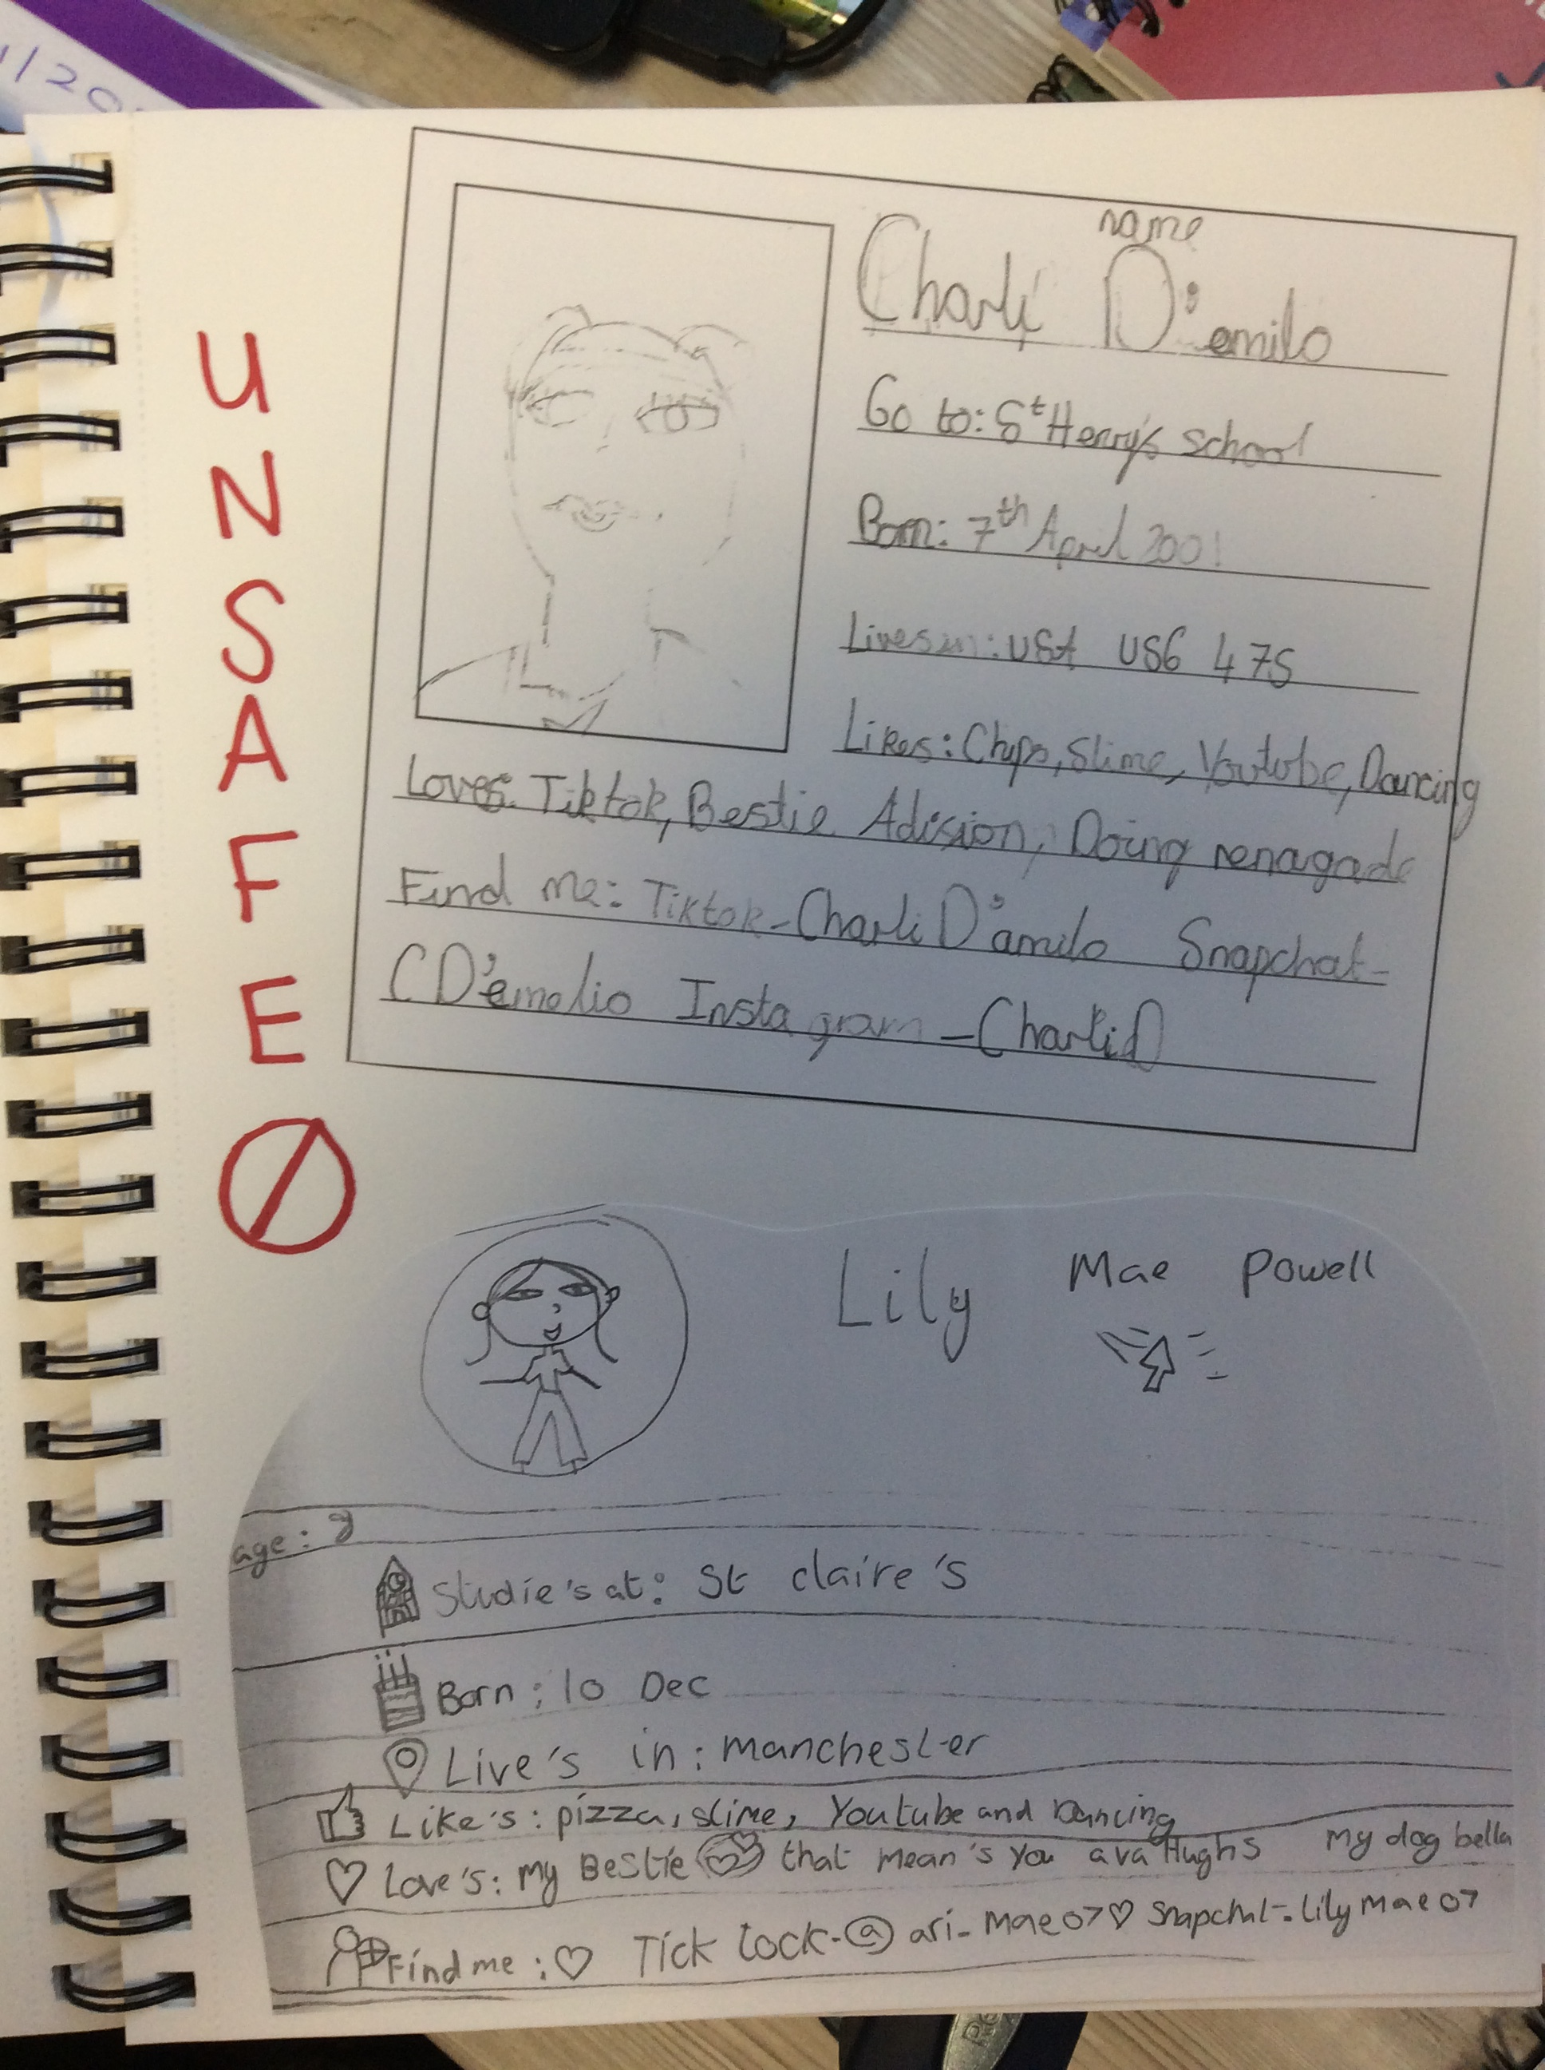
Online safety
These are our safe examples for player profiles. (AF)
These are bad examples because they give personal information like an address. (DT)

Slide 6
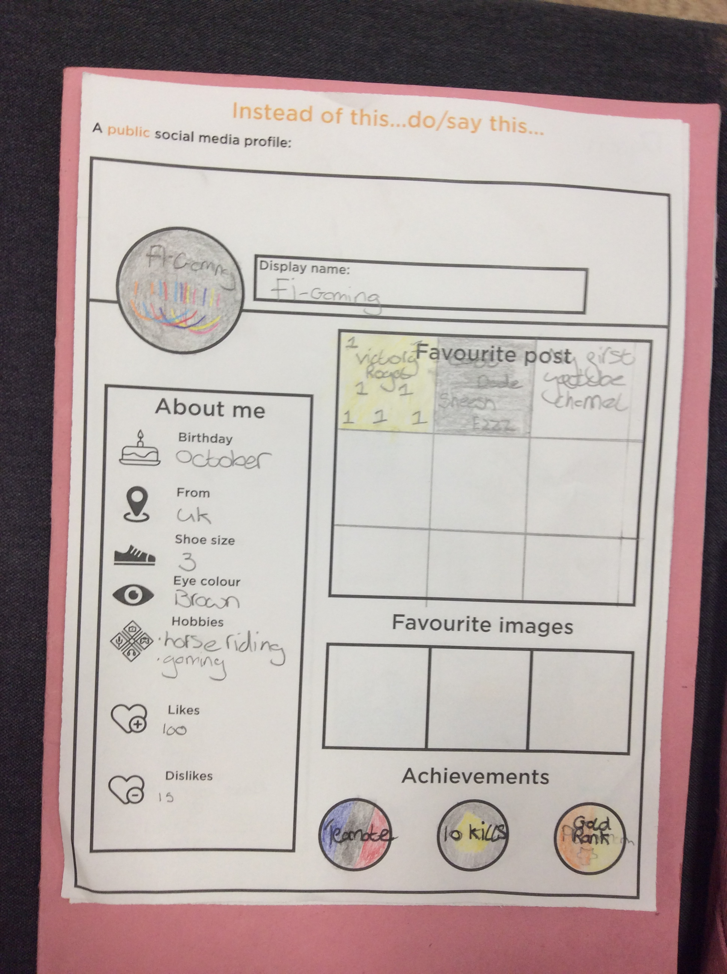
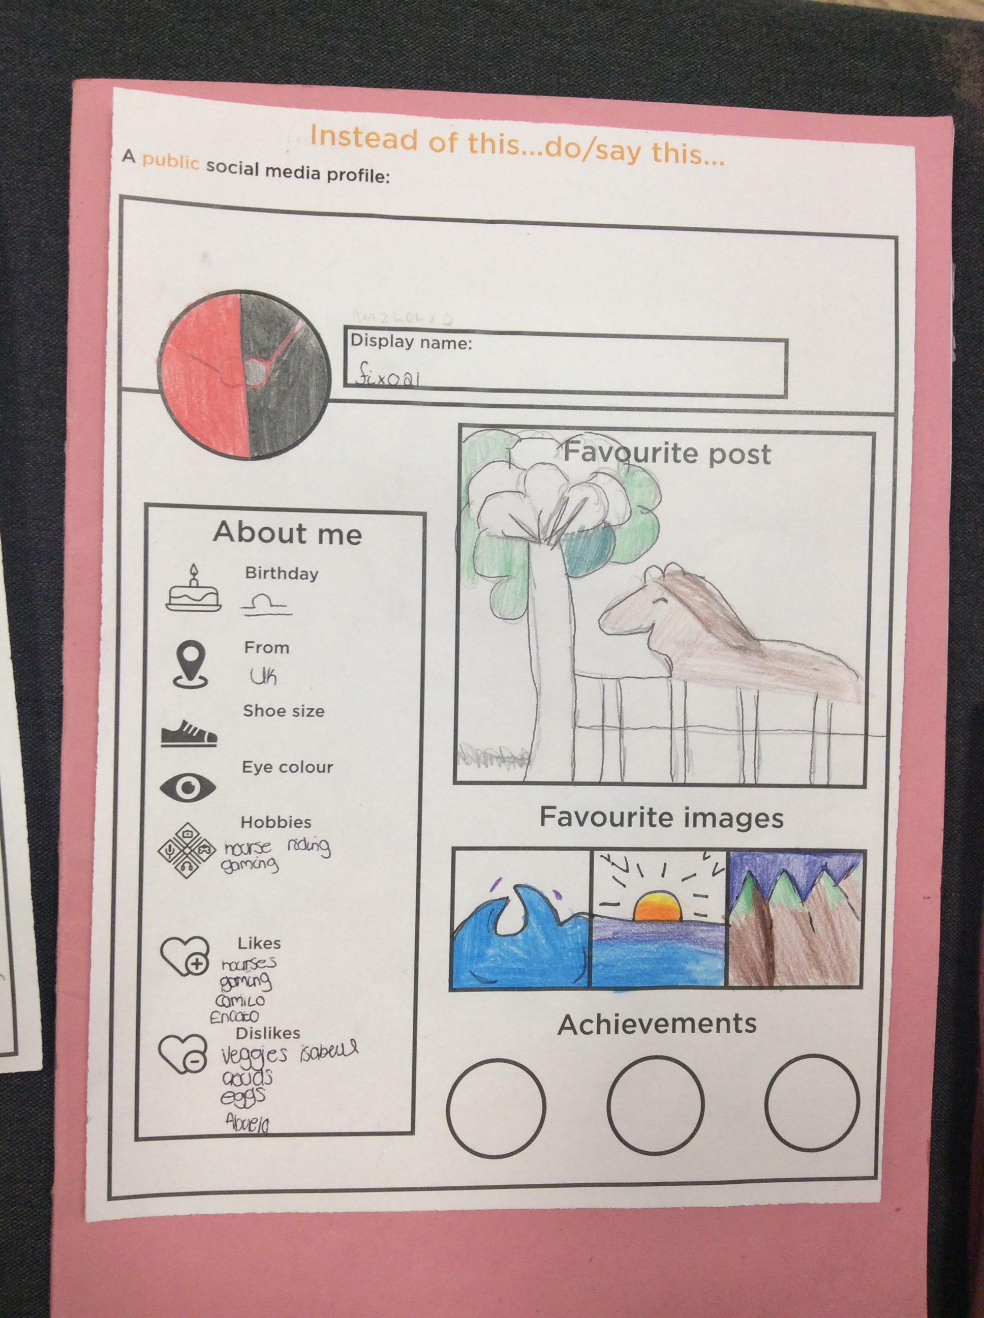
Online safety
Remember never post you own photo. ZW

Slide 7
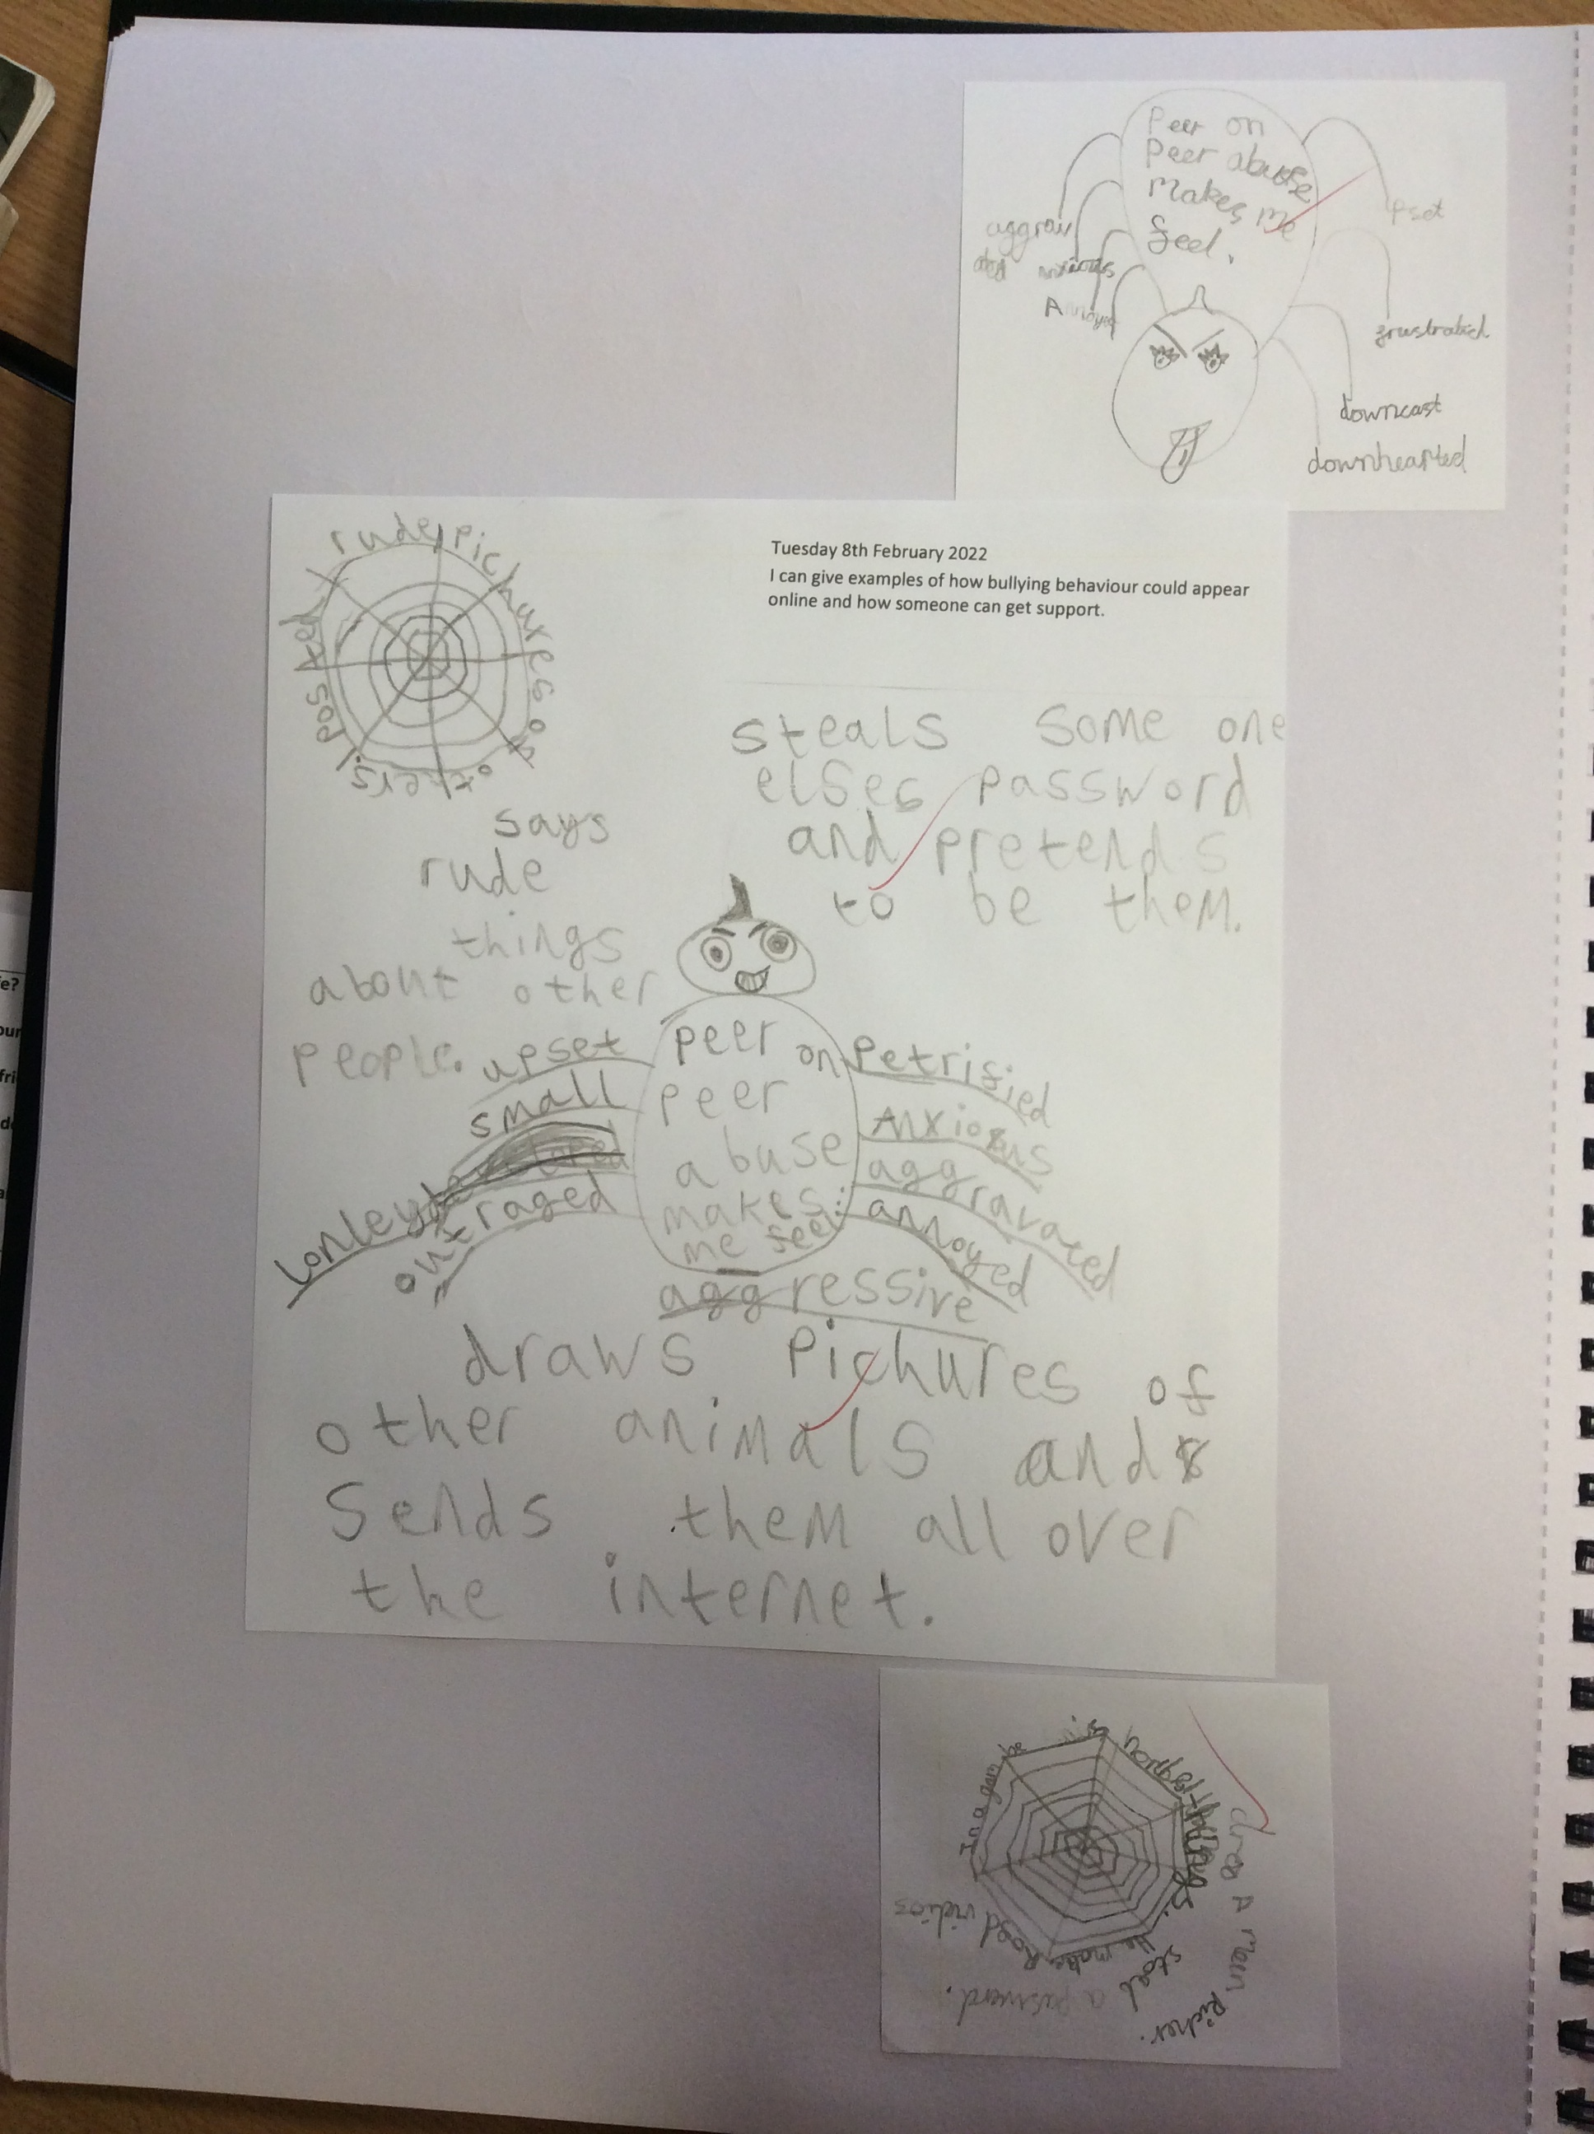
Online safety

Slide 8
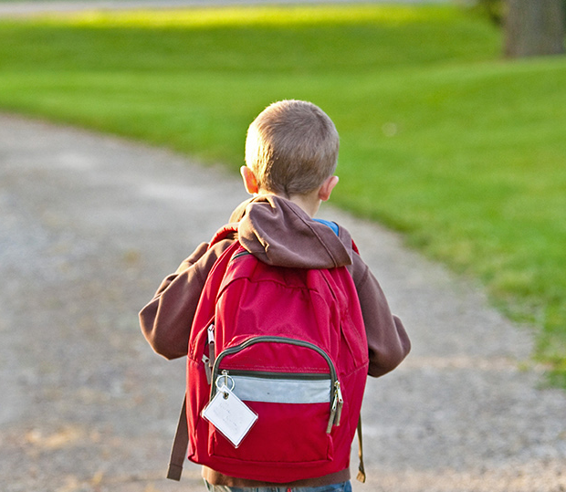
Thank You!
We hope you learn something new…
You can see more examples on our class pages for Internet Safety.
Internet Safety Day February 2022 | Fulwood, St Peter's Church of England Primary School (secure-primarysite.net)

Slide 9
Customize this Template
Template Editing Instructions and Feedback

