Slide 1
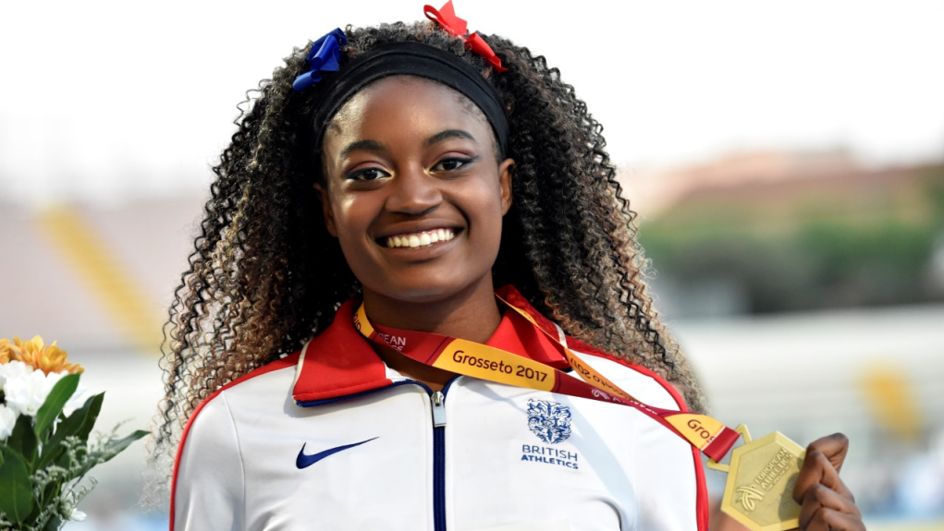
Our Day with Naomi Ogbeta
By Reception, Year 1 and Year 2

Slide 2
Assembly
We were all excited to meet Naomi in the assembly she gave.
She talked about her life and her jumping.
She told us she had only started jumping when she got to high school.
Lots of people asked her lots of questions and she answered them all.
Some of them were really funny.

Slide 3
Our Challenge
We had to do 1 minute challenges with Naomi.
These included press ups, burpees, running on the spot and star jumps.
We worked our way round the different activities and then got a sticker at the end.
We raised a lot of money through sponsorship at home.

Slide 4
What we thought
It has made me think about getting fit.
I think I might want to do jumping in the future.
I want to be healthy and eat healthy food.

Slide 5
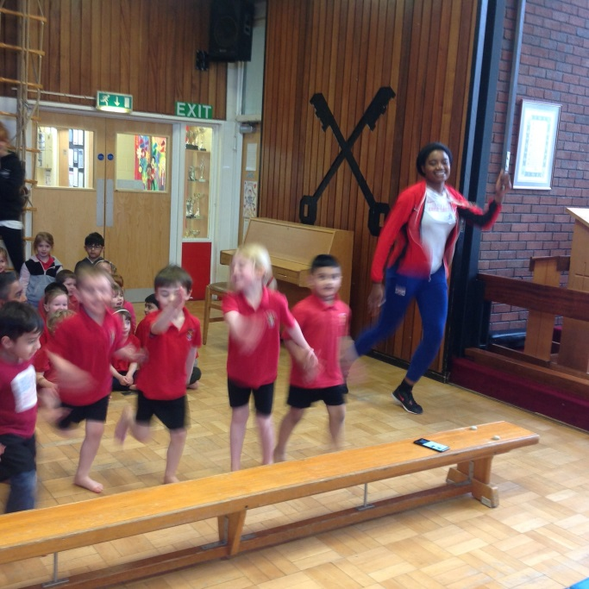
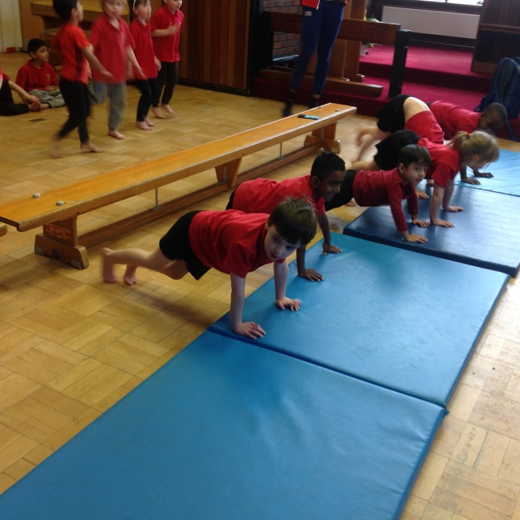
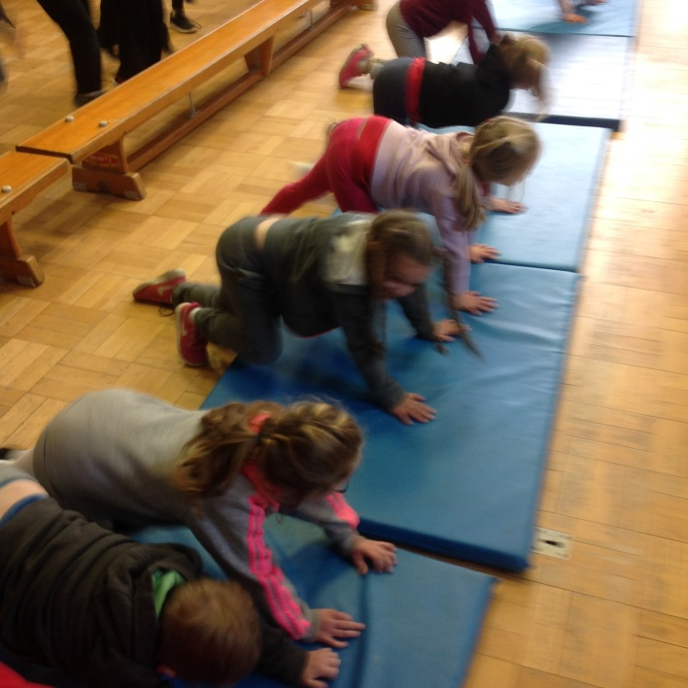
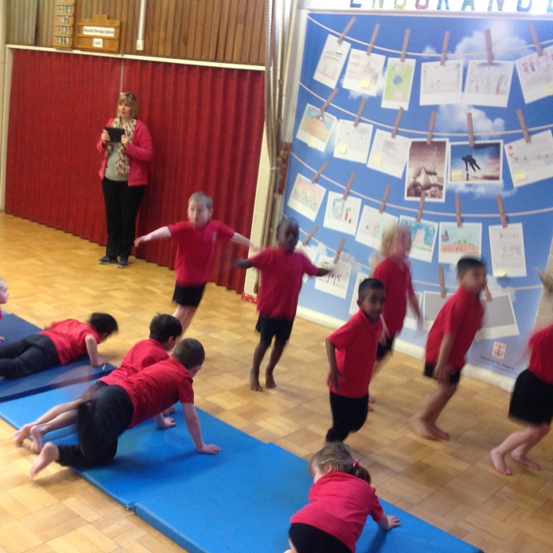
Photos

