Slide 1
SMOKING
By Lily , Tai and Mary

Slide 2

PREGNANT SMOKING
Pregnant with smoking is very dangoures because it could kill the baby or the baby could have a breathing problem.

Slide 3
WHAT’S IN A CIGERET’S?
Cigarette's contain harmful ingredients .There are more than 4000 ingredients such as ;
Nicotine
Tar
Carbon monoxide
Formaldehyde
AMMonla
Hydrogen cyanide
Arsenic
And ddt

Slide 4
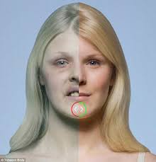
THIS IS WHAT HAPPENS AFTER SMOKING AND NOT SMOKING!!!

Slide 5
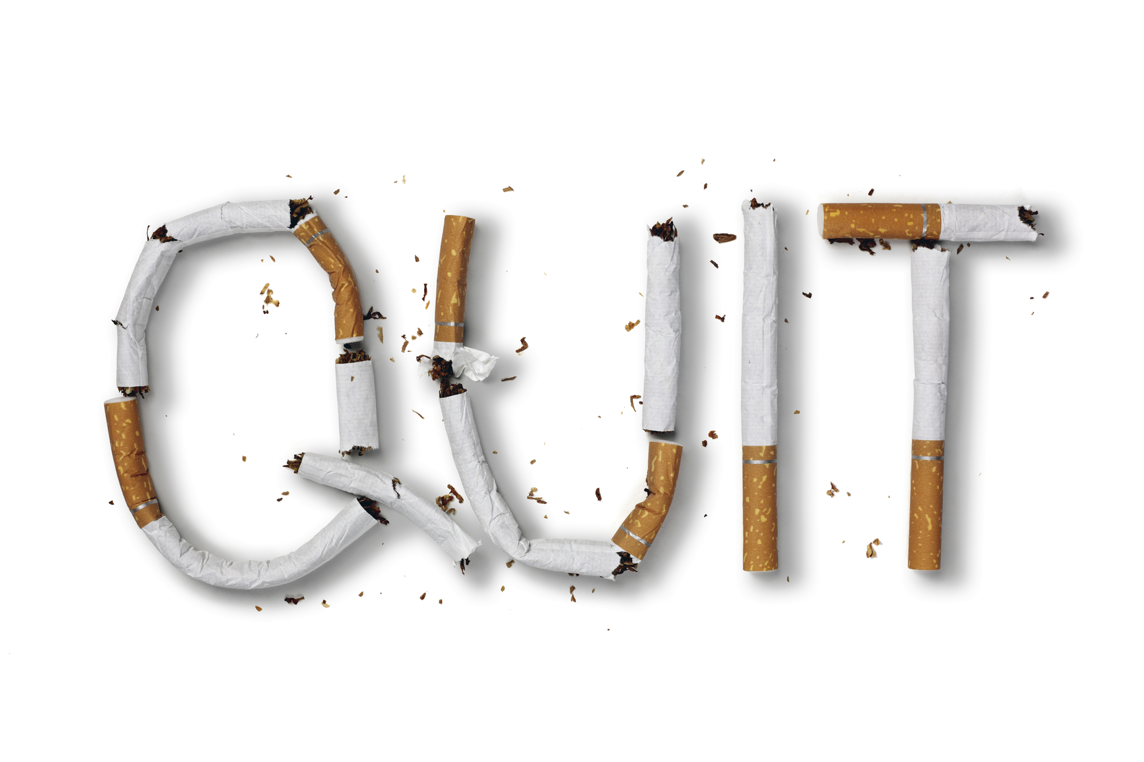
our work!!!

Slide 6
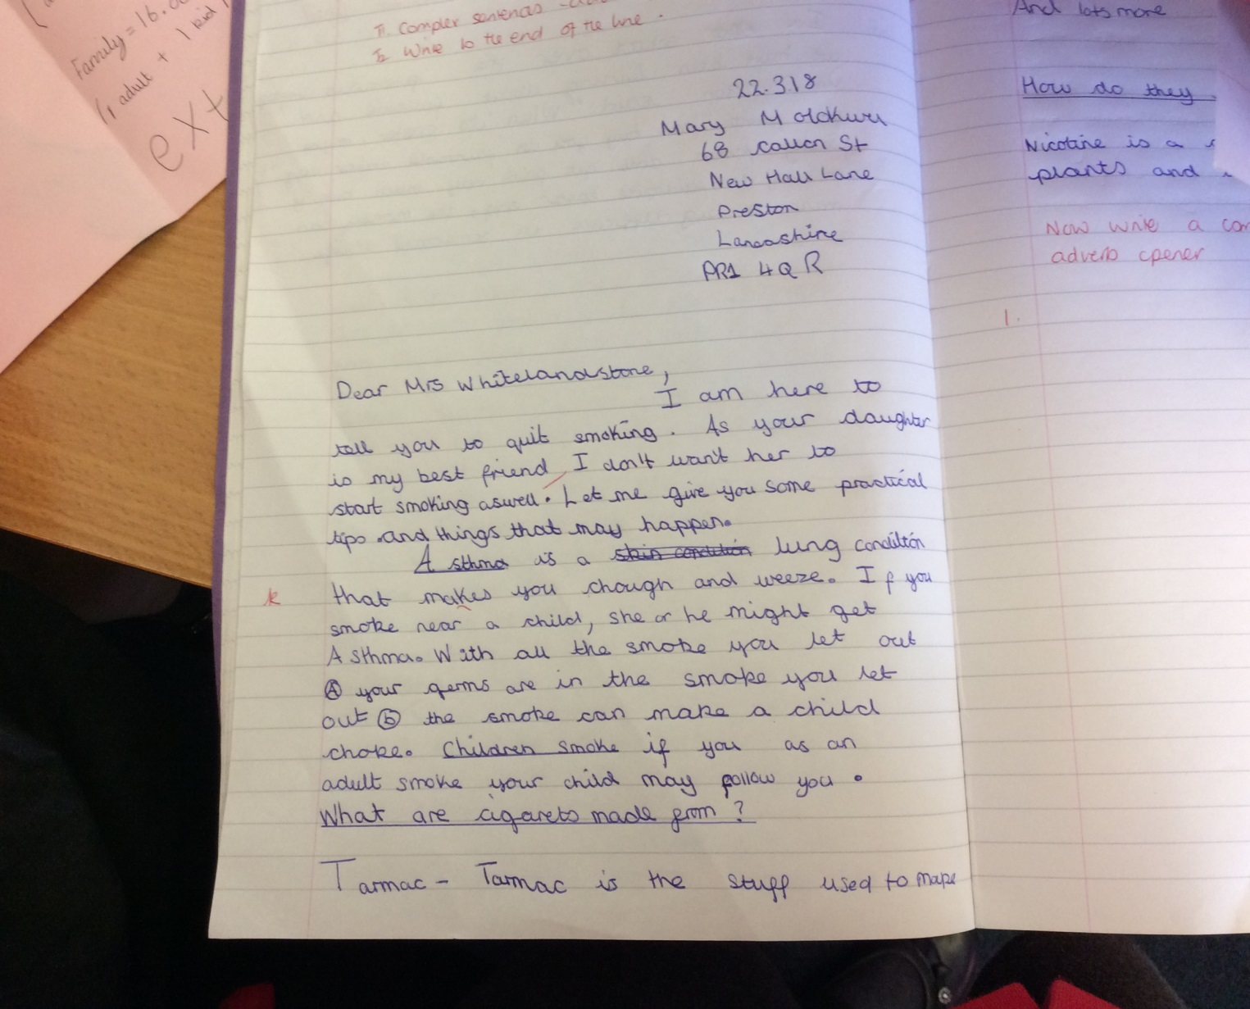
Mary Molokwu Y4 PSHE WORK!!!

Slide 7
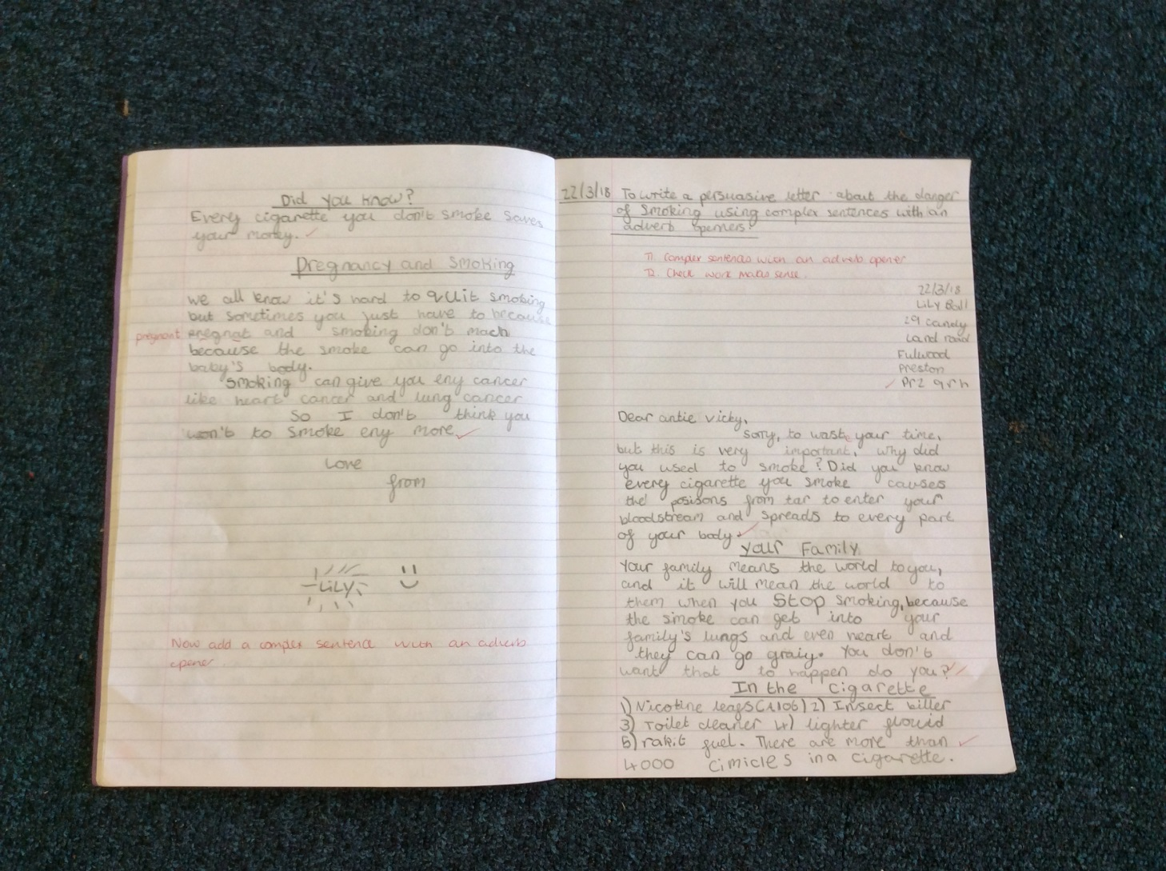
LILY BALL’S Y4 PSHE WORK!!!

Slide 8
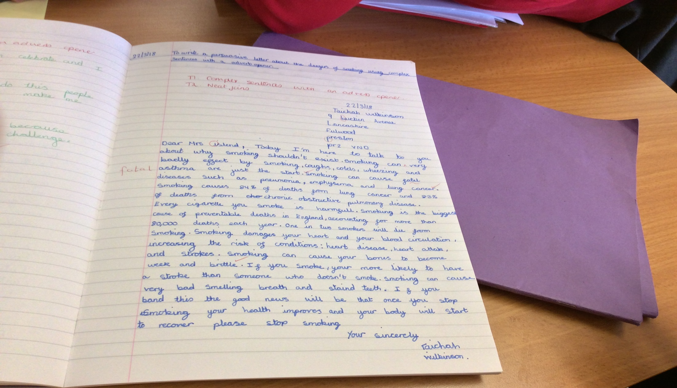
TAICHAH WILKINSON’S Y4 PSHE WORK!!!

Slide 9
Website you can visit
https://lookoutzone.co.uk/
Then go on look out tobacco

Slide 10
Thanks for whatching

