Slide 1
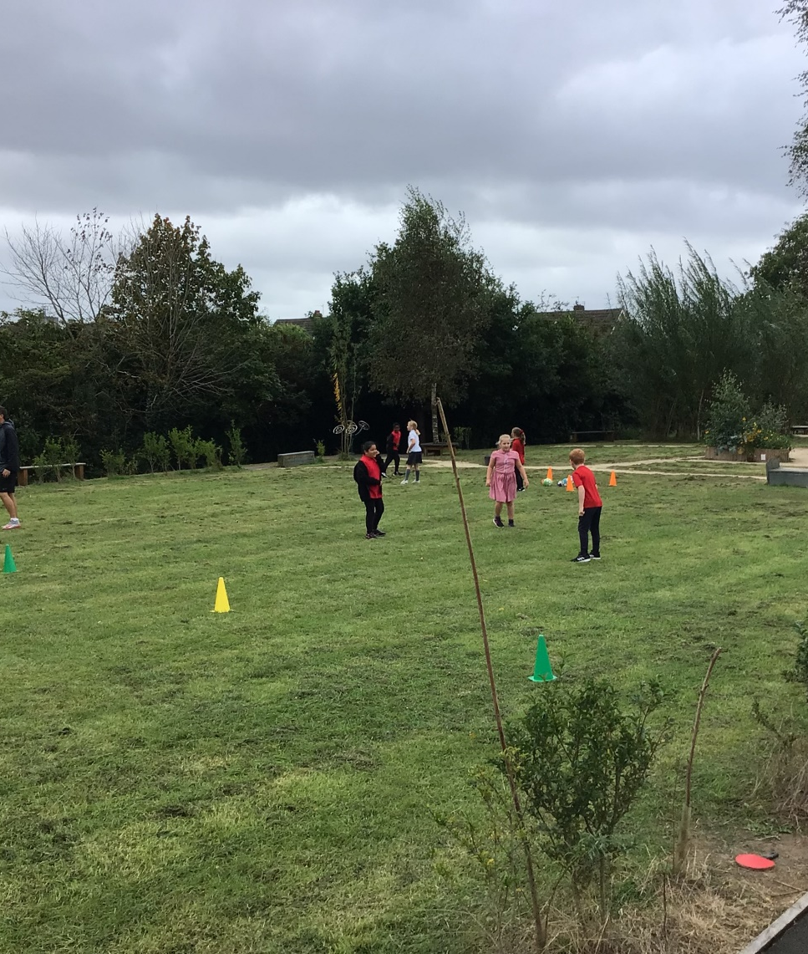
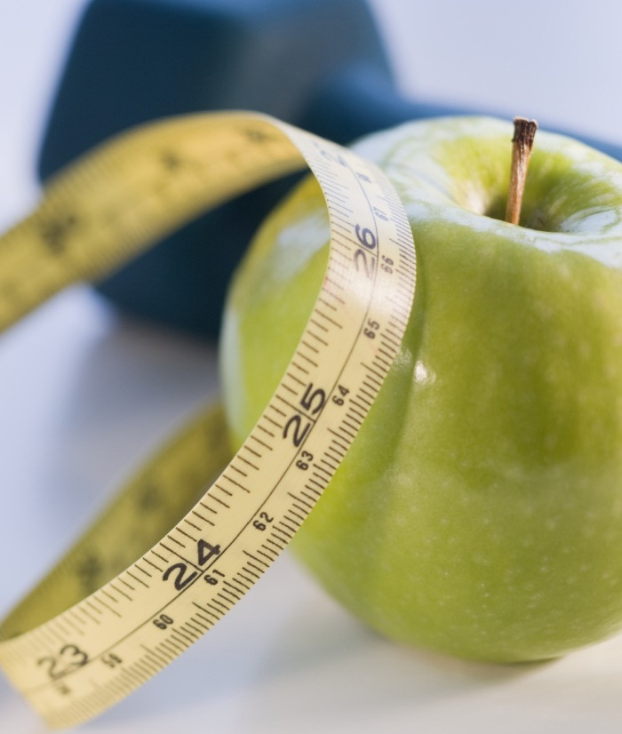
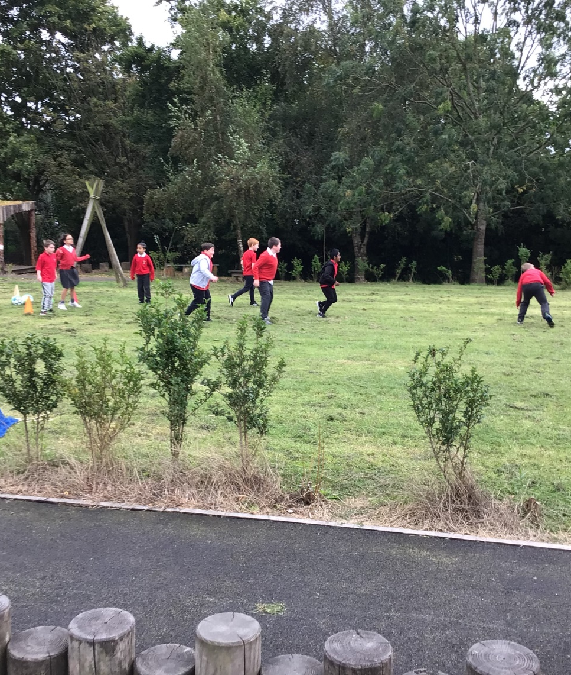
Sport we are involved with during lunchtime , lesson times and after school

Slide 2
Autumn term – lunchtimes with coach gunn
Coach Gunn has been in school at lunchtimes for a club, which has had lots of different activities. This I have enjoyed, because I can’t stay after school. (FD)
This term I have made new friends and had fun learning about ball skills, I enjoy the dodge ball best. (LW)
Coach Gunn has helped me to get fit and make new friends with children that are not in my class. (FN)
I have enjoyed tennis, I have seen tennis on the television and I would like to play it when I am older as well. It has been good to be able to take part in this as I did not really like PE (ZP)
I went to the club and now I am in the school football team and I have played lots of games at different schools. I have really enjoyed this and found out I am good at football. (OW)

Slide 3
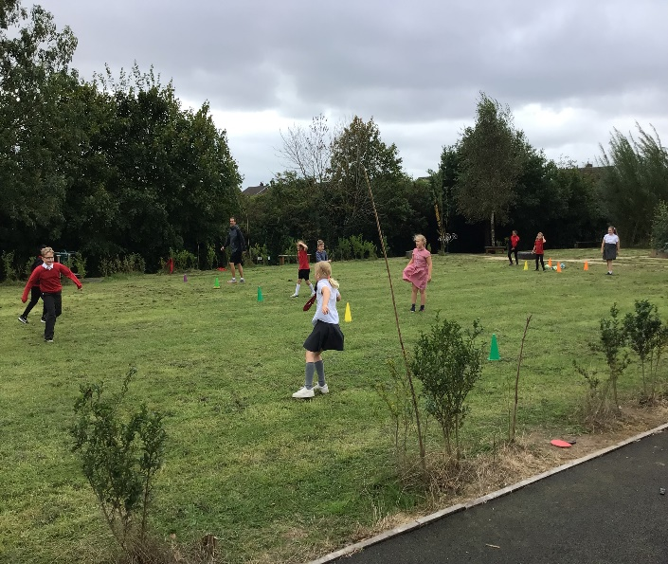
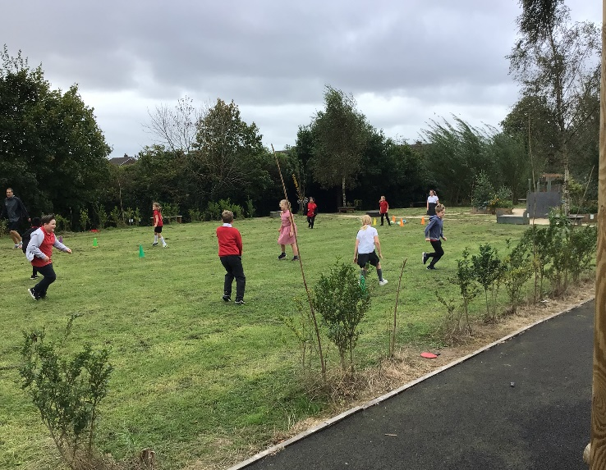
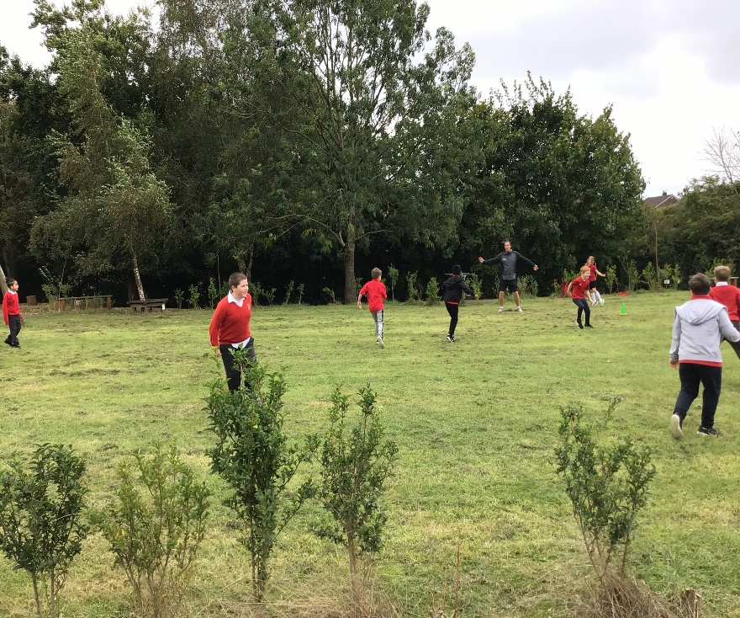
We play with all different ages and that helps to make new friends.

Slide 4
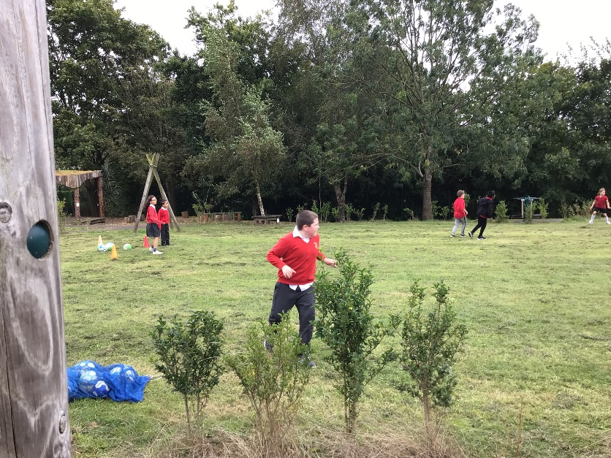
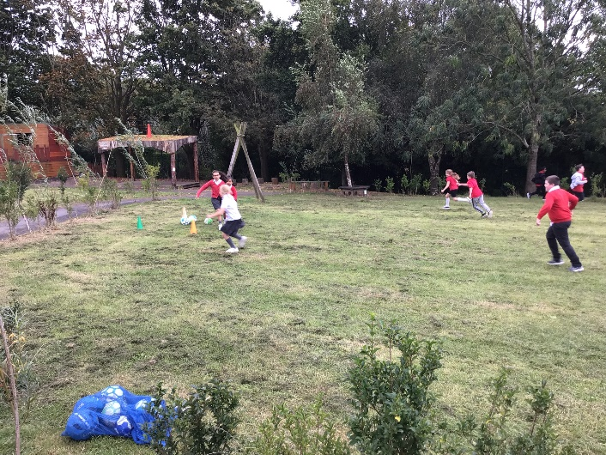
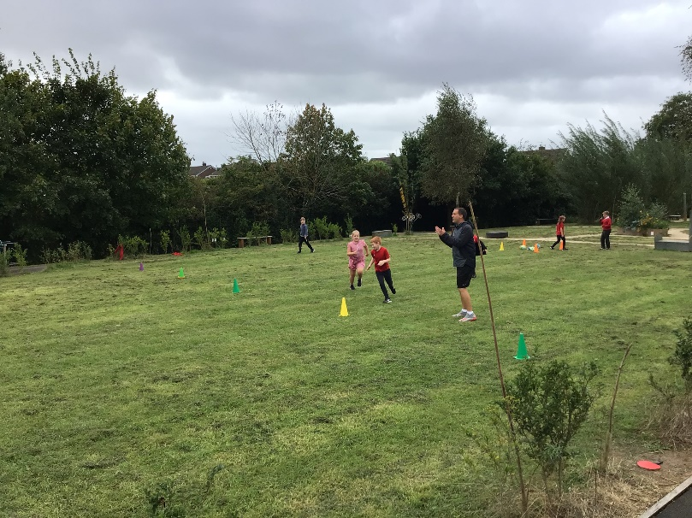
Why take part?
We have been learning about why it is important to be fit and healthy. Did you know that the food we eat fuels our bodies and that exercise keeps all the body parts well? (MP)
I could not stay after school as I go to my grandmas with my brother after school (SL)
I wanted to make new friends and try something different and coach Gunn is kind and helpful (MK)
Dodgeball and chase are great fun (AF)

Slide 5
Extra-curricular football
We train at lunchtime and afterschool Mr Simpson, Mr Parkinson and Mr Marr all help us.
I love playing for the team and I have started to work hard in other lessons as well, then I can go to extra training time. We are through to the semi finals of the cup and this is exciting. (MT)
We have to play fairly and be respectful of the refs decision, even if we disagree. (AW)
I play for the girls team and we have been working hard at passing. My Mum and dad sometimes come to watch and say how good we are. ( E)
In assembly we celebrate are wins and loses with the rest of the school and I feel proud, everyone claps. (M)

Slide 6
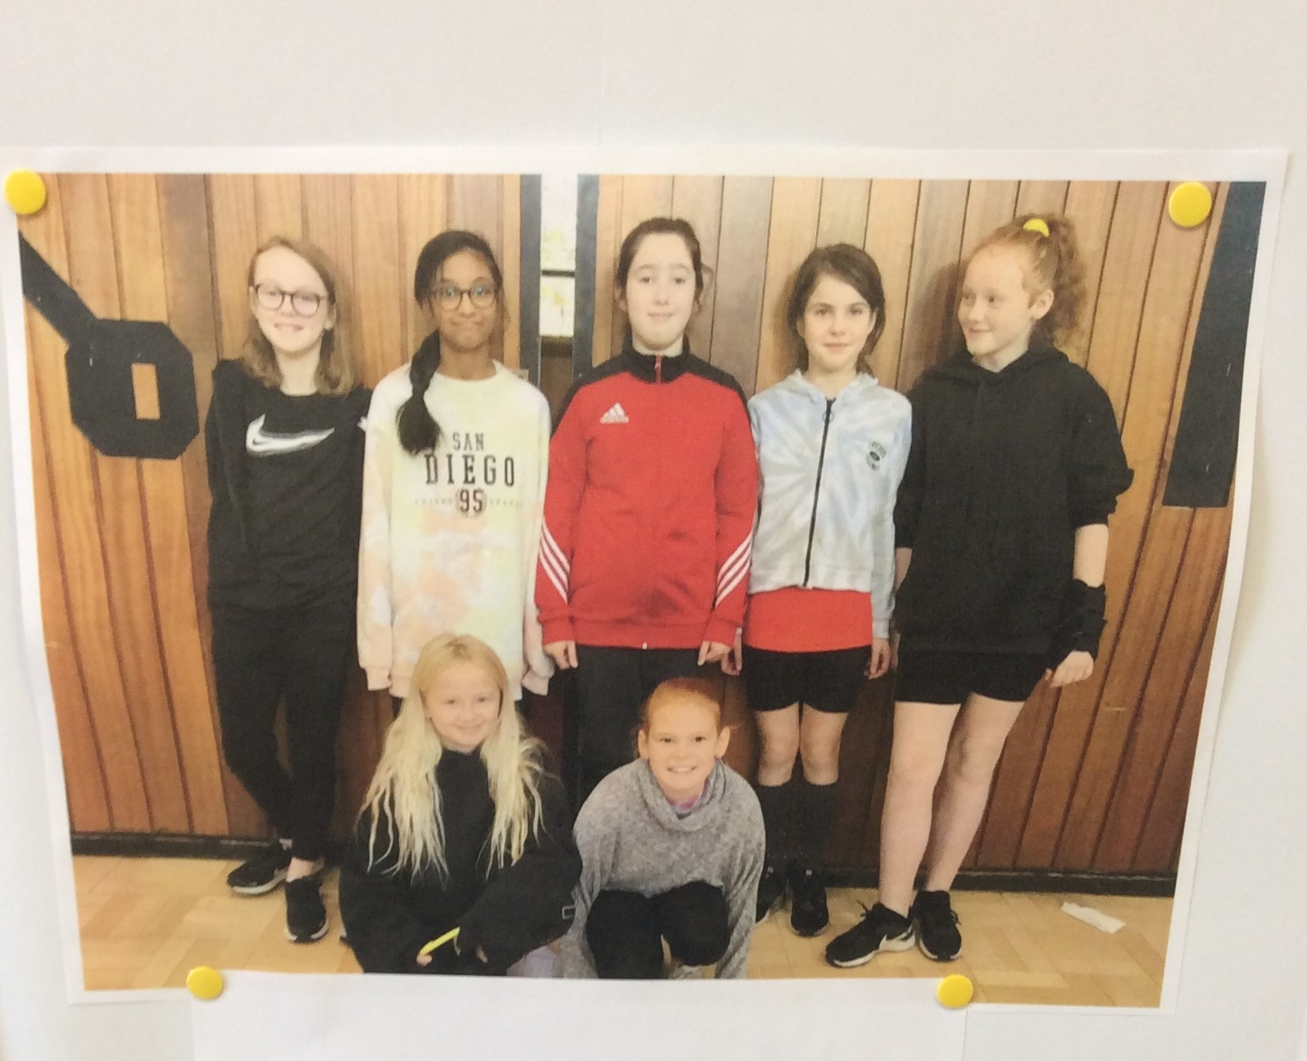
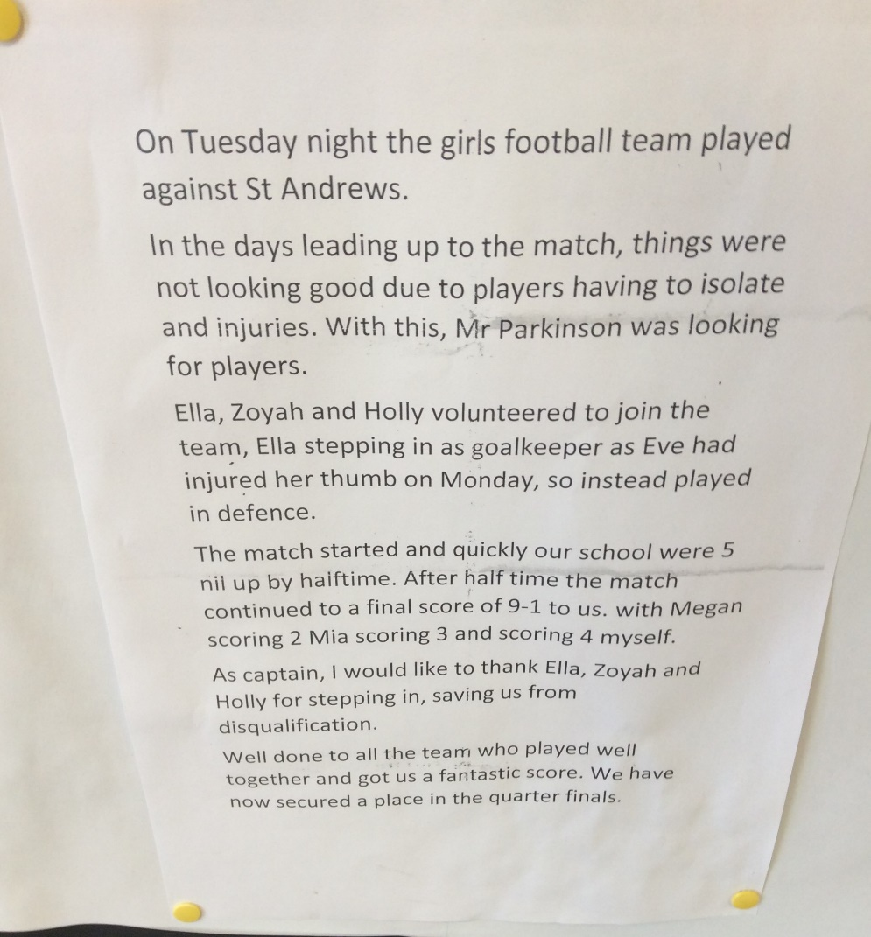
Our report

Slide 7
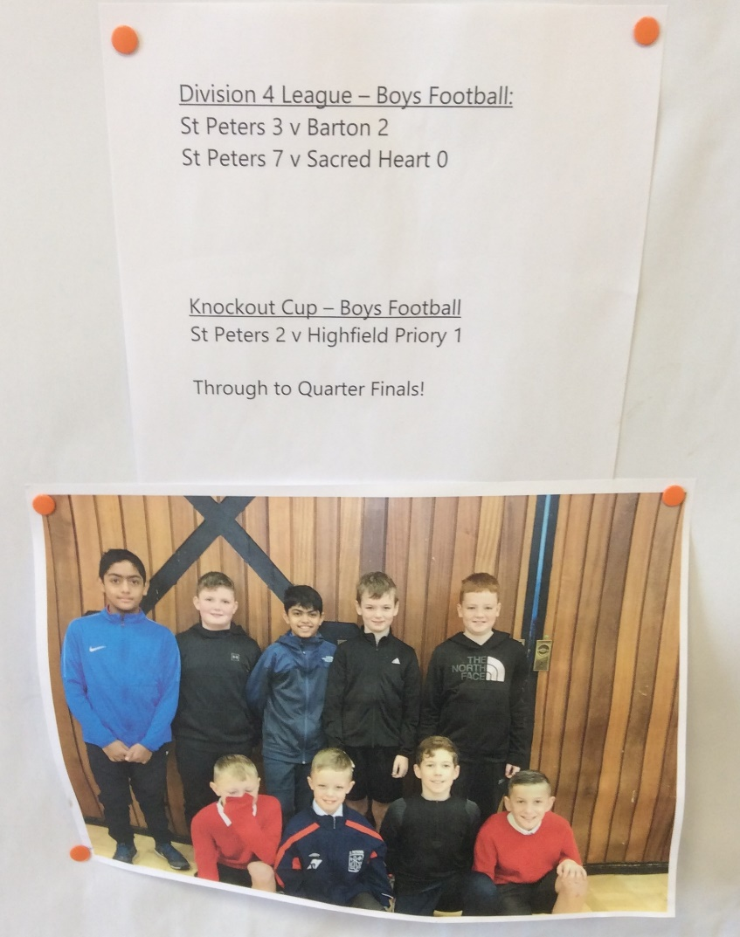
We are the boys squad and our results so far

Slide 8
The road to Tokyo
We had fun learning about the Olympics in class and then we learned about the para-Olympics, this is for people who have a disability. (MM)
Our teachers organised for para sports people to come into school and they showed us why sport is important. (EF)
We watched different sports and learned how they had been changed to make it available to everyone. I thought this was clever. (PP)
We then got to take part in different sports, we had a wheelchair race and then our teachers had a race as well. (LA)
I liked the archery and had to learn how to sit so I could let the arrows go safely. (BS)
We had an assembly to help us understand about the difficulties that some people have (DS)

Slide 9
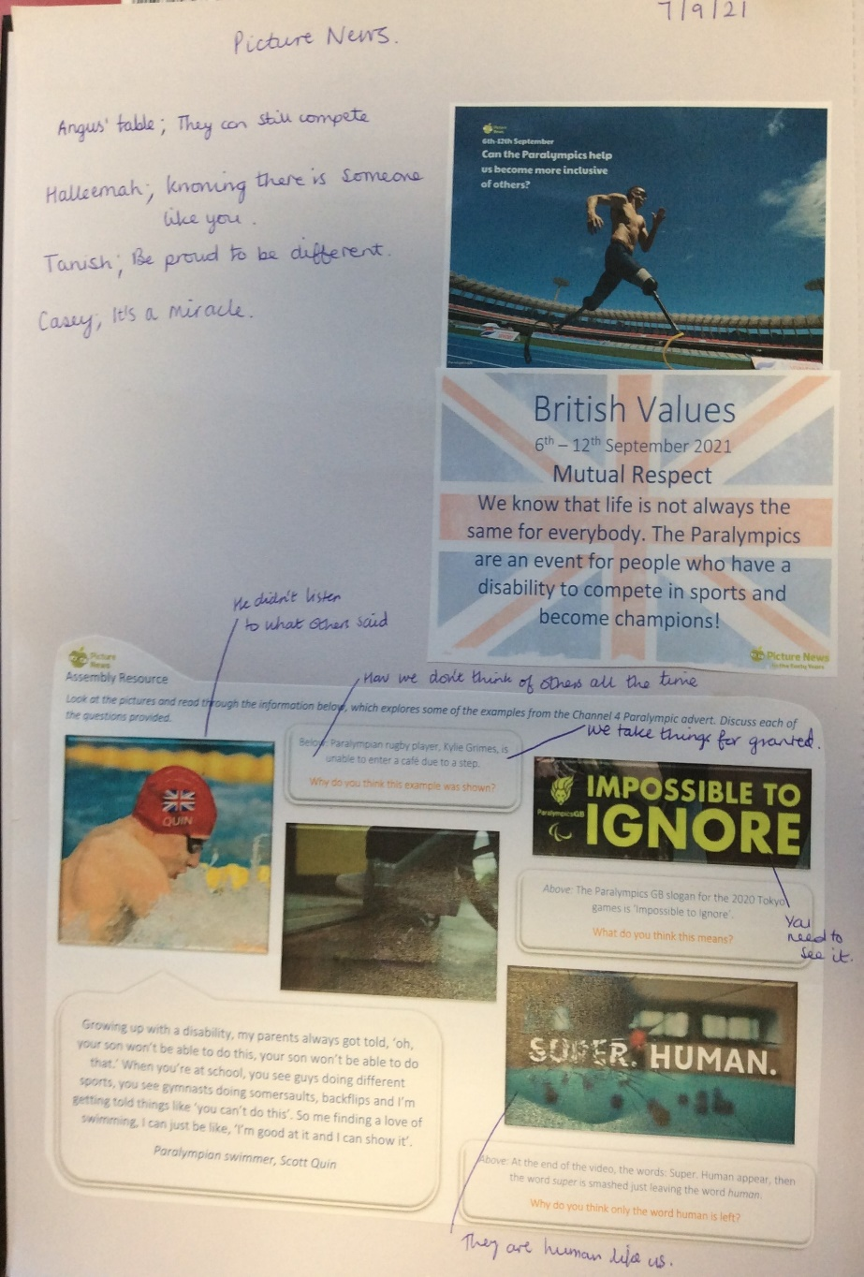
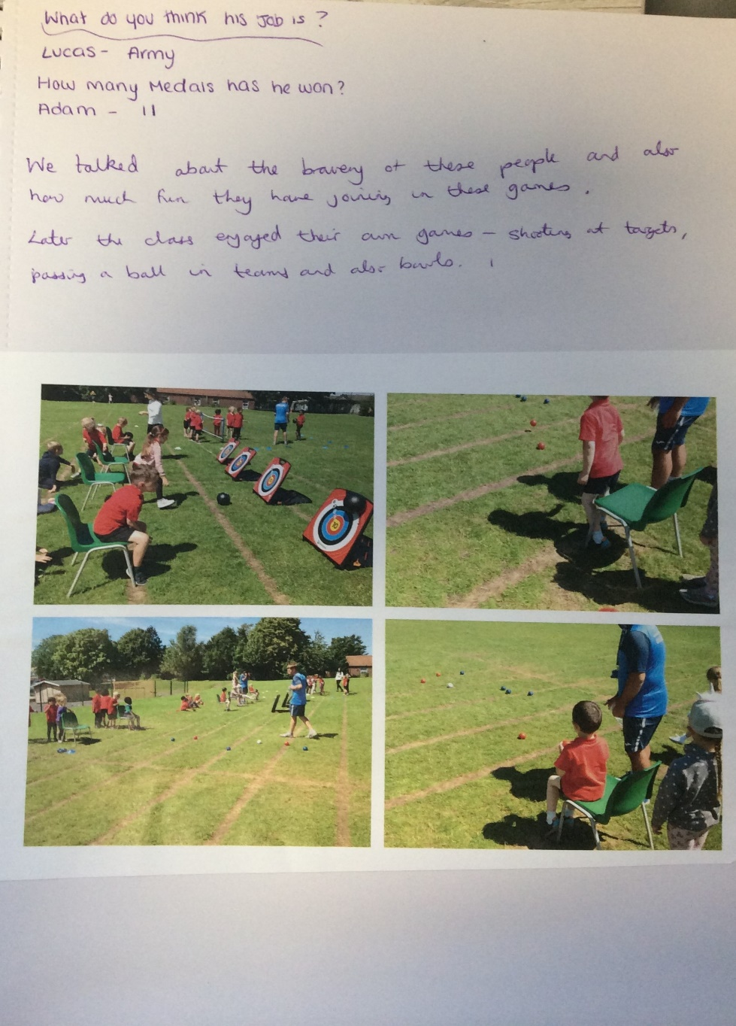
This taught us about the need for respect and the difficulties that some athletes face.

Slide 10
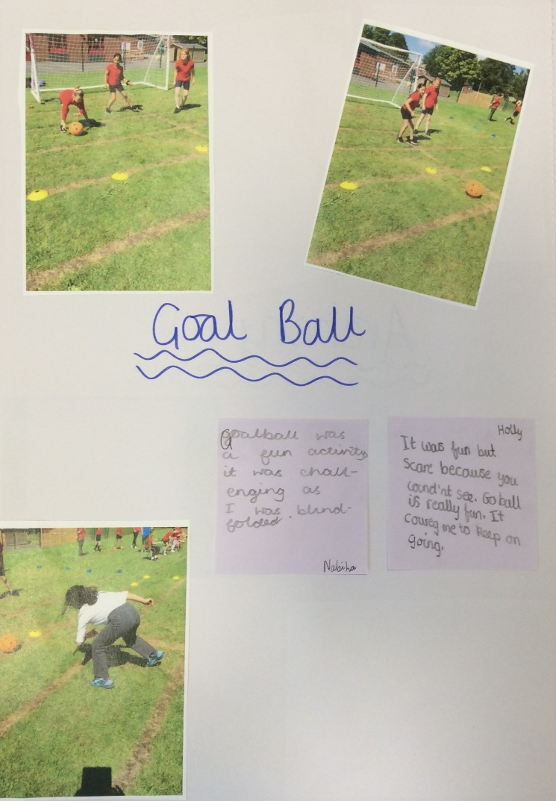
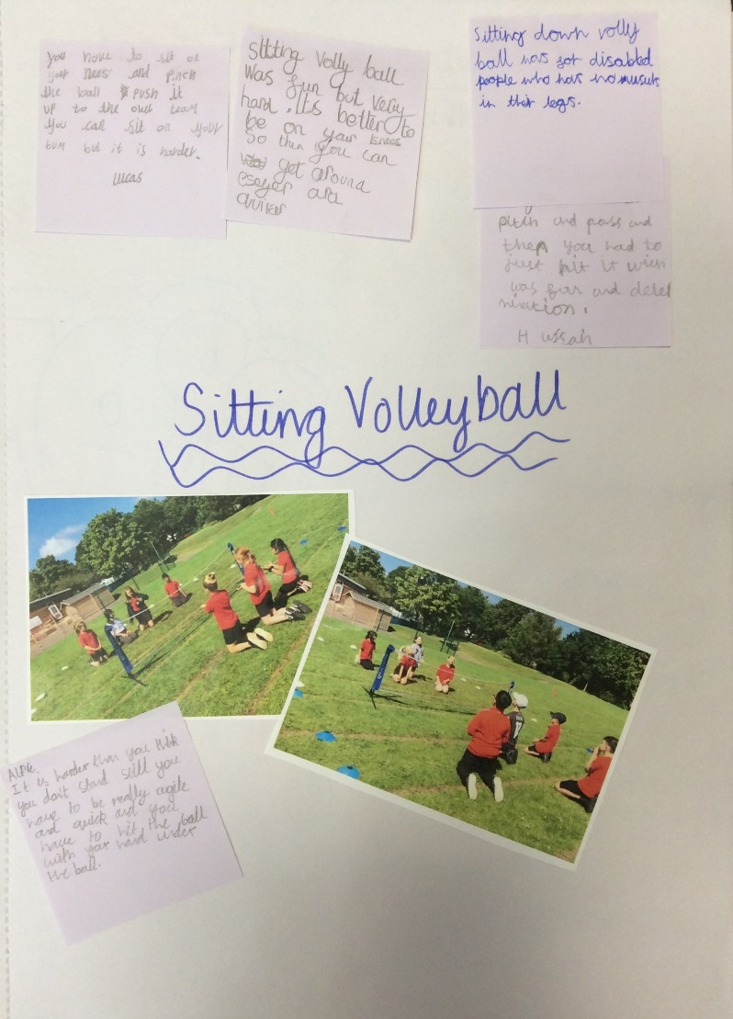
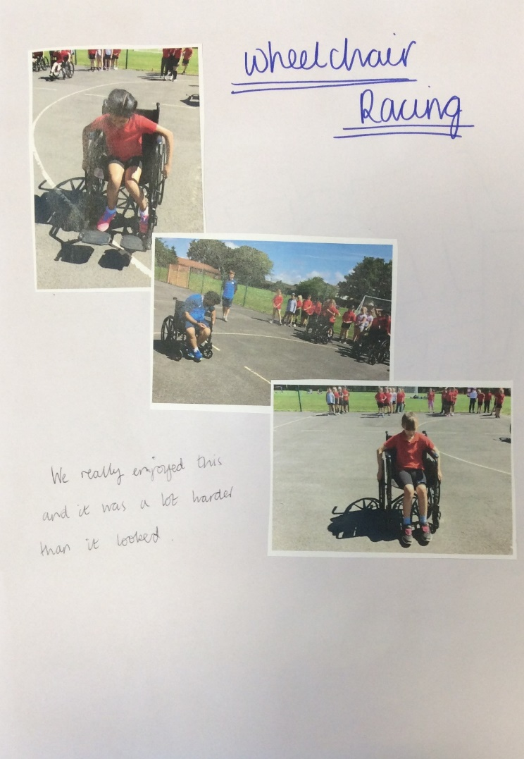
Pictures of our road to Tokyo activities.

Slide 11

We have been very busy in school even with COVID and lockdowns.
I hope I can carry on with my lunchtime clubs, because they are fun and I can’t go to clubs after school. (JP)
I have loved my time in the school football team and representing the school, I have never done this before. (LB)

