Slide 1
Welcome to Fitness id Fun!!!!
Inspirational athlete, leads the way at Fulwood St. Peter’s C.E. Primary School.

Slide 2
Naomi Ogbeta
Naomi is an Olympic athlete, she needs to train very hard and also needs sponsorship to take part in training and events. (Year 6)
She is very dedicated to her sport and has shown great resilience and motivation when injury struck. (Year 5)
I too want to be a long jumper. (SSW year 4)

Slide 3
Please go to the Healthy Schools page on our school website, we have lots of photographs of the whole school taking part in the circuit set up by Naomi. If you look closely you might even see one or two of the teachers taking part as well. (BD)
We all collected sponsorship money and Naomi got some and school got the rest. Our school then had choose what to spend our share of the money on. After spending time with each class the School Council met and then after lots of discussions they decided to pay for a bouncy castle obstacle course to be used during our sports day week. (ES)
Everyone was very excited and everyone was able to take part. Each class had an hour and were timed taking part. Nursery also took part, but some of our bigger children had to go out and help them as they found it too hard. (TF year 3)
Our mums and dads came to support us and they cheered us on. I was tired at the end of our class time. My heart was beating very fast. Naomi said that was a good thing. (year 2)

Slide 4
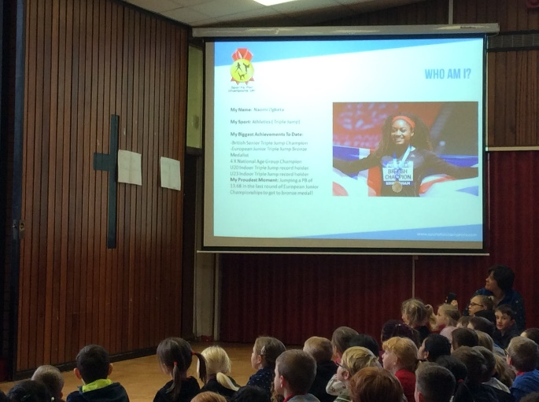

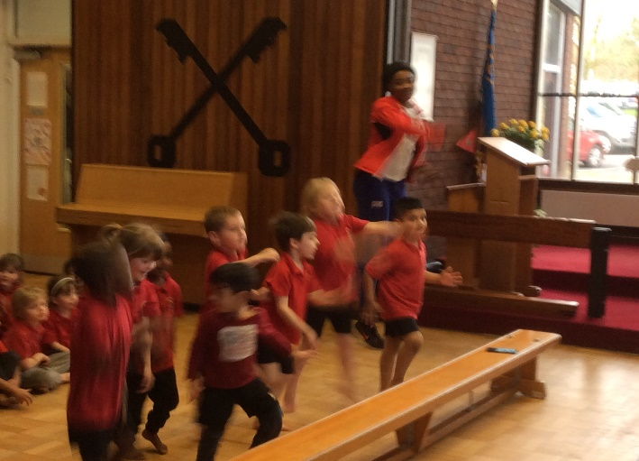
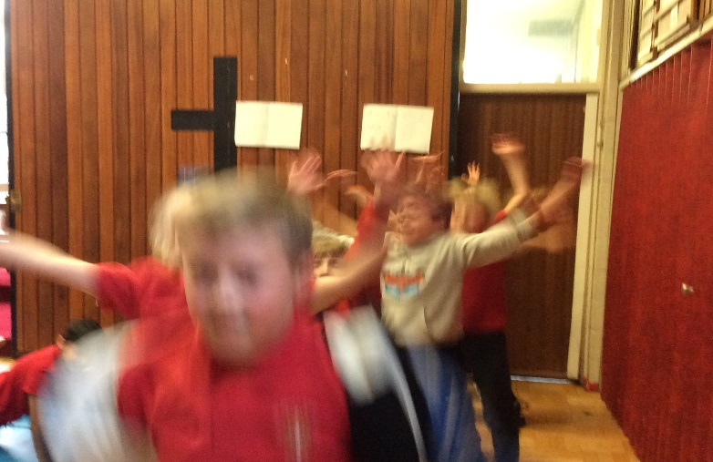
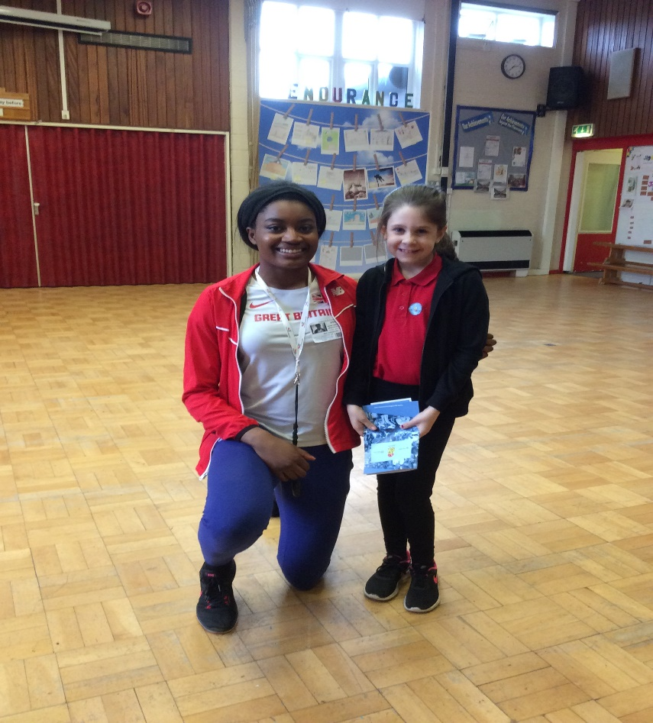
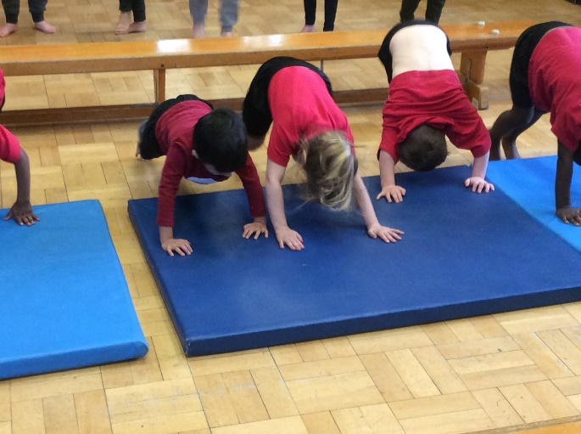
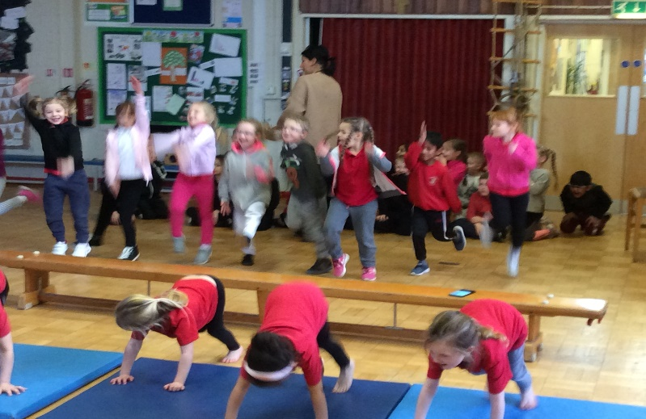
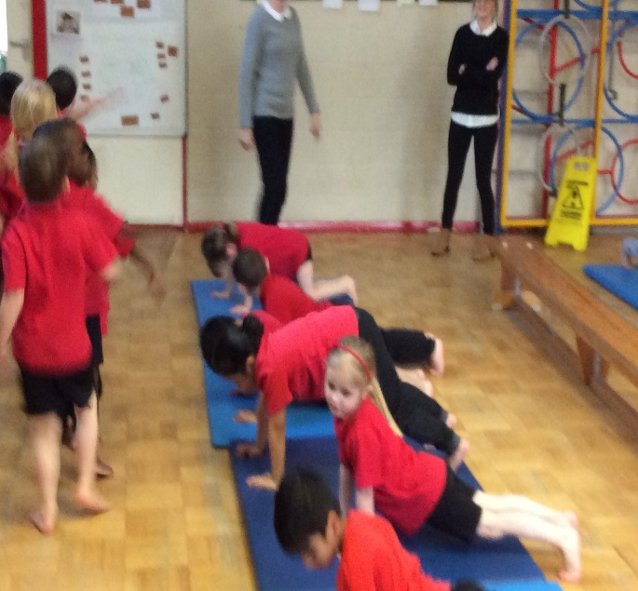
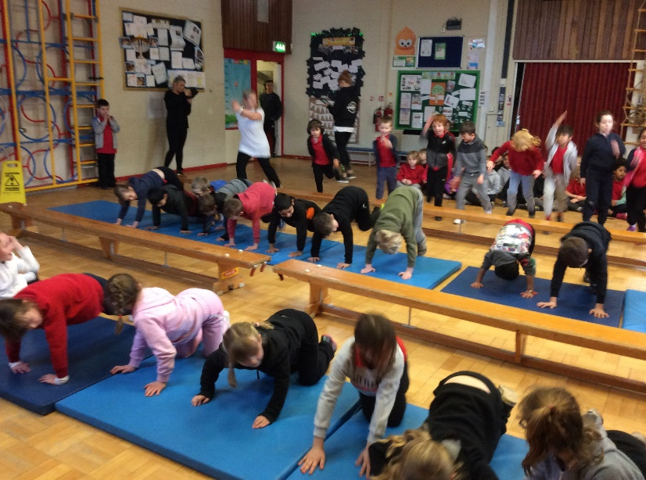
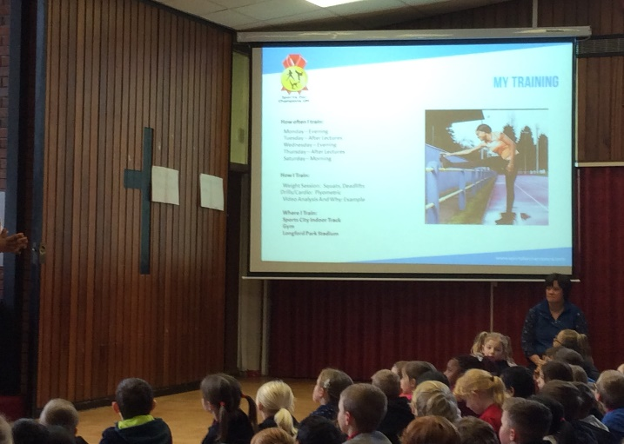

Slide 5

How we changed our lives.
At the end of the summer we were all asked to discuss in our classes what we liked and didn’t like about PE and sports in school and when we are at home.
The school council went to a meeting with some of the teachers and they came back with a voting chart. We had to decide what sports we would like to try. I wanted to try football because I had seen it on television.

Slide 6

What happened next…
We have a new teaching assistant and he takes us to sporting events. This year I went to tennis and we won! I was so proud of our team (BH)
At lunchtimes not only do we now have an activity course with climbing ropes and exercise machines around the field, we also had a teaching assistant, he has set up a table tennis tournament for juniors. Last week I was in the final and played against a year 6 boy. I lost but it was the taking part that counted and there is always next term to try again. (FD)
There is also a orienteering lunch time club and the course changes each week. Some of our year 6 children help to set this up and help the younger children take part. (Yr 6)
Some of our older children and dinner staff are holding skipping games with our younger children too. Every class is taking part in the Daily Mile at some point during the day. (TW)

Slide 7
Tennis is great fun !!
I joined tennis after school our coach was a lady she was called Angela we learnt skills about hitting over the net, gaining points of our opponents, and scoring. I thought it was great fun. My parents have let me join the tennis club as part of my holidays when they are at work.
Lots of my friends came to and my mum is letting me go to the club on a Saturday morning now as well.

Slide 8
Awards!!
On the last day I won a trophy for all my hard work and effort. I brought it into school and I shared it with everyone in our Special Achievement assembly, Everyone in school clapped and I thought Naomi would be pleased that I have taken part in some sport.
That day our tennis tournament winners were presented with a trophy I thought one day I will be able to be apart of that team if I keep trying and stay fit. (LS Year 3)

Slide 9
What else is happening ?
Well our teachers have listened to what we want to take part in. We have loads of different after school club activities including, football by PNE, basketball is starting after half term and I know there is a waiting list, we have strictly dancing, cheer leading and hopefully cricket and tennis will begin again in the spring term. Hockey an netball are also starting.
Our teacher has arranged for another Olympic sports person visit again to keep us motivated and also so that we can hold another sponsorship day as we all learnt a lot about motivation, resilience, health and determination.

Slide 10
Extra–Curricular Sports.
We have a cheer leading club on a Monday evening and we get to put a dance together and then we share our routine at the end of every half term and this helps me to keep fit and also spend time with my friends.
Mr. Simpson / Mr. Parkinson are our football coaches and they also enters us for team events such as tennis, swimming galas, cross country runs and lots of other sporting events.

Slide 11
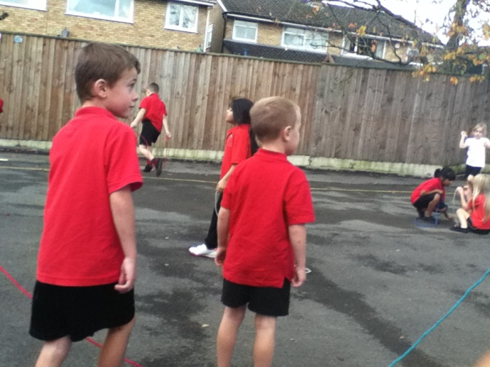
Skipping
Skipping has been fun and also I know it is a good way to exercise my heart. At playtimes we have some ropes to play with as well.

Slide 12

Helping Others!!!
Buy taking part in the sponsorship for these two Olympic athletes we are helping them achieve their dreams. It is good to help others by doing something kind. But this has also helped our school hold an additional sports day, which was great fun and healthy. So this is why we are taking part for a second time.

Slide 13
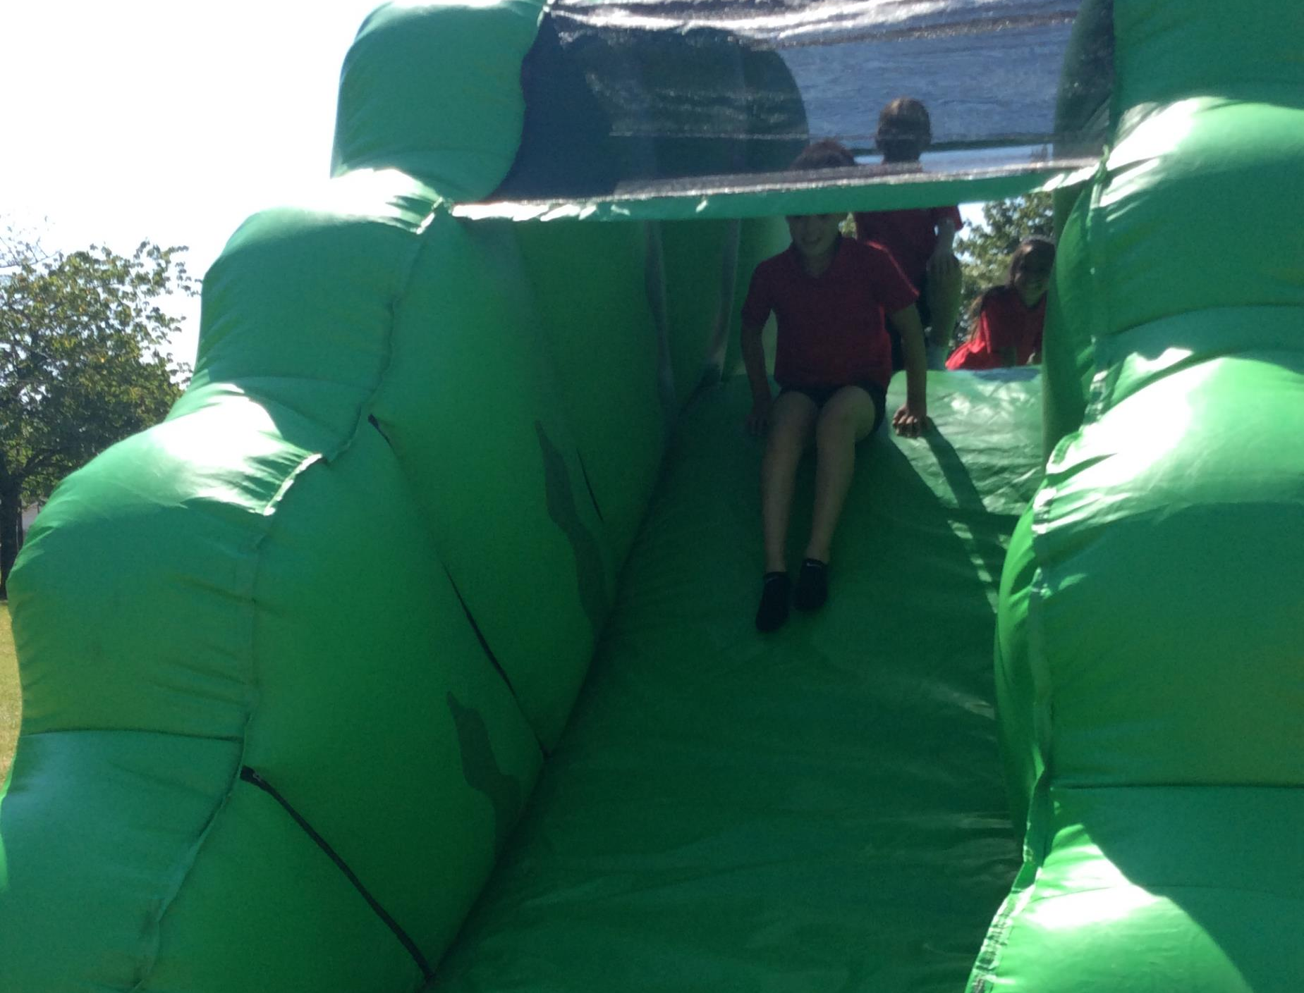
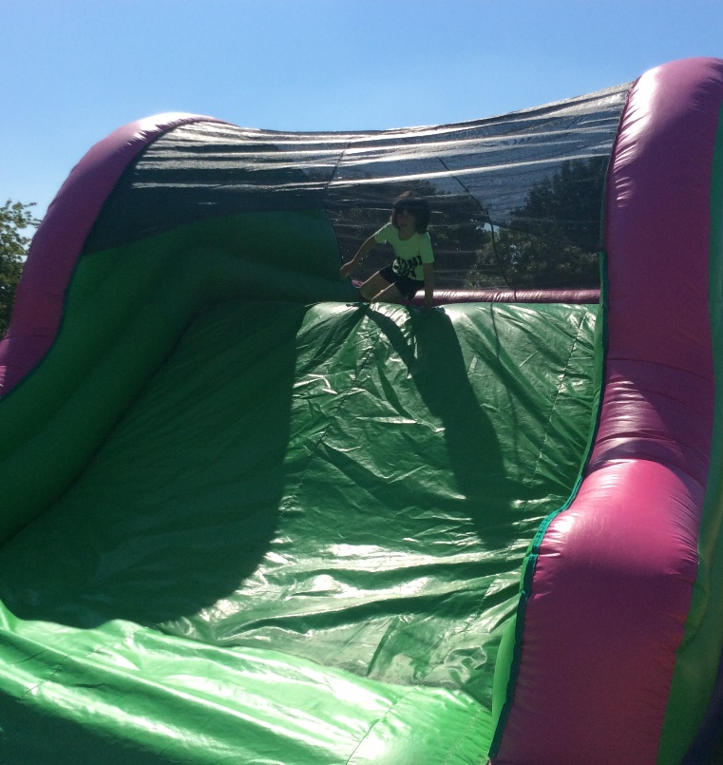
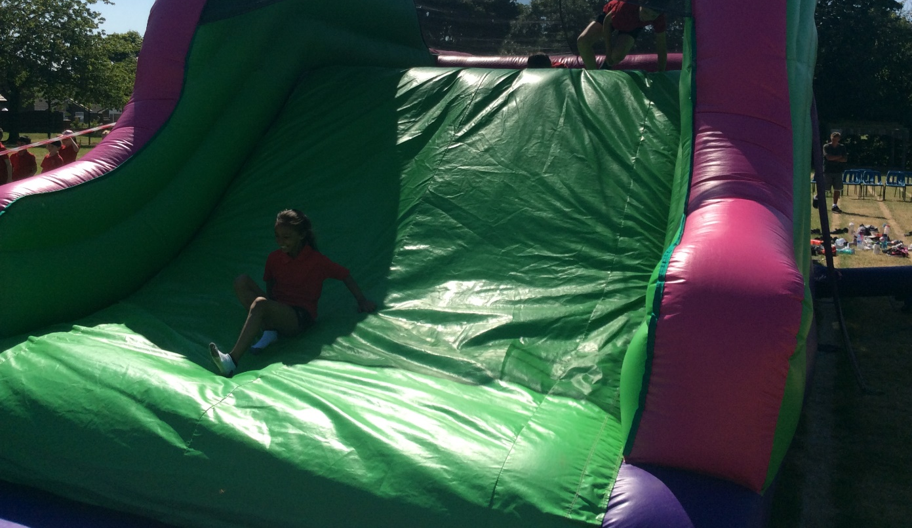
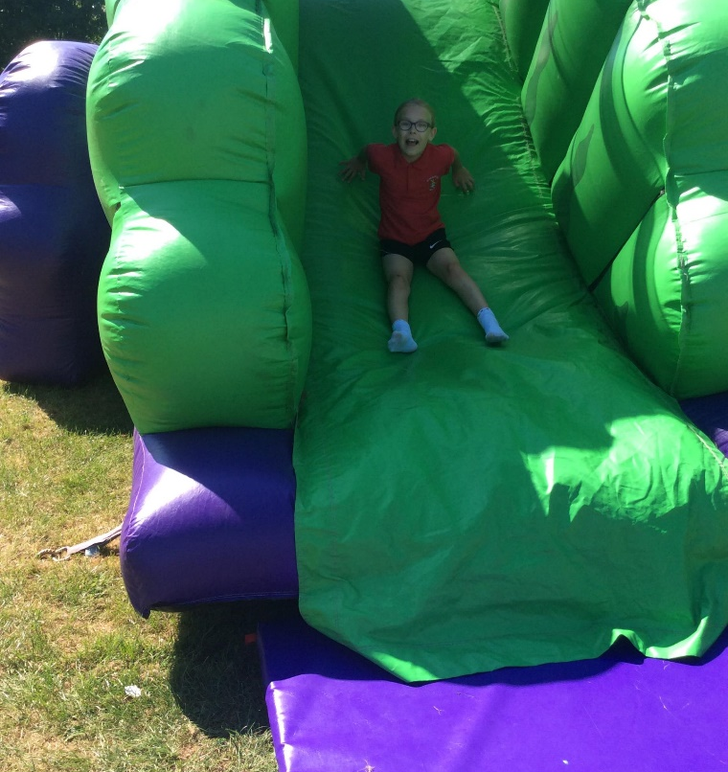
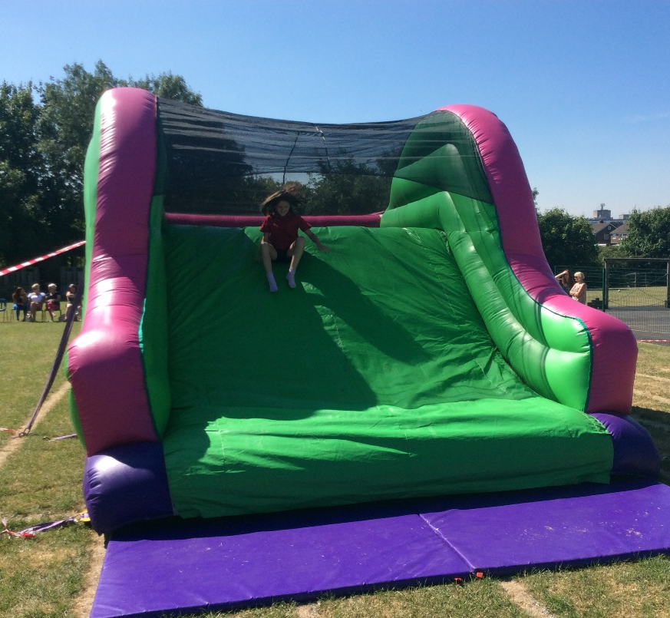
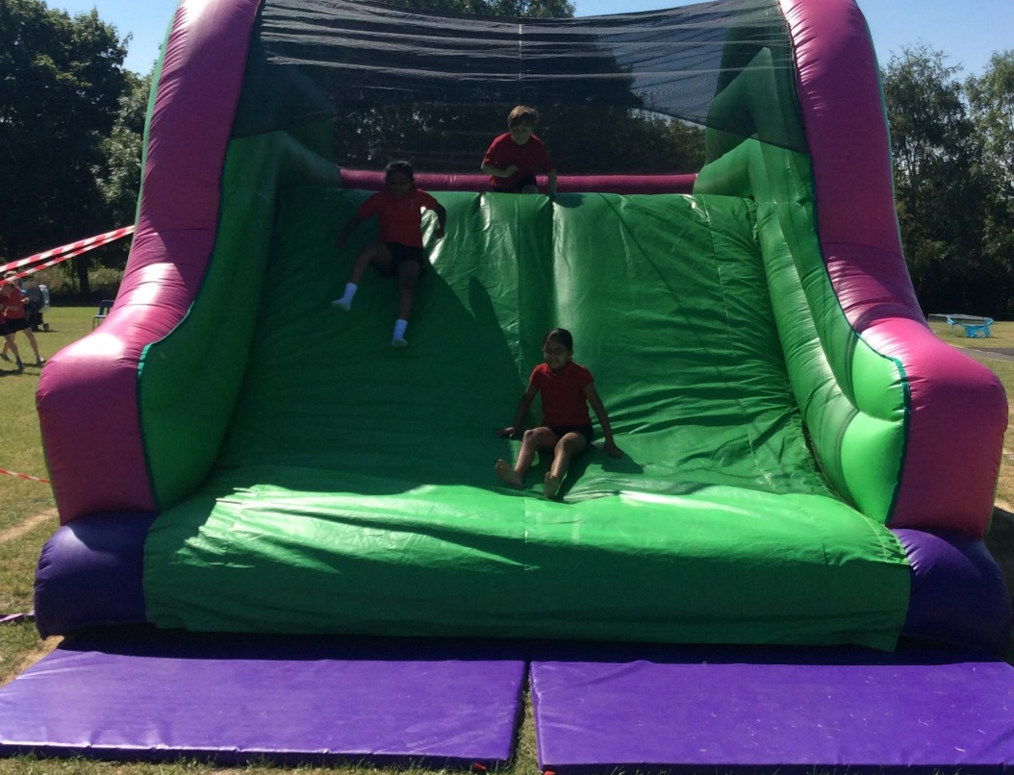

Slide 14
Heartbeat Sessions
We have been lucky this year to have a visit from Heartbeat and Sian came into school to talk to each class about keeping fit and healthy. Some of our junior classes also did CPR and that was important incuse of any emergencies. (FD year 4).
Take a look at our school website under healthy schools to see what else we have been involved in.

Slide 15
Special Achievements.
On Friday’s we have an assembly which is about celebrating all the good things that have happened in that week. Our teachers share good news and if we are chosen we sit on the sofa and get a special badge and certificate. At the end of our assemblies children get to share their awards from outside of school. Last week we had swimming, dance, football and rugby. The teacher always asks how others could get involved as well. It’s nice to see our friends get certificates.

