Slide 1

Year 3
Mile a Day

Slide 2
Year 3 Mile a Day
We have been taking part in the Mile a Day. We wanted to get fit.
We did not like PE or sport and our teachers challenged us for the autumn term to run the Daily Mile. (N)
I like to try and run faster and further than I managed to run the day before. (A)
I like our Daily Mile because it tires me out and makes my body feel good. (A)
The Daily Mile helps my body to be fit and healthy. (R)
Doing The Mile a Day helps me with my football practice because it makes me stronger. (T)

Slide 3
Year 3 Mile a Day
The Daily Mile challenges me and makes me stronger, it makes me feel proud that I can run a mile and run it faster each day. (J)
I feel happy with myself after The Daily Mile because I have challenged myself. (A)
The Daily Mile helps me to complete part of my hour a day exercise. (F)
The Daily Mile makes me feel fit. (S)
The Daily Mile makes me feel calm because I can run off all of my worries. (S)

Slide 4
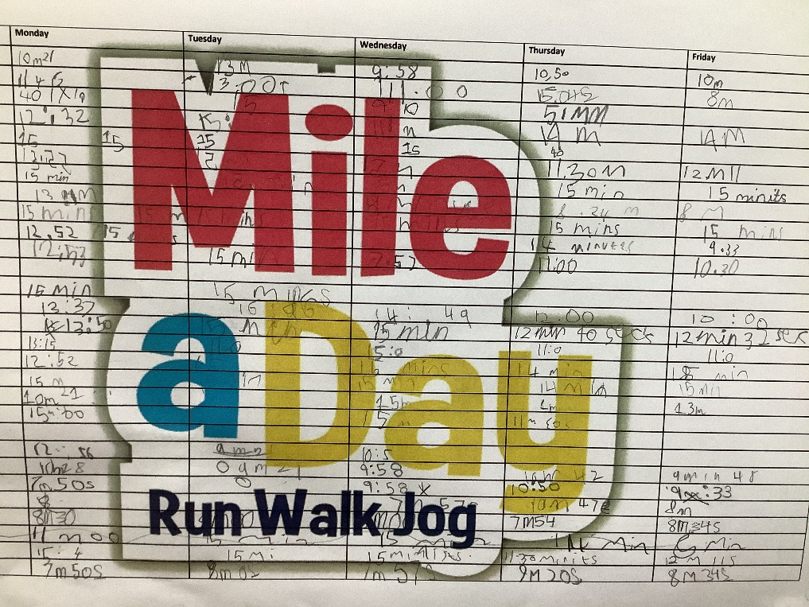
Year 3 Mile a Day
We have our chart on our classroom day we write down our times and then see how we are getting fitter and faster. (J)

Slide 5
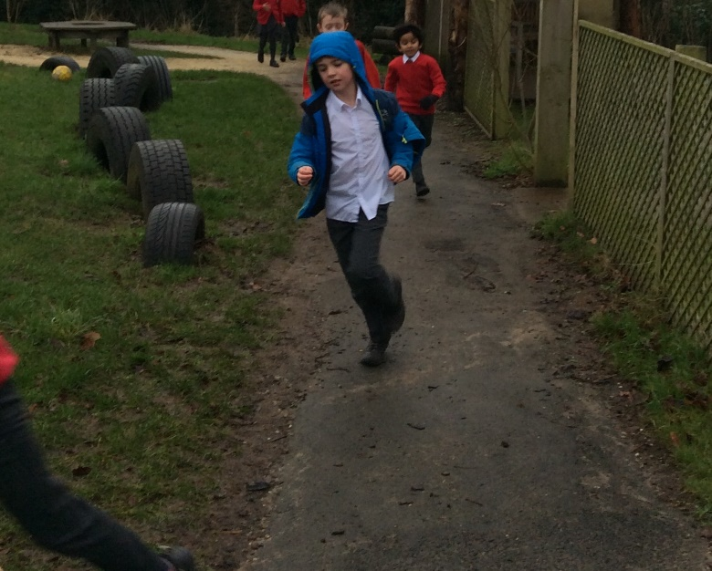
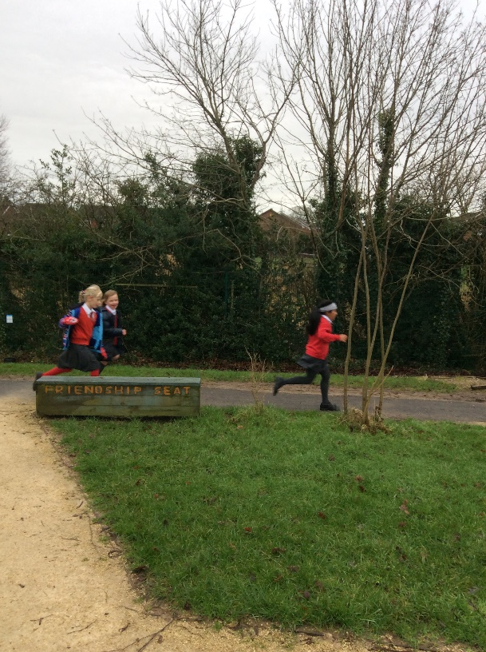
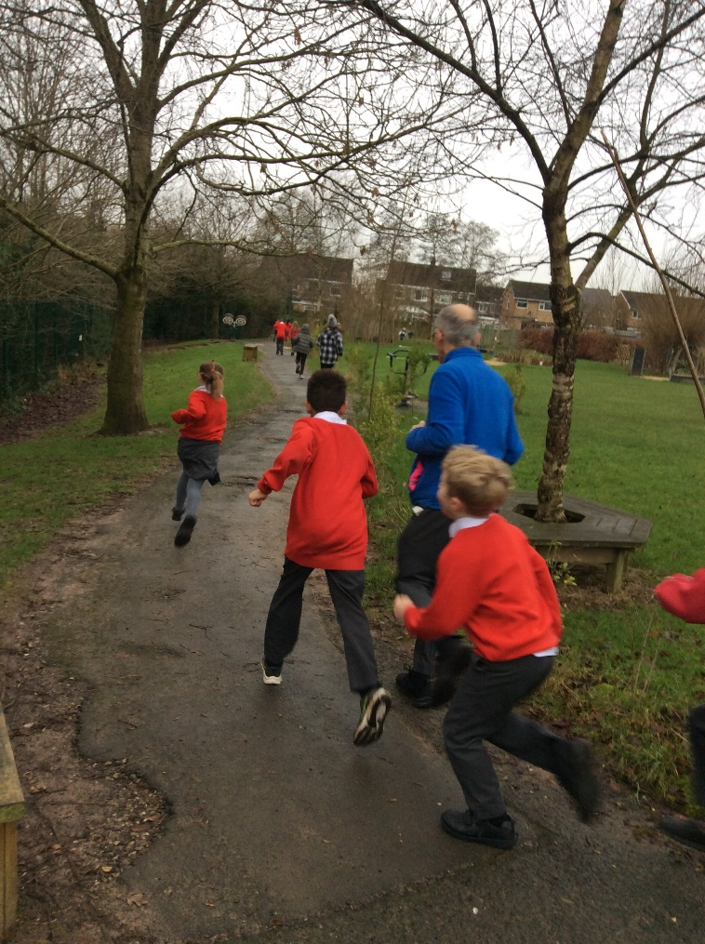
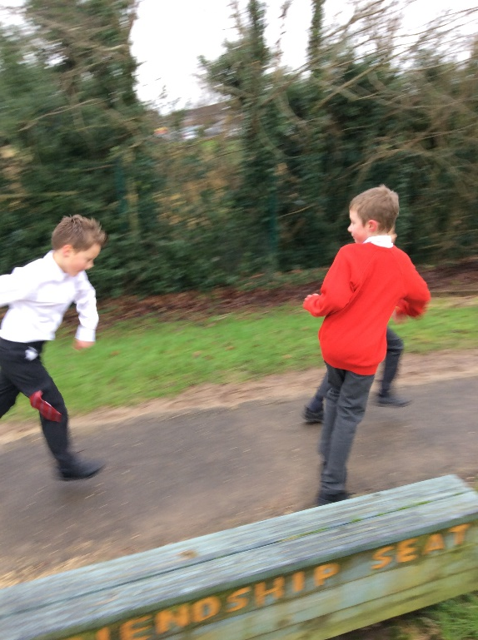
Here are the pictures of our daily Mile.
The Daily Mile hurts my muscles, but it is good because they are getting stronger and i'll be able to run further. (H)

Slide 6
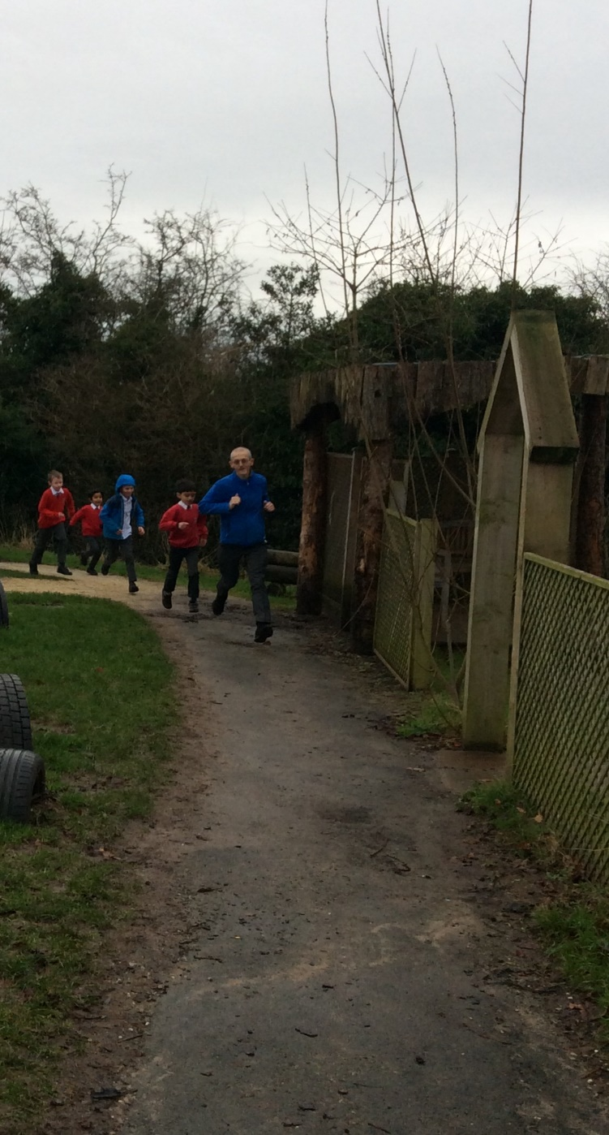
Spring Term
This term we are challenging our teachers to run the daily Mile every day… They are getting fitter as well. We know that this is helping us to stay emotionally fit as well and that is really important. (O)
Every day a different teacher from our class takes the challenge. We are getting faster than some of the adults.
(P)

