Slide 1
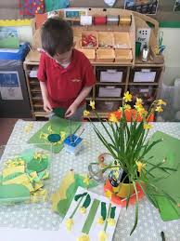
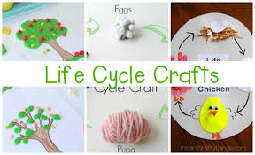
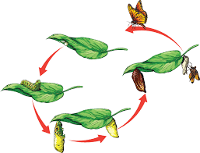
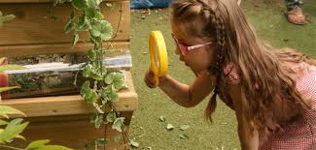
In communication and language, we will be using full sentences to talk about plants in our community and life cycles that we will be observing.
We will be using conjunctions
to extend our ideas.
In PSHE, we will be talking about being respectful to each other, staff and all adults.
We will also express our ideas and feelings about our experiences using full sentences, including use of past, present, and future tenses and making use of conjunctions
In physical development, we will be moving around safely when taking part in weekly PE lessons.
During continuous provision, we will work together to participate in large scale construction and den building in the outdoor area.
At every opportunity, we will continue to hold and use a pencil effectively to form the letters of the alphabet.
In phonics, we will continue to segment the sounds in words and blend them to read. They will begin to read and understand simple sentences. The children will gain more awareness of digraphs and trigraphs.
In Literacy, we will be reading a range of stories and factual books to find out about different plants, life cycles and baby animals.
We will be writing full sentences, including using capital letters and full stops.
We will also be using our phonics skills to write words related to spring, plants, life cycles and baby animals.
In maths, we will be focussing on numbers to 20 – counting, ordering & naming
We will also continue working out 1 more and 1 less.
We will be moving on to adding 2 numbers together and subtracting to find out how many is left.
Summer Term 1
Reception Topic
Ready Steady Grow
In expressive, art & design, we will be using role play to explore plants, seeds and seedlings.
We will be using clay to create a print of leaves and using a range of media to express their ideas of Spring, life cycles etc.
In understanding the world, we will be finding out about different plants and minibeasts.
We will continue to talk about significant events in their own experience.
We will look closely at similarities, differences, patterns & change in plants & minibeasts. From our observations of watching seedlings and life cycles we will talk about what we have seen.
Home Learning Opportunities
Look at your garden/outdoor environment…..What type of plants, trees, minibeasts that live and grow in your garden/outdoor?
What type of plants, trees, minibeasts that are in your local area?
Can you show your child a hedgerow, wild plants on your way to school?

