Slide 1
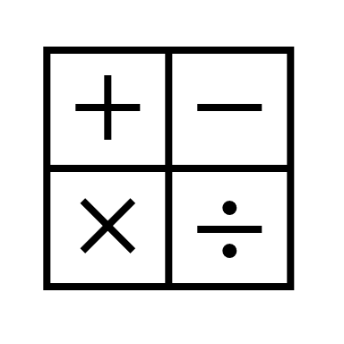
In maths, we will be learning about fractions, finding halves, quarters and thirds of objects and amounts. We will also be learning to tell the time to the nearest 5 minutes.
In religious education, we will be finding out about Islam and the importance of prayer.
In RHE, we will be exploring feelings and emotions.
In computing, we will be learning to develop programming by using code blocks to write code and fix mistakes by debugging.
In English, we will be using the book ‘The Great Fire of London’ by Emma Adams which links to our History topic this half term. We will be using the book to write our own information booklet.
In history, we will be learning about The Great Fire of London. We will be looking at the events of the fire and comparing London today and in the past.
Year 2 Summer 1
In science, we will be learning all about plants and what they need to grow.
In art, we will be exploring clay sculptures.
In PE, we will be developing our skills in invasion games and net and ball games.
In music, we will be exploring improvisation and how we can respond to music.

